Slide 1
Data Management Plan

Slide 2


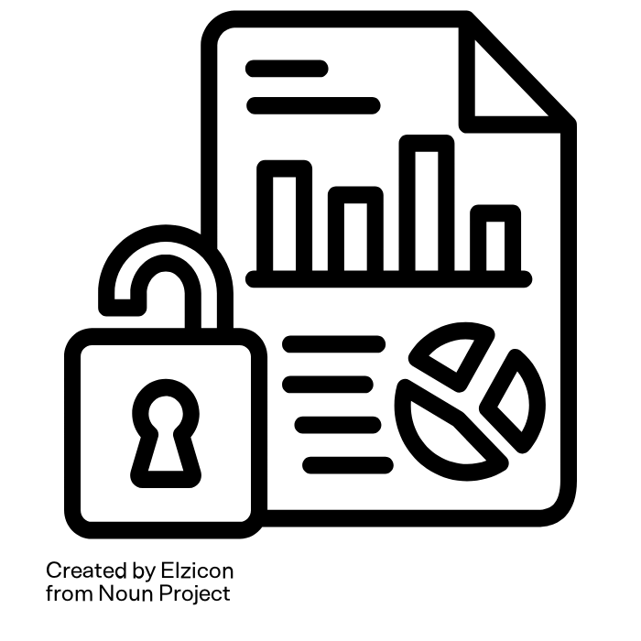
Planning Agricultural Trials
Examples for Your Data Management Plan (DMP)
Measuring instruments:
  Do you need new or project-specific equipment?
  What kind of software is used?
  In which formats will the data be available?
Data types:
  Are you using public or proprietary data?
  Is anonymisation necessary?
Remember! A DMP is a living document, you can update and modify it as your project evolves
Sources: “Public Data” by Elzicon and “Microscope” by Yogi Aprelliyanto from Noun Projec licensed under CC BY 3.0, RDMkit is licensed under CC BY 4.0
Notes:
Slide content: We’ll go into more detail on agricultural data management later, but here are a few things to think about early, before you write your DMP.
For example, if you’re planning field trials, will you need new measuring instruments or project-specific equipment? What software do they use, and what data formats will they generate?
You also need to consider your data types: Are you working with public data or sensitive/private datasets? If people are involved, do you need to anonymise the data?
And don’t worry if you don’t know all the answers right away a Data Management Plan is a living document. You can and should update it throughout your project as things change or become clearer.

