Slide 1
Finding Data
for Reuse

Slide 2
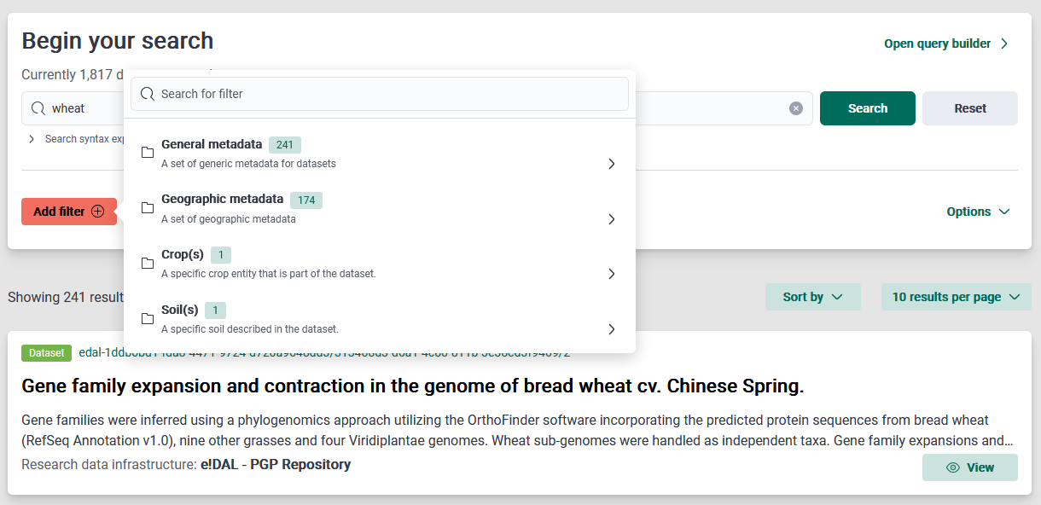
Step 1: use the filters
Use filters to refine your search
Which search query do you use?
Source: Screenshot from FAIRagro Search Hub taken on 24.07.25
Notes:
Slide content:
how to use the search in the most efficient way. In this case, use filters to refine what are you looking for.
The image show how to search for an specific word in your search.

Slide 3
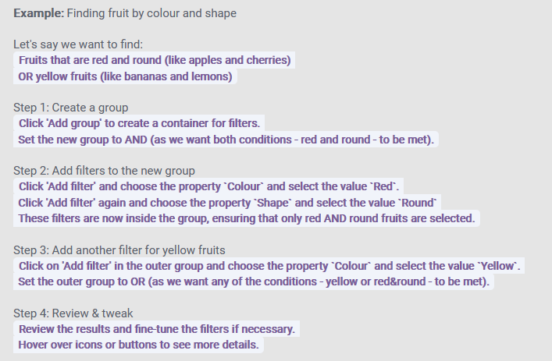
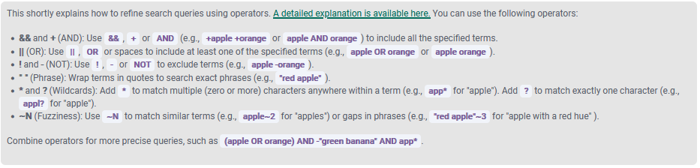
Step 2: build your query
Use operators to build your query
Which search query do you use?
Detailed explanations available here
Source: Screenshot from FAIRagro Search Hub taken on 24.07.25
Notes:
Slide content:
Short explanation on how to write a query to make your search better.
The Search Hub provides an explanation of Operators that can be uses, as well as a tutorial and a step by step guide.

Slide 4
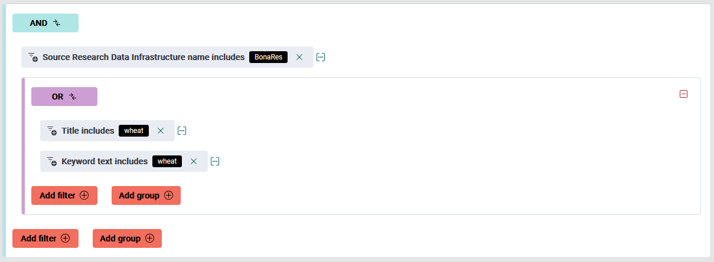
Step 3: use the query builder
The query builder may help you!
Which search query do you use?
On the website you will find a pre-build example, a “how to build the example” tour and a tutorial explain the query builder!
Source: Screenshot from FAIRagro Search Hub taken on 24.07.25
Notes:
Slide content:
The query builder can be used to create complex search queries

Slide 5
Step 4: refine your search
Repositories and Data Aggregators use different strategies to make the data more discoverable
  familiarize yourself with the controlled vocabularies, subject categories and search field of your resource
Refine your search after first try
  broaden or narrow your approach based on the retrieved results
Explore interesting looking results
  these can link to related ones (e.g., from the data provider, from different time series, …)
Source: modified from Gregory et al. (2018)
Notes:
Slide content:
Refine your search
In many cases, your initial search may not retrieve relevant data or all of the data that you need. Based on the retrieved results, you may need to broaden or narrow your approach. Apart from rephrasing your search query and using search operators, as discussed in Tip 3, facets or filters specific to individual repositories can be used to narrow the scope of your results. Refinements such as data format, types of analysis, and data availability allow users to quickly find usable data.
Examining results that look interesting (for example, by clicking on links for ‘more information’) can be a signal of the type of information that you find relevant. These results can then be linked to related ones (e.g., from the data provider, from different time series), and in subsequent searches, other results algorithmically determined to be related will be brought to the top of the results list.
Save your search and data-source details
Record the data source and data version if you access or download a data product. This may be accomplished by noting the persistent identifier, such as a digital object identifier (DOI) or another Global Unique Identifier (GUID) assigned to the data. Recording the URL from which you obtained the data can be a quick way of returning to it but should not be trusted in the long term for providing access to the data, as URLs can change. It is also a good practice to save a copy of any original data products that you downloaded. You may, for example, need to go back to original data sources and check if there have been any changes or corrections to data. Registering with the data portal (as described in Tip 3) or registering as a user of a specific data product allows the repository to contact you when necessary. Such information may be needed when you publish a paper that builds on the data you accessed. If there are any errors found in the original data, registering with the data service allows them to contact you to see if there is an impact on any research conclusions that you have drawn from this data.
If you have registered with a portal, it may also be possible to save your searches, allowing you to resume your data search at a later time with all previously defined search criteria. Some portals use RESTful search interfaces, which means you can bookmark a results set or dataset and return to it later simply by going to the bookmark.
Gregory et al. (2018)

