Slide 1
Finding Data
for Reuse

Slide 2
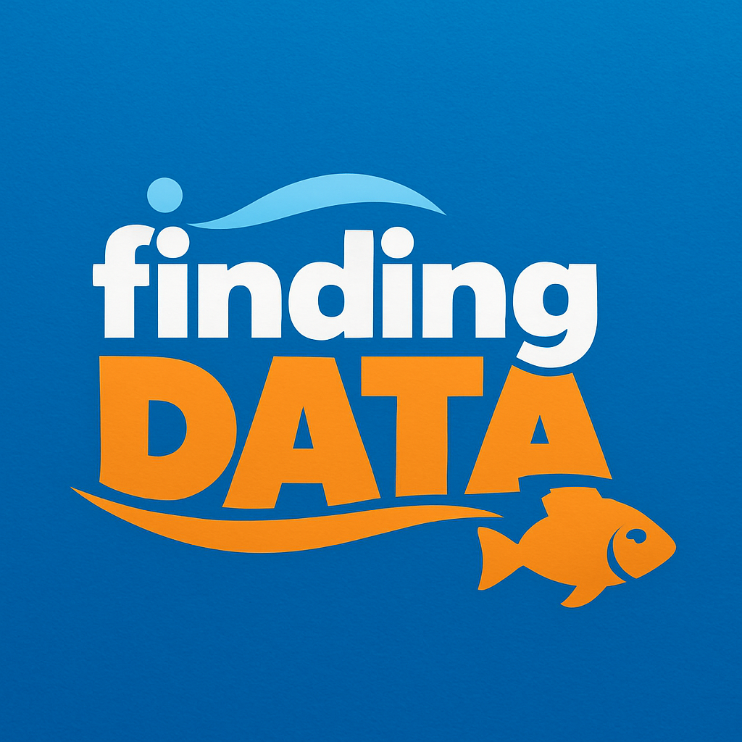

Finding Data
Open the FAIRagro Search Hub.
How many datasets on winter wheat do you find?
https://search-hub.fairagro.net/
Illustration: Created by ChatGPT (public domain)
Notes:
Link: https://search-hub.fairagro.net/

Slide 3


Finding Data
How many datasets on winter wheat do you find?
278 Datasets with “winter” OR “wheat”
149 Datasets on “winter wheat”
150 Datasets with “winter wheat” OR “winter” AND “wheat” in the title
(24.04.2026)
Illustration: Screenshots Search Hub taken on 24.07.25, Image created by ChatGPT (public domain)
Notes:
Note: Update the numbers before use!
Slide content:
When searching for -winter wheat- you will find 278 Datasets that include the term winter or the term wheat in any field, this may not all be datasets on winter wheat
When searching for -”winter wheat”- you will find less datasets, namely 149. They all include the term “winter wheat” in any field - they should all have data about winter wheat.
But you can’t be sure, that with this, you found all datasets about winter wheat… if you search for datasets that include the term “winter” and the term “wheat” in the title OR “winter wheat” in any fields, you’ll find one more dataset - this one speaks of “winter and summer wheat” in the title and is therefore not found, when searching for datasets including the term “winter wheat”.

