Slide 1
Data Storage

Slide 2
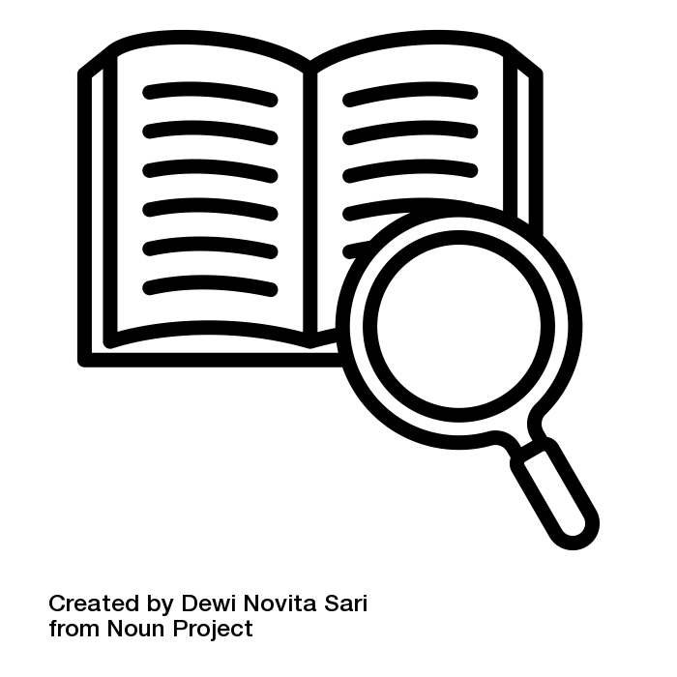
What is Data Preservation?
“Activities necessary to ensure safety, integrity and accessibility of data for as long as necessary. Prevents data from becoming unavailable and unusable over time.”
Done by experts (e.g. by repository)
Ensure that data is organised
Ensure your data described with appropriate metadata and documentation
Use standard and open-source file formats
Good Research Practice: preserve data for at least 10 years after end of project
Sources: modified from Elixir by FAIRagro, Illustration: “definition” by Dewi Novita Sari is licensed under CC BY 3.0
Notes:
Slide content:
Imagine you are trying to work with really old data—let's say 25 years old. Even if you found devices that could read the floppy disk or CD-ROM, would your computer be able to open the file format? Would you still have the necessary programs and software to open them? This is why data preservation is important!
Reasons for preserving data over a long period of time:
Funders, publishers, and institutions usually require data to be preserved for at least five or ten years after the end of the project. The DFG Guidelines on Good Scientific Practice recommend preserving data for at least ten years.
Ensure that your data can be verified and reproduced several years after the project ends. There are multiple examples of retracted journal articles due to data loss.
Data can be reused by you yourself or by others.
Some data is of significant value to an institute, a nation, society, or the environment.
What to think about:
not all data should be preserved - consider data for preservation, that is:
required by funders etc
not easily re-generatable (eg. raw data, analysis workflow)
needed for legal or ethical reasons
of great value
propably needed in future for reuse or validation (scientifically, historically or culturally)
important: you don’t do data preservation on your own!
Long-term preservation is conducted by experts, such as those in long-term preservation repositories or archives.
For example, BonaRes and publisso offer long term preservation
They change file format & update software (so they do not become outdated or obsolete).
They change hardware and other storage media to avoid degradation.
prepare your data for long-term preservation
prefer standard and open-source formats instead of proprietary ones
have your data organised and well described
have your data provenance clearly described
have your data clearly licensed
Source:
Deutsche Forschungsgemeinschaft. (2025). Guidelines for Safeguarding Good Research Practice. Code of Conduct. https://doi.org/10.5281/zenodo.14281892
RDMkit: https://rdmkit.elixir-europe.org/preserving

