Slide 1
Data Publication
Preparing data for publishing

Slide 2
Step 2 - Prepare your documentation
Have you prepared documentation files for your dataset(s)?
Have you spelled out acronyms and explained the labels of your variables and values?
Have you included research methodology reports and any other relevant information?
Have you chosen a meaningful title?
Source: modified from the University of Edinburgh - Information Services - Research Data Service by FAIRagro 2024
Prepare your data
Prepare your documentation
Check your data rights
Make your data reusable
Notes:
Slide content:
when your data is ready to be published, you need to prepare your documentation:
have you already prepared documentation files for your dataset(s)? -> in the best case scenario, data documentation should be done right at the time, you are collecting and processing your data.
when it comes to publishing your data, it is especially important, that others (and maybe your future self) are able to understand where your data comes from, how it was processed and what it contains: therefor make sure you have explanations of all variable, values and used abbreviations and codes included.
one very important metadata about your data is the title. Put some thoughts into it, to make sure your title describes the most important aspects of your dataset in a meaningful way!

Slide 3
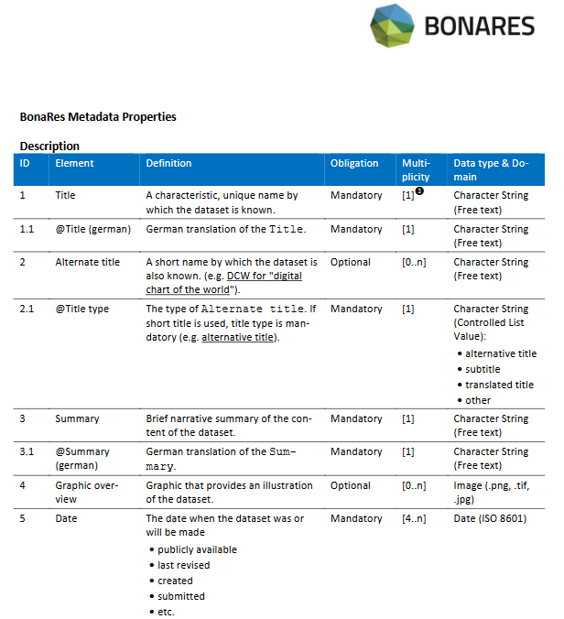
Have your Metadata ready
What type of metadata is mandatory for your repository?
Illustration: Gärtner et al. The BonaRes Metadata Schema licensed under CC BY 4.0
Prepare your data
Prepare your documentation
Check your data rights
Make your data reusable
Notes:
Slide content:
Besides data documentation such as README files and codebooks, you need to have your metadata ready. Find out what metadata your repository requires; most repositories have their metadata schema available, such as this one from the BonaRes Repository. You need to have all the mandatory metadata elements available when uploading your data. Additionally, there are often multiple optional and/or recommended metadata elements that should be added to make your dataset as findable and understandable as possible to potential reusers.

