Slide 1
Data Repositories
Data Sharing and Publishing

Slide 2
BonaRes Repository
Challenge: Management diverse agricultural data
Lab. analysis
soil pH
plant dry matter
...
(Remote) sensing
Satellite, areal
Spectroscopic
...
Soil profile
standardized
field data: e.g. color
...
Sequencing
plant
microbiome
...
Environment
weather
climate
biodiversity
...
Social data
surveys
farm data
...
Long Term Experiment
complex data
related tables
...
Authors' rights have top priority
Research data should be made available:
For free reuse
Meaningfully aggregated
User-friendly
Modell outcome
BODIUM
…
Other
source code
audio/video
...
Notes:
Slide content: This slide highlights the main challenge: managing highly diverse agricultural research data.
In this context, BonaRes deals with many different data types. These include laboratory analyses, remote sensing data from satellites or aerial platforms, complex long-term experiment datasets with related tables, social survey data, standardized soil profile descriptions, sequencing data such as plant microbiome analyses, environmental data like weather and biodiversity, as well as source code or multimedia files. In some cases, model outputs also need to be integrated.
A key principle of the BonaRes Repository is that authors’ rights have top priority. At the same time, research data should be made available for free reuse whenever possible. This means datasets should be meaningfully aggregated, well documented, and user-friendly.

Slide 3
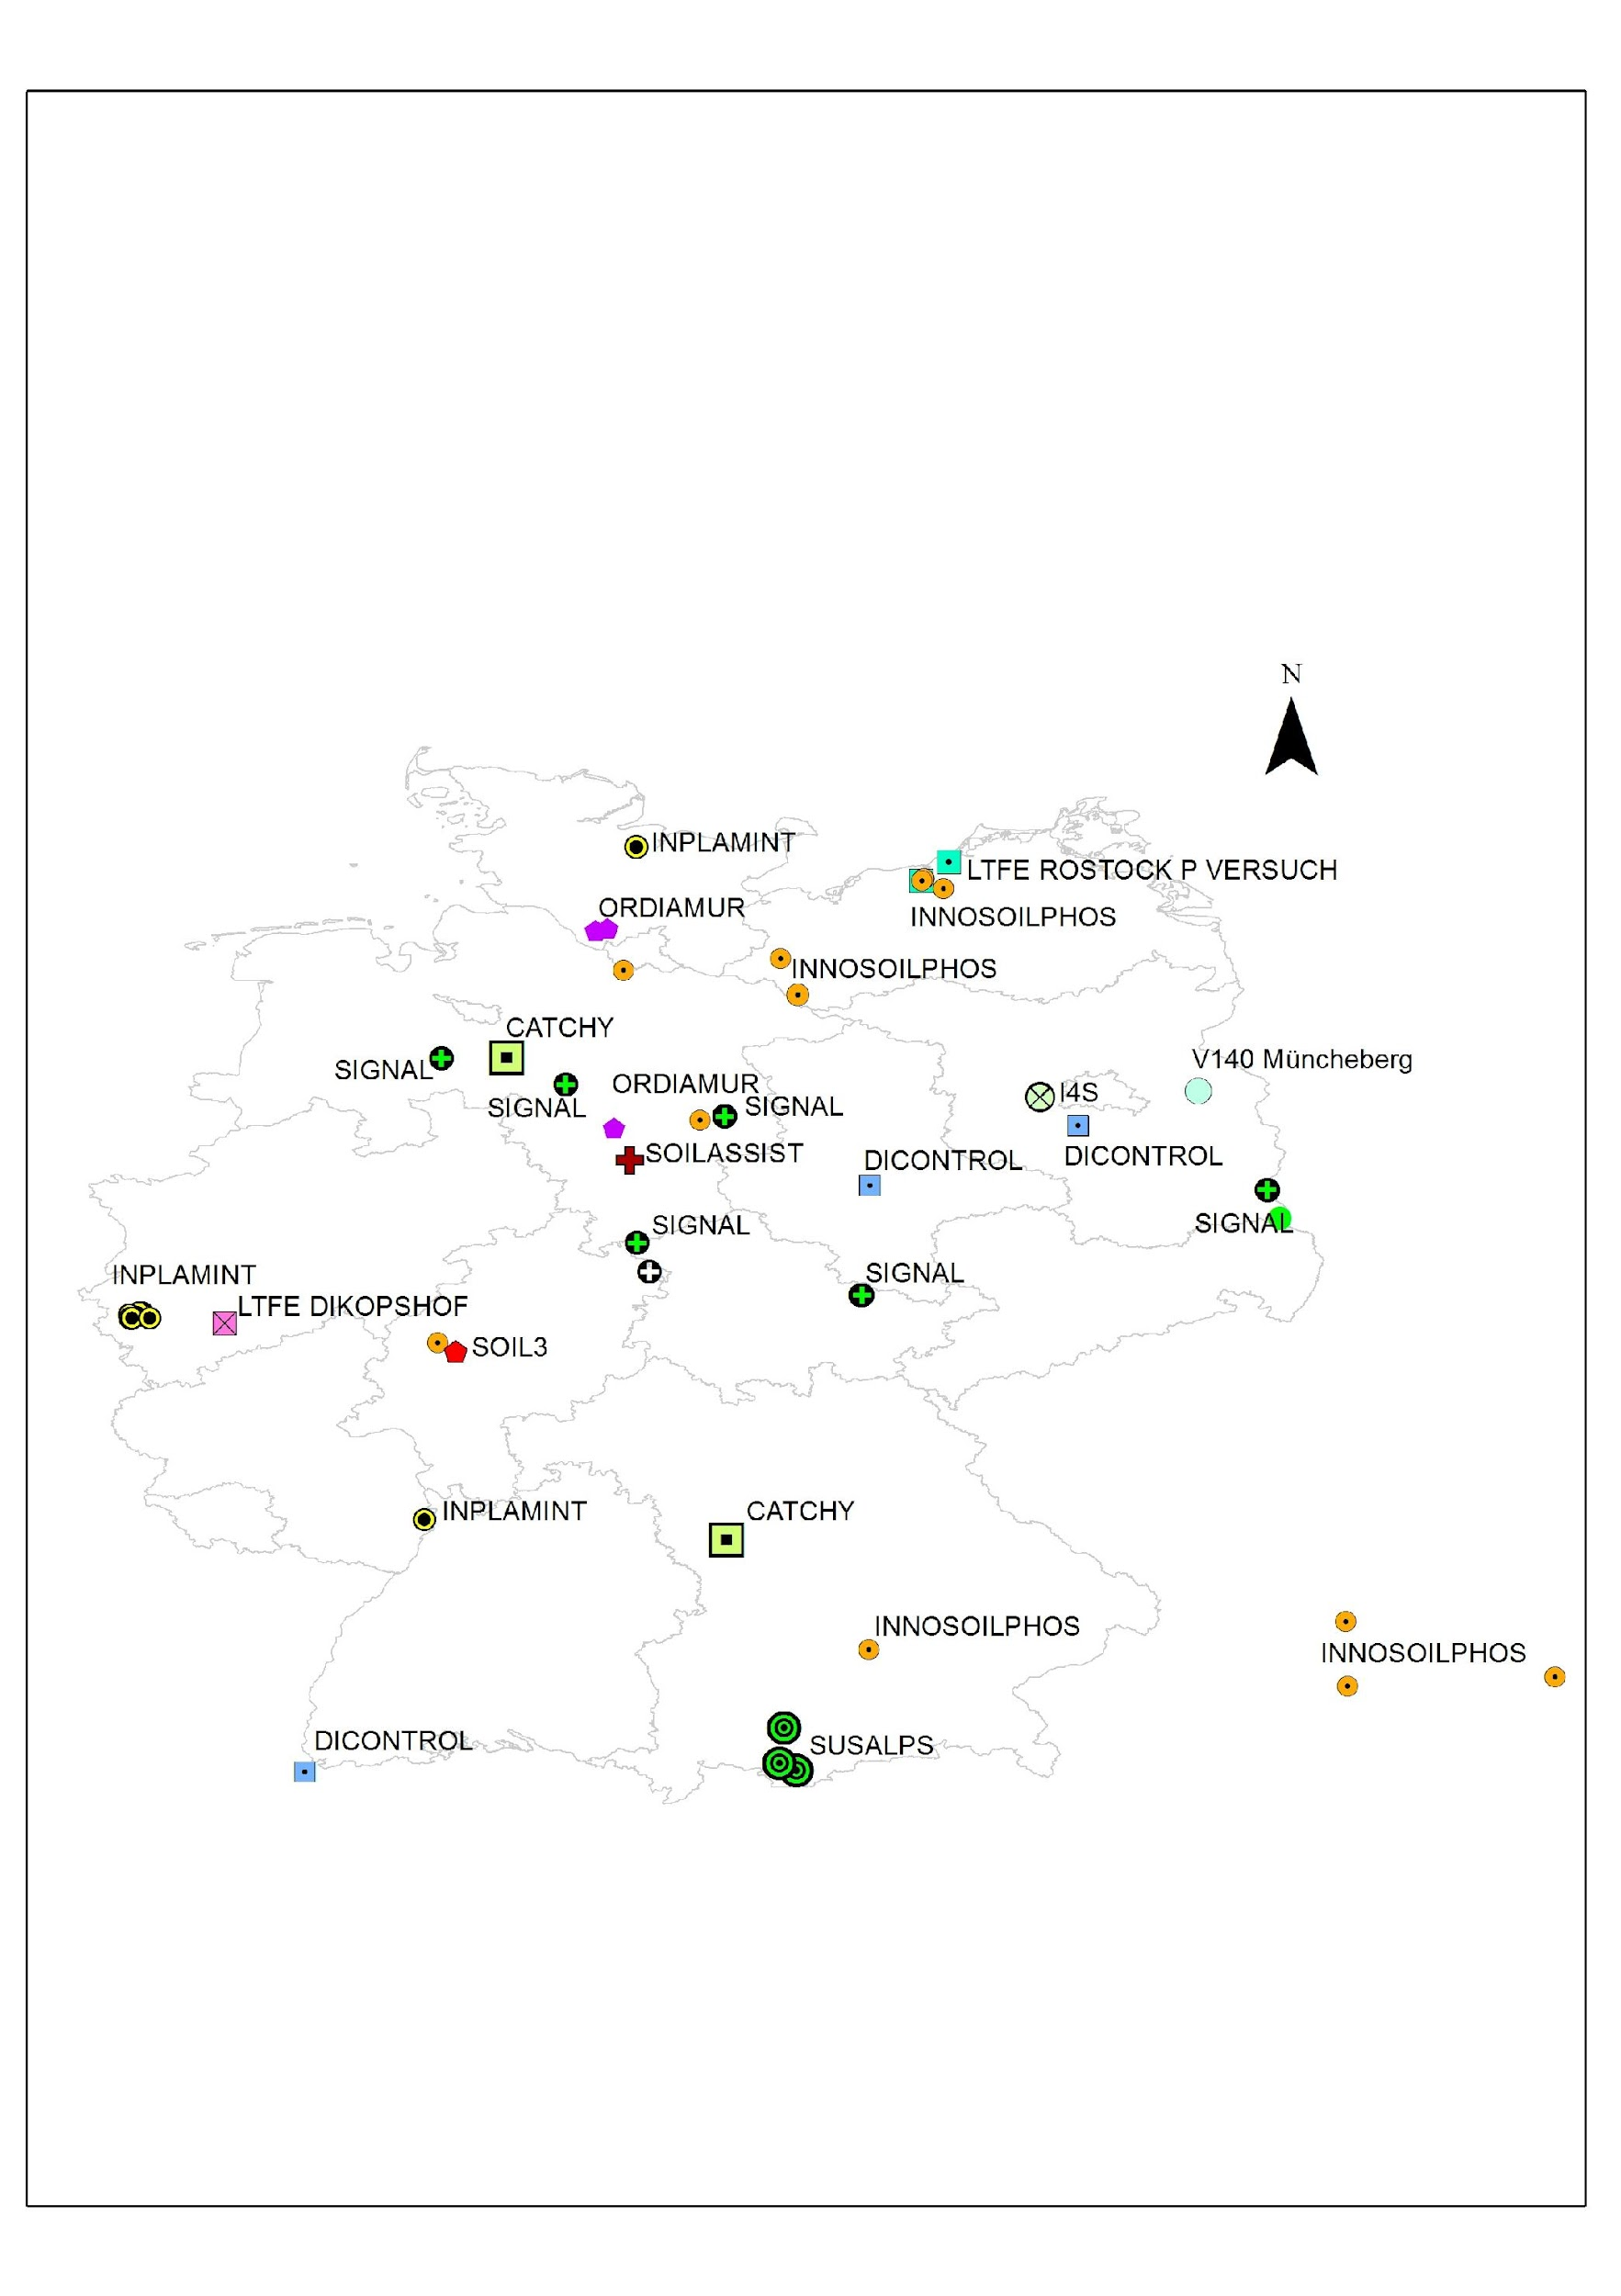
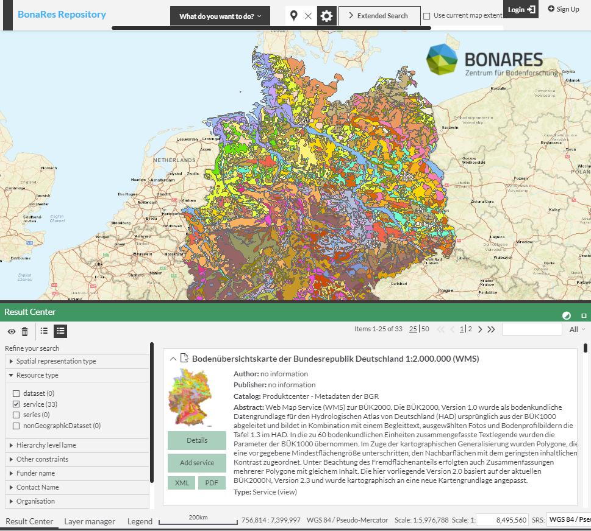
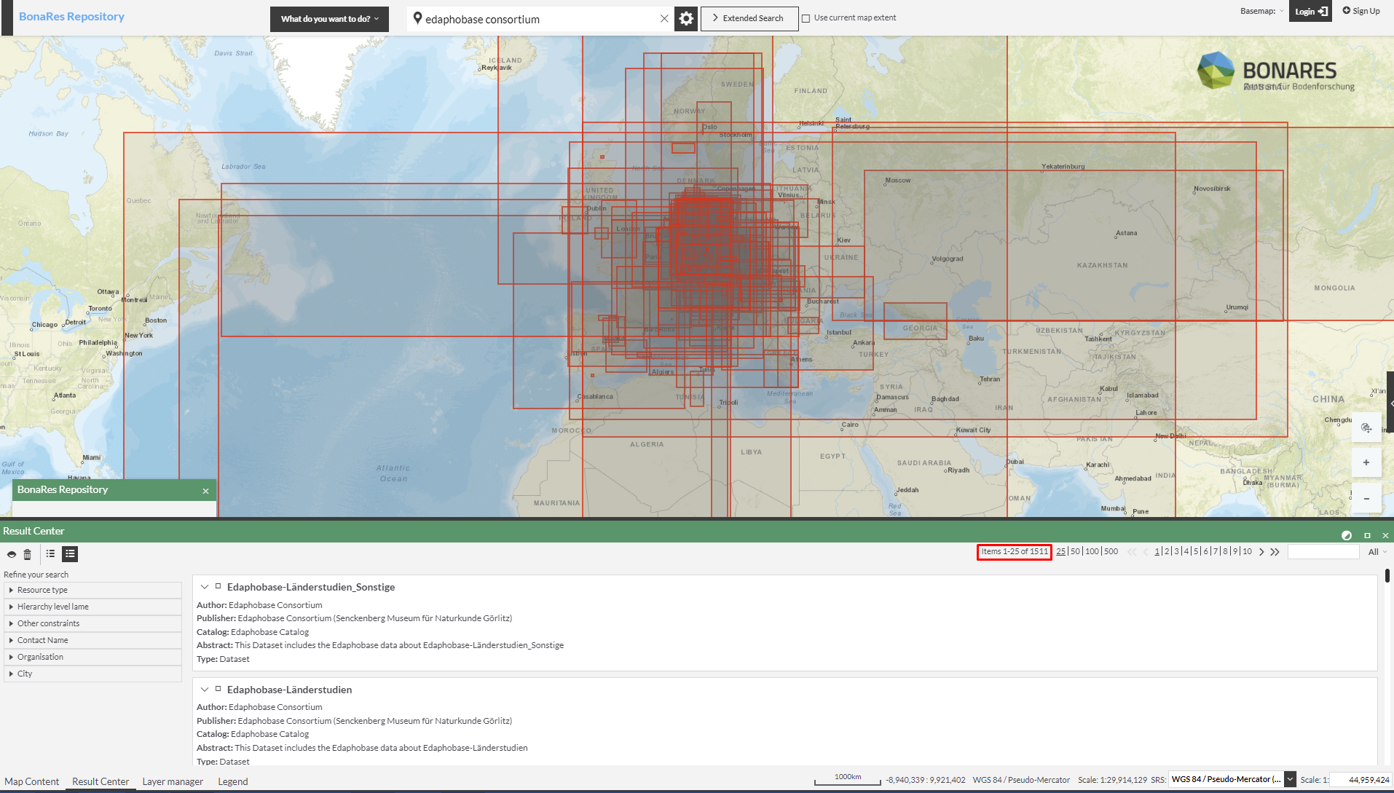
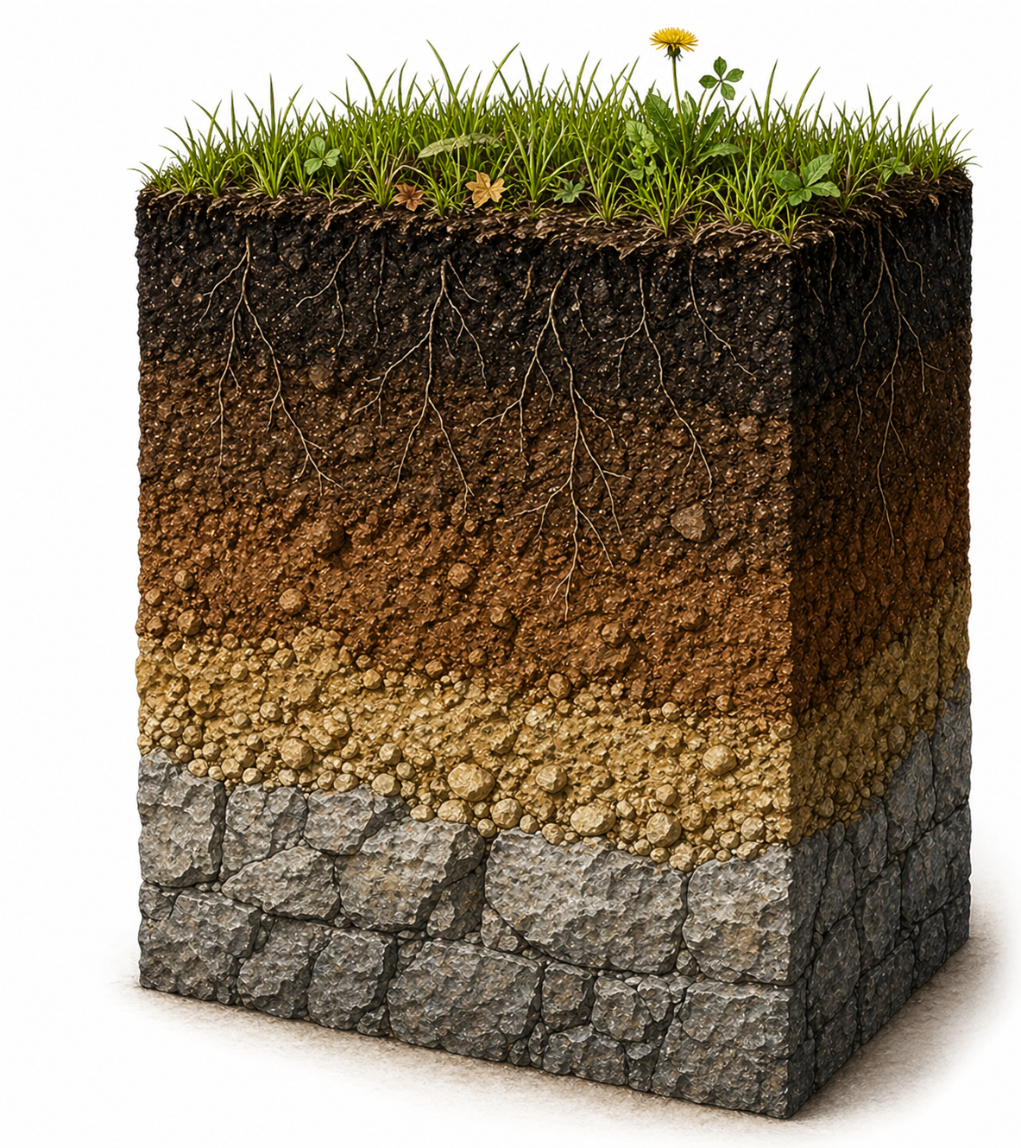
BonaRes Repository - Find >4000 data
BonaRes Repository
>650 data published
BGR Product Center
>950 data findable
Edaphobase
>1900 data findable
DataCite Commons
Harvested by
Google Dataset Search
Illustrations:US Department of Agriculture, Picture Soil sample by ChatGPT (2026), Screenshots BonaRes Repo, taken on 23.04.2026 are public domain
Notes:
Slide content: Currently, more than 4,000 datasets are findable through BonaRes. This includes over 650 datasets that are published directly in the BonaRes Repository.
Through harvesting and cooperation with external platforms, additional datasets become accessible. For example, more than 950 datasets via the BGR Product Center and over 1,900 via Edaphobase.
All datasets published in BonaRes are registered with DataCite and indexed by Google Scholar, which means they can also be discovered and harvested through these services.

