Slide 1
Licenses
Creative Commons

Slide 2

CC copyright licenses: five components
Attribution (BY): author/creator must always be credited
Non-Commercial (NC): must not be used for commercial purposes
Share Alike (SA): redistribution/adaptations only under the same conditions
No Derivatives (ND): no adaptations or derivatives are permitted
Public domain: none of the above limitations
Source: Bobrov et al. 2021, Cozatl et al. 2021 and Rathmann et al. 2021 modified by ZB MED 2022
Notes:
Slide content:
this slide shows the different components of CC licenses. The first four components can be combined in different ways as you can see on the following slide

Slide 3

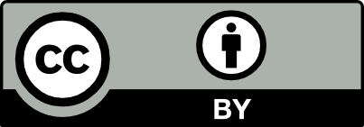

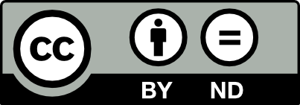
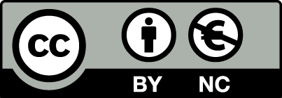
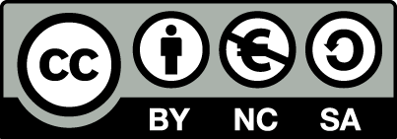
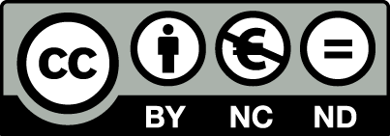
CC license components and combinations
most open
CC 0 Public Domain
CC BY Name author
CC BY-SA Name author - Share under same license
CC BY-ND Name author - No changes
CC BY-NC Name author - No commercial use
CC BY-NC-SA Name author - No commercial use - Share under same licence
CC BY-NC-ND Name author - No commercial use - No changes
least open
Source: Rathmann et al. 2021 and Rice 2020 modified by ZB MED 2022
Notes:
Slide content:
Creative Commons has different license modules depending on the conditions under which creators want to make their data available.
CC0 enables the creator to give up any copyright (as far as possible) on their data. It puts the work into the public domain. CC0 enables reusers to distribute, remix, adapt, and build upon the material in any medium or format, with no conditions. This also includes the obligation to cite the creator. However, scientists still need to cite due to the Good Research Practice.
CC BY enables reusers to distribute, remix, adapt, and build upon the material in any medium or format, so long as attribution is given to the creator.
CC BY-NC enables reusers to distribute, remix, adapt, and build upon the material in any medium or format for noncommercial purposes only, and only so long as attribution is given to the creator. Non-commercial means, not primarily aimed at a business advantage or monetary compensation, in this context.
CC BY-ND enables reusers to copy and distribute the material in any medium or format in unadapted form only, and only so long as attribution is given to the creator.
CC BY-SA allows the same reuse as with the CC BY. If you remix, adapt, or build upon the material, you must license the modified material under identical terms.
Listed here are all the modules, as well as the possible combinations.
Not every CC license can be recommended equally. The CC BY-NC and the CC-BY-ND are not compatible with the Open Access principles and should therefore not be used.

