Slide 1
Data Protection
Consequences

Slide 2
Legal Basis
of the data processing

Slide 3
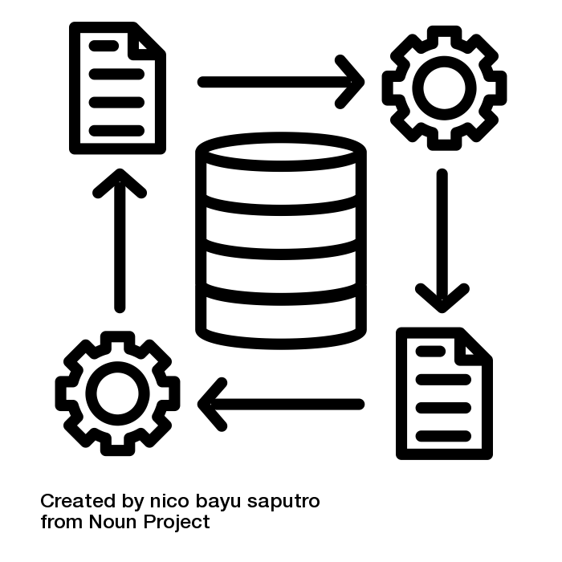
Data processing
Any operation (or set of operations) which is performed on personal data, whether or not by automated means
Data processing must fulfil certain requirements!
Illustration: “data processing” by nico bayu saputro is licensed under CC BY 3.0
Notes:
Slide content:
the following slides show the legal basis of data processing. But was it data processing according to GDPR?
Data processing is a very broad term! It includes everything that can be done with data -> collection, storage, organisation, use, deletion, modification
Automated means: everything for which information technology infrastructure (hardware, software, transmission networks) is used -> everything that can be done with personal data using IT systems
Non-automated means: e.g. handwritten notes

Slide 4
When is data processing lawful?
Art. 5 GDPR names everything,
a processor needs to pay
attention to
Data processing must fulfil certain requirements!
Illustration: “data processing” by nico bayu saputro is licensed under CC BY 3.0

Slide 5
When is data processing lawful?
purpose limitation
lawfulness
integrity & confidentiality
fairness
Art. 5 GDPR
accountability
transparency
storage limitation
data minimisation
accuracy
Notes:
Slide content:
Art. 5 GDPR is a central standard of the regulation. It sets out the principles that data processing must fulfil in order to be permitted. When it comes to justifying lawfulness as a data processor and making decisions, it is always a question of examining the so-called proportionality of actions and balancing interests.
Regarding Art. 5 GDPR:
Lawfulness means: only on the basis of consent or other legal legitimisation. These legitimisations ultimately result from Art. 6 GDPR
fariness means: duty to take into account the interests of the data subject - keyword: fairness of processing
Transparency means: data subject must be able to understand data processing retrospectively
purpose limitation contains 2 principles:
Processing must be carried out for specified, clear purposes
-> no processing “in stock”
-> The processing purposes determine the necessity, the legal basis in accordance with Art. 6 GDPR and the information obligations in accordance with Art. 13 et seq. GDPR and how transparent the data processing is
No incompatibility with the purpose of the collection -> purpose limitation in the narrower sense -> Exceptions for scient. research
Data minimisation contains the necessity for the processing to be relevant for the purpose, the processing needs to be a necessary and an adequate measure:
Relevant for the purpose means: Suitability - does the data processing fulfil the intended purpose?
Necessary measure means: Necessity - Is there a lesser means? e.g. anonymous collection in surveys. Is unnecessary data collected?
Adequate means: Have the processing interests been weighed against the interest of the data subjects not to process data and does the processing interest prevail?
accuracy means: The accuracy must exist both with regard to facts and with regard to conclusions from them/forecasts/value judgements
in regard to storage limitation: There is an exception for scientific research. There is an exception for scientific research if compensation is provided in the form of guarantees.
integrity and confidentiality also includes protection against unintentional access/loss/destruction - it does not matter whether the person responsible is responsible for the loss etc. or whether there was ‘force majeure’.

