Slide 1
Data Protection
Consequences

Slide 2
Data Protection
Research & Data Protection

Slide 3
Science and data privacy
Exception to the purpose limitation principle (Art. 5 para. 1 b)
Permissibility of further processing for scientific research purposes
  Compensation through obligation to create protective guarantees (Art. 89 para. 1)
Exception to the principle of certainty: Keyword “Broad Consent”
Exemption from the erasure obligation (Art. 17 para. 3 d)
Notes:
Slide content:
Science and data protection
This slide discusses some of the special features that arise for science in relation to data protection. Here, we have limited ourselves to presenting the aspects relevant to the participants' domains.
The exception to the purpose limitation principle according to Art. 5 para. 1 lit. b) GDPR: if data is further processed for the purpose of scientific research, it is assumed that this further processing is never incompatible with the original purpose of collection. In return, however, the controller must then comply with the data protection safeguards specified in Art. 89 GDPR. In this context, the catalogue of measures in Section 22 para. 2 sentence 2 BDSG is instructive.
Exception to the principle of certainty: Recital 33 of the GDPR states that in the field of scientific research, consent to data processing can also be given for specific areas and not only for specifically named purposes.

Slide 4
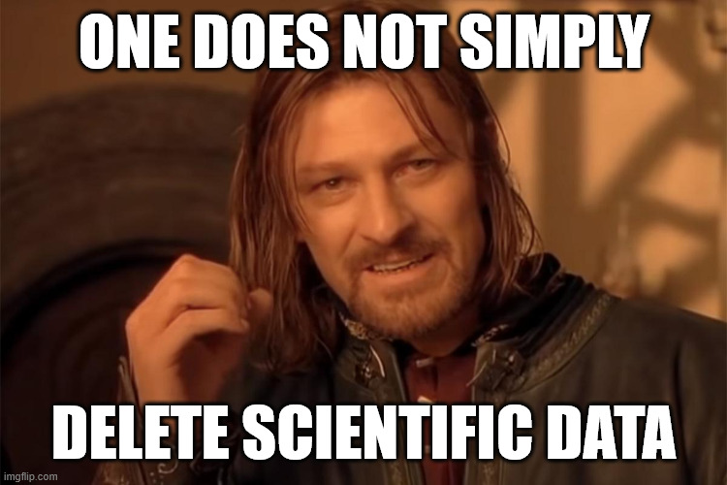
Science and data privacy
Exception to the purpose limitation principle (Art. 5 para. 1 b)
Permissibility of further processing for scientific research purposes
  Compensation through obligation to create protective guarantees (Art. 89 para. 1)
Exception to the principle of certainty: Keyword “Broad Consent”
Exemption from the erasure obligation (Art. 17 para. 3 d)
if realisation of the processing objectives is likely to be impossible or seriously impaired as a result!
Illustration: image from imgflp.com- free to use acc. to copyright exeptions
Notes:
Slide Content:
Exception to the erasure obligation pursuant to Art. 17 para. 3 lit. d) GDPR: If processing is necessary for scientific research and erasure is likely to render impossible or seriously impair the achievement of the specific research purposes. In this case, the guarantees of Art. 89 GDPR must be complied with.

