Slide 1
Foodies Unite!
Team 5 - Jessica Lam, Sophie Chen, Regine Firmeza, Jowyl Ong

Slide 2

Abstract: Legacy System
Yelp
PROBLEM: Posted reviews not guaranteed to stay on page
Go through evaluation based on status of user
First-time reviewer
Number of positive reviews posted
Filter reviews
PROBLEM: Reviews are a tool users take advantage of
Directed towards employees
Negative reviews to compromise
Gaining attention online, potential disruption
Notes:
sophie

Slide 3
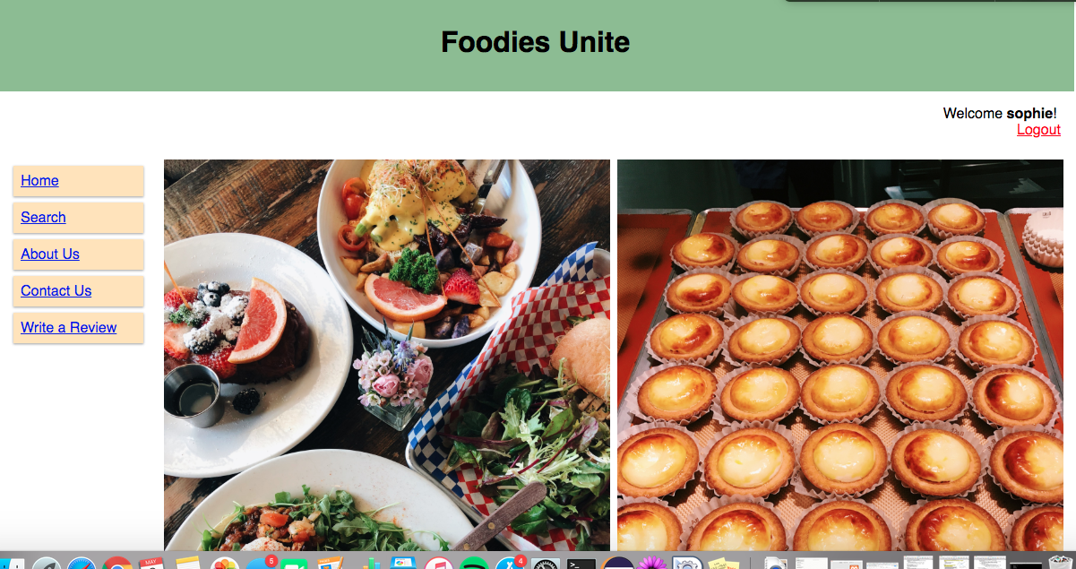
Abstract: Current System
Foodies Unite!
SOLUTION: No filter
Users disagree/agree with reviews via comment
Use judgment to determine validity of review
SOLUTION: Comment
Yelp = “Useful, Funny, and Cool”
May not be very helpful for users
Determine validity
Rate solely on business products or service
Can be reported
Notes:
sophie

Slide 4
Abstract: Project Overview
A food review website that is mainly run by users.
Users will be able to
Search for restaurants
Read reviews of restaurants
Write reviews
Post pictures
Comment
Report a review for unfair judgement (ie. racist, sexist, entitlement)
Reviews should mainly focus on food and not the employees
Notes:
sophie

Slide 5
Functional Requirements
Creating review
Upload picture
Search capability
Categorizes review using tags
Comment on review
Notes:
Regine

Slide 6
Nonfunctional Requirements
Implemented using PHP and MySQL
Reported reviews will be removed when admins review the report (Ethical requirement)
All inputs are required. If not entered, a message prompting the user to enter the field will appear.
Security of user information
Notes:
regine

Slide 7
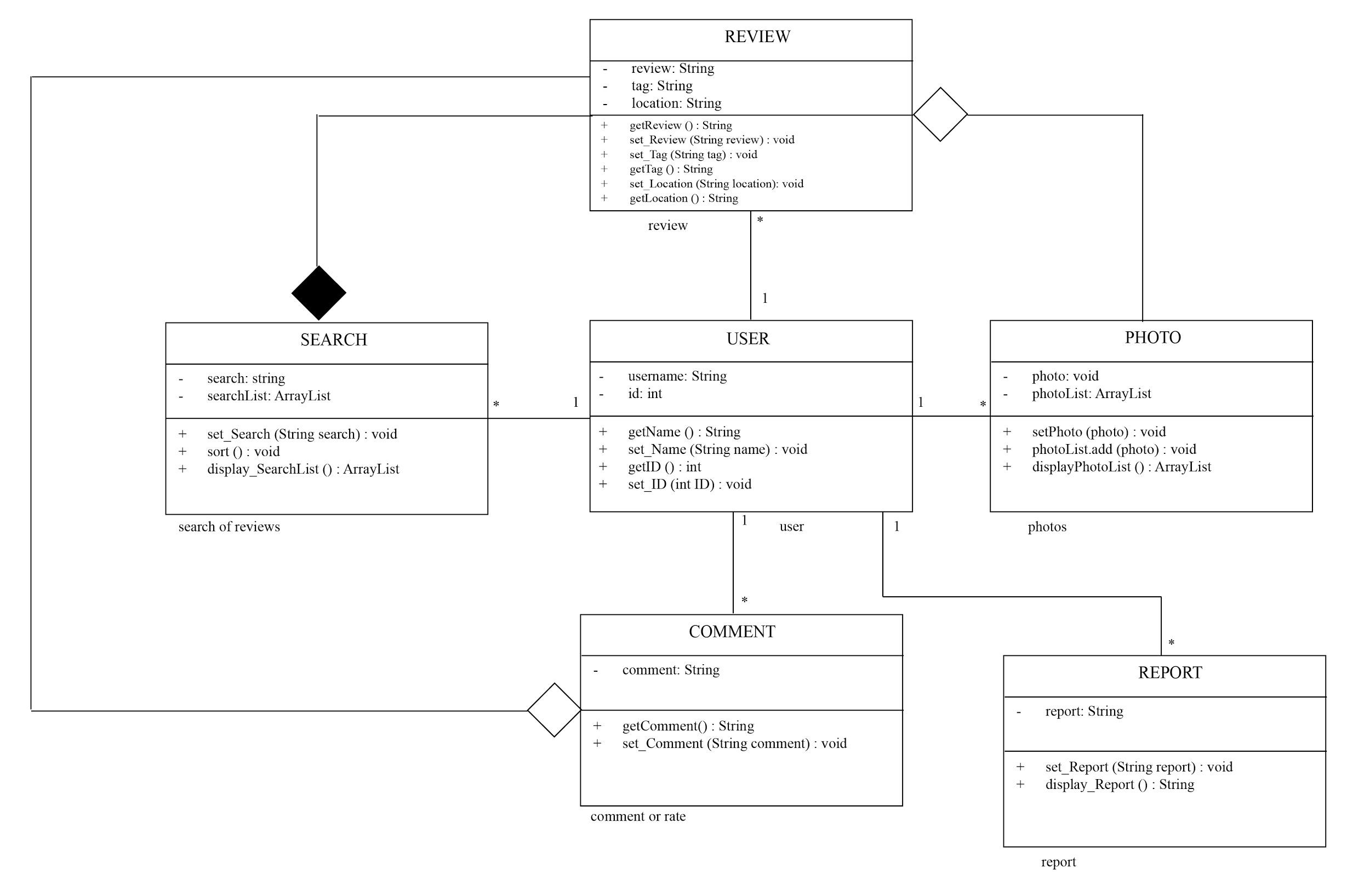
Architectural Design - Class Diagram
Notes:
jowyl
White box = association (can be standalone or with another class)
Black box = made up of (cannot exist without the class)
Ex. Photos can be attached with a review, but users can upload it without one. In the other hand, the chart needs to have reviews to be functioning.

Slide 8
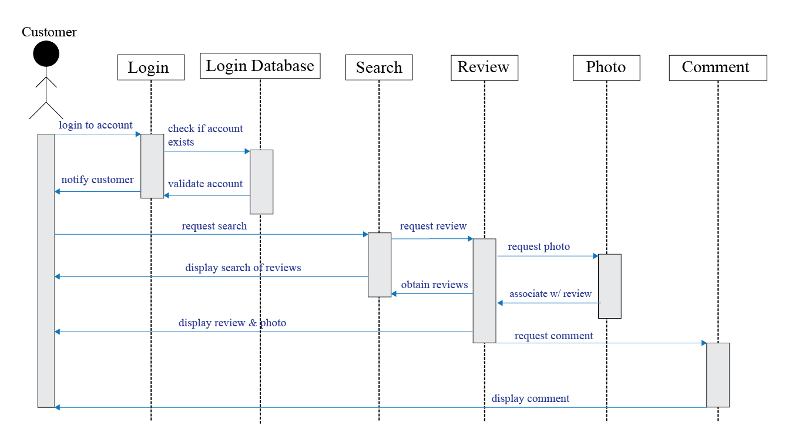
Architectural Design - Sequence Diagram
Notes:
jowyl
Login screen → database manager → search screen
Log in to account
Check if account exists
Validate account (database)

Slide 9
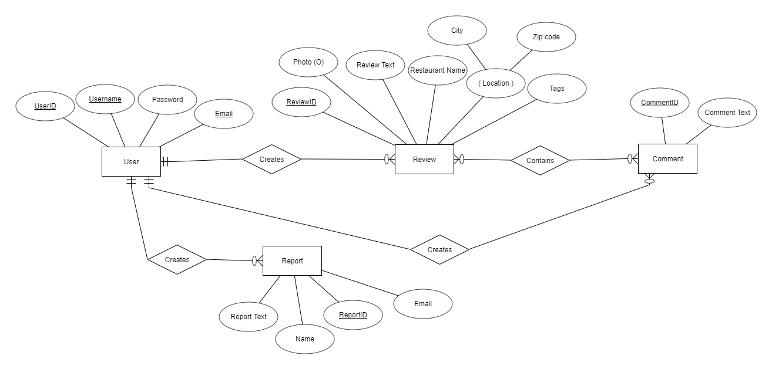
Architectural Design - Database Design
Notes:
jowyl
Relational diagram for login (user, account)

Slide 10
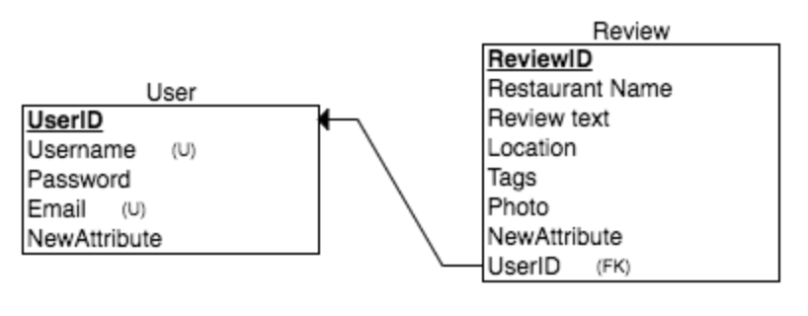
Relationship Diagram: User creates review
Notes:
jowyl

Slide 11
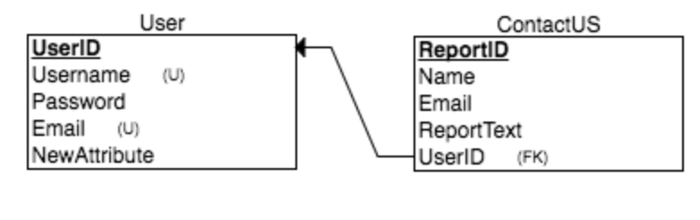
User creates report
Notes:
jowyl

Slide 12
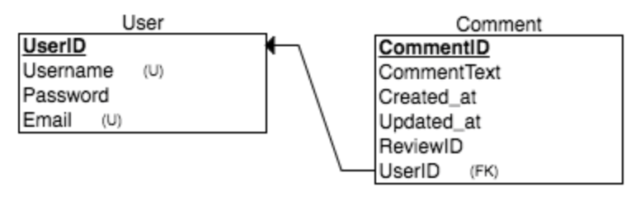
User creates comment
Notes:
jowyl

Slide 13
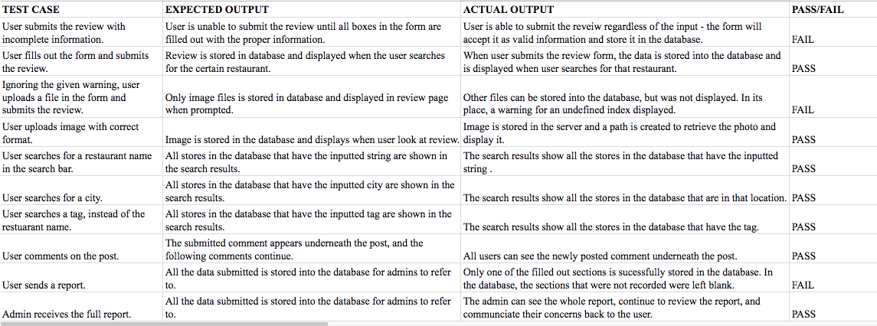
Unit Testing
Notes:
Regine
FAIL #1: It failed bc we didn’t implement a required attribute so user can submit without inputtong anything
FAIL #2: We did not do an implementation that limit the file type to only jpg, jpeg, png.
FAIL #3: The wrong table was

Slide 14
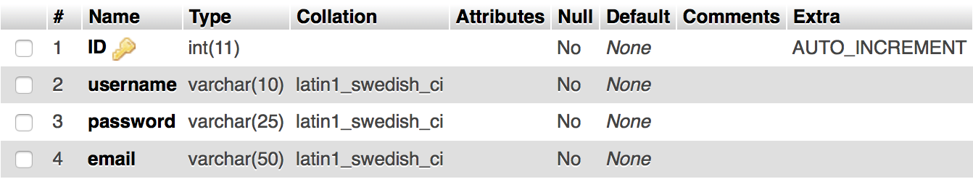
User Database
Server: localhost
Database: loginDB
Table: user
Used in commentserver.php and server.php when registering and logging in

Slide 15
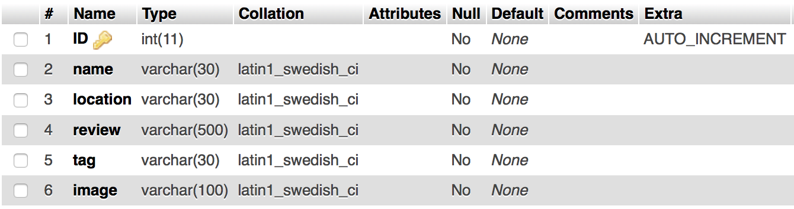
Review Database
Server: localhost
Database: loginDB
Table: review
Used in server2.php, searchserver.php, and commentserver.php

Slide 16
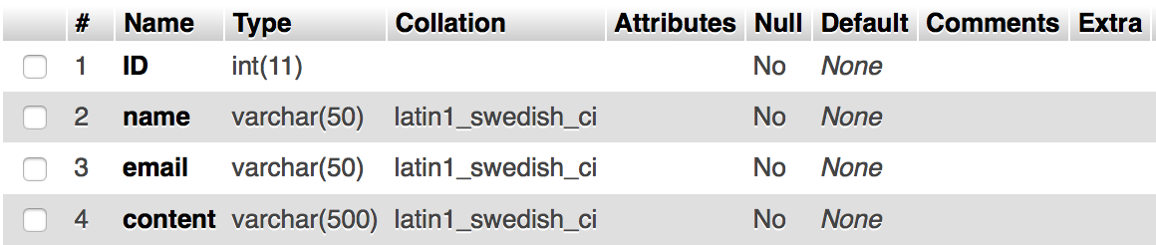
Reporting/Question Database
Server: localhost
Database: loginDB
Table: contactus
Used in reportserver.php

Slide 17
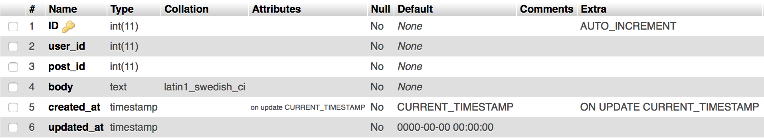
Comment Database
Server: localhost
Database: loginDB
Table: comments
Used in commentserver.php

Slide 18
Demo

