Slide 1


OpenEHR Technical

Slide 2
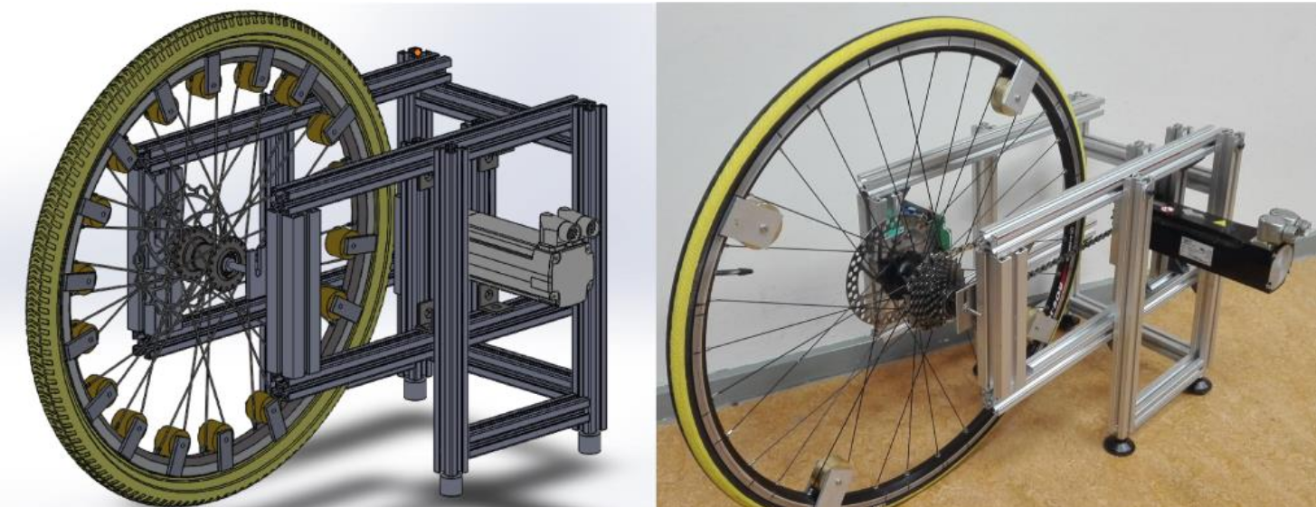
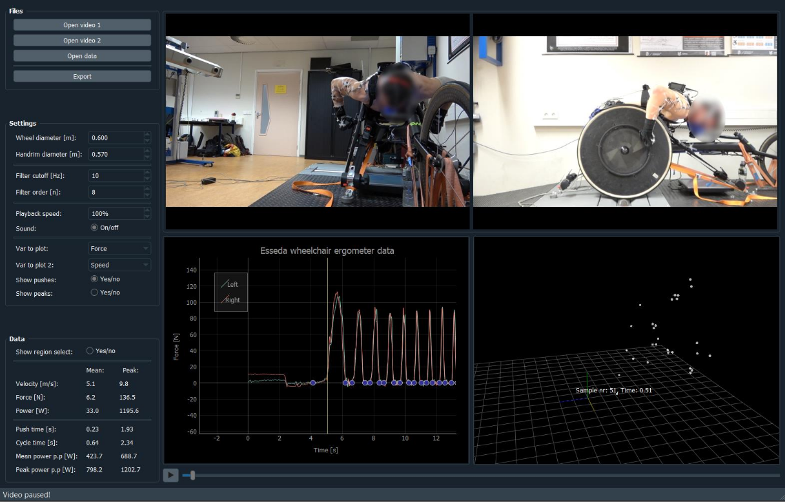
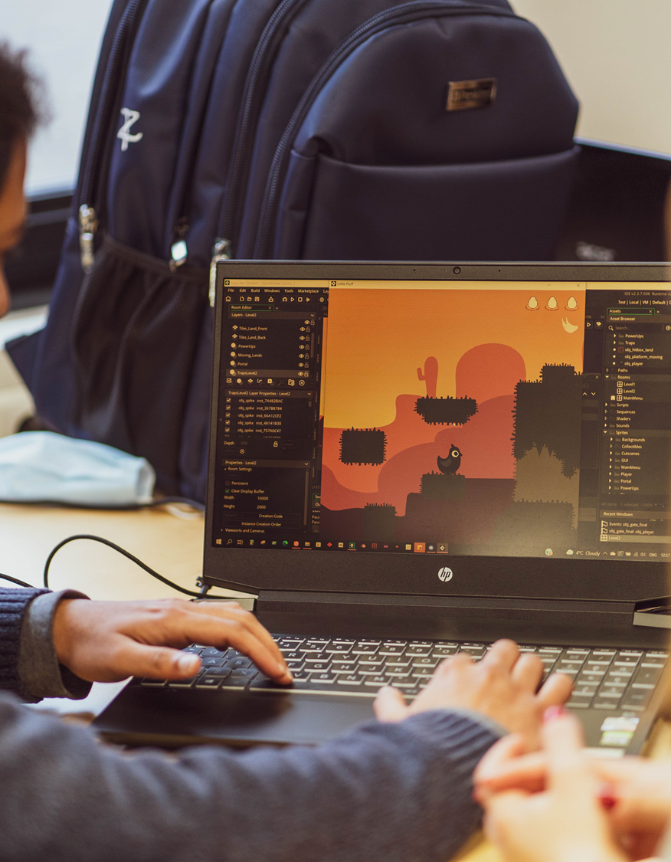
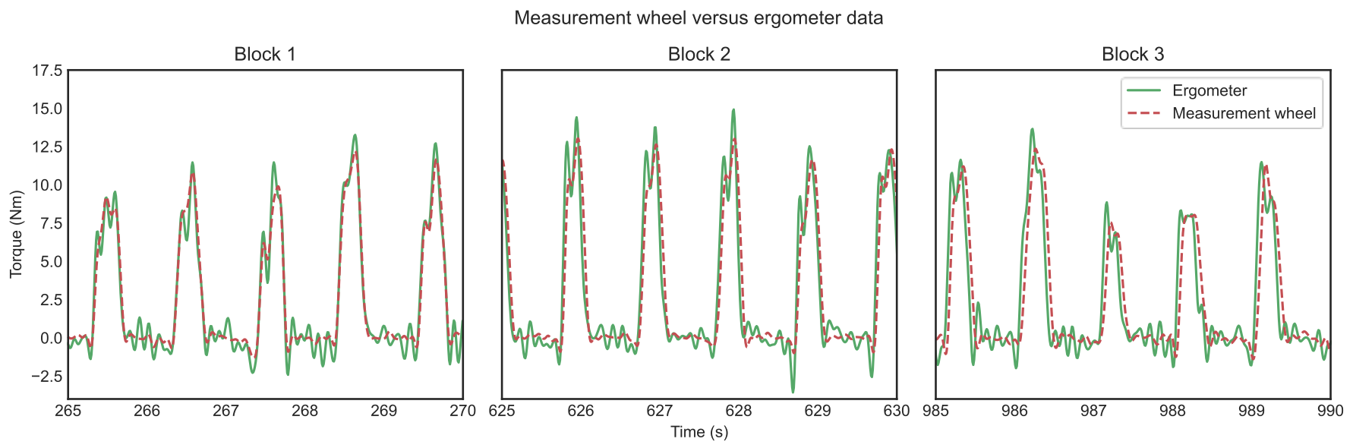
Sophie de Klerk
Bewegingswetenschapper
Signaal analyse
Data science
Creative Media & Game Technologies
Health Informatics

Slide 3
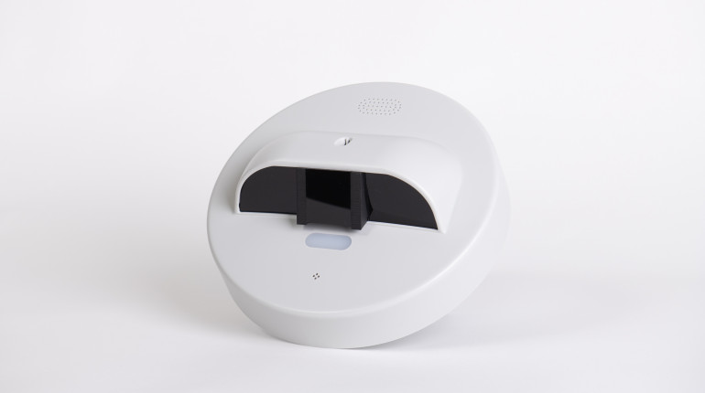
Project examples
1
Predicting falls
Predicting bladder infections
Matching interventions

Slide 4
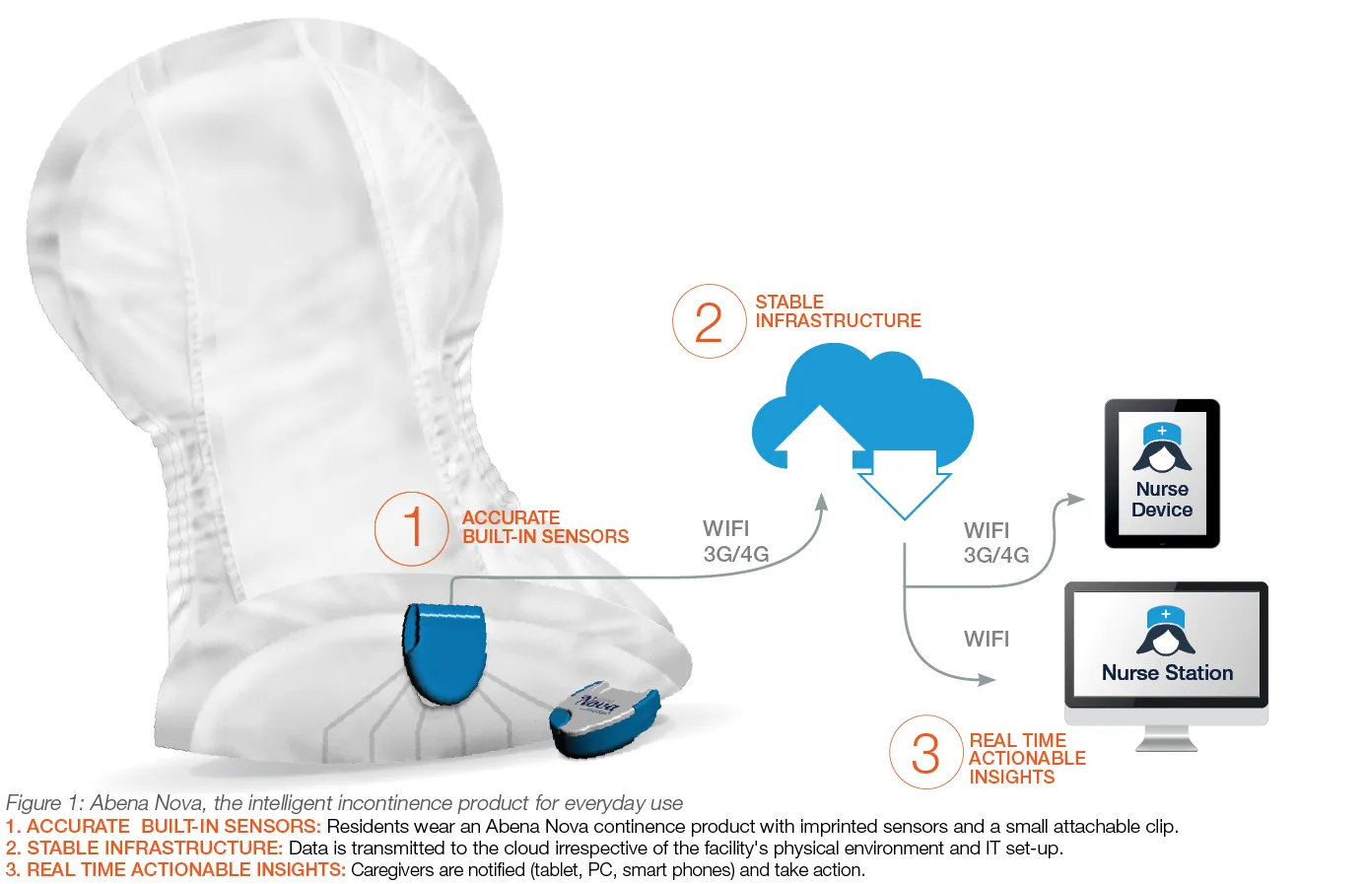
Project examples
1
Predicting falls
Predicting bladder infections
Matching interventions
2

Slide 5

Project examples
1
Predicting falls
Predicting bladder infections
Matching interventions
2
3

Slide 6
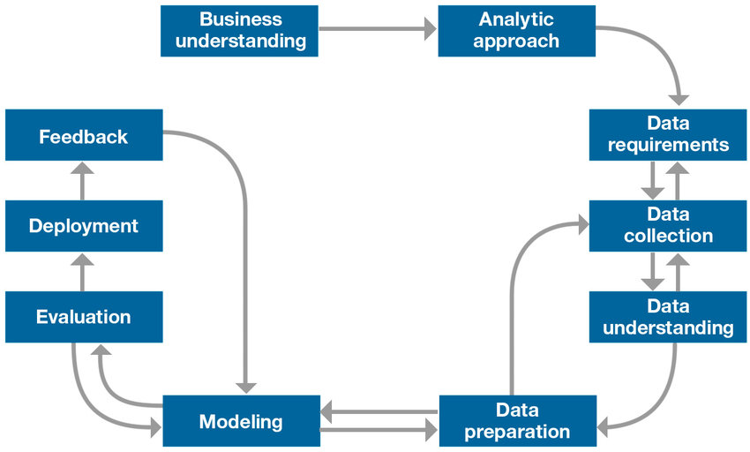
Challenges
Data availability
Data quality
Data quantity
Data types
IBM Data Science Methodology

Slide 7
Challenges
Data availability
Data quality
Data quantity
Data types
IBM Data Science Methodology

Slide 8
Research line Health Informatics

Slide 9
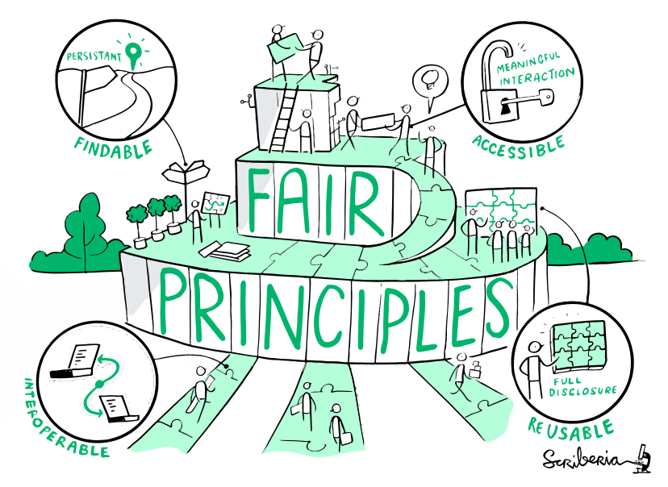
Key concepts
Data centric
Open standards
Platform
Critical approach
FAIR
Scriberia for The Turing Way

Slide 10
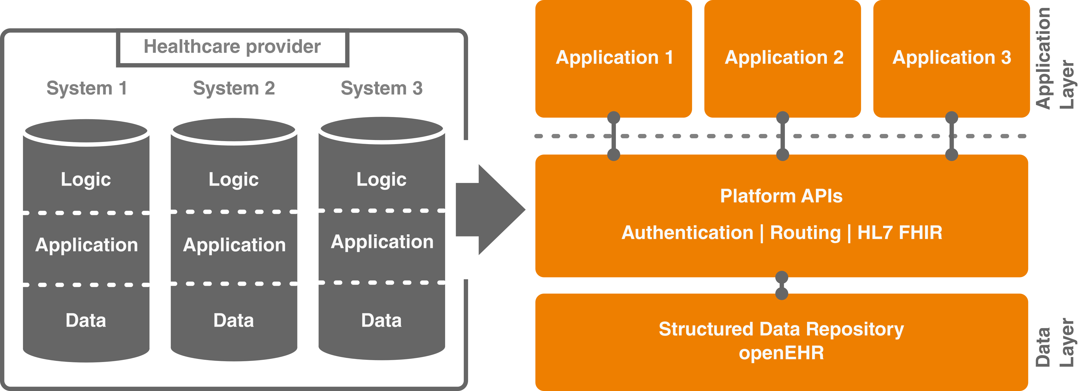
Application versus data driven

Slide 11
Application versus data driven

Slide 12
Modern EHRs
Data centric
Open standards
Platform
Secondary use
Prevent vendor lock-in

Slide 13
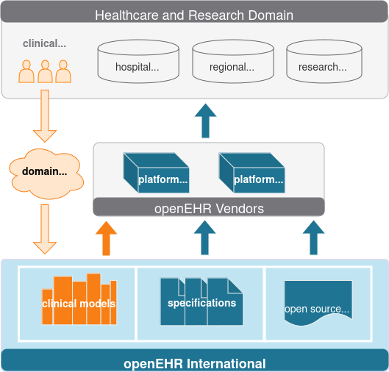
openEHR
Electronic Health Record
Open specification
Non-profit
International community

Slide 14
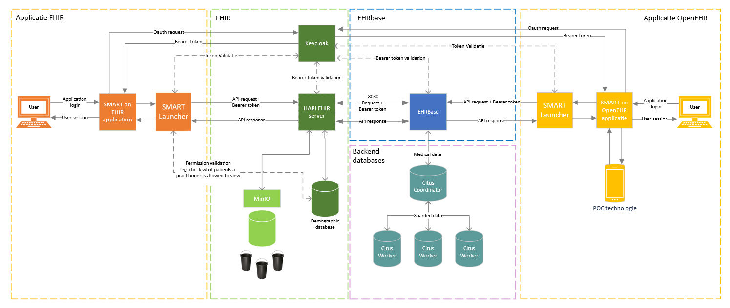
Previous work
Open source reference implementation
Open source stack is incomplete
Application backend
openEHR is too big for this application

Slide 15


Previous work
Open source reference implementation
Open source stack is incomplete
Application backend
openEHR is too big for this application

Slide 16



Future projects on OpenEHR
Hospital use case (Isala): Requirements of storage of clinical data
Own database (current situation)
FHIR DB
OMOP
OpenEHR
Federation of openEHR instances (multi-vendor)
Code24
EHRBase

Slide 17

Future projects on OpenEHR
Hospital use case (Isala): Requirements of storage of clinical data
Own database (current situation)
FHIR DB
OMOP
OpenEHR
Federation of openEHR instances (multi-vendor)
Code24
EHRBase

Slide 18
OpenEHR

Slide 19
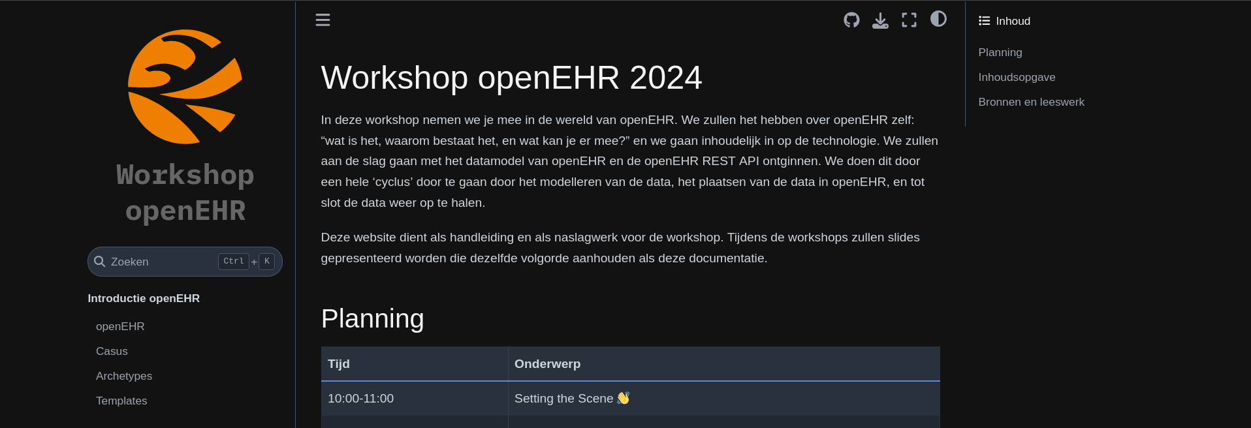
https://sophiedkk.github.io/openEHR-Hanze

Slide 20
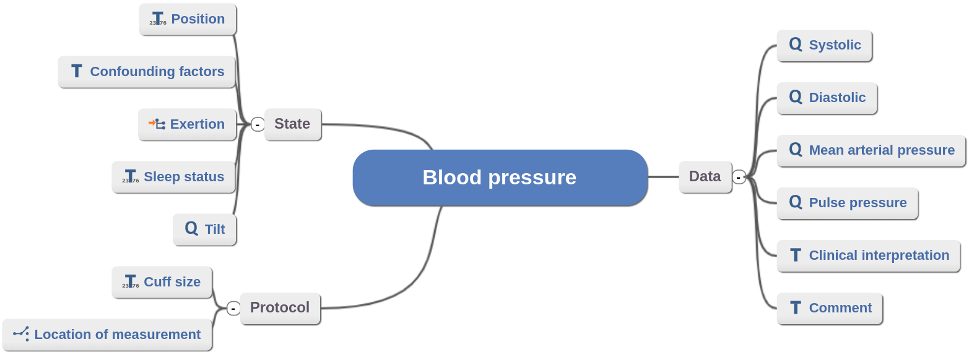
openEHR
Archetypes
Templates
Compositions
Standard APIs

Slide 21
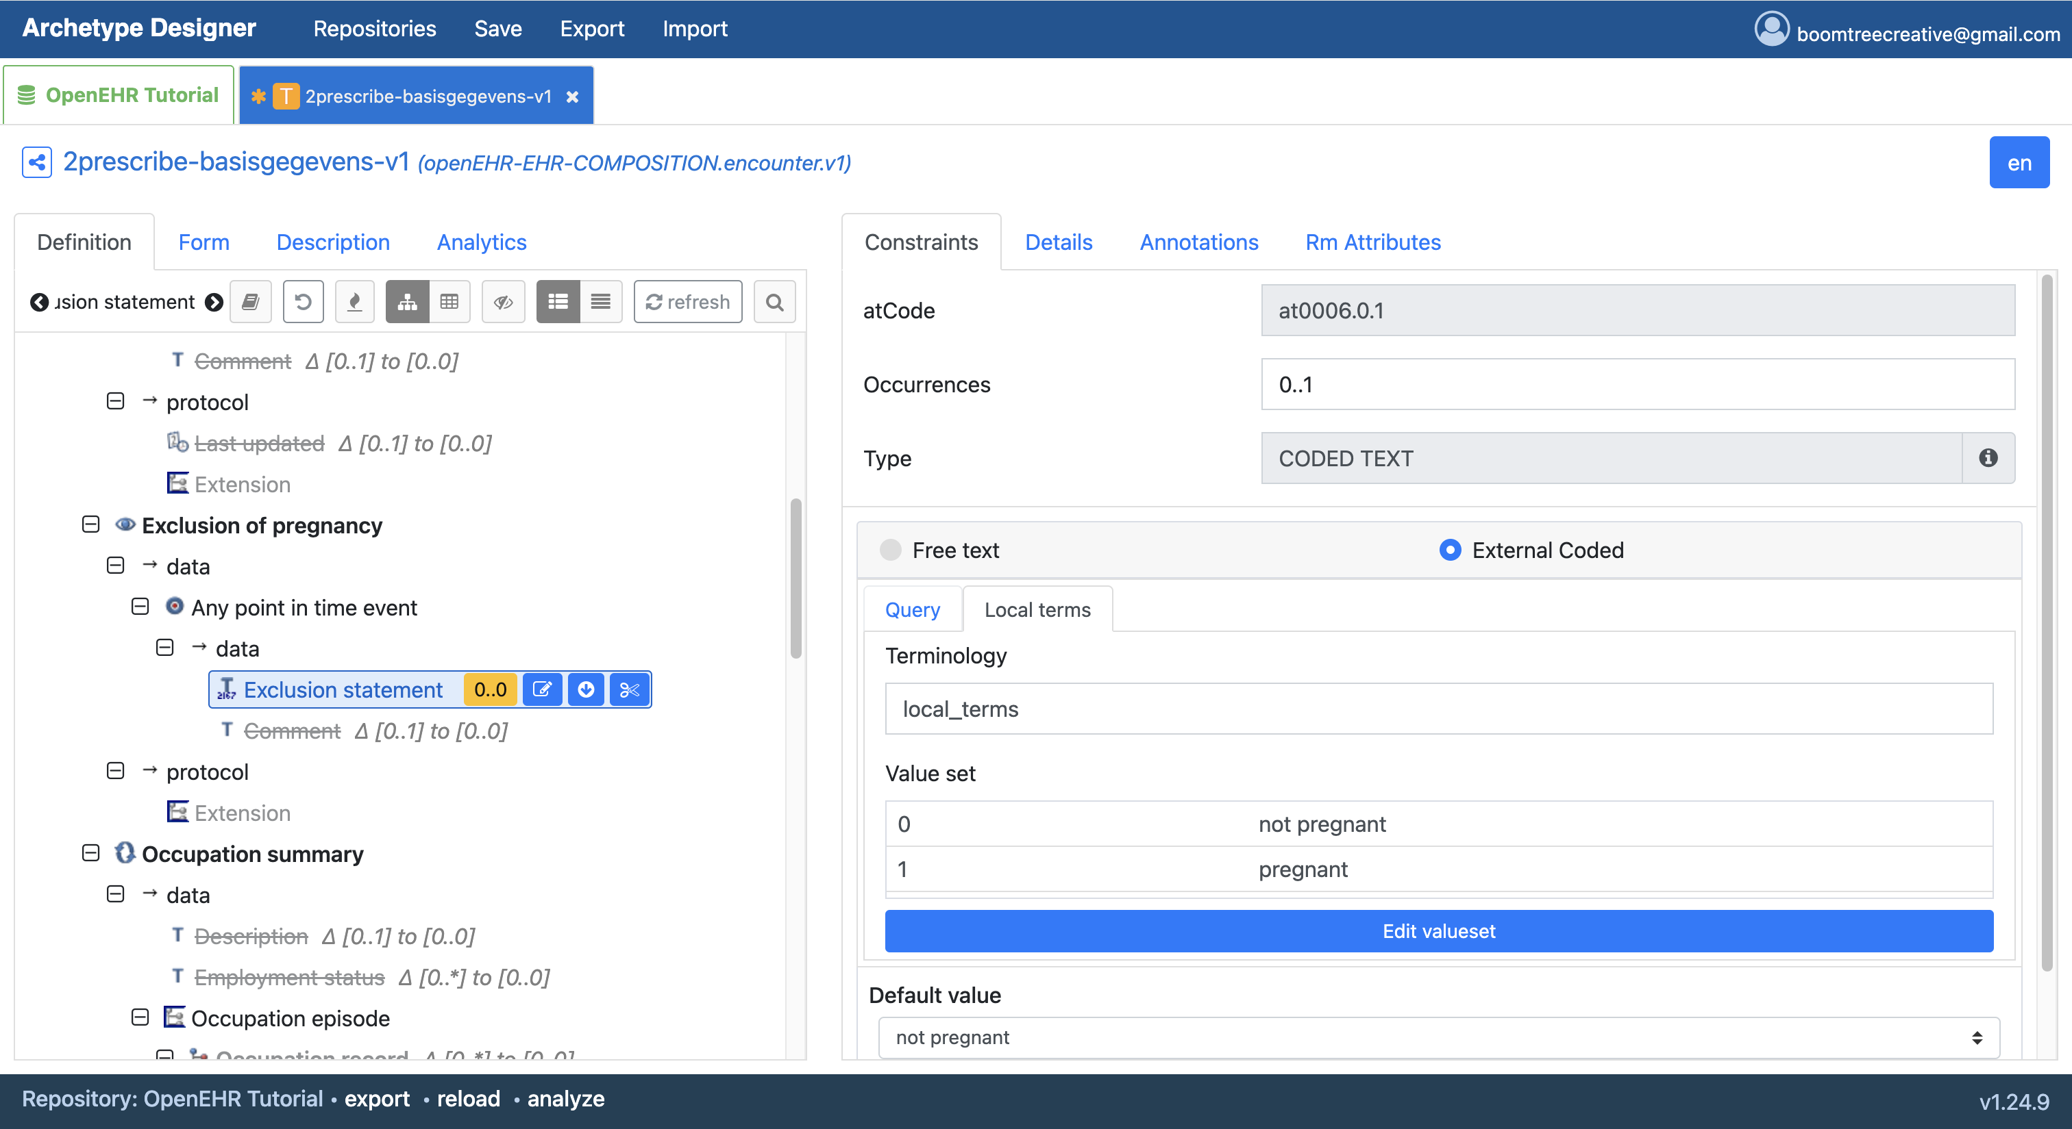
openEHR
Archetypes
Templates
Compositions
Standard APIs

Slide 22
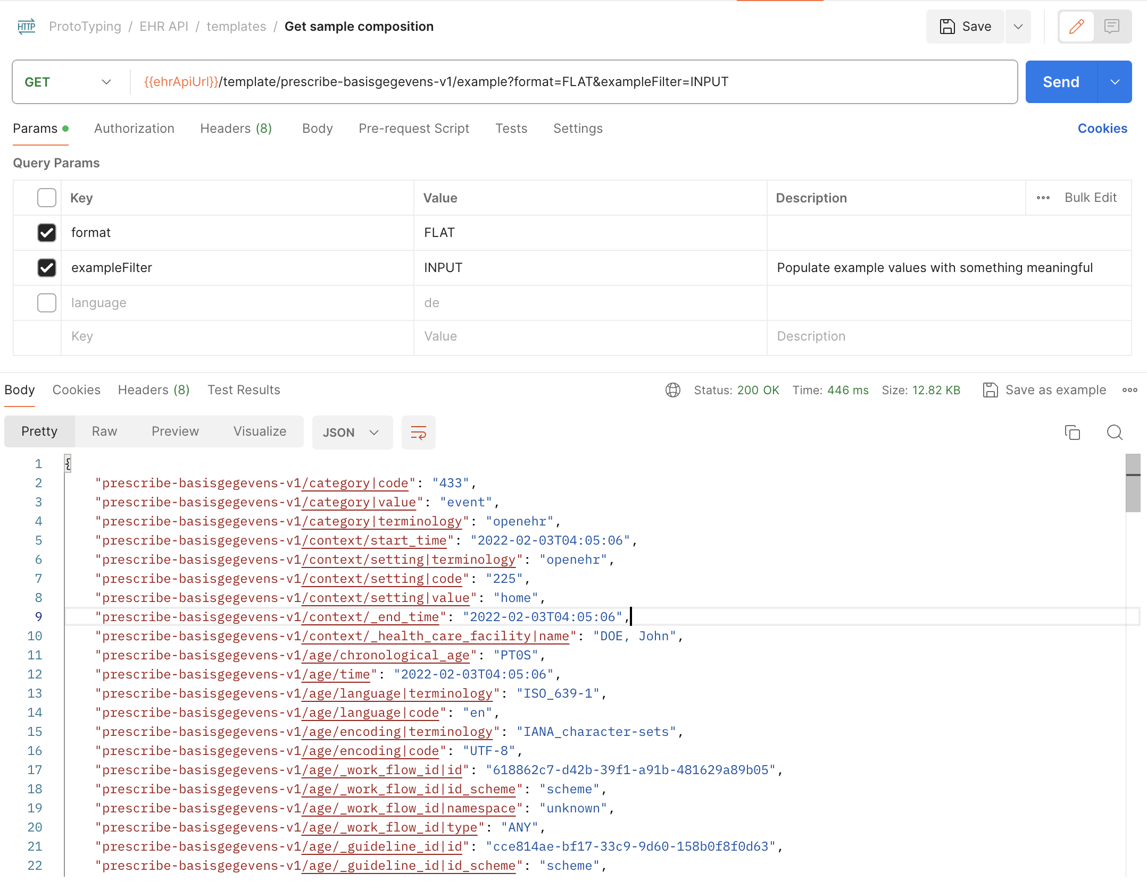
openEHR
Archetypes
Templates
Compositions
Standard APIs

Slide 23
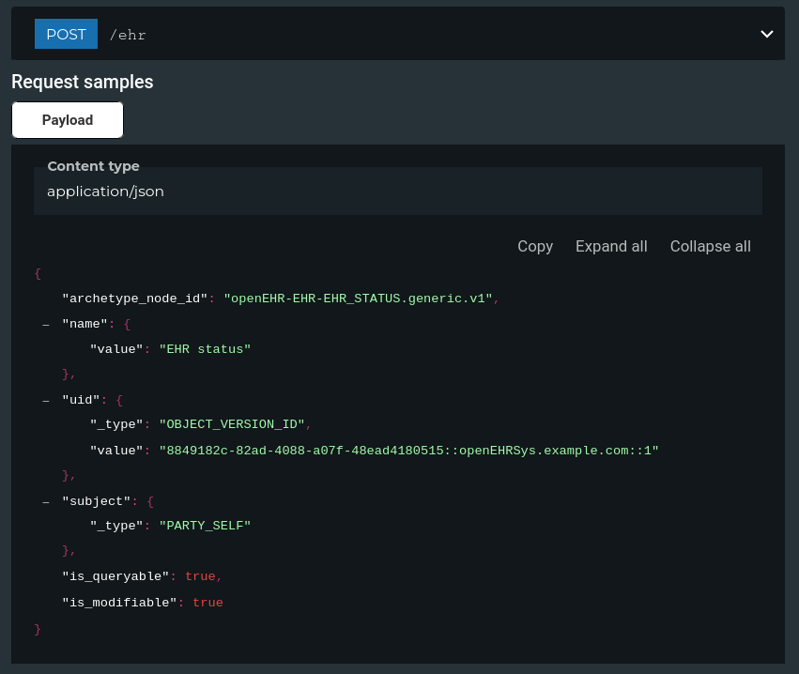
openEHR
Archetypes
Templates
Compositions
Standard APIs

Slide 24
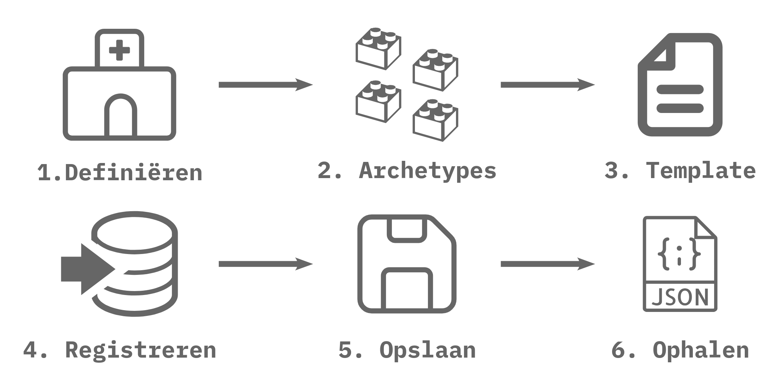

Slide 25
Archetypes

Slide 26
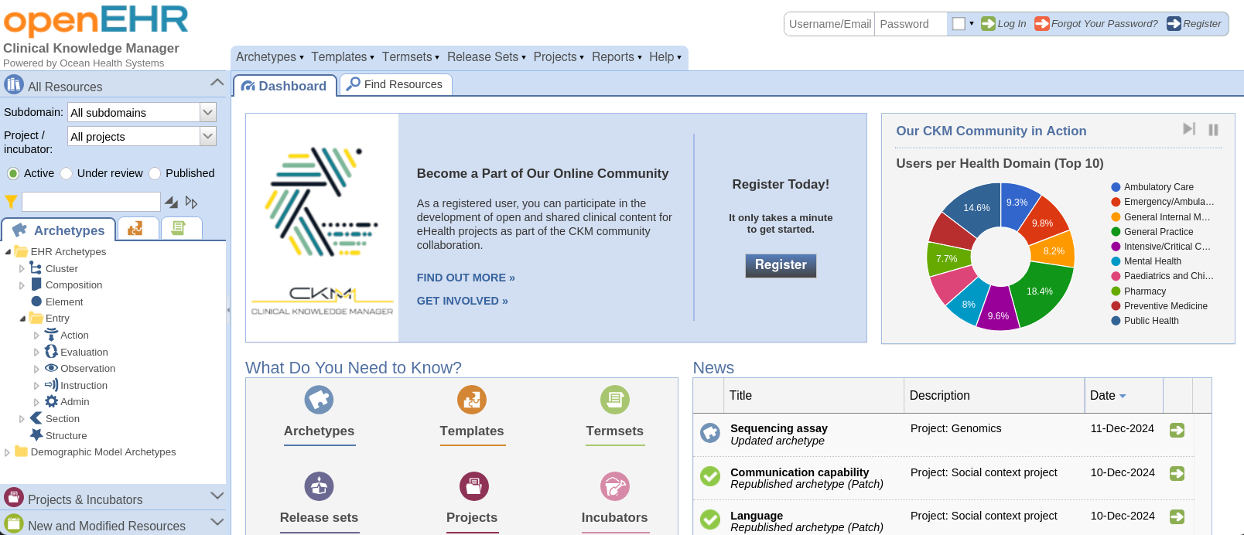
Archetypes
Clinical Knowledge Manager
Klinische concepten
Exporteren
Inspecteren
https://ckm.openehr.org/ckm/

Slide 27
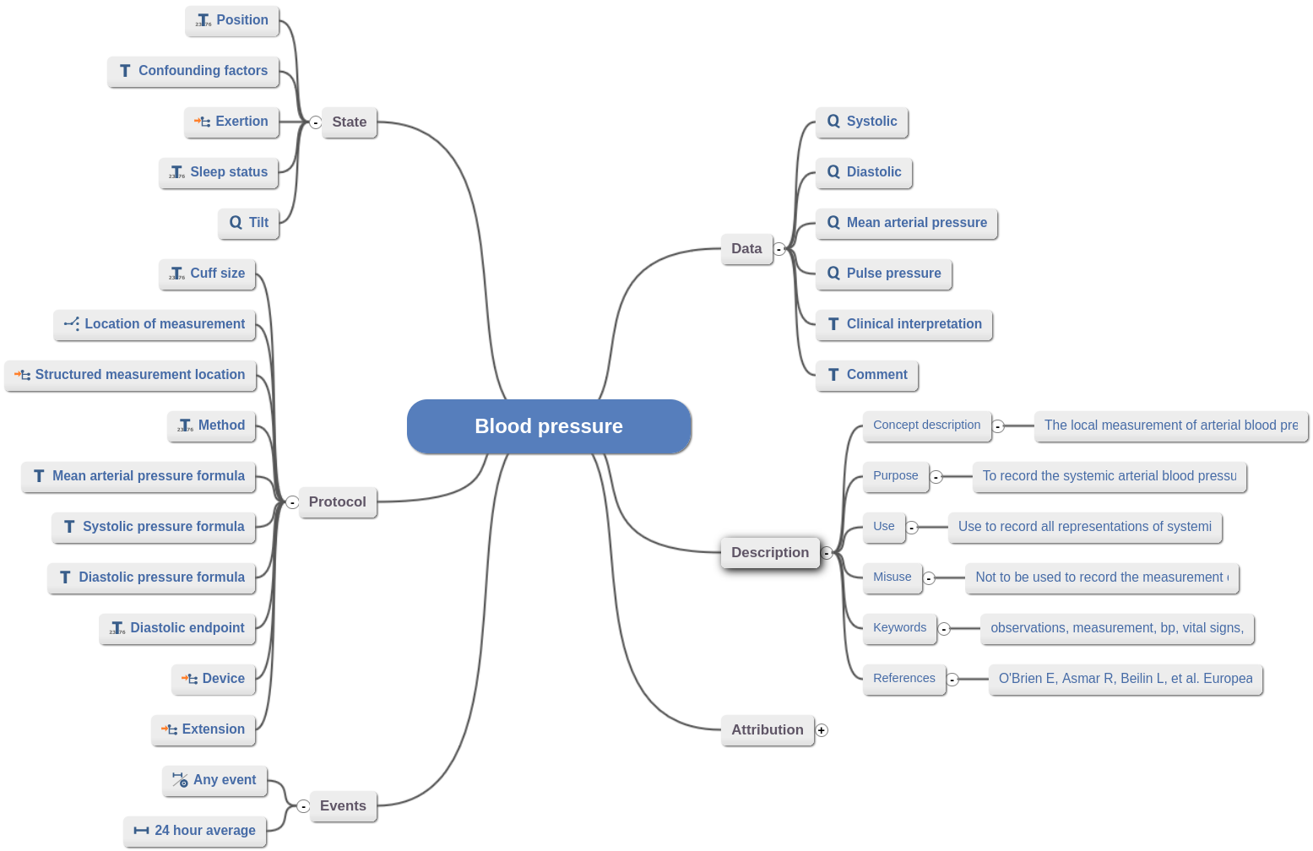
Archetypes
Clinical Knowledge Manager
Klinische concepten
Exporteren
Inspecteren

Slide 28
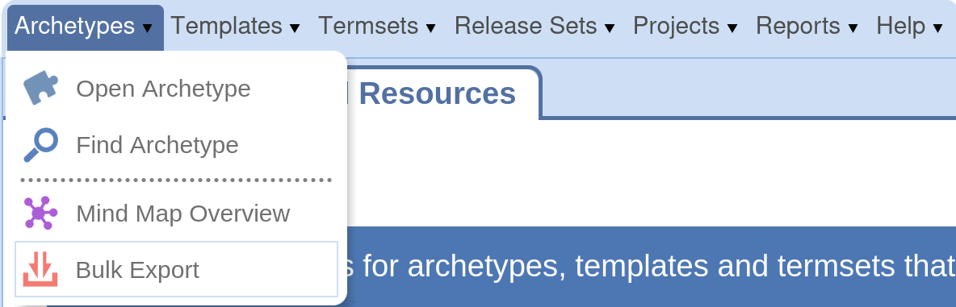
Archetypes
Clinical Knowledge Manager
Klinische concepten
Exporteren
Inspecteren

Slide 29
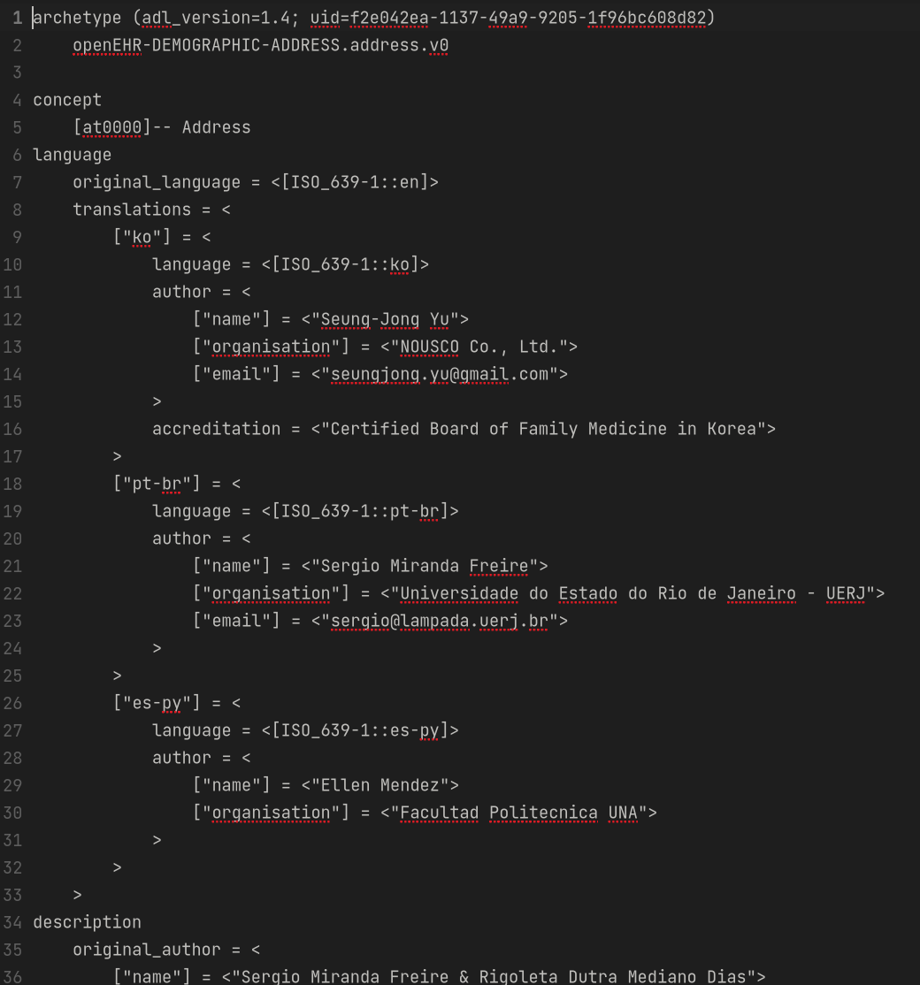
Archetypes
Clinical Knowledge Manager
Klinische concepten
Exporteren
Inspecteren

Slide 30
Aan de slag!

Slide 31
Archetypes & Templates

Slide 32
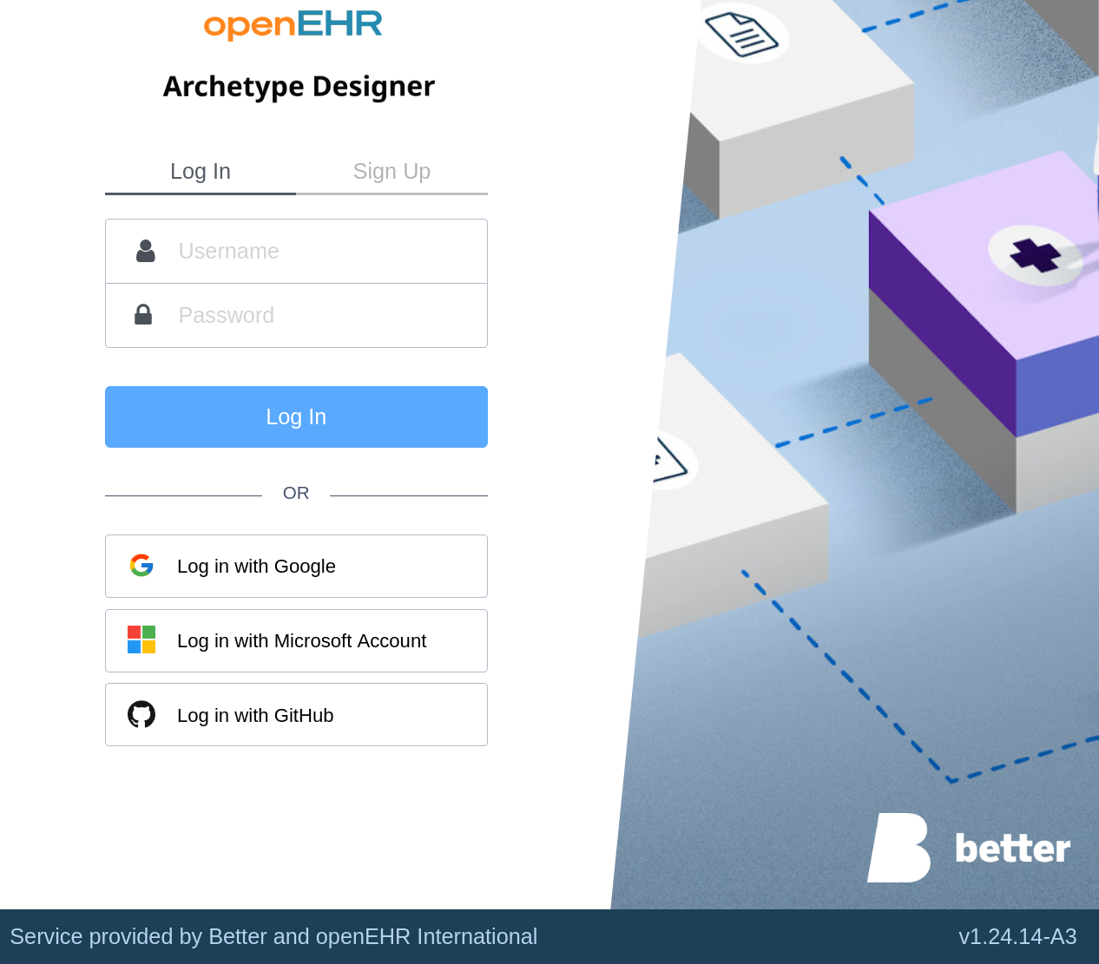
Templates
Archetype Designer
Repositories
Root archetype
Content
Tweaken
Exporteren
https://tools.openehr.org/

Slide 33
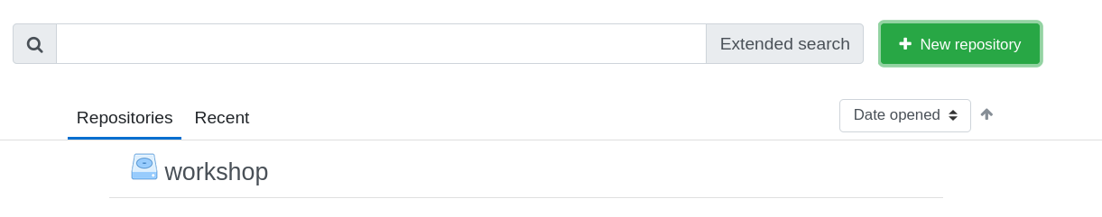
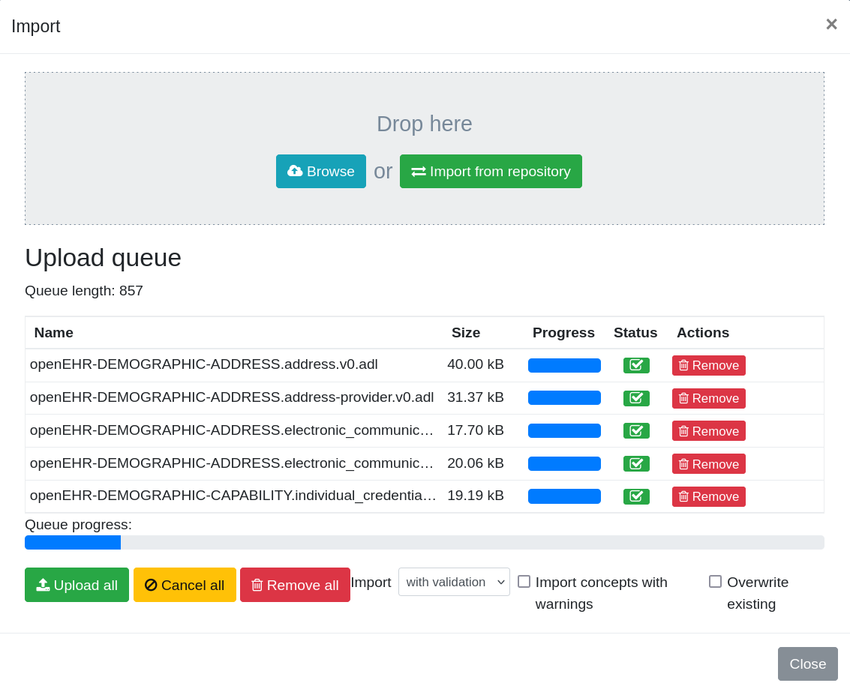
Templates
Archetype Designer
Repositories
Root archetype
Content
Tweaken
Exporteren

Slide 34
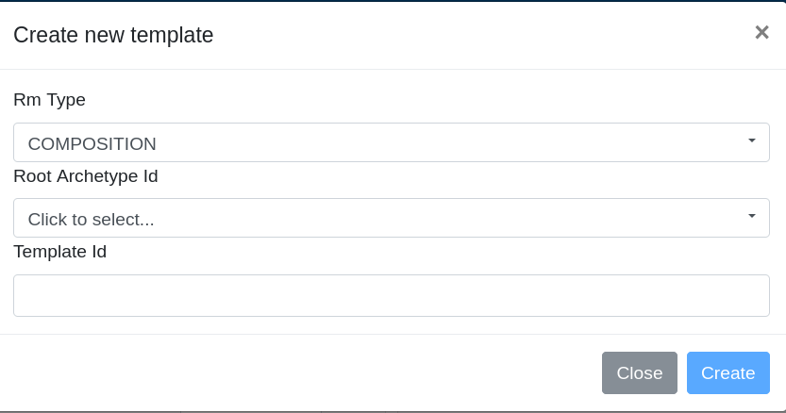
Templates
Archetype Designer
Repositories
Root archetype
Content
Tweaken
Exporteren

Slide 35
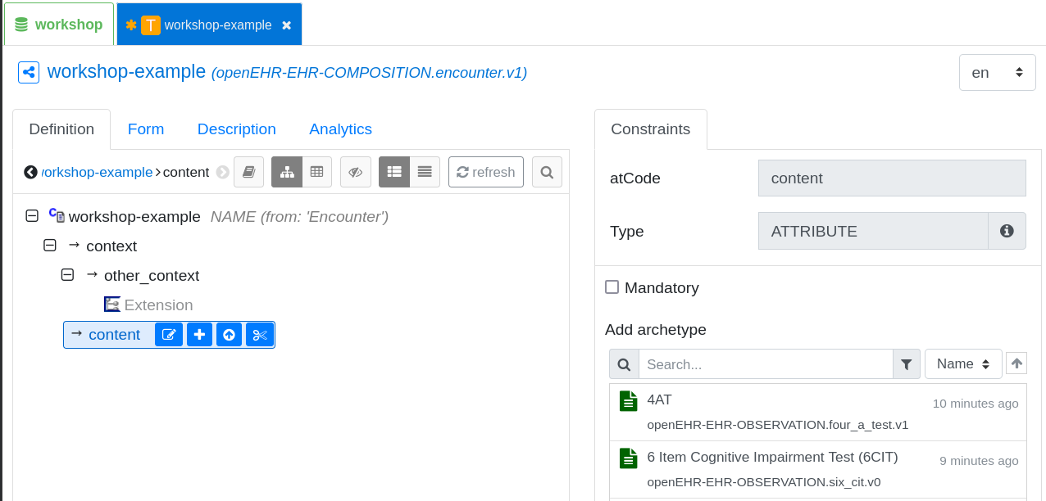
Templates
Archetype Designer
Repositories
Root archetype
Content
Tweaken
Exporteren

Slide 36
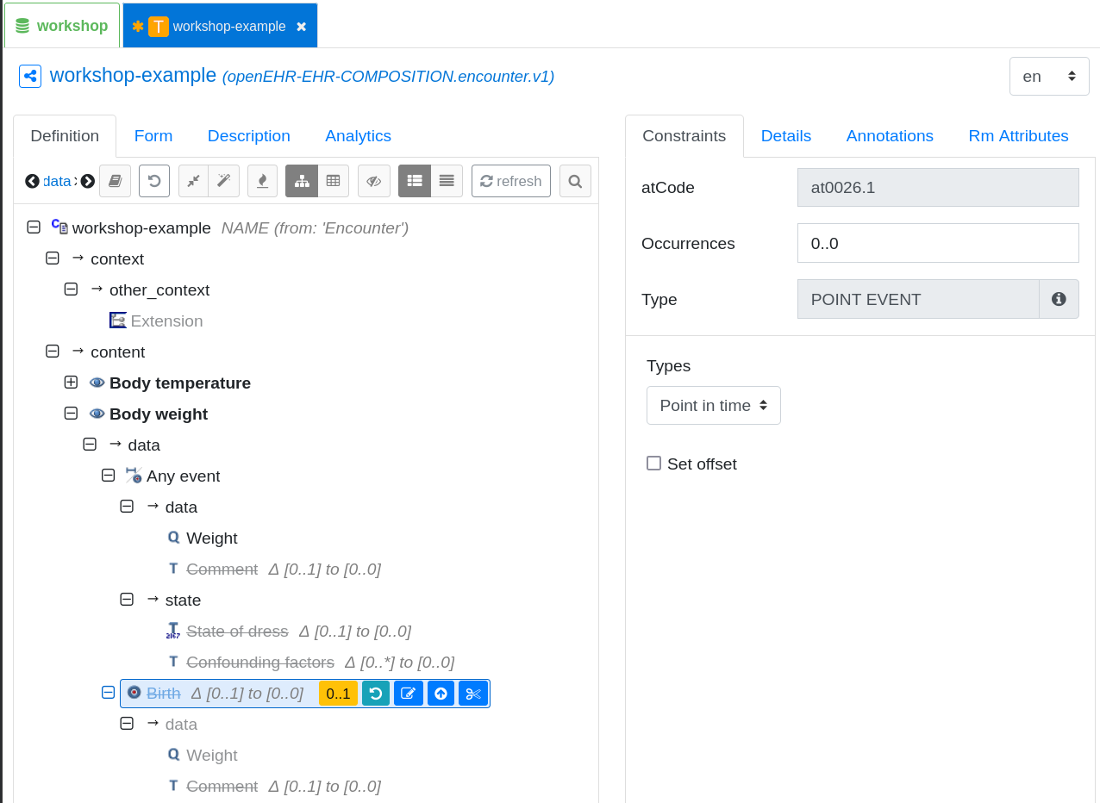
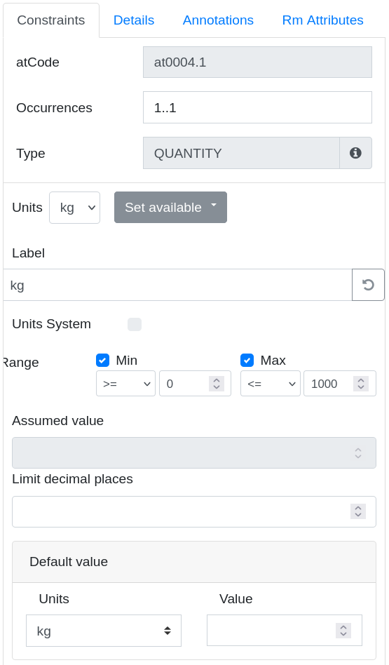
Templates
Archetype Designer
Repositories
Root archetype
Content
Tweaken
Exporteren

Slide 37
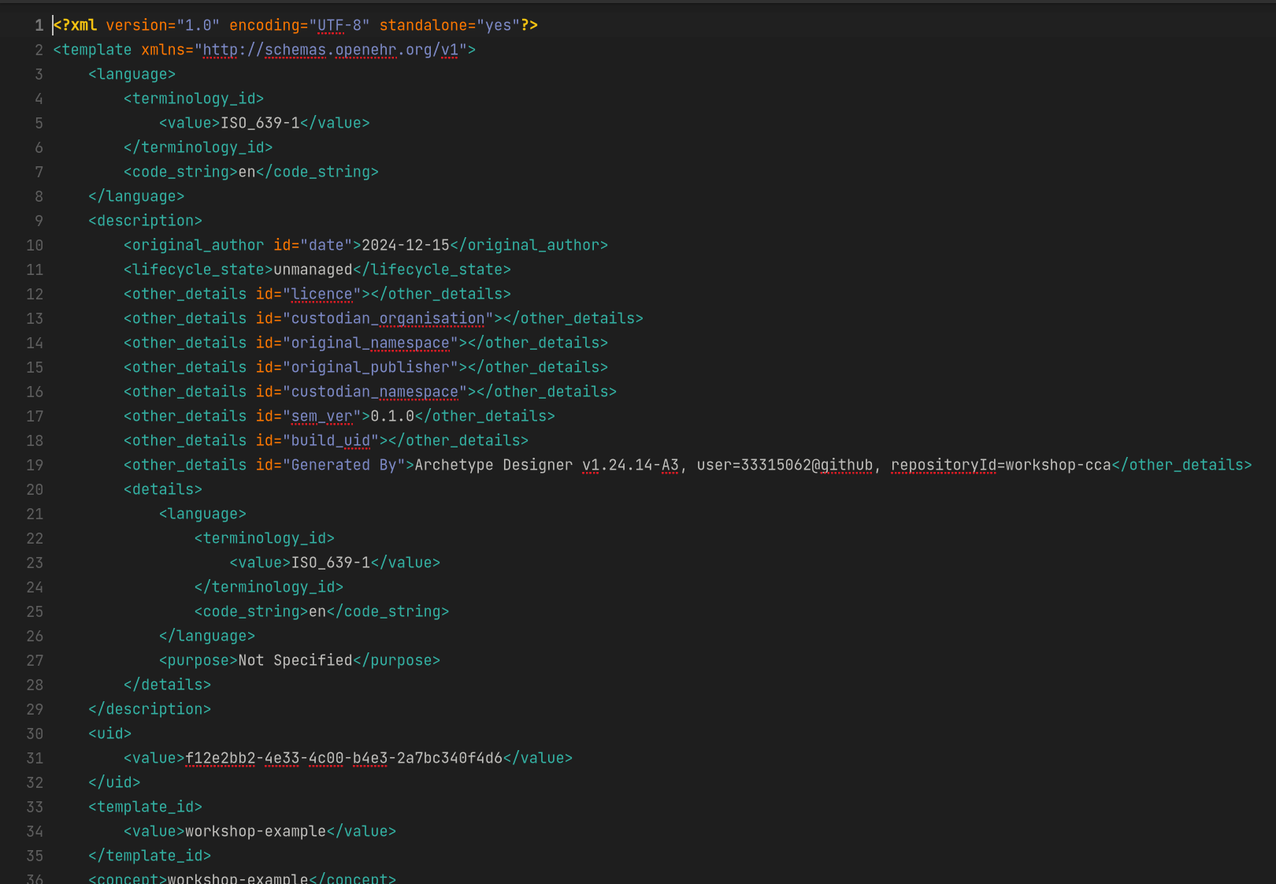
Templates
Archetype Designer
Repositories
Root archetype
Content
Tweaken
Exporteren

Slide 38
Aan de slag!

Slide 39
EHRBase

Slide 40

EHRBase
Open Source
Gebaseerd op Archie
Vitagroup
Optie 1: Sandbox
Optie 2: Docker
https://sandkiste.ehrbase.org/
https://docs.ehrbase.org/

Slide 41
Aan de slag!

Slide 42
openEHR API

Slide 43
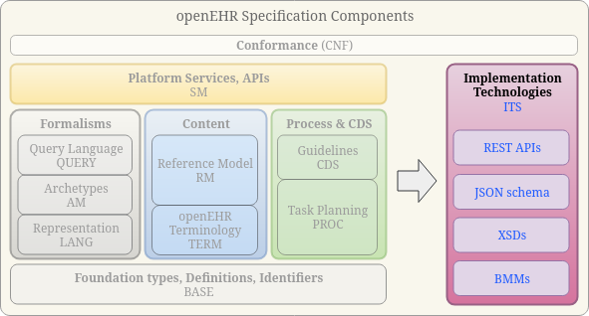
openEHR API
OpenEHR Specificatie
EhrScape API
Documentatie
API Client
https://docs.ehrbase.org/api/hip-ehrbase/ehr
http://localhost:8080/ehrbase/swagger-ui/index.html

Slide 44

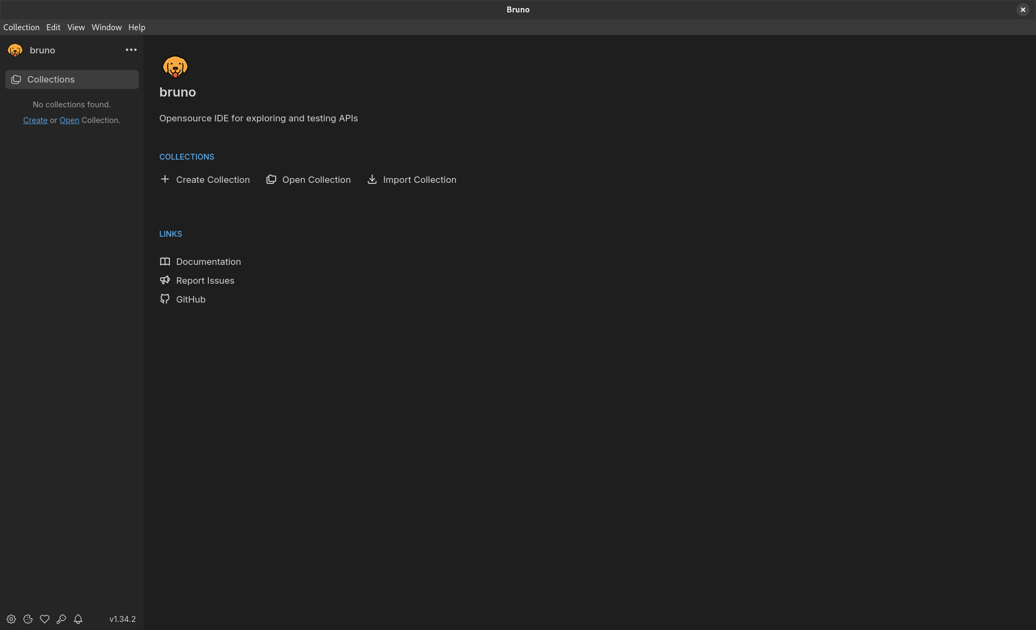
Bruno
Open Source
Git friendly
Collection
New Request
New Environment
https://www.usebruno.com/

Slide 45
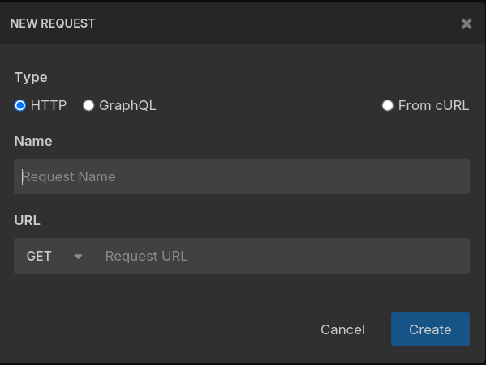
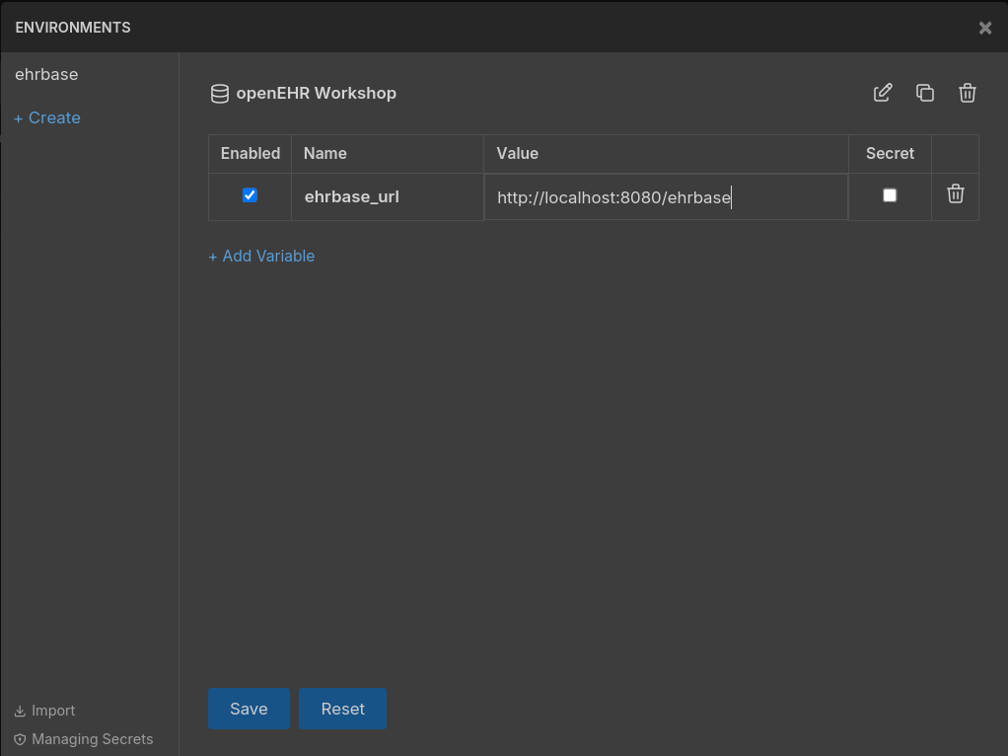
Bruno
Open Source
Git friendly
Collection
New Request
New Environment
https://www.usebruno.com/

Slide 46
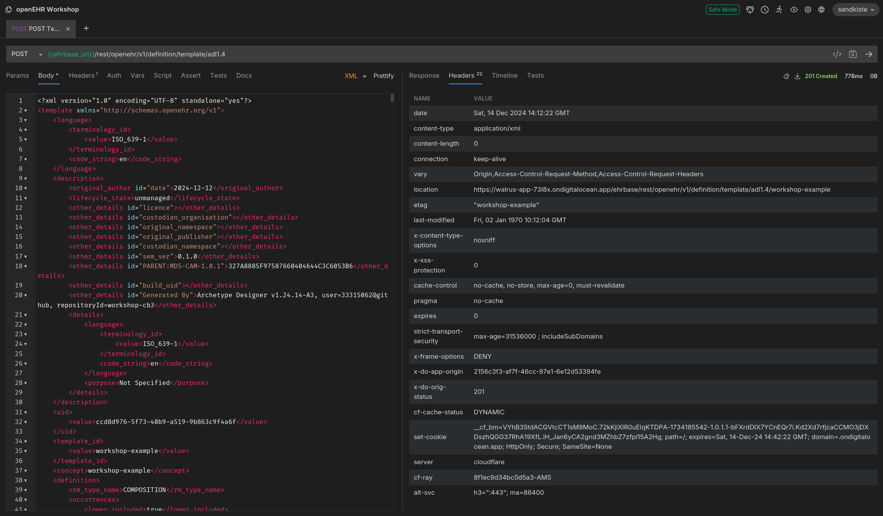
API stappen
Template uploaden
EHR aanmaken
Compositie posten
Compositie ophalen

