Slide 1
Stopped cosmic muons in the calorimeter
Muon lifetime and Michel spectrum, cosmic run 125329
Extracted position, no field · calorimeter only, no MC · 10.3 M events, 10.8 h
29 October 2026
Notes:
Studies of cosmic muons that stop in the calorimeter disks, using run 125329 in the extracted position (no solenoid field). Everything is data-driven: there is no cosmic MC yet. Main topics: the muon lifetime, which was low in the first pass, and the Michel spectrum.

Slide 2
Summary
2.201 ± 0.015
44.2 ± 0.2
8.4%
µs: muon lifetime of the stop sample
MeV: Michel edge E₀ from hit groups
of Michel decays deposit < 10 MeV
PDG τ(µ⁺) = 2.197 µs
38.8 MeV from reco clusters
lost by the cluster threshold
The first-pass τ = 2.117 µs and its 1.4 µs second component came from how the prompt muon was defined, not from physics
Reco clusters split one cosmic into several same-time pieces, and SiPM time offsets add echo clusters: tracks appear to end early
Tracks built from SiPM-corrected hits fix both, and the lifetime agrees with PDG. Hit groups that count each crystal once give a Michel spectrum ending at the 52.8 MeV endpoint
Notes:
Three numbers to take away. The lifetime now agrees with PDG. The Michel edge from hit groups is about 5 MeV higher and sharper than from clusters. And the 10 MeV cluster threshold loses 8% of the decays. The rest of the talk is how we got there.

Slide 3
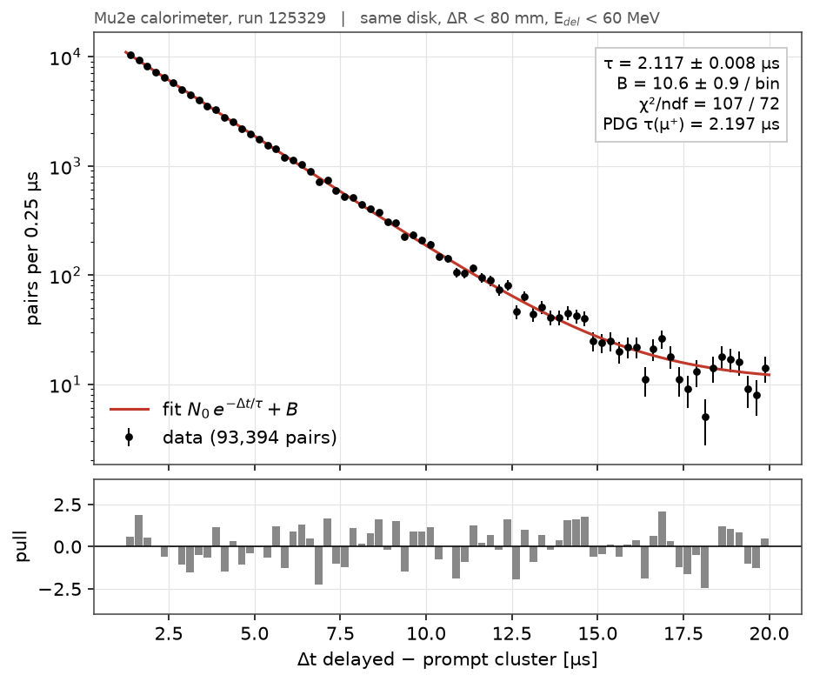
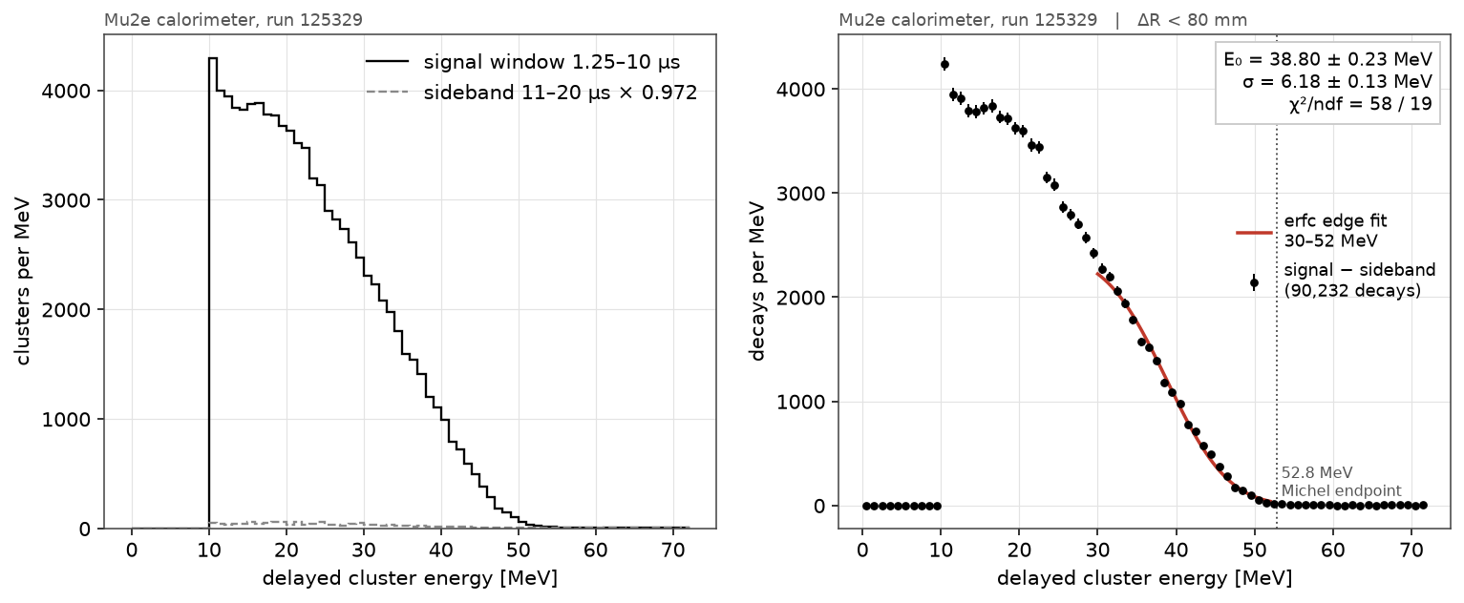
Where we started: cluster pairs
Prompt = any earlier cluster on the same disk within 80 mm; each delayed cluster paired with the closest one
τ = 2.117 ± 0.008 µs from 1.25 µs, rising to 2.148 ± 0.018 µs from 4 µs
Two-component fit: 9.5% with τ₂ = 1.44 ± 0.22 µs, read as µ⁻ stopping in light materials
Michel edge E₀ = 38.8 ± 0.2 MeV, σ = 6.2 MeV (clusters ≥ 10 MeV)
Notes:
This is the first pass from the README, sections 2 and 3. The lifetime was 4% low and grew when the fit started later, which is the signature of a short-lived component. We interpreted it as mu-minus in light materials. The Michel spectrum from clusters had its edge at 38.8 MeV.

Slide 4
Decay electrons sat ahead of the stop
A muon at rest emits its positron isotropically: up and down should match to within the polarization effect (≲ 0.1)
With reco clusters, decay electrons were 4× more often below the "stop" than above it: the track went on below the crystal we called its end
The same in every decay-time bin and for single-crystal clusters, so not a channel-recovery effect
All candidates; Michel groups > 3 MeV within 80 mm, 1.5–9 µs, sideband-subtracted. Middle bar from a 400 k-event test sample.
Notes:
The key diagnostic. If the stop crystal is right, Michel deposits are symmetric around it. They were not: minus 0.62 overall and minus 0.69 in the purest selection. Merging same-time clusters halves it; correcting SiPM times and building tracks from hits removes it. The left-right control was zero in the first and final versions.

Slide 5
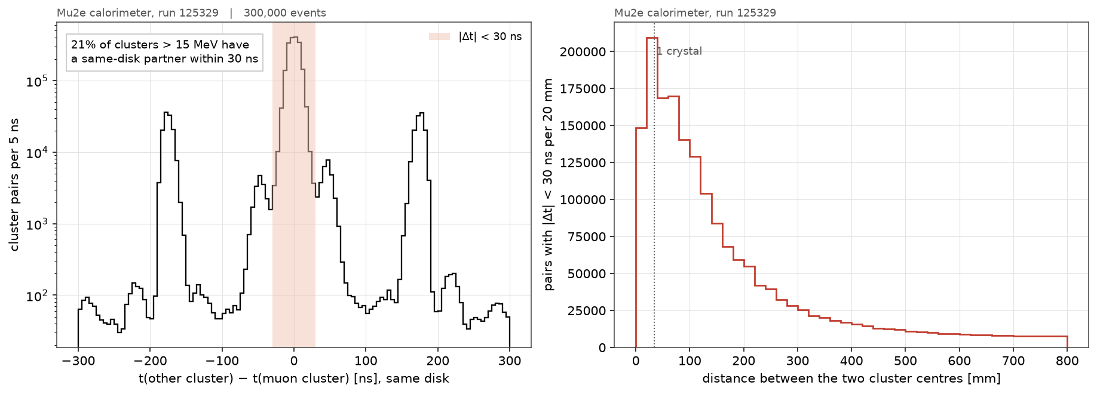
Two ways a track ends early
Split clusters
21% of clusters above 15 MeV have a same-disk partner within 30 ns, typically 1–4 crystals away. The upper piece looked like a stop.
SiPM time offsets
The ±170 ns peaks are echo clusters from SiPMs shifted by k × 169 ns (283 crystals). A shifted crystal drops out of the track.
Notes:
Left: time difference between a muon cluster and every other cluster on the same disk. The central peak is the same cosmic split into pieces. The side peaks at plus or minus 170 ns are the echo clusters from the SiPM time-calibration offsets. Right: the split pieces are mostly one to four crystals apart, so they are fragments of one track, not separate muons.

Slide 6
New stop finder: tracks from corrected hits
1
2
3
4
Correct hit times
Chain hits into tracks
Pick the stop
Collect delayed hits
Per-SiPM offsets from sipm_abs_offsets.py, for single-SiPM and merged hits
Same disk, time gaps < 30 ns; reco clusters are not used
Lowest end of the energy-weighted track axis; reject if an earlier muon is within 25 µs and 150 mm
Within 150 mm, −20 to +60 µs, grouped in time; a split crystal counts once
6.53 M muon candidates · stop sample (last-crystal energy 25–70 MeV, ≥ 40 mm of disk ahead): 662 k
fill_stops.py: about 2 min for the run on 4 cores
Notes:
The new stop finder never uses reco clusters. Hit times are corrected with the per-SiPM offset table measured in section 1. Hits on the same disk with gaps under 30 ns form a track. The stop is the lowest end of the track, since cosmics go down. A track with another muon shortly before it nearby is rejected, which removes Michel electrons and leftover echoes as prompts.

Slide 7
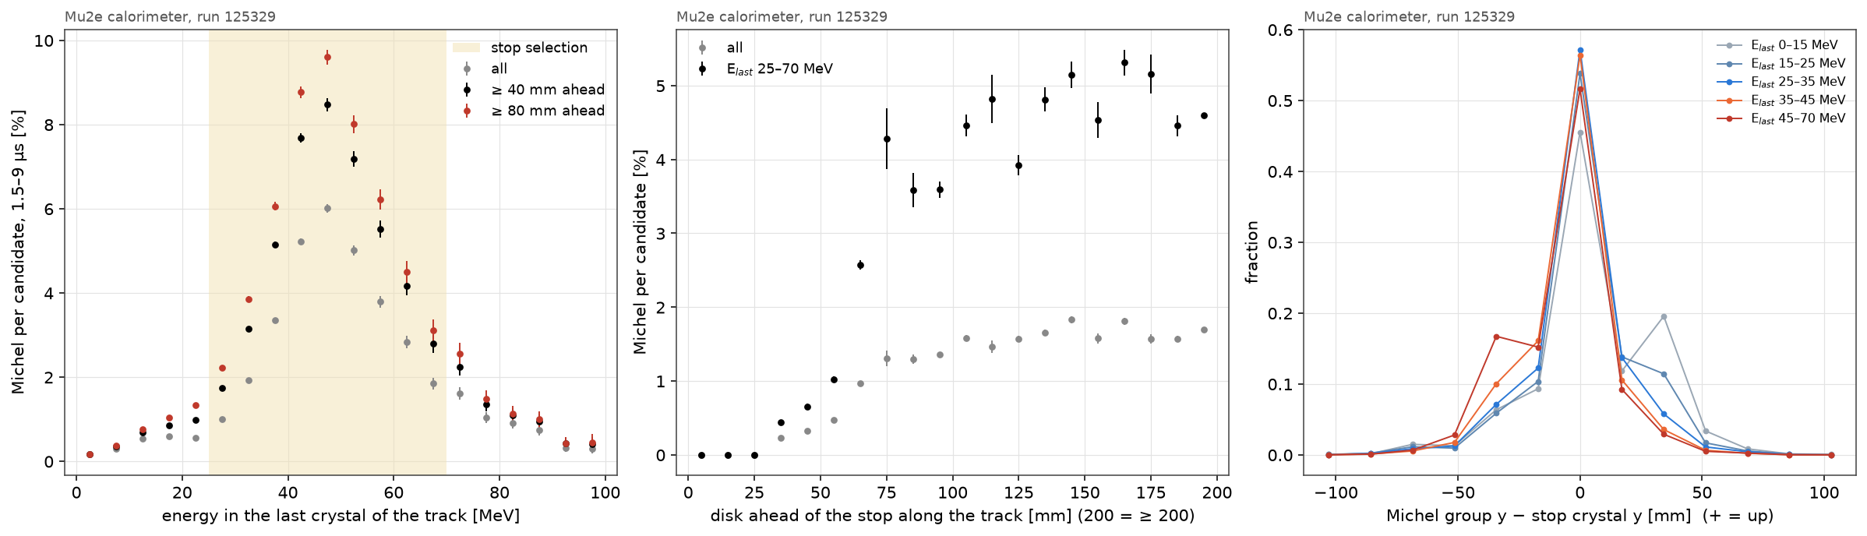
Most track ends are not stops
The calorimeter can't see a muon leave through a disk face: the Michel rate per candidate is 0.4% at low last-crystal energy and 7–8% at the Bragg peak (40–50 MeV) with ≥ 80 mm of disk ahead
Stop sample: 3.7% Michel per candidate, so roughly 14% real stops (window efficiency 0.49, f(µ⁺) ≈ 0.55)
Right: the Michel position still shifts with last-crystal energy; the stop is known only to about one crystal
Notes:
Purity is the main limitation of a calorimeter-only stop. A muon that exits through the front or back face looks just like a stop. Last-crystal energy is the best handle: a Bragg peak in the last crystal means the muon really ended there. The purity matters for the charge ratio, but not for the lifetime, which only needs the Michel-tagged events.

Slide 8
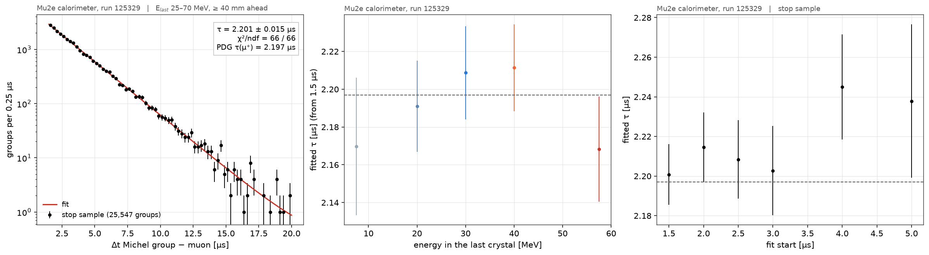
Lifetime agrees with PDG
Fit 1.5–20 µs
Michel groups 10–60 MeV within 80 mm: τ = 2.201 ± 0.015 µs, χ²/ndf = 66/66
By last-crystal energy
Split by the stop-purity proxy: no trend, all within about 1σ of 2.197 µs
By fit start
Flat within errors (points share data), so no short-lived second component
Notes:
Left: the stop-sample fit, starting at 1.5 microseconds to stay clear of the post-muon soft-hit burst and the echo region. Middle: if mu-minus in light material were pulling tau down, the low last-crystal-energy bins would sit low; they don't. Right: a second component would make tau rise with the fit start; it is flat within errors. The digitizer clock scale is fine.

Slide 9
It was the method, not the sample
Sample | τ from 1.25 µs | 2nd component
Cluster pairs (first pass) | 2.117 ± 0.008 µs | 9.5%, τ₂ = 1.44 µs
New: all candidates, no purity cut | 2.209 ± 0.011 µs | none
New: stop sample | 2.218 ± 0.015 µs | none
New: stops < 40 mm from the disk edge | 2.12 ± 0.04 µs | not significant
Even with no purity cut the new method gives the PDG value, so the purity cuts are not hiding anything
The bias sits in the first-pass prompt definition (fragments, echoes, Michels as prompts); which of these produced the 1.4 µs component is not yet isolated
Stops near the disk edge are 2σ low: possibly µ⁻ in the outer support, still open
Notes:
Same data, different prompt definition. Without any purity cut the new method already gives 2.21 microseconds with no second component, so the low first-pass value was a reconstruction effect. Stops near the edge are about 2 sigma low, which could be real mu-minus capture in the outer support ring, but it is only 15% of the decays. Next step: rerun the old pair method adding fragments, echoes and Michel prompts back one at a time.

Slide 10
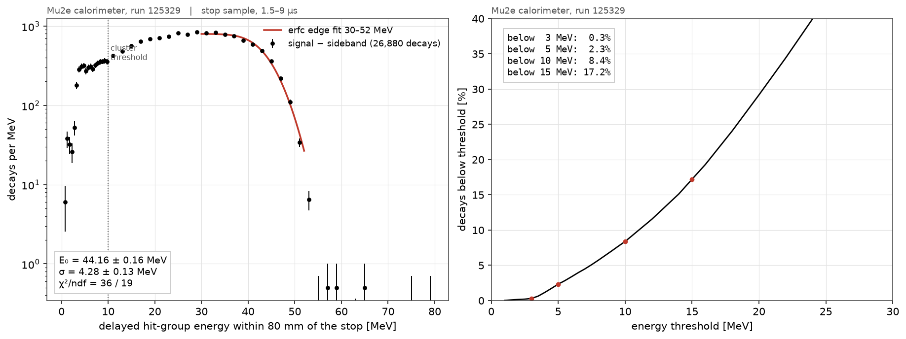
Michel spectrum from hit groups
Hit groups sum all hits within 150 mm and 30 ns, down to 0.5 MeV, with each crystal counted once; background from the 15–22.5 µs sideband
The spectrum ends at the 52.8 MeV endpoint; 8.4% of decays fall below the 10 MeV cluster threshold, 0.3% below 3 MeV
Notes:
Using hit groups instead of clusters lowers the threshold to about half an MeV. Each crystal counts once: the two single-SiPM hits of a split crystal each estimate the full crystal energy, and summing both had pushed the spectrum past the endpoint. The right panel gives the fraction of decays below a given threshold, which is useful for any cluster-based Michel analysis.

Slide 11
Michel edge: clusters vs hit groups
Method | Decays | E₀ [MeV] | σ [MeV]
Reco clusters ≥ 10 MeV, ΔR < 80 mm (first pass) | 90 k | 38.80 ± 0.23 | 6.18 ± 0.13
22/10/26 slides | – | 42.80 ± 0.12 | 5.13 ± 0.10
Hit groups, stop sample, fit 30–52 MeV | 26.9 k | 44.16 ± 0.16 | 4.28 ± 0.13
Hit groups, stop sample, fit 35–55 MeV | 26.9 k | 45.04 ± 0.16 | 3.50 ± 0.10
Why the edge moves up
Hit groups keep the energy that split clusters lose, so the edge rises by about 5 MeV and sharpens. This is the likely cause; it is not checked against MC.
What it can't tell us yet
E₀ moves by about 0.9 MeV with the fit range. Without MC, E₀ can't be converted to an absolute electron energy scale: leakage and threshold effects are unknown.
Notes:
The cluster edge is low and broad because clusters miss energy: the clustering splits showers just as it splits muon tracks, and there is a 10 MeV threshold. Hit groups recover that energy. The fit-range dependence is about 0.9 MeV, larger than the statistical error. To turn this into an energy calibration we need cosmic MC through the same chain.

Slide 12
Conclusions and next steps
Conclusions
Next steps
Reco clusters can't define a stopped muon in cosmics: tracks are split in time and by SiPM offsets
With SiPM-corrected hit tracks, τ = 2.201 ± 0.015 µs, consistent with PDG; the clock scale is fine
Michel edge E₀ = 44.2 ± 0.2 (±0.9 from fit range) MeV, σ = 4.3 MeV; 8.4% of decays fall below 10 MeV
Isolate which part of the first-pass prompt definition produced the 1.4 µs component
Fix the per-SiPM time constants and check the clustering time window against them
Follow up the edge stops (2.12 ± 0.04 µs): µ⁻ in support material?
Cosmic MC through the same chain, to turn E₀ into an electron energy scale
Notes:
The clustering and SiPM-time issues affect any cosmic analysis that relies on reco clusters, so they are worth fixing upstream. The Michel edge is now a usable, self-consistent number, but it needs MC before it becomes a calibration.

