Slide 1
Usecase, Activity Diagram, Class Diagram
Chat App Encryption
Kelompok 3 | TI-22-PB
- Siti Rohmah (222310054)
- Sophie Makianoor (222310062)
- Naila Martiza (222310071)

Slide 2
Table of contents
01
02
03
Section
Section
Section
Usecase
Activity Diagram
Class Diagram

Slide 3
01
Usecase

Slide 4
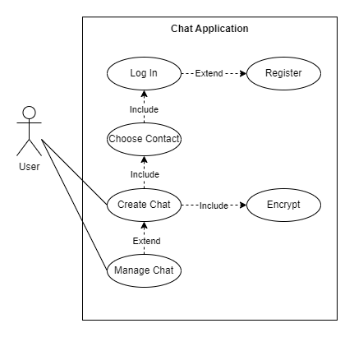
Usecase

Slide 5
02
Activity Diagram

Slide 6
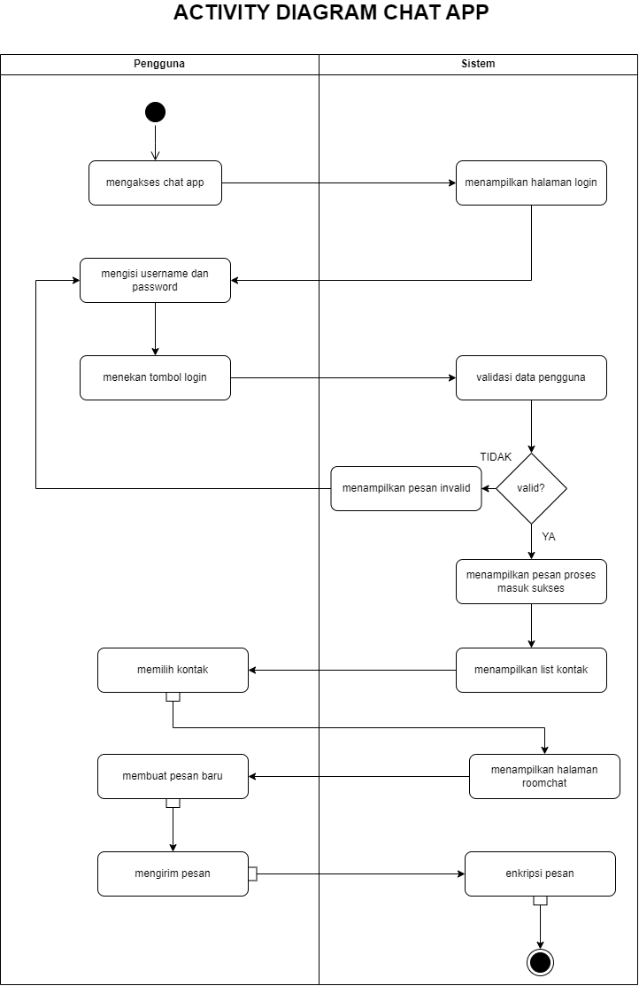
Activity
Diagram

Slide 7
03
Class
Diagram

Slide 8
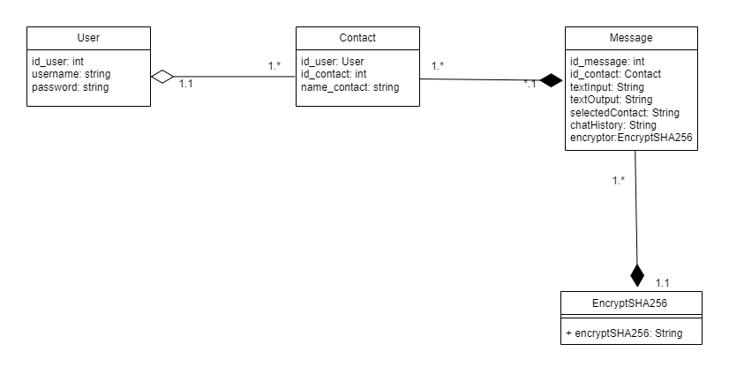
Class Diagram

Slide 9
Thanks!
Does anyone have any questions?

