Slide 1

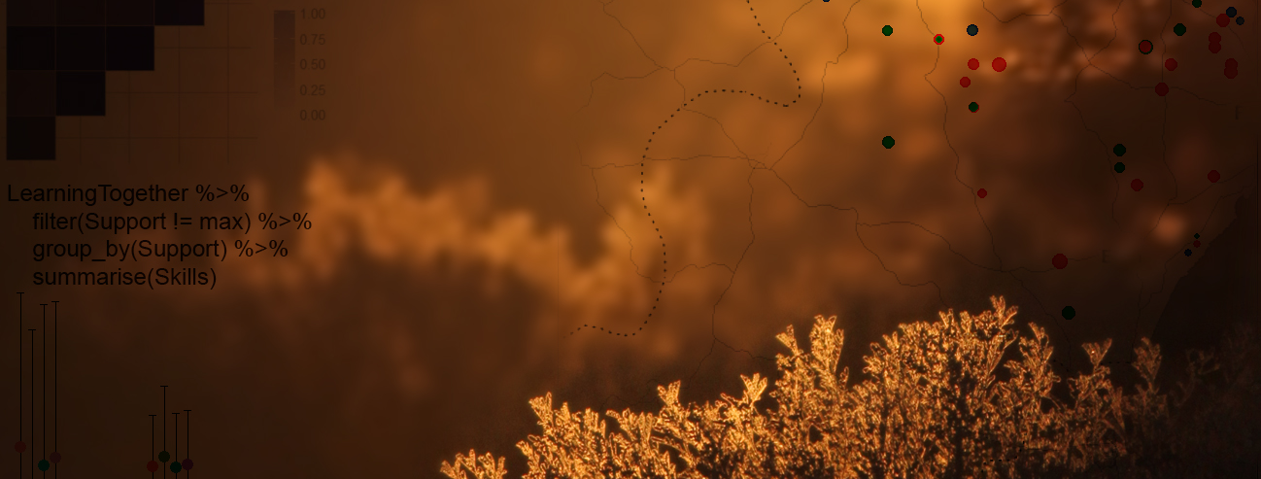
Quantifying population change and visualising species occurrence
Gergana Daskalova, Francesca Mancini
John Godlee, Sandra Angers-Blondin
Isla Myers-Smith

Slide 2
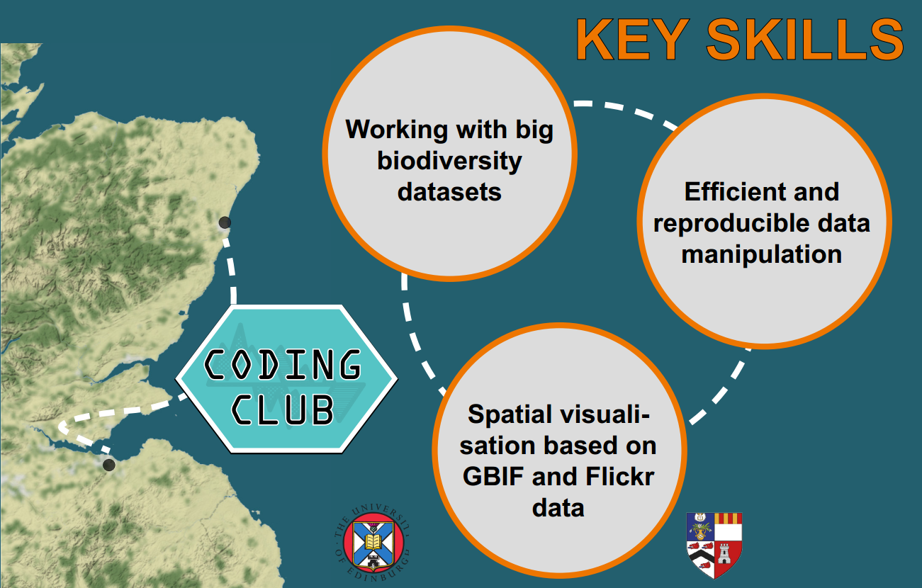
Workshop aims

Slide 3

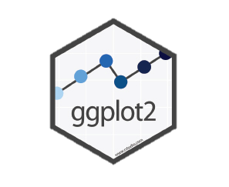

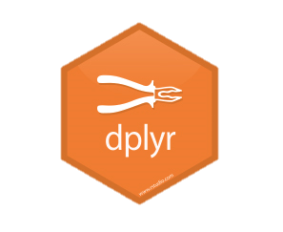


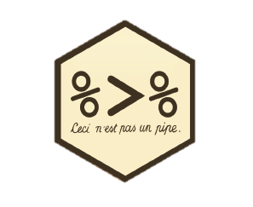

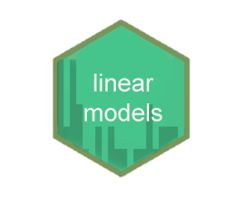
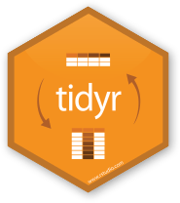
Import
Visualise
Communicate
Transform
tidyverse
Tidy
Model

Slide 4
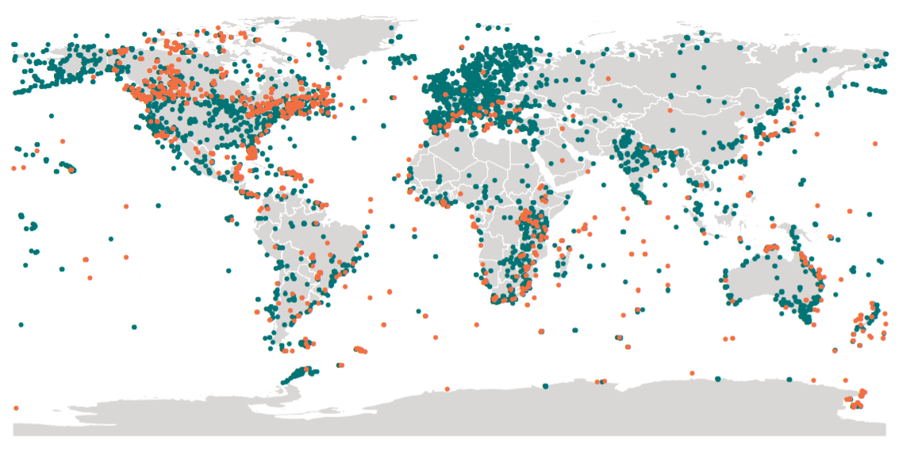
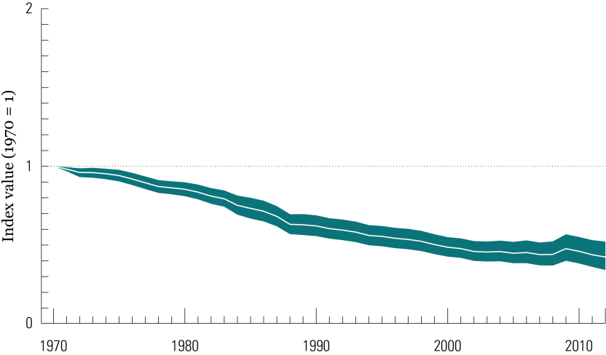
Living Planet Index
Quantifying global biodiversity change
http://www.livingplanetindex.org

Slide 5
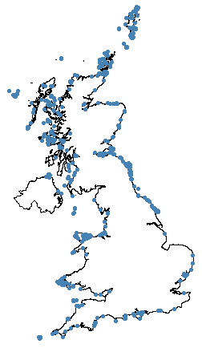
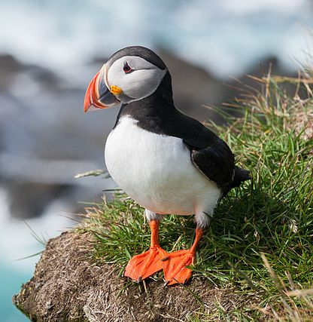


Visualising species occurrence // Density maps

Slide 6

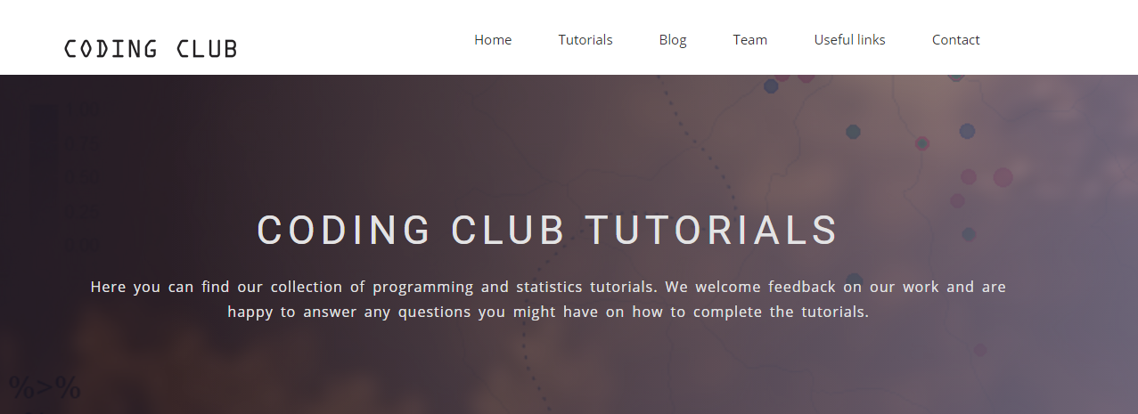
https://ourcodingclub.github.io/2017/03/20/seecc.html

Slide 7
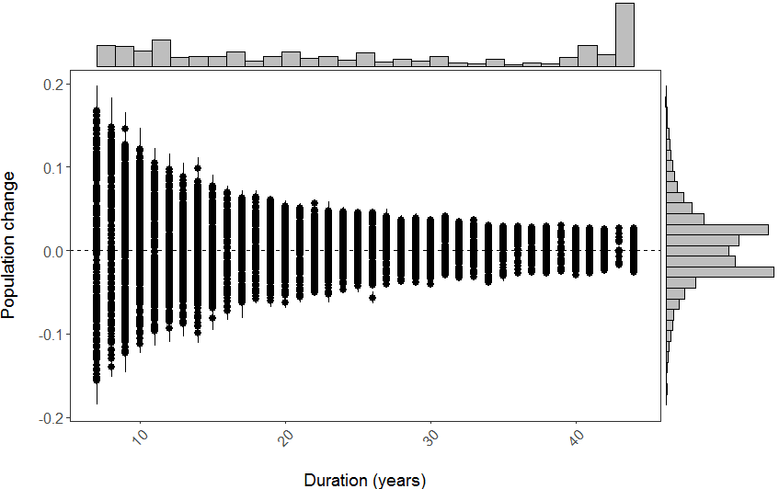
Results – what does it all mean?

Slide 8
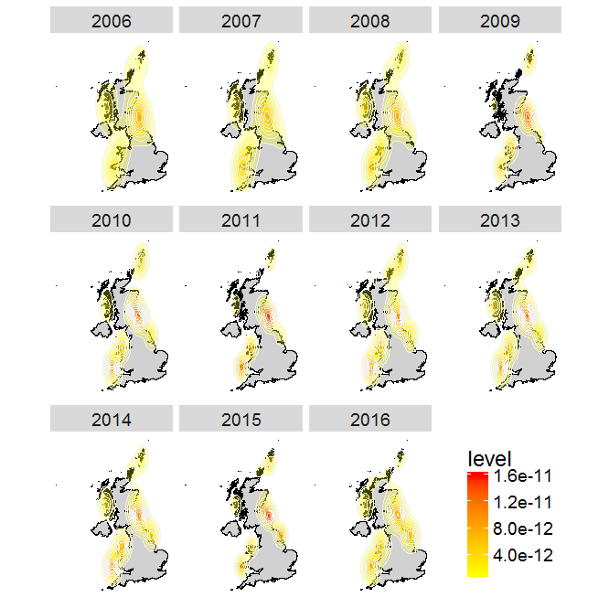
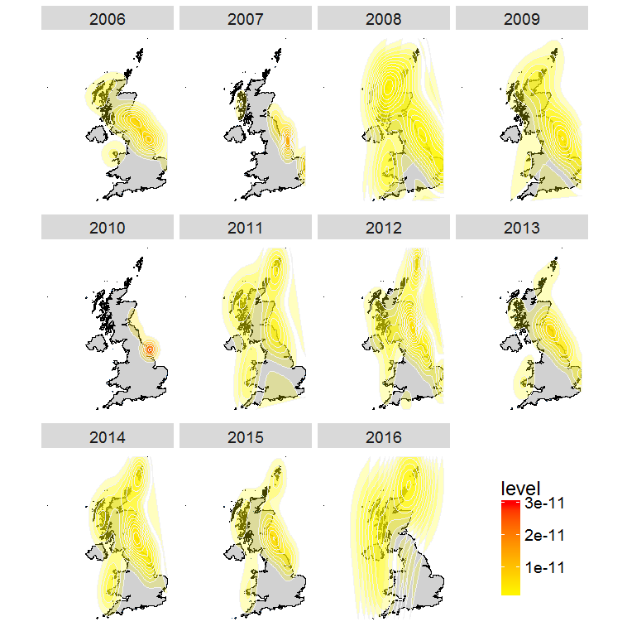
Results – what does it all mean?

Slide 9
Results – what does it all mean?
Temporal and spatial dynamics
Social media and GBIF can complement each other
Need for open data!
Barve V. (2014). Discovering and developing primary biodiversity data from social networking sites: A novel approach, Ecological Informatics, 24 194-199. DOI: http://dx.doi.org/10.1016/j.ecoinf.2014.08.008

