Slide 1

STT 461: Final Report
Minne“soda”-
An analysis of Convenience Store Data and Subgroup Trends on Health
Prepared by Megan Halpin & Sophie S

Slide 3
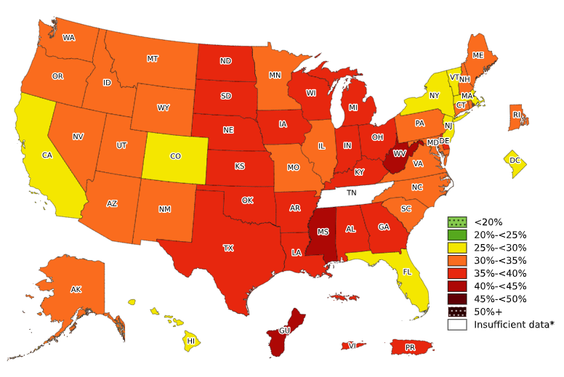


WHY Minnesota?
Staple Foods Ordinance
  2014
  2015-2017
United States Obesity Rate
Global Impact
Convenience Store Growth
  2035

Slide 4
HEI Background Information
HEI Index
  Food Score
  Recommended intake by Age
  per 1000 kcal
Add other Key information
Key Info

Slide 6
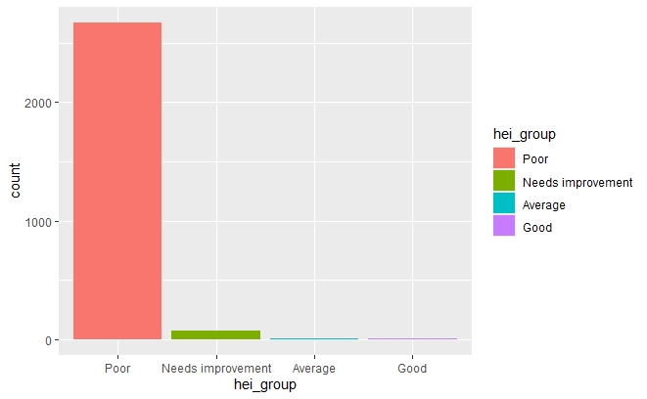
Diet Quality
Overall, All Surveyed
No scores received a High rating, or surpassed 90 points.

Slide 7
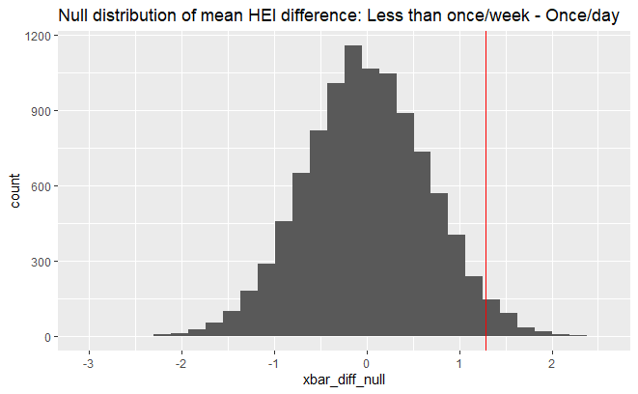
Findings & Conclusions
Average HEI: 30.65
Mean HEI
Female: 31.47
Male: 30.07
Bachelor’s + : 32.17
Associate’s: 30.44
Highschool: 29.95
1-6 Times/ Wk: 31.20
Less Than Once/Wk: 30.93
Minimum Once/Day: 29.64
Customers who shop at small and medium food stores less than once a week have better average diet quality overall.

Slide 8
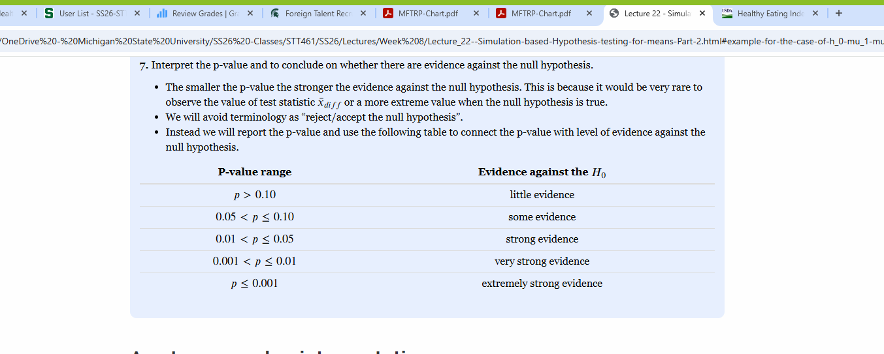

Slide 9
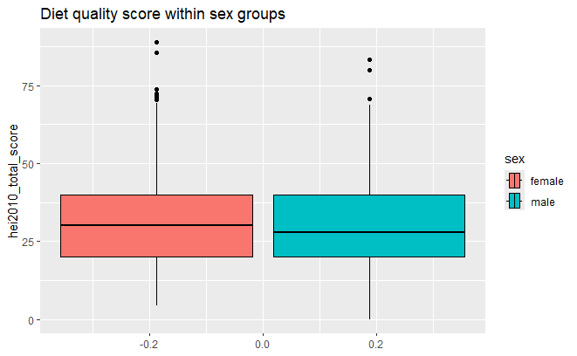
Gender & Education: Diet Quality Score
Gender HEI Comparison
Total HEI Scores

Slide 10
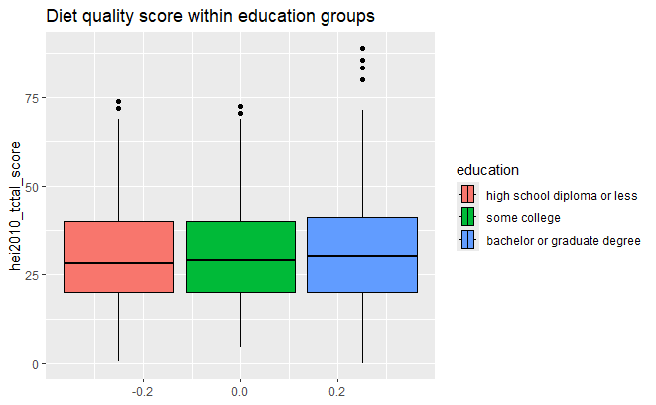
Gender & Education: Diet Quality Score
Gender HEI Comparison
Total HEI Scores

Slide 11
Boxplot of HEI in different shopping frequency groups

Slide 12
Does the Minnesota Staple Food Ordinance Improve Diet Quality Over Time?

Slide 13
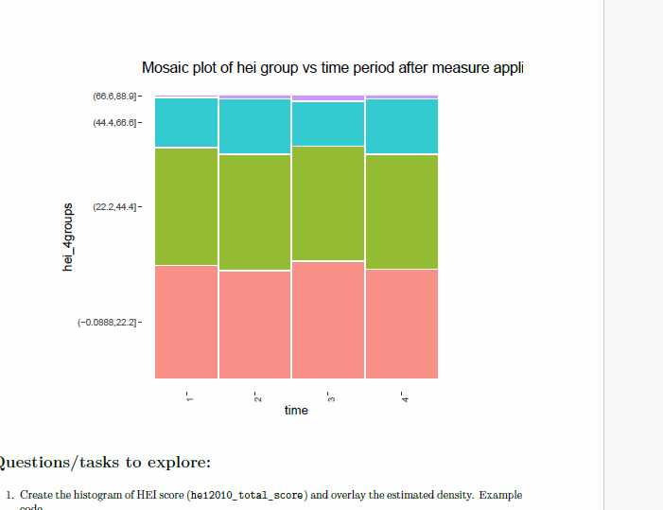

Slide 14
Input all sources here later.

Slide 15
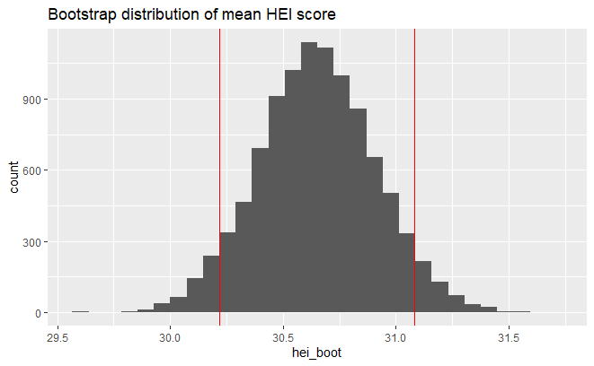
Study Repetition

Slide 16
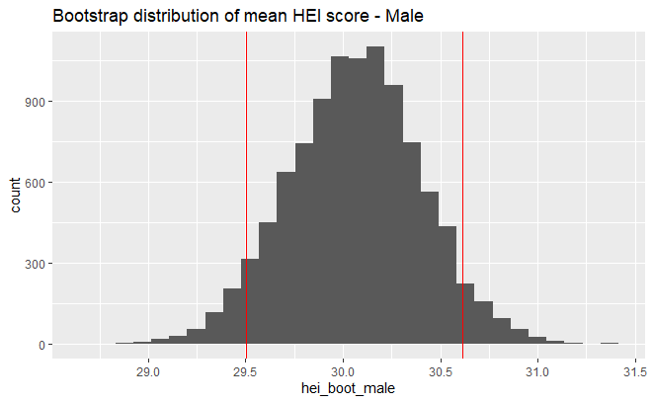
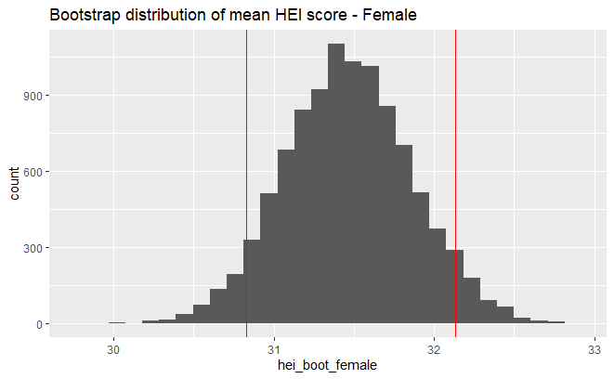
Repetition by Gender
Bootstrap: Male Mean HEI
Bootstrap: Female Mean HEI

Slide 17
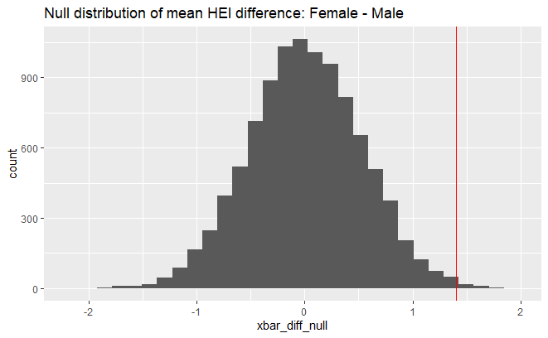
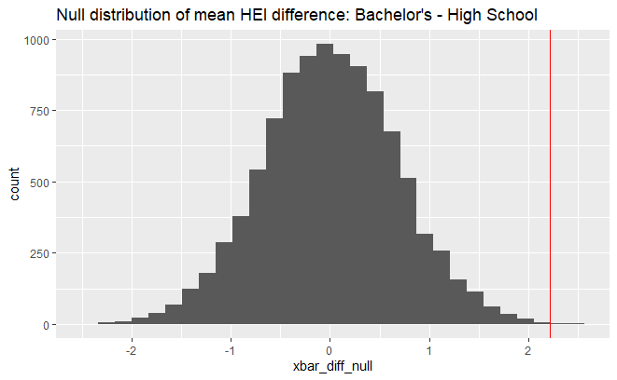
Null Distributions, Gender and Education Variation
Bootstrap: Male-Female
Bootstrap: Bachelors- Highschool

Slide 20
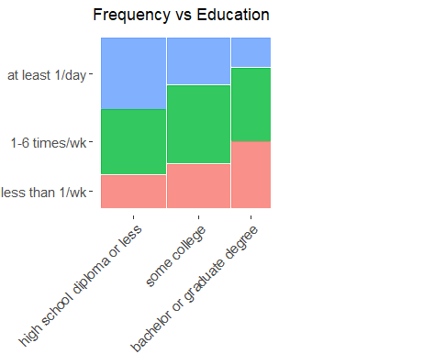
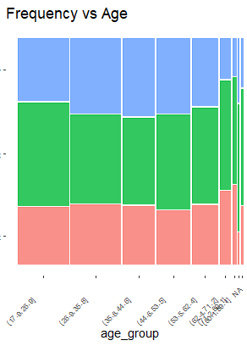
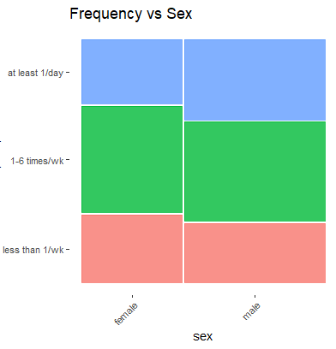
Purchase Frequency

