Slide 1


Chapter 1 Introduction
A note on the use of these ppt slides:
We’re making these slides freely available to all (faculty, students, readers). They’re in PowerPoint form so you see the animations; and can add, modify, and delete slides (including this one) and slide content to suit your needs. They obviously represent a lot of work on our part. In return for use, we only ask the following:
Computer Networking: A Top Down Approach
If you use these slides (e.g., in a class) that you mention their source (after all, we’d like people to use our book!)
If you post any slides on a www site, that you note that they are adapted from (or perhaps identical to) our slides, and note our copyright of this material.
Thanks and enjoy! JFK/KWR
All material copyright 1996-2012
J.F Kurose and K.W. Ross, All Rights Reserved

Slide 2
Reading assignment: Chapter 1

Slide 3
Chapter 1: roadmap
1.1 what is the Internet?
1.2 network edge
end systems, access networks, links
1.3 network core
packet switching, circuit switching, network structure
1.4 delay, loss, throughput in networks
1.5 protocol layers, service models
1.6 networks under attack: security
1.7 history
Notes:
3

Slide 4


Slide 6
















What’s the Internet?
mobile network
global ISP
Interconnected networks
home
network
regional ISP
institutional
network
Notes:
6

Slide 7



Hardware view
PC
millions of connected computing devices:
hosts = end systems
running network apps
mobile network
server
wireless
laptop
global ISP
smartphone
home
network
communication links
fiber, copper, radio, satellite
transmission rate: bandwidth
regional ISP
wireless
links
wired
links
Packet switches: forward packets (chunks of data)
routers and switches
router
institutional
network
Notes:
7

Slide 8





More hardware: networked appliances
Web-enabled toaster +
weather forecaster
IP picture frame
http://www.ceiva.com/
Tweet-a-watt:
monitor energy use
Slingbox: watch,
control cable TV remotely
Internet
refrigerator
Internet phones

Slide 9
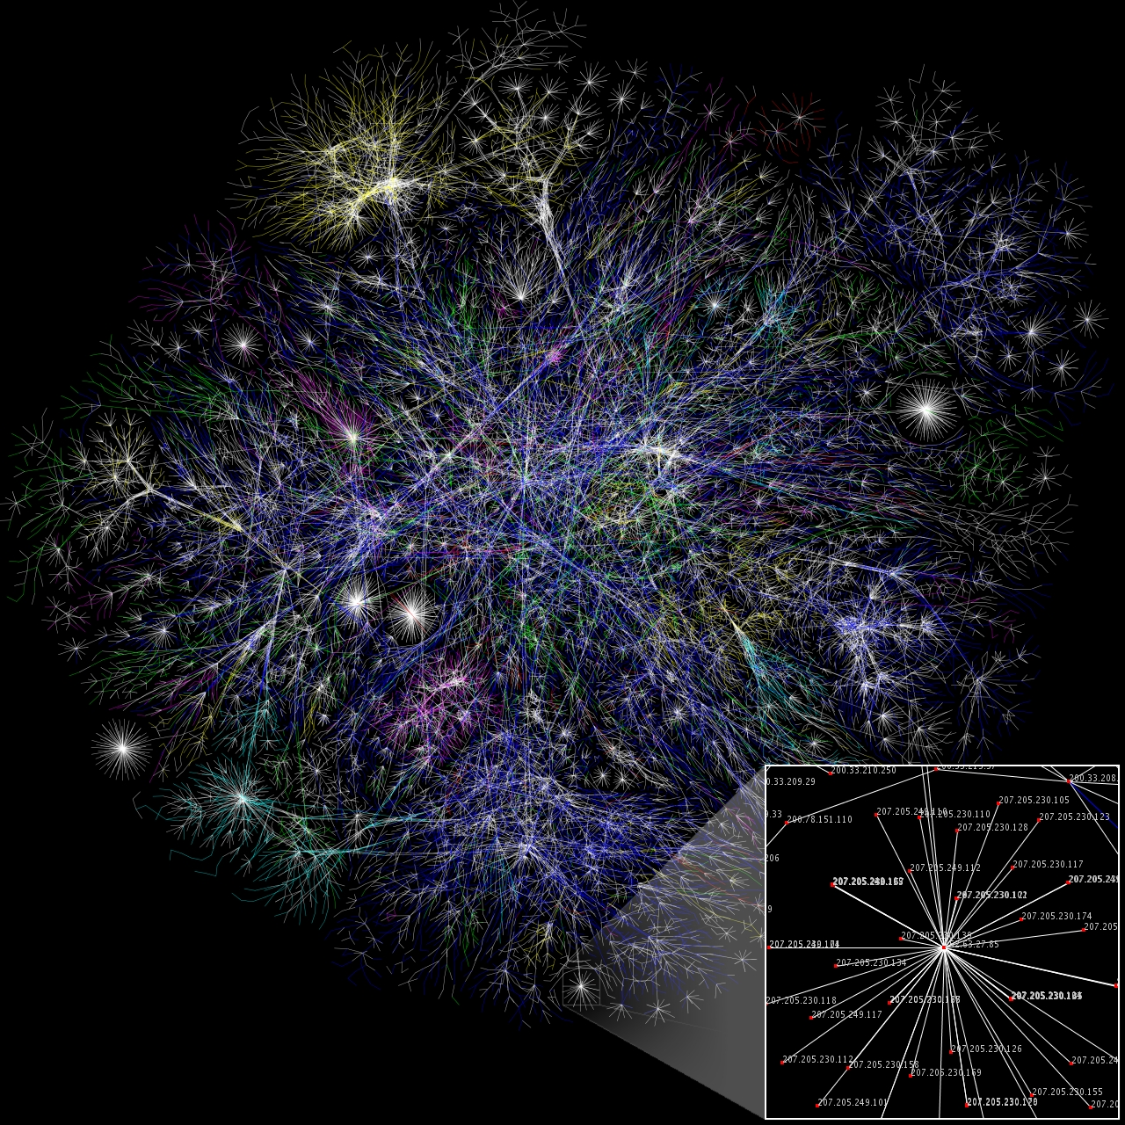
Data
view
7.7 exabytes
daily

Slide 10
Protocol view
protocols control sending, receiving of msgs
e.g., TCP, IP, HTTP, Skype, 802.11
mobile network
global ISP
home
network
regional ISP
institutional
network

Slide 11

What’s a protocol?
network protocols:
all communication activity in Internet governed by protocols
protocols define format, order of msgs sent and received among network entities, and actions taken on msg transmission, receipt

Slide 12
Internet standards
RFC: Request for comments
IETF: Internet Engineering Task Force

Slide 13
Service view
mobile network
Infrastructure that provides services to applications:
Web, VoIP, email, games, e-commerce, social nets, …
provides programming interface to apps
hooks that allow sending and receiving app programs to “connect” to Internet
provides service options, analogous to postal service
global ISP
home
network
regional ISP
institutional
network

Slide 14
Chapter 1: roadmap
1.1 what is the Internet?
1.2 network edge
end systems, access networks, links
1.3 network core
packet switching, circuit switching, network structure
1.4 delay, loss, throughput in networks
1.5 protocol layers, service models
1.6 networks under attack: security
1.7 history
Notes:
14

Slide 15


A closer look at network structure:
network edge:
hosts: clients and servers
servers often in data centers
mobile network
global ISP
access networks, physical media: wired, wireless communication links
home
network
regional ISP
network core:
interconnected routers
network of networks
institutional
network

Slide 16

Access networks and physical media
Q: How to connect end systems to edge router?
residential access nets
institutional access networks (school, company)
mobile access networks
keep in mind:
bandwidth (bits per second) of access network?
shared or dedicated?

Slide 17

Access net: digital subscriber line (DSL)
central office
telephone
network
DSL
modem
splitter
DSLAM
ISP
voice, data transmitted
at different frequencies over
dedicated line to central office
DSL access
multiplexer
use existing telephone line to central office DSLAM
data over DSL phone line goes to Internet
voice over DSL phone line goes to telephone net
< 2.5 Mbps upstream transmission rate (typically < 1 Mbps)
< 24 Mbps downstream transmission rate (typically < 10 Mbps)

Slide 19



Access net: cable network
cable headend
…
cable
modem
splitter
C
O
N
T
R
O
L
V
I
D
E
O
V
I
D
E
O
V
I
D
E
O
V
I
D
E
O
V
I
D
E
O
V
I
D
E
O
D
A
T
A
D
A
T
A
1
2
3
4
5
6
7
8
9
Channels
frequency division multiplexing: different channels transmitted
in different frequency bands

Slide 20
Access net: cable network
cable headend
…
cable
modem
splitter
CMTS
cable modem
termination system
data, TV transmitted at different
frequencies over shared cable
distribution network
ISP
HFC: hybrid fiber coax
asymmetric
network of cable, fiber attaches homes to ISP router
homes share access network to cable headend
unlike DSL, which has dedicated access to central office

Slide 21
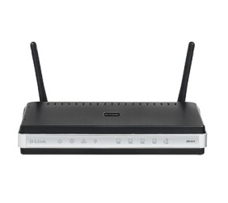
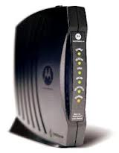





Access net: home network
wireless
devices
to/from headend or central office
often combined
in single box
cable or DSL modem
wireless access
point (300 Mbps)
router, firewall, NAT
wired Ethernet (1 Gbps)

Slide 22
Digital Network vs Analog Network

Slide 23



Wireless access networks
shared wireless access network connects end system to router
via base station aka “access point”
wireless LANs:
within building (100 ft – 200 ft)
802.11b/g/n (WiFi): 11, 54, 450 Mbps transmission rate
to Internet

Slide 24





Wireless access networks
wide-area wireless access
provided by telco (cellular) operator, from10 miles to 1500 feet
between 2Mbps and 1Gbps
3G, 4G: LTE, 5G
to Internet

Slide 25









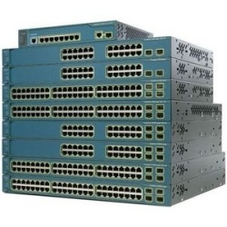
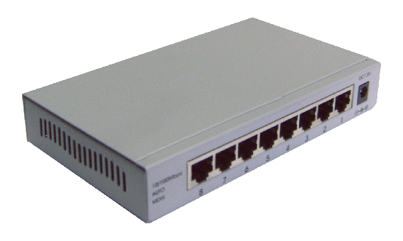
Enterprise access networks (Ethernet)
institutional link to
ISP (Internet)
institutional router
Ethernet
switch
institutional mail,
web servers
typically used in companies, universities, etc
10 Mbps, 100Mbps, 1Gbps, 10Gbps, 100Gbps transmission rates
today, end systems typically connect into Ethernet switch

Slide 26







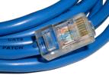
Physical media
bit: propagates between transmitter/receiver pairs
physical link: what lies between transmitter & receiver
guided media:
signals propagate in solid media: copper, fiber, coax
unguided media:
signals propagate freely, e.g., radio
twisted pair (TP)
two insulated copper wires
Category 5: 100 Mbps, 1 Gpbs Ethernet
Category 6: 10Gbps

Slide 27


Physical media: coax, fiber
coaxial cable:
two concentric copper conductors
bidirectional
broadband:
multiple channels on cable
fiber optic cable:
glass fiber carrying light pulses, each pulse a bit
high-speed operation:
high-speed point-to-point transmission (e.g., 10’s-100’s Gpbs transmission rate)
low error rate:
repeaters spaced far apart
immune to electromagnetic noise

Slide 28
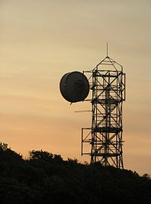
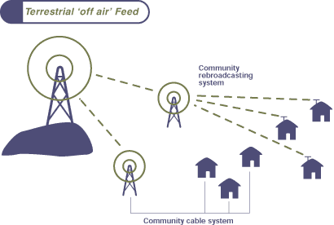
Physical media: radio
signal carried in electromagnetic spectrum
no physical “wire”
bidirectional
propagation environment effects:
reflection
obstruction by objects
interference
radio link types:
terrestrial microwave
e.g. up to 45 Mbps channels
LAN (e.g., WiFi)
450Mbps
wide-area (e.g., cellular)
4G cellular: ~ 30 Mbps
satellite
Kbps to Mbps channel (StarLink 100+Mbps download and 10+Mbps upload)
270 to 20 msec end-end delay
geosynchronous versus low altitude

Slide 29
Chapter 1: roadmap
1.1 what is the Internet?
1.2 network edge
end systems, access networks, links
1.3 network core
packet switching, circuit switching, network structure
1.4 delay, loss, throughput in networks
1.5 protocol layers, service models
1.6 networks under attack: security
1.7 history
Notes:
29

Slide 30









The network core
mesh of interconnected routers
packet-switching: hosts break application-layer messages into packets
forward packets from one router to the next, across links on path from source to destination
each packet transmitted at full link capacity

Slide 31
circuit switching for telephone

Slide 32
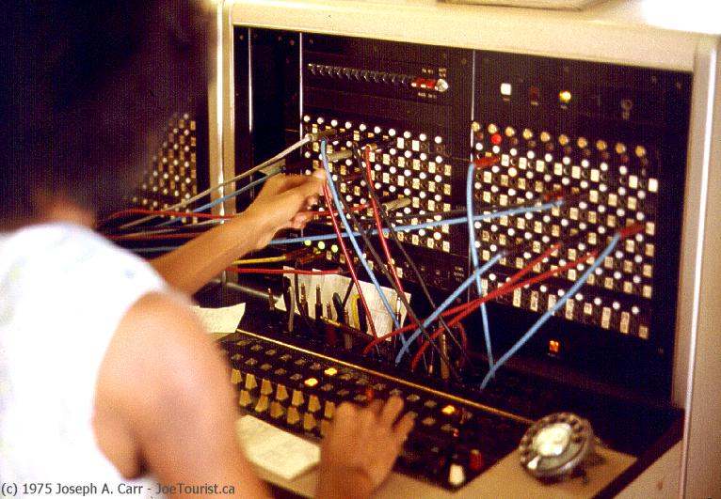
circuit switching
end-end resources allocated to, reserved for “call” between source & dest:
In diagram, each link has four circuits.
call gets 2nd circuit in top link and 1st circuit in right link.
dedicated resources: no sharing
circuit-like (guaranteed) performance
circuit segment idle if not used by call (no sharing)
Commonly used in traditional telephone networks

Slide 33
Circuit switching: FDM versus TDM
Example:
FDM
4 users
frequency
time
TDM
frequency
time
Notes:
Two simple multiple access control techniques.
Each mobile’s share of the bandwidth is divided into portions for the uplink and the downlink. Also, possibly, out of band signaling.
As we will see, used in AMPS, GSM, IS-54/136

Slide 35
A
.
.
.
B

Slide 36
Packet switching versus circuit switching
packet switching allows more users to use network!
example:
1 Mb/s link
each user:
100 kb/s when “active”
active 10% of time
circuit-switching:
10 users
packet switching:
?
N
users
…..
1 Mbps link
* Check out the online interactive exercises for more examples

Slide 38



Packet-switching: store-and-forward
L bits
per packet
source
3
2
1
R bps
R bps
destination
takes L/R seconds to transmit (push out) L-bit packet into link at R bps
store and forward: entire packet must arrive at router before it can be transmitted on next link
one-hop numerical example:
L = 7.5 Mbits
R = 1.5 Mbps
one-hop transmission delay = 5 sec
end-end delay = 2L/R (assuming zero propagation delay)
more on delay shortly …

Slide 39
Packet Switching: queueing delay, loss
R = 100 Mb/s
C
A
D
R = 1.5 Mb/s
B
E
queue of packets
waiting for output link
queuing and loss:
If arrival rate (in bits) to link exceeds transmission rate of link for a period of time:
packets will queue, wait to be transmitted on link
packets can be dropped (lost) if memory (buffer) fills up

Slide 40
Packet switching versus circuit switching
is packet switching a “slam dunk winner?”
great for bursty data
resource sharing
simpler, no call setup
excessive congestion possible: packet delay and loss
protocols needed for reliable data transfer, congestion control
Q: How to provide circuit-like behavior?
bandwidth guarantees needed for audio/video apps
still an unsolved problem (chapter 7)
Q: human analogies of reserved resources (circuit switching) versus on-demand allocation (packet-switching)?

Slide 41
Two key network-core functions
routing: determines source-destination route taken by packets
routing algorithms
forwarding: move packets from router’s input to appropriate router output
routing algorithm
0111
local forwarding table
destination
output link
0100
0101
0111
1001
3
2
2
1
1
3
2
0100
0111
dest address in arriving
packet’s header

Slide 42
Internet structure: network of networks
End systems connect to Internet via access networks
Residential, company and university networks
Access networks in turn must be interconnected.
So that any two hosts can send packets to each other
Resulting network of networks is very complex
Evolution was driven by economics and national policies
Let’s take a stepwise approach to describe current Internet structure

Slide 43
Internet structure: network of networks
Question: given a large numer of access networks, how to connect them together?
…
…
access
net
access
net
access
net
access
net
access
net
access
net
access
net
…
…
access
net
access
net
access
net
access
net
access
net
access
net
…
access
net
access
net
…
access
net

Slide 44
Internet structure: network of networks
Option: connect each access network to every other access network?
…
…
access
net
access
net
access
net
access
net
access
net
…
…
access
net
access
net
…
connecting each access network to each other directly doesn’t scale: O(N²) connections.
…
…
access
net
access
net
…
access
net
access
net
access
net
…
access
net
…
access
net
access
net
…
access
net

Slide 45
Internet structure: network of networks
Option: connect each access ISP to a global transit ISP? Customer and provider ISPs have economic agreement.
…
…
access
net
access
net
access
net
access
net
access
net
access
net
access
net
…
…
global ISP
access
net
access
net
access
net
access
net
access
net
access
net
…
access
net
access
net
…
access
net

Slide 46
Internet structure: network of networks
But if one global ISP is viable business, there will be competitors ….
…
…
access
net
access
net
access
net
access
net
access
net
access
net
access
net
ISP A
…
…
access
net
ISP B
access
net
ISP C
access
net
access
net
access
net
access
net
…
access
net
access
net
…
access
net

Slide 47
Internet structure: network of networks
But if one global ISP is viable business, there will be competitors …. which must be interconnected
Internet exchange point
…
…
access
net
access
net
access
net
access
net
access
net
IXP
access
net
access
net
ISP A
…
…
IXP
access
net
access
net
ISP B
ISP C
access
net
access
net
peering link
access
net
access
net
…
access
net
access
net
…
access
net

Slide 48
Internet structure: network of networks
… and regional networks may arise to connect access nets to ISPs
…
…
access
net
access
net
access
net
access
net
access
net
IXP
access
net
access
net
ISP A
…
…
IXP
access
net
access
net
ISP B
ISP C
access
net
access
net
access
net
regional net
access
net
…
access
net
access
net
…
access
net

Slide 49
Internet structure: network of networks
… and content provider networks (e.g., Google, Microsoft, Akamai ) may run their own network, to bring services, content close to end users
…
…
access
net
access
net
access
net
access
net
access
net
IXP
access
net
access
net
ISP A
…
…
Content provider network
IXP
access
net
access
net
ISP B
ISP B
access
net
access
net
access
net
regional net
access
net
…
access
net
access
net
…
access
net

Slide 50
Internet structure: network of networks
Tier 1 ISP
Tier 1 ISP
Google
IXP
IXP
IXP
Regional ISP
Regional ISP
access
net
access
net
access
net
access
net
access
net
access
net
access
net
access
net
at center: small # of well-connected large networks
“tier-1” commercial ISPs (e.g., Level 3, Sprint, AT&T, NTT), national & international coverage
content provider network (e.g, Google): private network that connects it data centers to Internet, often bypassing tier-1, regional ISPs

Slide 51
Tier-1 ISP: e.g., Sprint
POP: point-of-presence
to/from backbone
peering
…
…
…
…
…
to/from customers

Slide 52
Chapter 1: roadmap
1.1 what is the Internet?
1.2 network edge
end systems, access networks, links
1.3 network core
packet switching, circuit switching, network structure
1.4 delay, loss, throughput in networks
1.5 protocol layers, service models
1.6 networks under attack: security
1.7 history
Notes:
52

Slide 53
How do loss and delay occur?
packets queue in router buffers
packet arrival rate to link (temporarily) exceeds output link capacity
packets queue, wait for turn
packet being transmitted (delay)
A
B
packets queueing (delay)
free (available) buffers: arriving packets
dropped (loss) if no free buffers

Slide 54
Four sources of packet delay
transmission
A
propagation
B
nodal
processing
queueing
d_{nodal} = d_{proc} + d_{queue} + d_{trans} + d_{prop}
d_{proc}: nodal processing
check bit errors
determine output link
typically < msec
d_{queue}: queueing delay
time waiting at output link for transmission
depends on congestion level of router

Slide 55
Four sources of packet delay
transmission
A
propagation
B
nodal
processing
queueing
d_{nodal} = d_{proc} + d_{queue} + d_{trans} + d_{prop}
d_{trans}: transmission delay:
L: packet length (bits)
R: link bandwidth (bps)
d_{trans} = L/R
d_{prop}: propagation delay:
d: length of physical link
s: propagation speed in medium (~2x10⁸ m/sec)
d_{prop} = d/s
d_{trans} and d_{prop}
very different
* Check out the Java applet for an interactive animation on trans vs. prop delay
Notes:
55

Slide 56
“Real” Internet delays and routes
what do “real” Internet delay & loss look like?
traceroute program: provides delay measurement from source to router along end-end Internet path towards destination. For all i:
sends three packets that will reach router i on path towards destination
router i will return packets to sender
sender times interval between transmission and reply.
3 probes
3 probes
3 probes

Slide 57
Packet loss
queue (aka buffer) preceding link in buffer has finite capacity
packet arriving to full queue dropped (aka lost)
lost packet may be retransmitted by previous node, by source end system, or not at all
buffer
(waiting area)
A
packet being transmitted
B
packet arriving to
full buffer is lost
* Check out the Java applet for an interactive animation on queuing and loss

Slide 58
Throughput
throughput: rate (bits/time unit) at which bits transferred between sender/receiver
instantaneous: rate at given point in time
average: rate over longer period of time
server, with
file of F bits
to send to client
link capacity
R_{s} bits/sec
link capacity
R_{c} bits/sec
server sends bits
(fluid) into pipe
pipe that can carry
fluid at rate
R_{s} bits/sec)
pipe that can carry
fluid at rate
R_{c} bits/sec)

Slide 59
Throughput (more)
R_{s} < R_{c} What is average end-end throughput?
R_{s} bits/sec
R_{c} bits/sec
R_{s} > R_{c} What is average end-end throughput?
R_{s} bits/sec
R_{c} bits/sec
bottleneck link
link on end-end path that constrains end-end throughput

Slide 60
Throughput: Internet scenario
per-connection end-end throughput: min(R_{c},R_{s},R/10)
in practice: R_{c} or R_{s} is often bottleneck
. . .
R_{s}
R_{s}
R_{s}
R
R_{c}
R_{c}
R_{c}
. . .
10 connections (fairly) share backbone bottleneck link R bits/sec

Slide 61
Chapter 1: roadmap
1.1 what is the Internet?
1.2 network edge
end systems, access networks, links
1.3 network core
packet switching, circuit switching, network structure
1.4 delay, loss, throughput in networks
1.5 protocol layers, service models
1.6 networks under attack: security
1.7 history
Notes:
61

Slide 62
Protocol “layers”
Networks are complex,
with many “pieces”:
hosts
routers
links of various media
applications
hardware, software
protocols
Question:
is there any hope of organizing structure of network?

Slide 63
Internet protocol stack
application: supporting network applications
FTP, SMTP, HTTP
transport: process-process data transfer
TCP, UDP
network: routing of datagrams from source to destination
IP, routing protocols
link: data transfer between neighboring network elements
Ethernet, 802.111 (WiFi), PPP
physical: bits “on the wire”
application
transport
network
link
physical

Slide 64
Encapsulation
source
message
M
application
transport
network
link
physical
segment
H_{t}
M
H_{t}
datagram
H_{n}
H_{n}
H_{t}
M
frame
H_{l}
H_{n}
H_{t}
M
destination
H_{n}
H_{t}
M
network
link
physical
M
application
transport
network
link
physical
H_{l}
H_{n}
H_{t}
M
H_{n}
H_{t}
M
H_{t}
M
H_{n}
H_{t}
M
H_{l}
H_{n}
H_{t}
M
router

Slide 65
Chapter 1: roadmap
1.1 what is the Internet?
1.2 network edge
end systems, access networks, links
1.3 network core
packet switching, circuit switching, network structure
1.4 delay, loss, throughput in networks
1.5 protocol layers, service models
1.6 networks under attack: security
1.7 history
Notes:
65

Slide 66
Network Security Bad guys: put malware into hosts via Internet
malware can get in host from:
virus: self-replicating infection by receiving/executing object (e.g., e-mail attachment)
worm: self-replicating infection by passively receiving object that gets itself executed
spyware malware can record keystrokes, web sites visited, upload info to collection site
infected host can be enrolled in botnet, used for spam. DDoS attacks

Slide 67


Slide 68
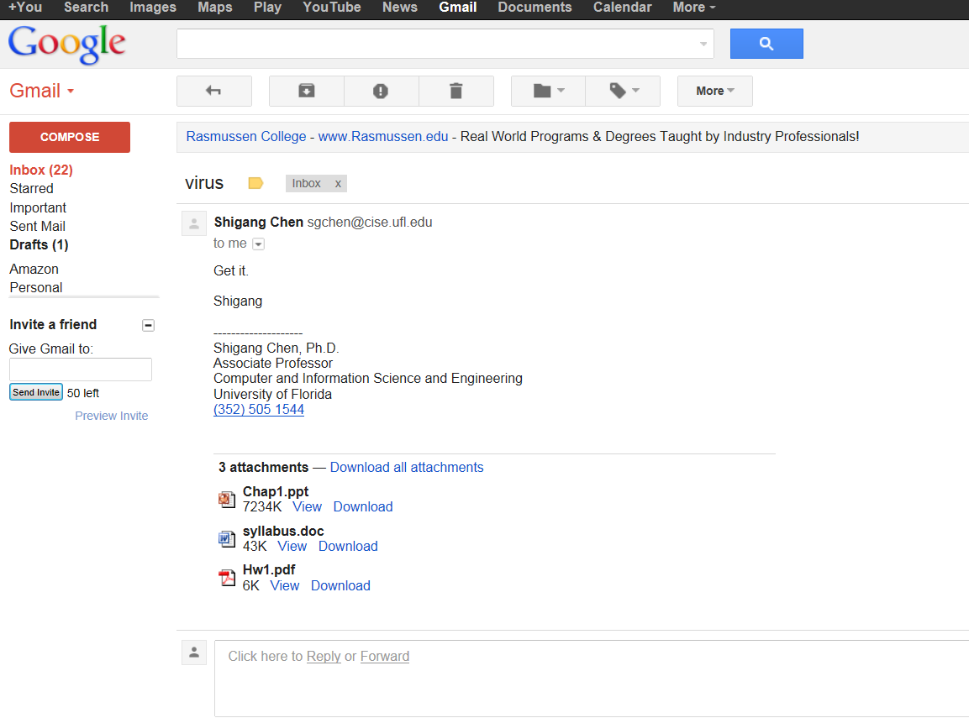

Slide 69
Bad guys: attack server, network infrastructure
Denial of Service (DoS): attackers make resources (server, bandwidth) unavailable to legitimate traffic by overwhelming resource with bogus traffic
1. select target
2. Compromise hosts (botnet)
3. send packets to target from compromised hosts
target

Slide 70
Bad guys can sniff packets
packet “sniffing”:
broadcast media (shared ethernet, wireless)
promiscuous network interface reads/records all packets (e.g., including passwords!) passing by
A
C
src:B dest:A payload
B
wireshark software used for end-of-chapter labs is a (free) packet-sniffer

Slide 71
Bad guys can use fake addresses
IP spoofing: send packet with false source address
A
C
src:B dest:A payload
B
… lots more on security (throughout, Chapter 8)

Slide 72
Chapter 1: roadmap
1.1 what is the Internet?
1.2 network edge
end systems, access networks, links
1.3 network core
packet switching, circuit switching, network structure
1.4 delay, loss, throughput in networks
1.5 protocol layers, service models
1.6 networks under attack: security
1.7 history
Notes:
72

Slide 73
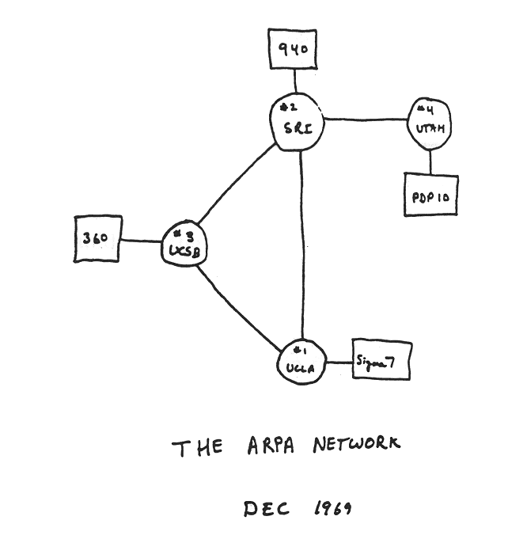
Internet history
1961-1972: Early packet-switching principles
1961: Kleinrock - queueing theory shows effectiveness of packet-switching
1964: Baran - packet-switching in military nets
1967: ARPAnet conceived by Advanced Research Projects Agency
1969: first ARPAnet node operational
1972:
ARPAnet public demo
NCP (Network Control Protocol) first host-host protocol
first e-mail program
ARPAnet has 15 nodes

Slide 74
Internet history
1972-1980: Internetworking, new and proprietary nets
1970: ALOHAnet satellite network in Hawaii
1974: Cerf and Kahn - architecture for interconnecting networks
1976: Ethernet at Xerox PARC
late70’s: proprietary architectures: DECnet, SNA, XNA
late 70’s: switching fixed length packets (ATM precursor)
1979: ARPAnet has 200 nodes
Cerf and Kahn’s internetworking principles:
minimalism, autonomy - no internal changes required to interconnect networks
best effort service model
stateless routers
decentralized control
define today’s Internet architecture

Slide 75
Internet history
1980-1990: new protocols, a proliferation of networks
1983: deployment of TCP/IP
1982: smtp e-mail protocol defined
1983: DNS defined for name-to-IP-address translation
1985: ftp protocol defined
1988: TCP congestion control
new national networks: Csnet, BITnet, NSFnet, Minitel
100,000 hosts connected to confederation of networks

Slide 76
Internet history
1990, 2000’s: commercialization, the Web, new apps
early 1990’s: ARPAnet decommissioned
1991: NSF lifts restrictions on commercial use of NSFnet (decommissioned, 1995)
early 1990s: Web
hypertext [Bush 1945, Nelson 1960’s]
HTML, HTTP: Berners-Lee
1994: Mosaic, later Netscape
late 1990’s: commercialization of the Web
late 1990’s – 2000’s:
more killer apps: instant messaging, P2P file sharing
network security to forefront
est. 50 million host, 100 million+ users
backbone links running at Gbps

Slide 77
Internet history
2005-present
~750 million hosts
Smartphones and tablets
Aggressive deployment of broadband access
Increasing ubiquity of high-speed wireless access
Emergence of online social networks:
Facebook: soon one billion users
Service providers (Google, Microsoft) create their own networks
Bypass Internet, providing “instantaneous” access to search, emai, etc.
E-commerce, universities, enterprises running their services in “cloud” (eg, Amazon EC2)

Slide 78
Introduction: summary
covered a “ton” of material!
Internet overview
what’s a protocol?
network edge, core, access network
packet-switching versus circuit-switching
Internet structure
performance: loss, delay, throughput
layering, service models
security
history
you now have:
context, overview, “feel” of networking
more depth, detail to follow!

