Slide 1
It’s a Juicin’ Life
Sophie Smith
“Ithaca is Advertising” Agency
sks277

Slide 2
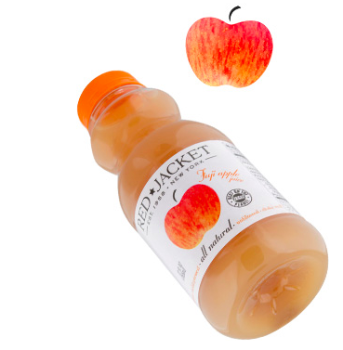
RED JACKET Juices
Notes:
The Product
Red Jacket Orchards produces a line of cold-pressed juices that include signature blends of various fruits and apple juice, ciders, Joe’s Lemonade, and stomps for sale by the bottle in a few sizes.

Slide 3
Why Red Jacket?
Healthy
Sustainable
Tasty
Notes:
Key Benefits
Red Jacket Juices differ from generic juice brands in many of their characteristics. Physically, the packaging is functional, unique, and colorful. The creativity in presentation also translates to the unique combinations of flavors available. From strawberry apple to iced tea lemonade, Red Jacket offers many options that do not appear in large, generic, chain stores like Walmart or Target. All Red Jacket products are made in New York and sold locally at farmers markets and alternative grocers like Whole Foods. The juices are set themselves apart due to the fact that they are all natural and unfiltered. They have no added sugar or water and include soluble fiber and 50% more antioxidants than clear juice. If these health benefits aren’t convincing enough, the growers employ sustainable practices in their orchards such as the use of solar energy to power the machines.

Slide 4
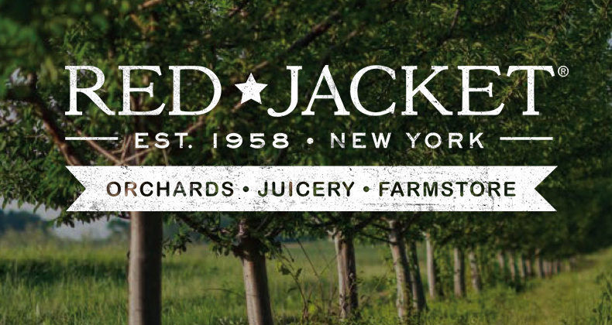
The Company
Notes:
Red Jacket Orchards is a family company, owned by three brothers: Mark, Joe, and Brian. It displays commitments to sustainability and quality at its orchards in Geneva, NY. The company has retailers throughout the United States that carry its products and a farm store in its hometown.

Slide 5
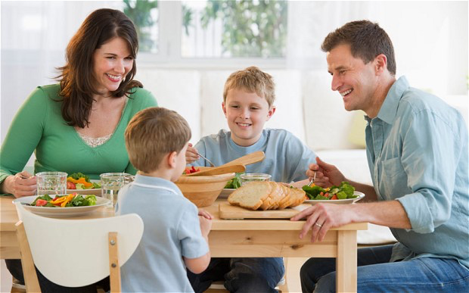
Customers
Notes:
The Target Audience
The target audience for these juices are New York resident families who enjoy buying locally grown products and leading active, healthy lifestyles. On a basic survival level, people need healthy drinking options that coincide with their attitudes about production and the environment. The buyers of these products will most likely include adults aged 18-50 who seek beverage choices that align with their busy, progressive lives.

Slide 6

Cognitive Dissonance Theory
Notes:
Theoretical Basis
Cognitive Dissonance Theory describes the “discrepancy between behavior and beliefs.”(Humphreys, 2015) It assumes that people require consistency in their lives and will avert situations that are inconsistent with their attitudes or beliefs. Inconsistency fuels dissonance and has to be diminished or eradicated. Specifically in regards to advertising, the theory details a process in which one first changes an attitude by means of presenting a message and then allows the behavior intended to follow with the attitude change.

Slide 7
Goals
Attitude Change → Behavior Change
Notes:
Intended Effect
The intended effect of this ad is to change the habit of buying generic brand juices in families to buying the locally-produced Red Jacket juices. The audience will have their attitude on beverage shopping altered so that they will begin the new behavior of purchasing Red Jacket juice. They will end the process believing their new choice will provide their family with a healthier, tastier, greener product that connects them more closely to their community and makes their lifestyle more simple and fulfilling.

Slide 8
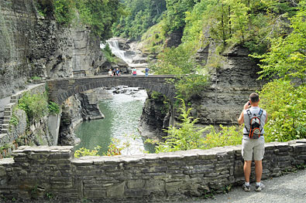
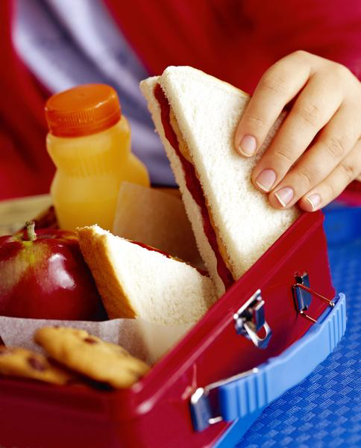

What?
Notes:
Message Characteristics
The ad’s message will be a rational appeal to “live the good life” by consuming and sharing with the kids Red Jacket Juices. It will urge a big change in how families go about grocery shopping and urge them to consider local options instead of generic brands. The audience will be comforted by the fact that the juices are made in New York state, a familiar place for them. It will have a family-oriented style that encourages making the best choices for your kids’ and your own health and the environment. It will present this choice as rewarding in creating a simple-minded lifestyle. The message will project different locations for consuming the juices, as pictured above. The options for consumption include from a lunchbox, on the way to work, on a nature hike, or at the breakfast table.

Slide 9
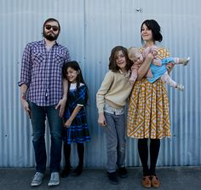
Who?
Notes:
Source Characteristics
The people acting in the ad will be a modern family that exhibit the carefree, arty, and earthy qualities of a progressive New York family. They will seem happy and attractive and can therefore, be trusted by the viewer to give good advice(on juice choices). This family will mimic the target audience to add similarity to the source. They will stay consistent with the beliefs of the audience by talking about their focus on their children and desires to help make the planet greener.

Slide 10
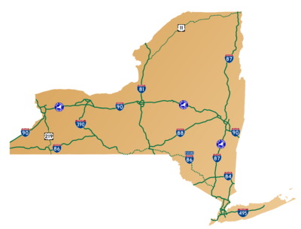




Where?
Notes:
Ad Placement
The ad will be placed in 2D form in the Ithaca Times(as well as other local newspapers) on Sunday mornings, when families will be thinking about their grocery shopping for the upcoming week.
It will also be placed on billboards on major New York highways leading to towns the have grocers, such as Whole Foods or Mrs. Greens, or convenience stores that carry Red Jacket juices so viewer will be inspired to buy them on their way across the state.
A short video ad will be shown on local New York State news channels because viewers of those channels are seeking information that validates their beliefs and this is the market for Red Jacket juices. If a person is watching a local news channel, it is likely that they care about supporting their local community and will be more likely to liken to the idea of a local product. It will air during morning news shows on the weekends so families will see it prior to running errands such as grocery shopping.

Slide 11
Environmental Issues
Notes:
Environmental Issues
The viewer might be influenced by other local products advertised in the media that won’t stand out as much as this one because it has so many more attributes related to taste and quality.

Slide 12
Boomerang?
Notes:
A possible boomerang of this ad would be that customers are so inspired by the local mission that they decide to grown their fruit and make their own juices.

Slide 13
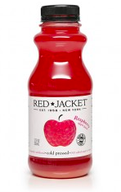
When your standard, old OJ isn’t GREEN enough anymore…..
Red Jacket Orchards
No Sugar Added
Unfiltered
Live the good life ☺
Choose RED JACKET JUICES!
Notes:
The Ad

Slide 14
REFERENCES
O’Keefe, D. (2009).Theories of persuasion. In R. Nabi & M. Oliver’s (Eds.), The Sage handbook of media processes and effects (pp. 271-272).Thousand Oaks, CA: Sage.
Humphreys, L. (2015, Sept 23). Theories of Persuasion Lecture. Communication 2200: Media Communication. Ithaca, NY: Cornell University.
Retrieved September 30, 2015 from http://redjacketorchards.com

