Slide 1
Sophie’s Summer Internship 2017
Sophie Smith
Major Advisor: Jodi Cohen
Internship Supervisor: Katharina Mennrich
June 22-August 10

Slide 2



overview
This summer, I interned with New York Disaster Interfaith Services (NYDIS), a nonprofit based in Manhattan. The organization is small, with about 30 employees, and covers the five boroughs of New York City. I worked with Katharina Mennrich, the Program Associate for Communications on the online presence of NYDIS and two other organizations our Executive Director, Peter Guiditis, manages: National Disaster Interfaiths Network(NDIN) and New York Voluntary Organizations Active in Disaster(NYVOAD). NYDIS works with various religious leaders and organizations to coordinate disaster recovery and prepare faith communities for future events. Much of their work currently revolves around SuperStorm Sandy but when the organization was founded in 2001, they provided aid to those affected by the events of 9/11. NYDIS manages the NYC Sandy Unmet Needs Roundtable which funds relief efforts for those still displaced by the SuperStorm in 2012. Some of the best work at NYDIS’ is through the Temporary Housing Services (THS) office which uses its Master Lease program to match clients with affordable temporary housing based on their personal needs.

Slide 3
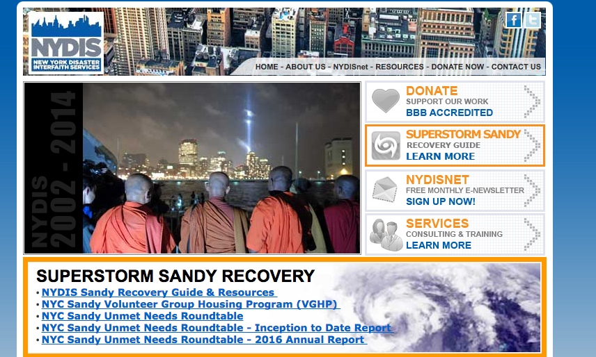
Responsibilities as an intern
Social media content production
and
newsletter editing
The NYDIS website:

Slide 4
Projects
Managed Facebook, Twitter, and LinkedIn accounts for NYDIS, NDIN, and NYVOAD using Hootsuite and Audiense
Drafted client success story narratives
Edited and compiled articles for NYDIS and iNET newsletters for July and August
Designed postcard to encourage partners to register for HOWAlert
Digitally archived NYDIS and NDIN tip sheets
Photographed staff for social media posts and organization events with Nikon D7000
Attended meetings with all staff, communications team, the NYC Sandy Unmet Needs Roundtable, and NYDIS’ Executive Director

Slide 5
outcomes
Increased following and likes on organization’s pages
Mastered new programs such as Hootsuite, Audiense, Microsoft Outlook, Microsoft Publisher
Practiced Adobe Photoshop and InDesign skills
Gained experience using a camera in professional settings

Slide 6
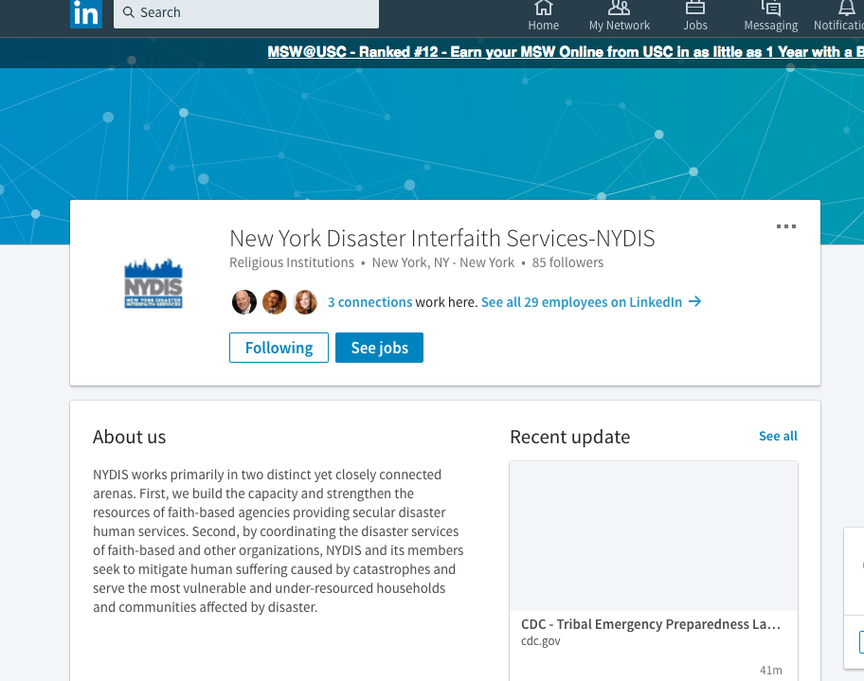
NYDIS Twitter page which I managed

Slide 7
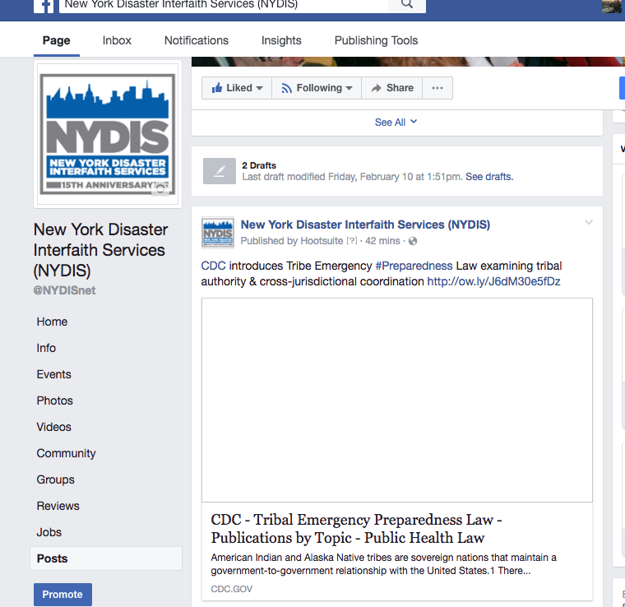
NYDIS Facebook page which I managed and grew to 607 likes

Slide 8
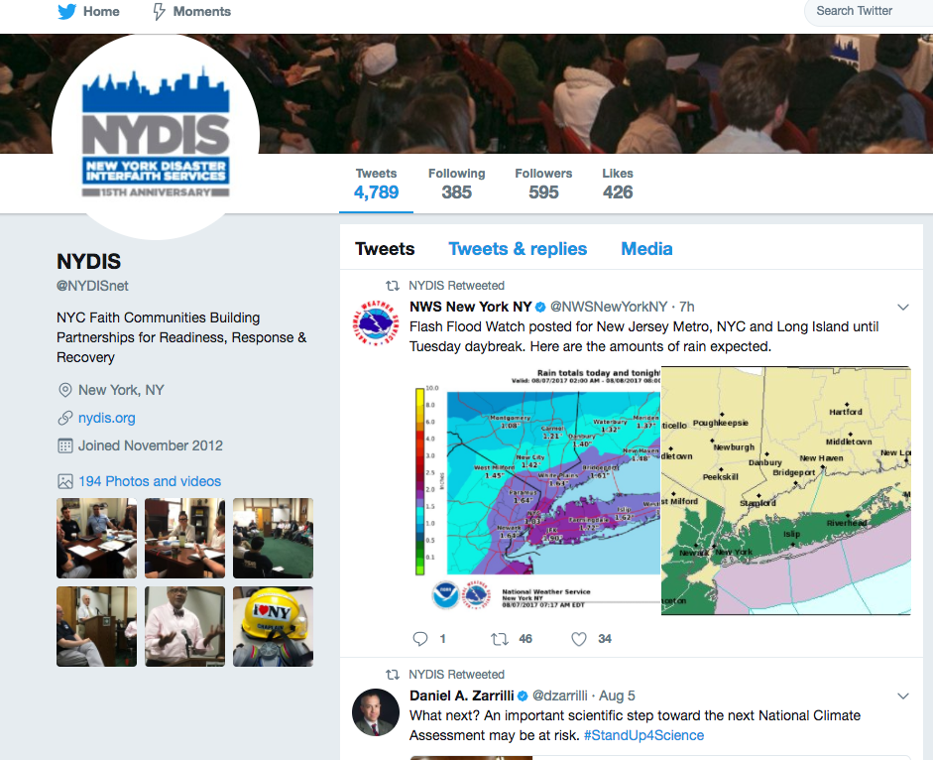
NYDIS LinkedIn page which I managed

Slide 9
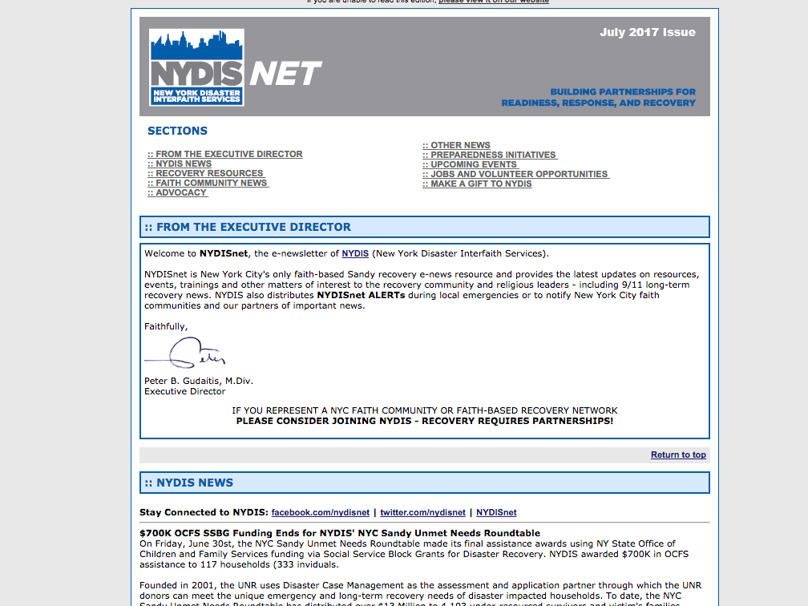
Front page of NYDIS monthly newsletter which I edited and drafted

Slide 10
Strengths and Weaknesses
I completed tasks quickly and thoroughly.
I had a pleasant demeanor around the office and was on time to work and meetings.
I worked well and maintained a professionalism with my supervisor and the caseworkers with which I interacted.
I was responsive to critiques of my work and returned drafts promptly.
I wasn’t very knowledgeable about non-profits, the emergency management sector, or faith organizations before I started work, so I had to learn a lot and ask many questions on those topics.
I was not very interested in many of the topics I was required to research and write about.

Slide 11
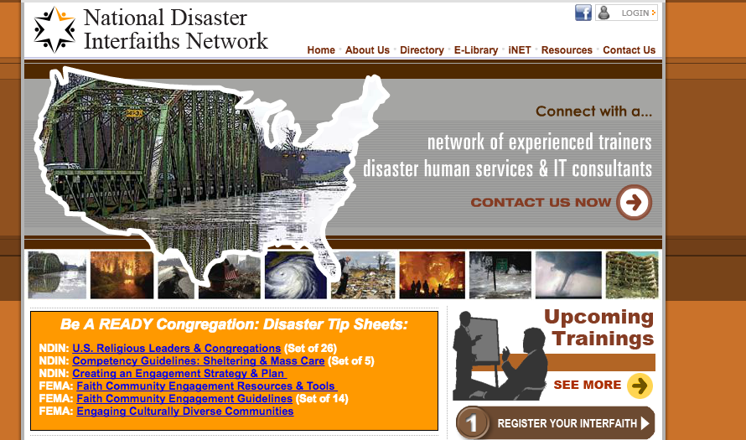
Lessons LEarned
Most of what I learned had to do with crafting posts for social media in a way so that they reach the most people or elicit a response. These strategies include tagging partner organizations and using hashtags. I also learned how to write more concisely and how to highlight the most important parts of an article or event.
Additionally, I became more familiar with working in an office environment. I attended meetings with other staff members that taught me about collaboration and compromise.

