Slide 1
How-to: Make teens put their phones down while driving
Alexa Eskenazi
Jamie Levine
Bradlee Lord
Sophie Smith

Slide 2
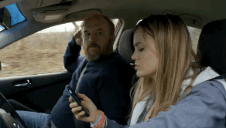
The Topic
The topic addressed is texting while driving

Slide 3
The Audience
Teenagers ages 14 – 19
Are about to be or are at the legal driving age
Therefore have the least amount of driving experience and most likely to get in an accident (O’Malley, 2013)
The age group that sends the most text messages (Farris, 2011)
Notes:
Transition Three Theories: Third Person, Cognitive Dissonance, Social Proof

Slide 4
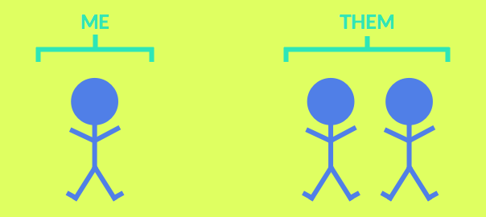
Theory 1: Third Person Effect
The third person effect can lead people to ignore information and messages that are actually personally important
Teens often convince themselves that they are invincible, and cannot be harmed by events that do harm others
Notes:
We directly target this with content that says, “You are not the exception to the statistics on the consequences of phone usage while driving.”

Slide 5
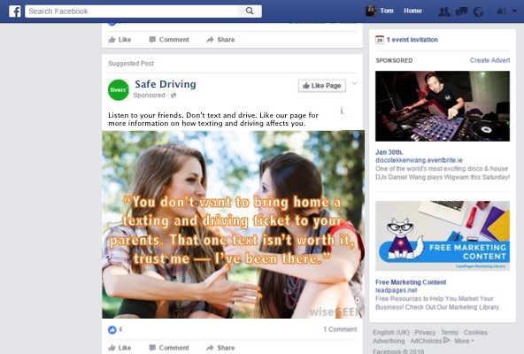
Message 1: Sponsored Content

Slide 6
Message 1: Sponsored Content
Why it Works
Facebook is the most popular and frequently used social media platform among teens (Lenhart, 2015)
Third person effect is strongest when people don’t agree with the message or they judge its source as negative, or when the message isn’t directly relative to them (Perloff, 1993)
The source is a friend people will listen to and the message is relatable
Goal of the Message
Change attitude by overcoming the third person effect

Slide 7
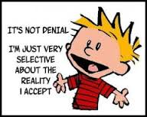
Theory 2: Cognitive Dissonance
The state of having inconsistent thoughts, beliefs, or attitudes, relating to behavior decision and attitude change
Teens must feel that texting and driving is a norm if they know that it is dangerous but continue to do it anyway

Slide 8

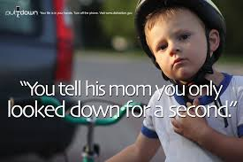
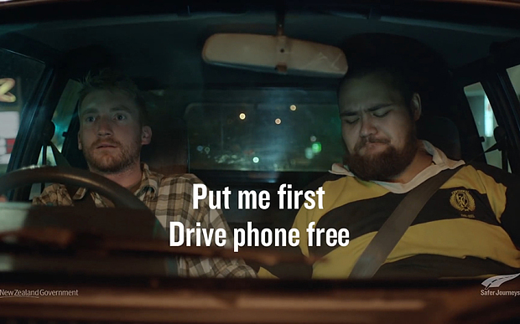
Message 2: TV Commercial

Slide 9
Message 2: TV Commercial
Why it Works
Creates a message that texting and driving is not and should not be considered the norm
Exposes teens to the benefits of not texting while driving
Lengthy commercial allows teens to consider behavior change
Clear message that texting and driving can kill, and provides an easily implementable way to avoid that fate
Goal of the Message
Change behavior through exposure to the proper behavior while driving

Slide 10
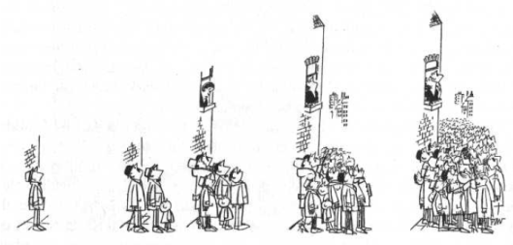
Theory 3: Social Proof
People view behaviors as correct to the extent in which they observe others engaging in them
Teens are very conscious of their social standing and feel the need to fit in with those around them
Notes:
Employing the idea of social proof will a very effective way to change behavior

Slide 11




Message 3: Viral Campaign
Pledge on Social Media
In the United States, 1 in 4 car accidents occurs due to texting while driving. It’s up to each and every one of us to change this. I pledge to not text and drive. #IDriveTextFreeBecause ____________. Why do you drive text free? Take the pledge.

Slide 12
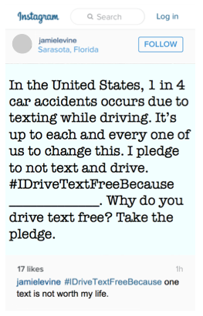
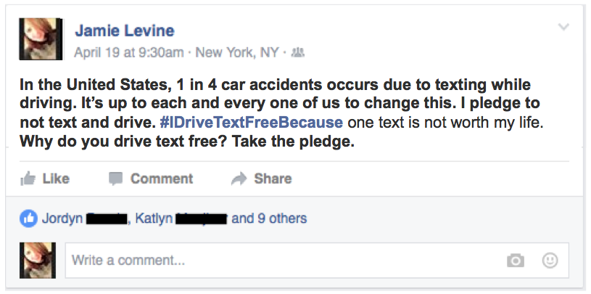
Message 3: Viral Campaign

Slide 13
Message 3: Viral Campaign
Why it Works
Teens are heavy users of social media
Exposure to opinions and experiences of peers
If your friends are taking the pledge to not text and drive, you are likely to do so as well
If you choose to not take the pledge, others may judge you as not caring about your safety or the safety of others you may drive with
Goal of the Message
Change behavior through exposure to opinions and experiences of peers
Notes:
If your friends are taking the pledge to not text and drive, you are likely to do so as well
If you choose not to take the pledge, others may judge you as not caring about your safety or the safety of others you may drive with
This campaign exposes teens to the opinions and experiences of their peers
Goal of changing behavior by exposing teens to their peers’ opinions and experiences

Slide 14
Proposed Evaluation Test
Record instances of texting while driving in two local towns using police records
Introduce sponsored content on to the Facebook newsfeeds of high school students that live in one of the local towns
The students from the other local town will not receive sponsored content on their Facebook newsfeeds
Record instances of texting while driving after the sponsored content has been introduced every quarter for a year (every three months)
Compare the police records (texting while driving accidents and arrests) of two towns before and three times after content was introduced

Slide 15
Proposed Evaluation Test
Dependent variable: Change in texting while driving after introduction of sponsored Facebook content
Control Condition: Town where sponsored content is not introduced
Experimental Condition: Town where sponsored content is introduced
Predicted Finding:
The town where the sponsored content is introduced will have decreased rates of texting while driving over time
Participant Sample: High school students at two local, public high schools

Slide 16
Questions?

Slide 17
References
Farris, A.M. (2011). LOL? Texting while driving in no laughing matter: Proposing a coordinated response to curb this dangerous activity. Washington University Journal of Law & Policy, 36, 233-260.
Lenhart, A. (2015, April 09). Teens, Social Media & Technology Overview 2015. Retrieved from http//www.pewinternet.org/ 2015/04/09/teens-social-media-technology-2015/
O'Malley Olsen, E., Shults, R. A., & Eaton, D. K. (2013). Texting while driving and other risky motor vehicle behaviors among US high school students. Pediatrics, 131(6). Retrieved from http:// pediatrics.aappublications.org/content/131/6/e1708
Perloff, R. M. (1993). Third-Person Effect Research 1983–1992: A Review And Synthesis. Int J Public Opin Res International Journal of Public Opinion Research, 5(2), 167-184. doi:10.1093/ ijpor/5.2.167

