Slide 1
Air pollution in seoul
Sophie Youk (sy5qm)
STAT 6130
4 May 2020

Slide 2
Background & Data
Background
Data obtained on the website Kaggle
Air Pollution in Seoul. https://www.kaggle.com/bappekim/air-pollution-in-seoul
Seoul Metropolitan Government (SMG) has collected and provided many public data including air pollution information. There are several stations measuring air pollution in South Korea including Seoul
Data
The 25 mearing stations in Seoul has measured air pollutants (SO₂, NO₂, O₃, CO, PM₁₀, PM_{2.5}) hourly
Used data by 8 hours since I can’t run the full dataset in my computer
Datasets from 12 AM on 1 January 2017 to 11 PM on 31 December 2019
Every station has its own code (101 to 125)
Address, latitude, and longitude indicate where the stations are located
Variables:
Measurement date: Measurement date and time
Station code: Measuring station code
Address: Address of measuring station
Latitude: Latitude of address
Longitude: Longitude of address
SO2: Sulfur dioxide
NO2: Nitrogen dioxide
O3: Ozone
CO: Carbon monoxide
PM10: Particulate matter
PM2.5: Particulate matter

Slide 3
Problem, model, method & Analysis
Problem
Relationship between 4 air pollutants and PMs
How the 4 air pollutants are related to the location (latitude, longitude, address, or stations code) and time (measurement date)
Model
Multivariate Regression Model 1
Responses: Measurement date, Station code, Latitude, Longitude
Predictors: SO₂, NO₂, O₃, CO, PM₁₀, PM_{2.5}
Multivariate Regression Model 2
Responses: PM₁₀, PM_{2.5}
Predictors: SO₂, NO₂, O₃, CO
Method
Exploratory Data Analysis
Plot each of 4 air pollutants vs. PM₁₀ and PM_{2.5}
Clustering
Used data by one week since I can’t run the full dataset in my computer
Focus on SO₂, NO₂, O₃, CO pollutants

Slide 4
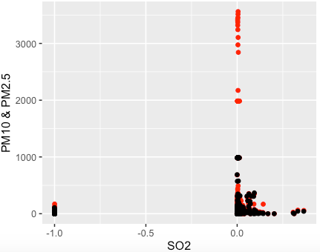
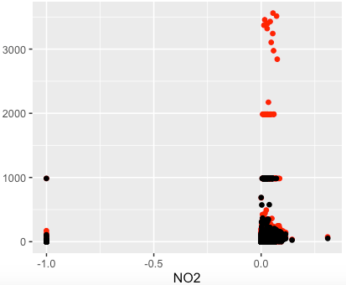
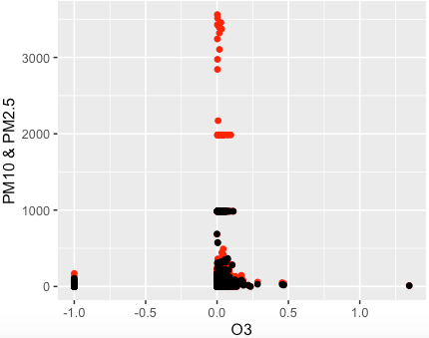
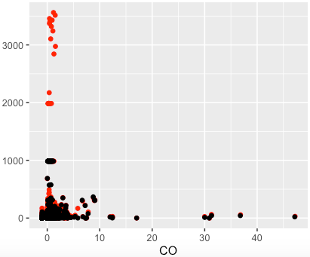
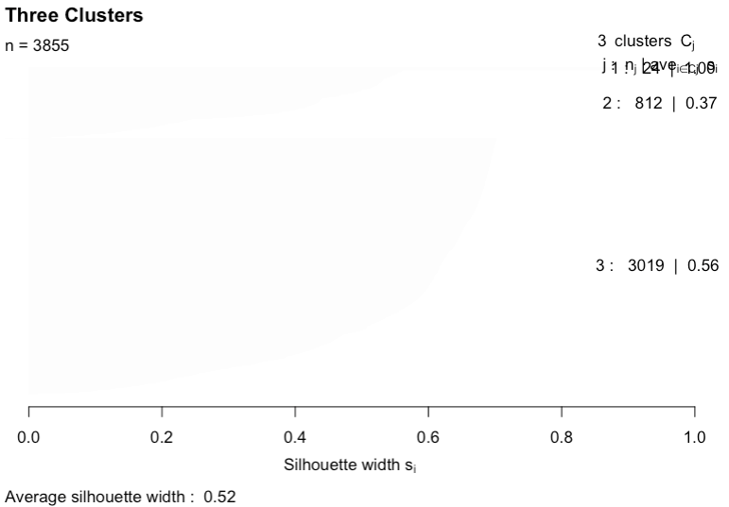
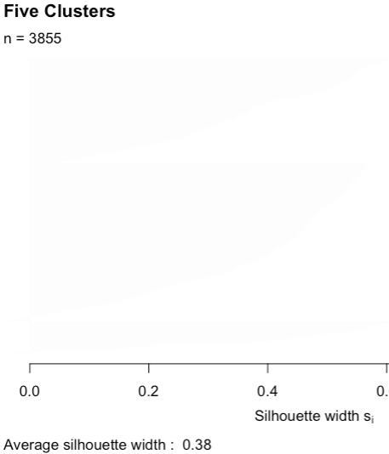
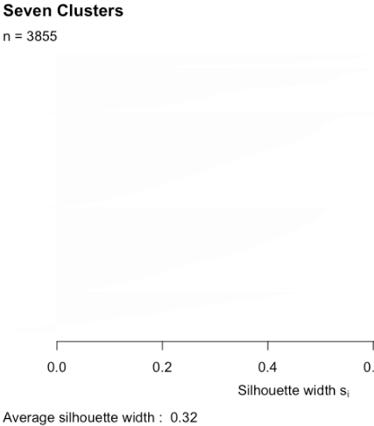
Remarkable plots
Figure 3: SO₂ vs. PM₁₀ & PM_{2.5}
Figure 4: NO₂ vs. PM₁₀ & PM_{2.5}
Figure 4: O₃ vs. PM₁₀ & PM_{2.5}
Figure 4: CO vs. PM₁₀ & PM_{2.5}
Figure 8: Average Silhouettes under 3, 5, and 7 Clusters

Slide 5
conclusion & discussion
Conclusion
Only NO₂ out of other pollutants and PMs was positively related to latitude
NO₂ values were recorded higher in northern counties.
SO₂ was negatively related to PM₁₀ and PM_{2.5} values
When SO₂ values were high, values of PM₁₀ and PM_{2.5} were recorded low
51 datasets have very high PM₁₀ values higher than approximately 2,000
According to the code information, four stations (116, 117, 121, and 122) are located southern or southwestern part of Seoul
Discussion
One county has only one measuring station
but the size, population, and number of factories are very various and random
Counties with high density of population and factories may have higher air pollutants values than other counties even though they have fewer population and factories in reality.
More information of predictors/factors can improve analyzing the air pollution data.
Rain sometimes decreases the air pollution measurements
Better to analyze data collected in the same condition of weather

