Slide 1
Bank Churner Prediction
Sophie Wang

Slide 2
Preview
EDA and Visualization
Feature engineering
Model selection
Model deployment (streamlit)
Key takeaways

Slide 3
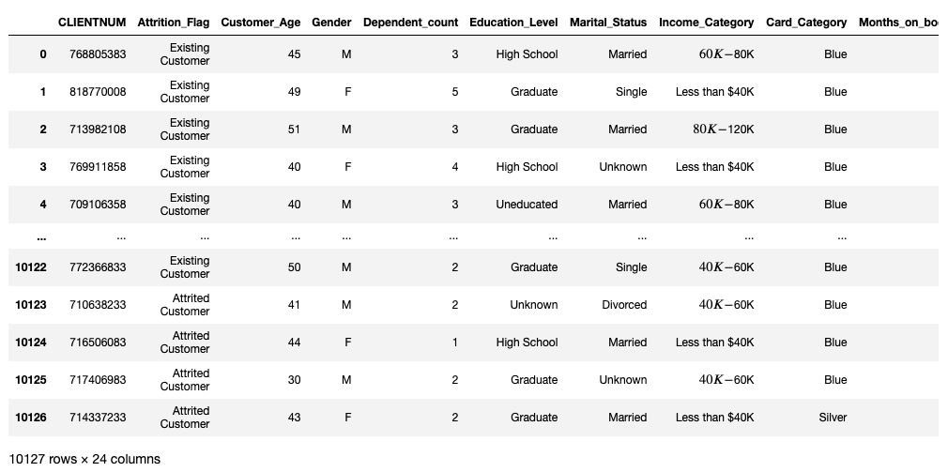
Dataset

Slide 4
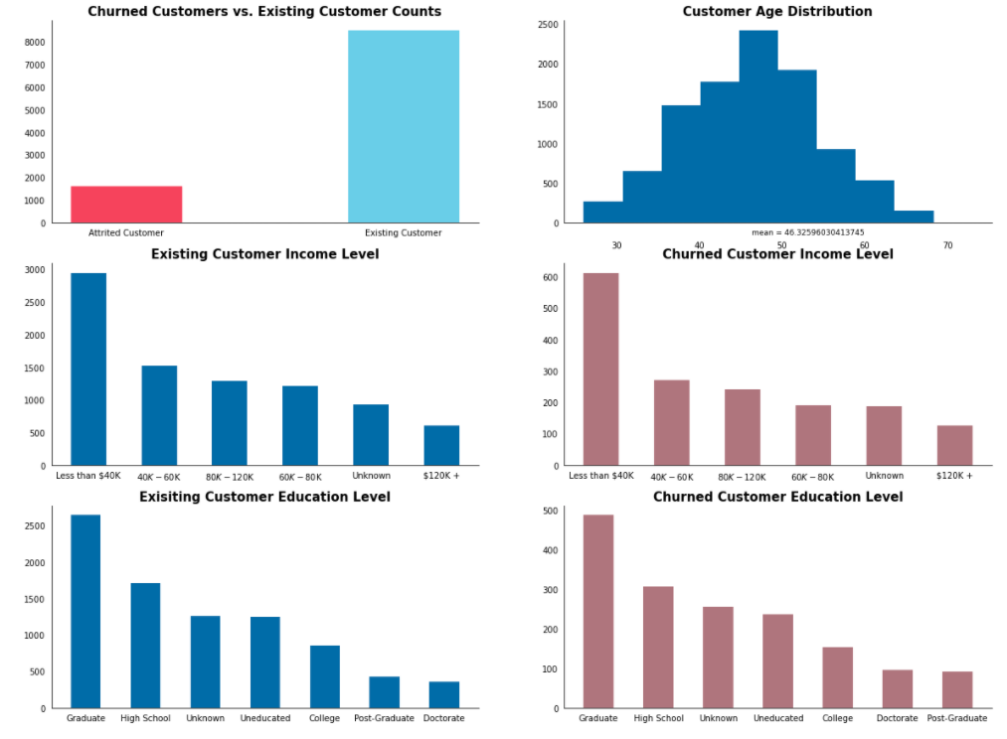
EDA and understand the data

Slide 5
Feature engineering
1: Dropped the customer ID number (not predictive and might hurt the model performance)
2: Impute numeric columns with median and impute categorical columns with most frequent value
3: OrdinalEncoder() to convert categorical features to numeric numbers
Everything is in sk-learn pipeline so I make sure to apply the same feature engineering process on both training and testing sets.

Slide 6
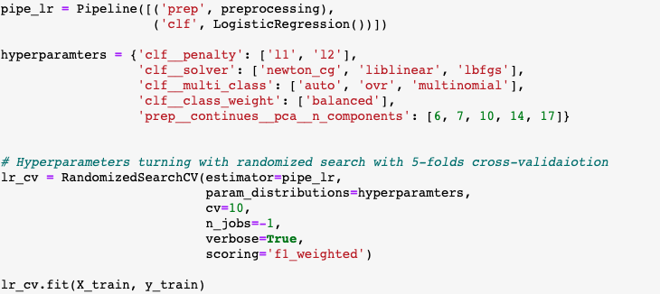
Logistic Regression
Weighted F1 score from CV: 0.8577

Slide 7
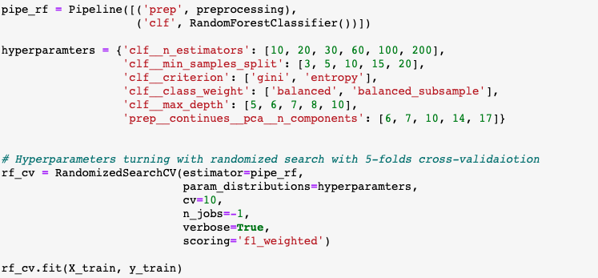
Random Forest
Weighted F1 score from CV: 0.9169

Slide 8
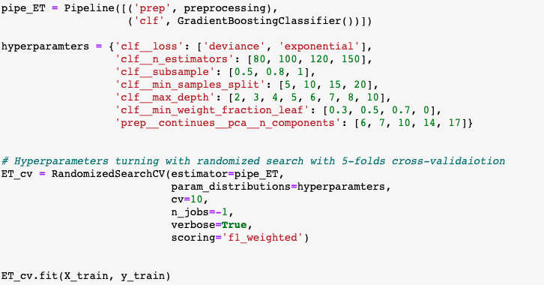
ExtraTreesClassifier
Weighted F1 score from CV: 0.9017

Slide 9
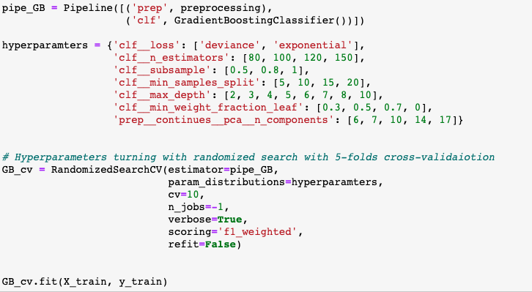
Gradient Boosting
Weighted F1 score from CV: 0.9136

Slide 10
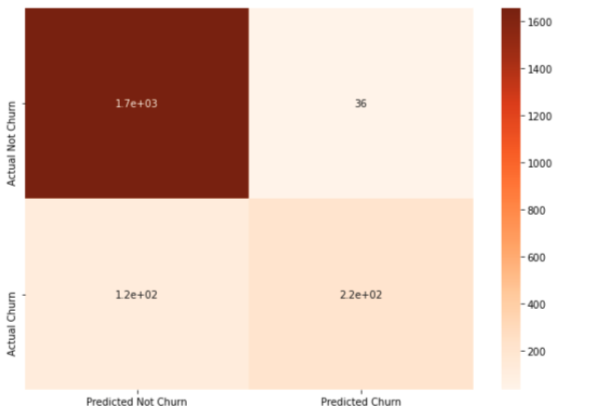
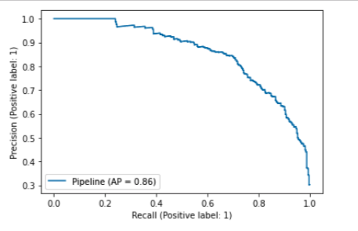
Gradient Boosting is the winner! ☺
Weighted F1 score: 0.919
Weighted ROC-AUC score = 0.813 (be careful)
Confusion matrix and PR curve:

Slide 11
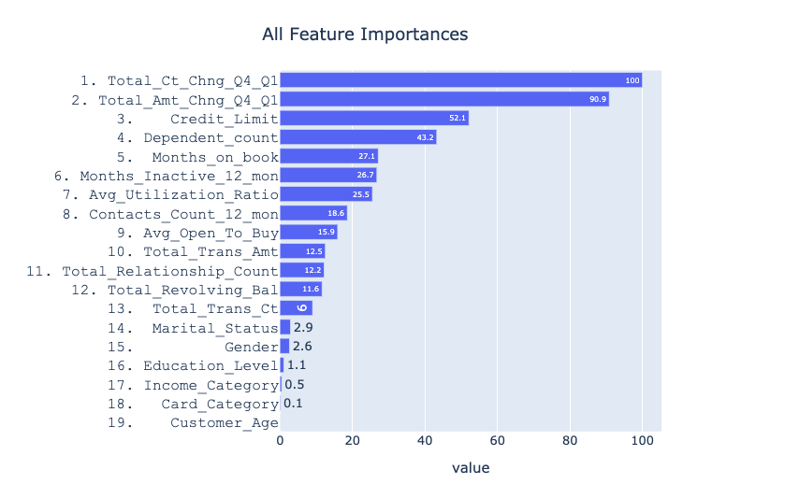
Feature importance on the winner model (match the initial EDA assumption)
Change in transaction Count (Q4 over Q1) is the most important feature for this model

Slide 12
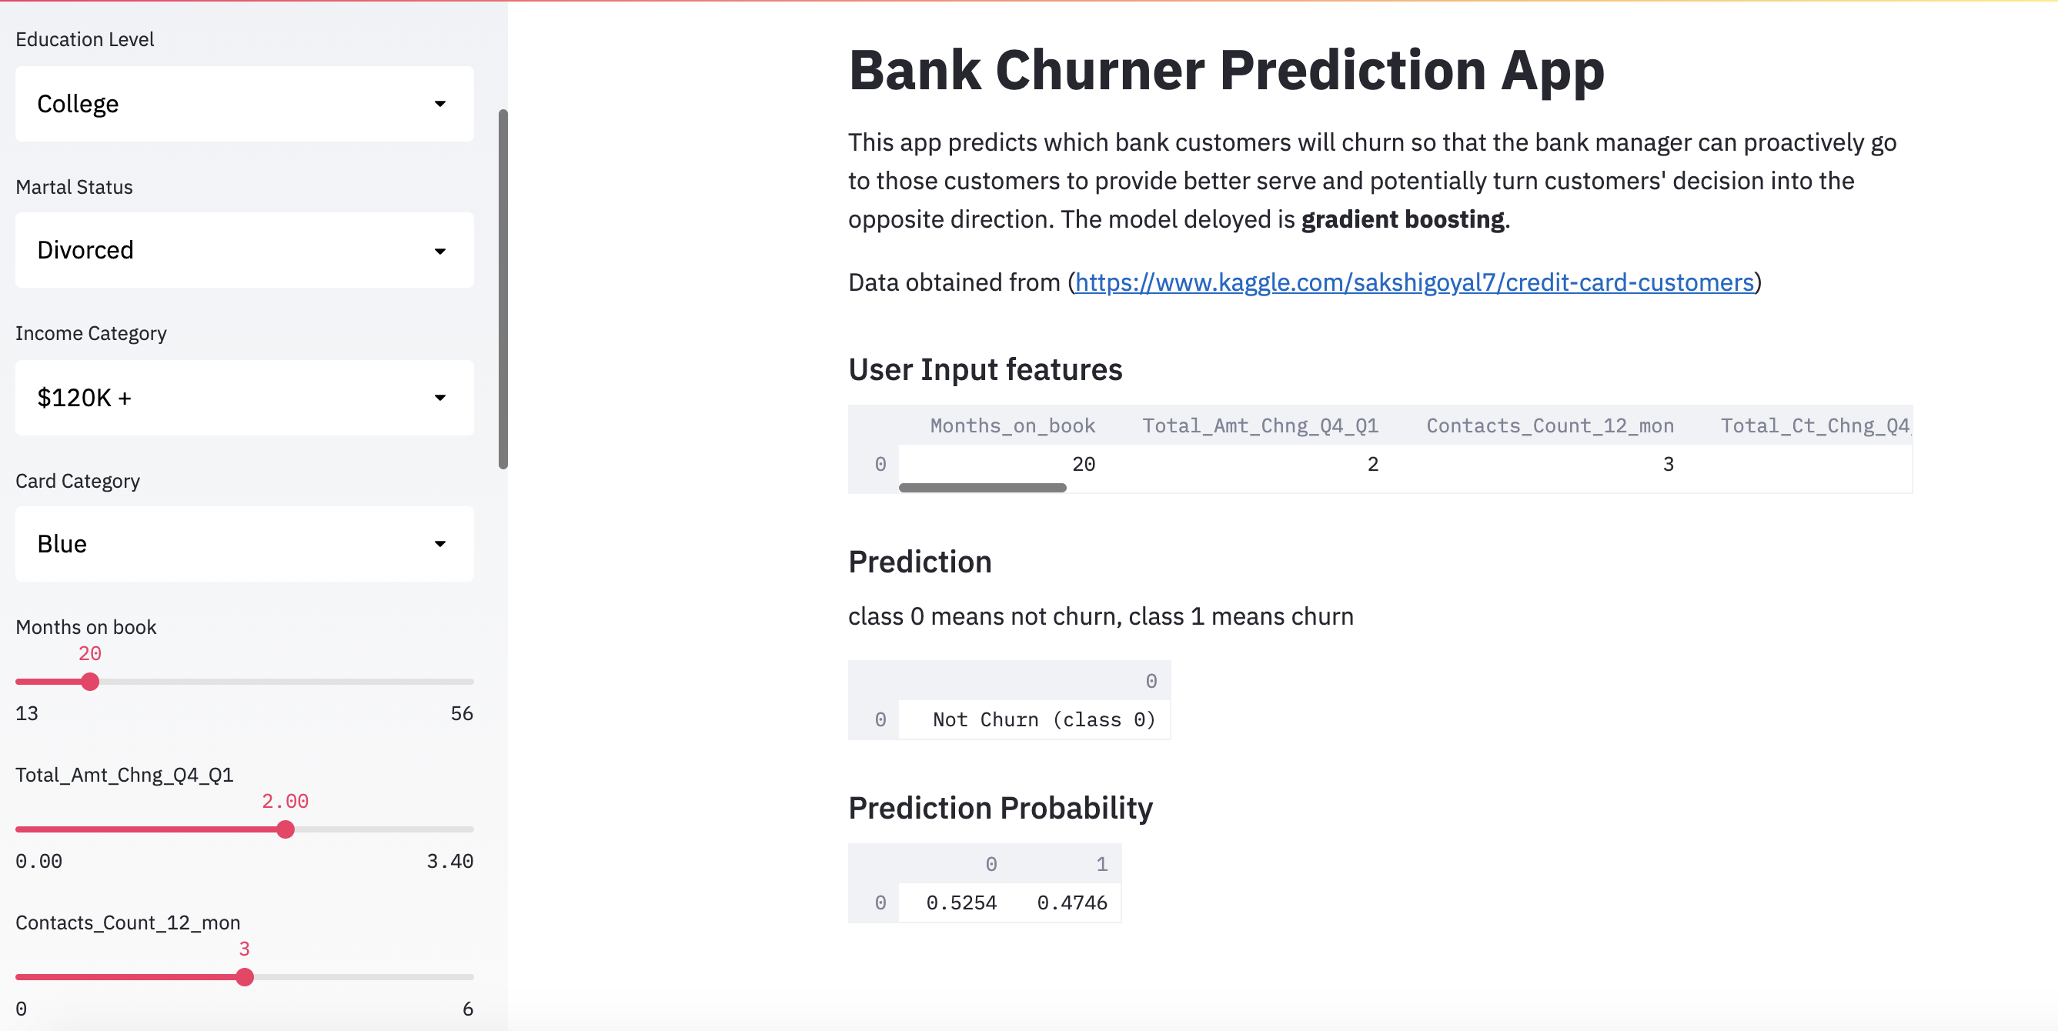
Deployment using Streamlit http://192.168.0.11:8502

Slide 13
Key Takeaways
Imbalanced dataset is very common in business world(carefully choose model and metrics)
Start from baseline model (linear model) and check if ensemble models can beat baseline model performance
Lock away test data at very beginning to prevent data leakage
Make sure the training and test set has the same distribution
Use RandomSearch instead of GridSearch to improve training speed
Check feature importance of the final model can help with business decisions (although feature importance is only a hint, not gospel since feature importance is model-specific)

