Slide 1
EDES 301 Smart Light Therapy Device Proposal
2/23/2025
Sophianne Loh

Slide 2
Background Information
Light therapy device that dynamically adjusts brightness of LED light strip based on time of day and ambient light levels
Increase brightness during the day when ambient light is dim
Decrease brightness during the night when ambient light is bright
Displays time of day on hex display
Two buttons allow for user to increase or decrease brightness, turn off lights manually
Interest in medical devices -> light therapy is known to help regulate circadian rhythms
Help individuals with sleep disorders, shift workers, or those with SAD
Partly inspired by Sunrise Alarm Clock project
Lights up LED strip light and plays music at a certain time of day
Additions in my project:
Inclusion of light sensor to detect room brightness, adjust LED intensity accordingly
Can operate without internet/need to plug into USB on PC

Slide 3
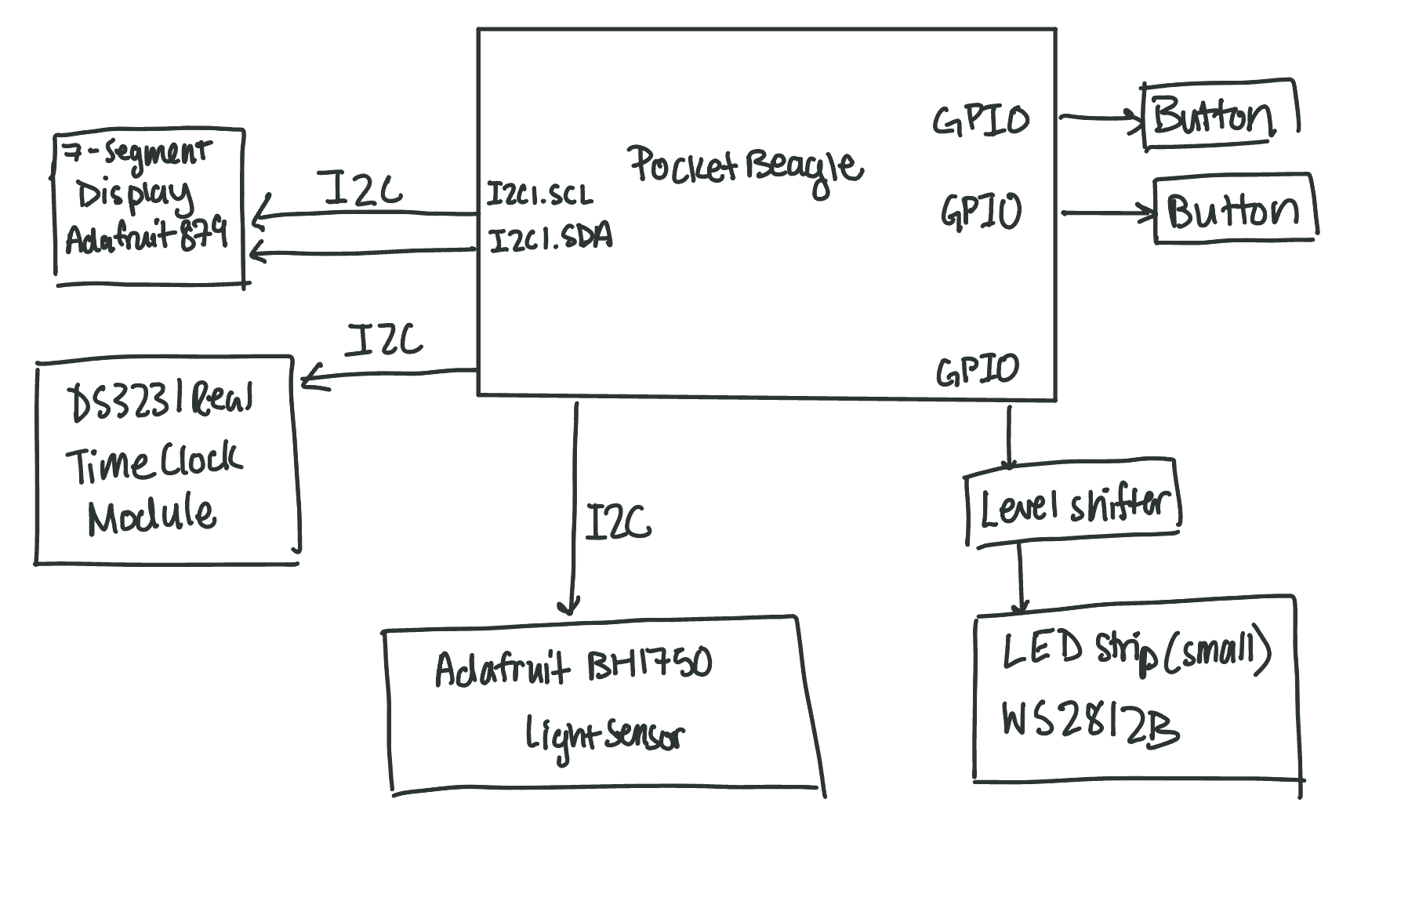
System Block Diagram

Slide 4
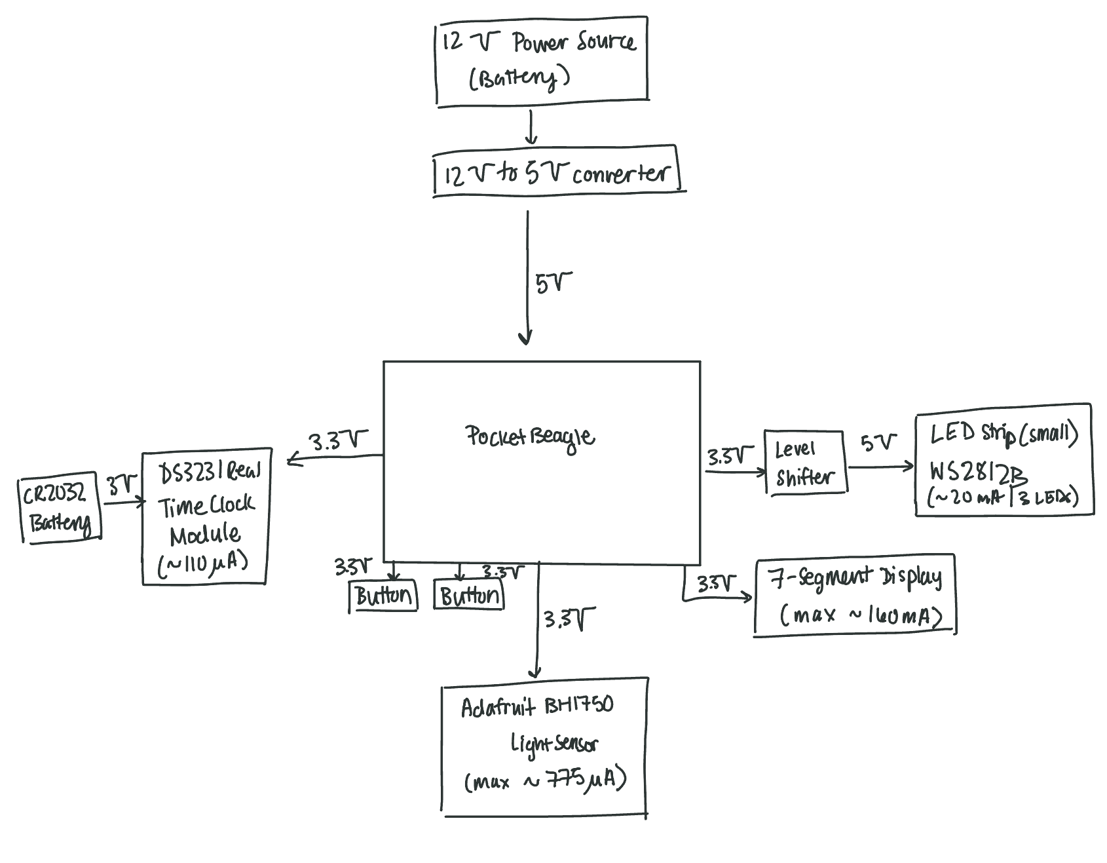
Power Block Diagram

Slide 5
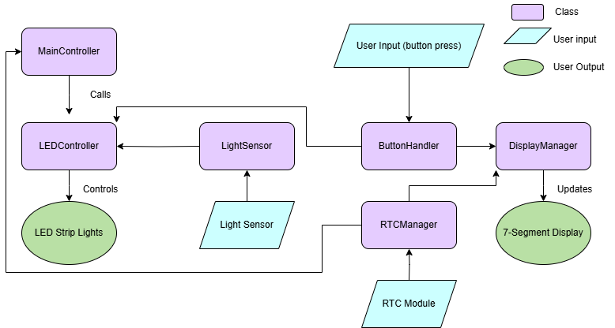
Software Block Diagram

Slide 6
Components / Budget
Component | EDES301 to Buy? | Cost
12 V battery | No | $0 (from OEDK)
12V to 5V converter | Yes | $1.78
LED Strip Lights (small strips) | Yes | $16.99
Adafruit BH1750 Light Sensor | Yes | $4.50
DS3231 Real Time Clock Module | Yes | $5.99
CR2032 Battery | No | $0 (from OEDK)
Level Shifter | Yes | $1.60
Buttons | No | $0 (provided in parts kit)
Hex Display | No | $0 (provided in parts kit)

