Slide 1
🎥 Movie Magic Platform
Smart movie recommendations
Presented by: Mary Sophiya
Tools Used: Python | Pandas |numpy| Scikit-learn | VADER | Pickle | Flask | HTML/CSS

Slide 2
📊 Project Overview
Objective:
- Analyze user movie reviews to detect sentiment
- Recommend similar movies using content-based filtering
- Predict the weather using historical data

Slide 3
☁️ Feature 1 - Weather Forecasting
Goal:
Predict today’s weather from historical data
Process:
- Kaggle dataset with temperature, humidity, wind etc
- RandomForestRegressor to predict temperature
- Temperature mapped to mood + quote
Tech: Pandas, Scikit-learn, Pickle

Slide 4
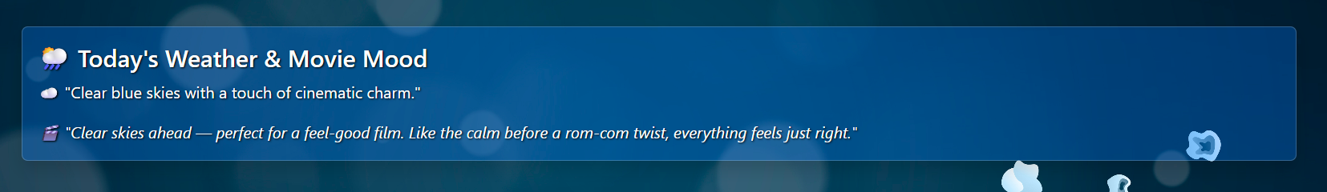
🌤️ Weather Forecasting Output Example

Slide 5
💬 Feature 2 - Sentiment Analysis
Goal:
Analyze movie review sentiment (Positive/Negative)
Process:
- Used VADER from NLTK
- Cleaned user text
- Displayed sentiment in UI
Example:
Input: “The movie was absolutely mind-blowing!”
Output: Positive

Slide 6
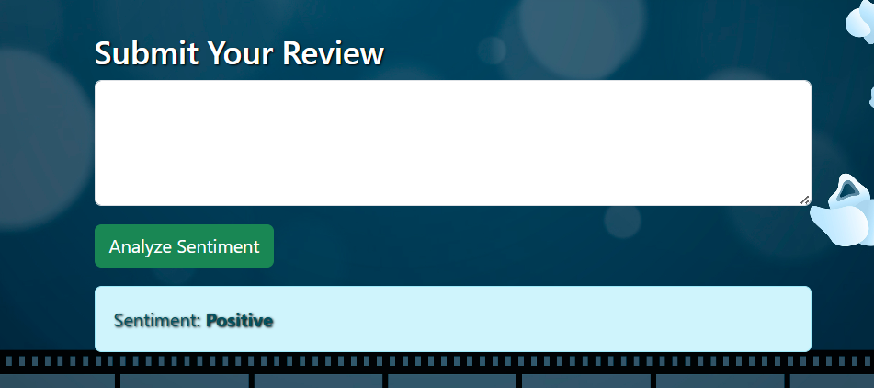
😀 Sentiment Analysis Demo

Slide 7
🎯 Feature 3 - Content-Based Recommendation
Goal:
Recommend 5 similar movies
Process:
- Kaggle dataset with movie metadata
- TF-IDF + Cosine similarity
- Randomly selected movie -> 5 closest
Libraries: Scikit-learn, Numpy, Pandas

Slide 8
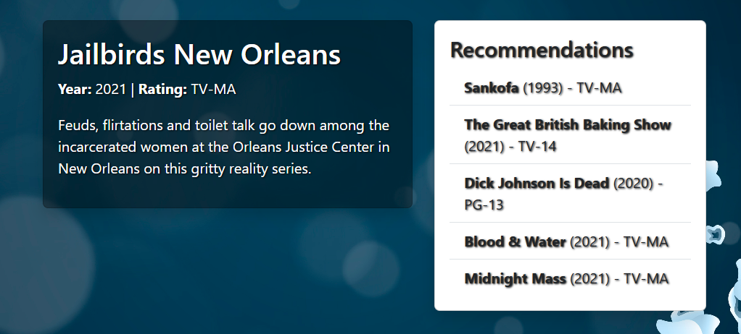
🎥 Recommendation Output Example

Slide 9
🧩 Tech Stack & Tools
- Frontend: HTML, CSS
- Backend: Python (Flask)
- ML Models: Random Forest, VADER, TF-IDF + Cosine
- Libraries: Pandas, Scikit-learn, NLTK, Pickle, Flask

Slide 10
🏁 Summary & Key Learnings
Achievements:
- Combined ML, NLP, Recommender systems
- Flask web app with dynamic interaction
Learnings:
- Data cleaning, modeling
- Flask deployment
- Practical ML integration

Slide 11
💡 Future Scope
- Collaborative filtering for personalization
- Replace dataset with real-time weather API
- More nuanced sentiment labels
- Enhanced UI/UX with themes

Slide 12
🙏 Thank You
Thank you for watching!

