Slide 1

LENDING CLUB CASE STUDY
Submitted By – Ravi Kumar Dhiman

Slide 2
Lending Club Case Study
Background:
A Consumer Finance Company specializes in lending various types of loan to urban customers.
Company decides on loan approval based on customer's profile
2 Major risks associated with approval decision:
Loss of Business: Loan approved when Customer is likely to repay loan.
Financial Loss: Loan approved when Customer is not likely to repay loan i.e., likely to default
Loan Accepted - 3 Scenarios occur :
Fully Paid: Principal and Interest Repaid.
Current: Ongoing Loan and Customer paying instalments. Loan Tenure not completed.
Charged-off: Instalments not paid in due time for a long time i.e., Customer Defaulted on Loan.
Loan Rejected - No transactional history present & hence, data not available with the Company/in the used dataset
Objective (What):
Identify & Understand the Driving Factors/Variables which are strong indicator of Loan Default to reduce the Bad Loans.
Reason (Why):
Lending Loans to Risky applicants is largest source of Credit Loss (Money lost when Borrowers refused to pay or run away with money owed)
The company can utilise this knowledge for its portfolio and risk assessment.

Slide 3
Basic Approach Followed
Data Understanding Importing the raw data from given file
Data Cleaning & Manipulation Removing null values and unwanted columns
Start
Data Visualization Visualize the cleaned data & the correlation to gather intel and derive understanding
Data Analysis Find any correlation between target and other variables
End

Slide 4
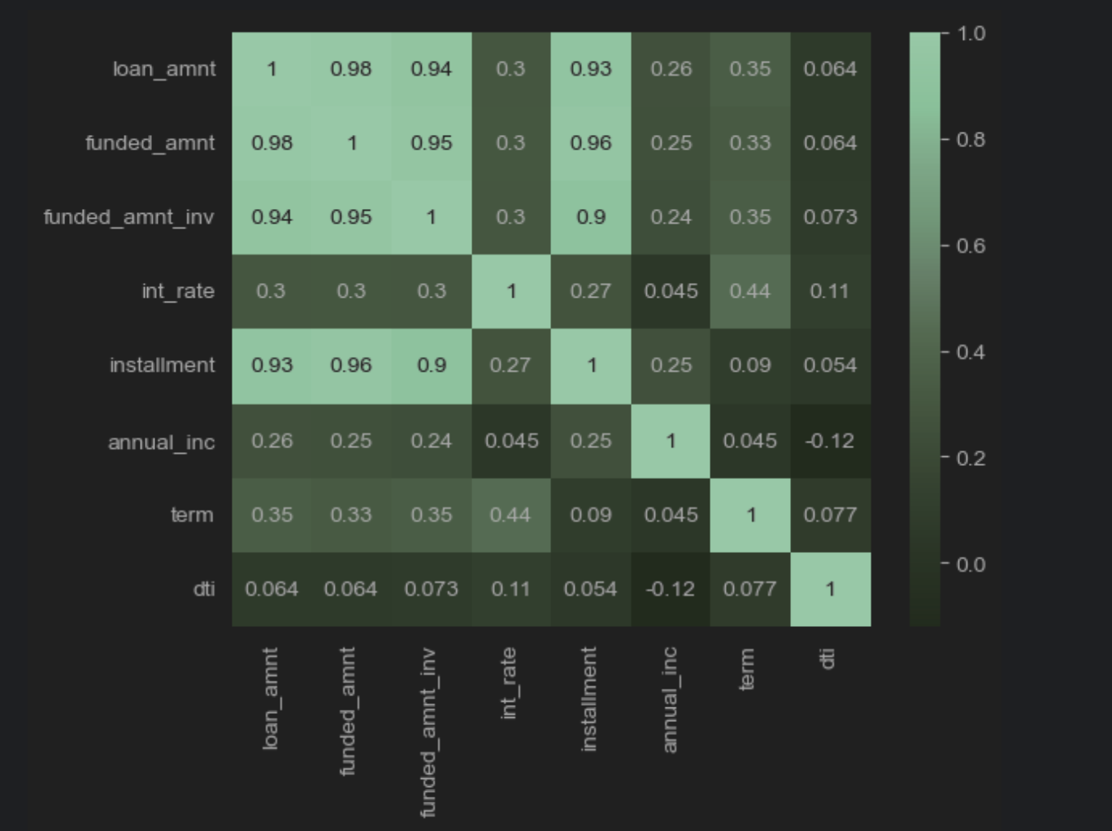
Correlation Analysis

Slide 5
Loan Status by Term
Loan Term | Status | Count
36 months | Fully Paid | 17880
 | Charged Off | 1934
60 months | Fully Paid | 5151
 | Charged Off | 1655
As seen in the table above, lesser loans defaulted when the term of the loan was 60 instead of 36.
One recommendation is that company should provide the loans for the longer term.

Slide 6
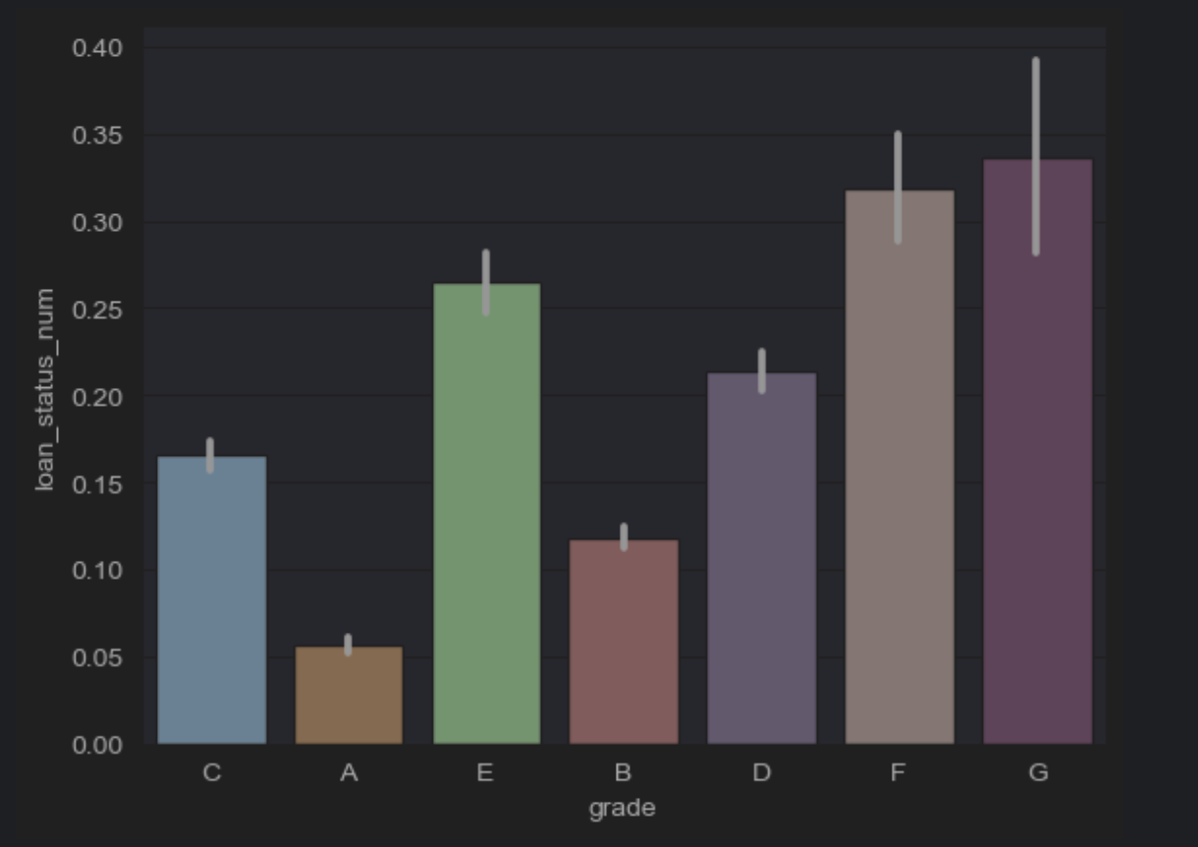
Loan Status by Grade
Loan with Grade A has the lowest default rate.
This rate gradually increase with respect to Grade
Recommendation – More loans of type A should be considered.

Slide 7
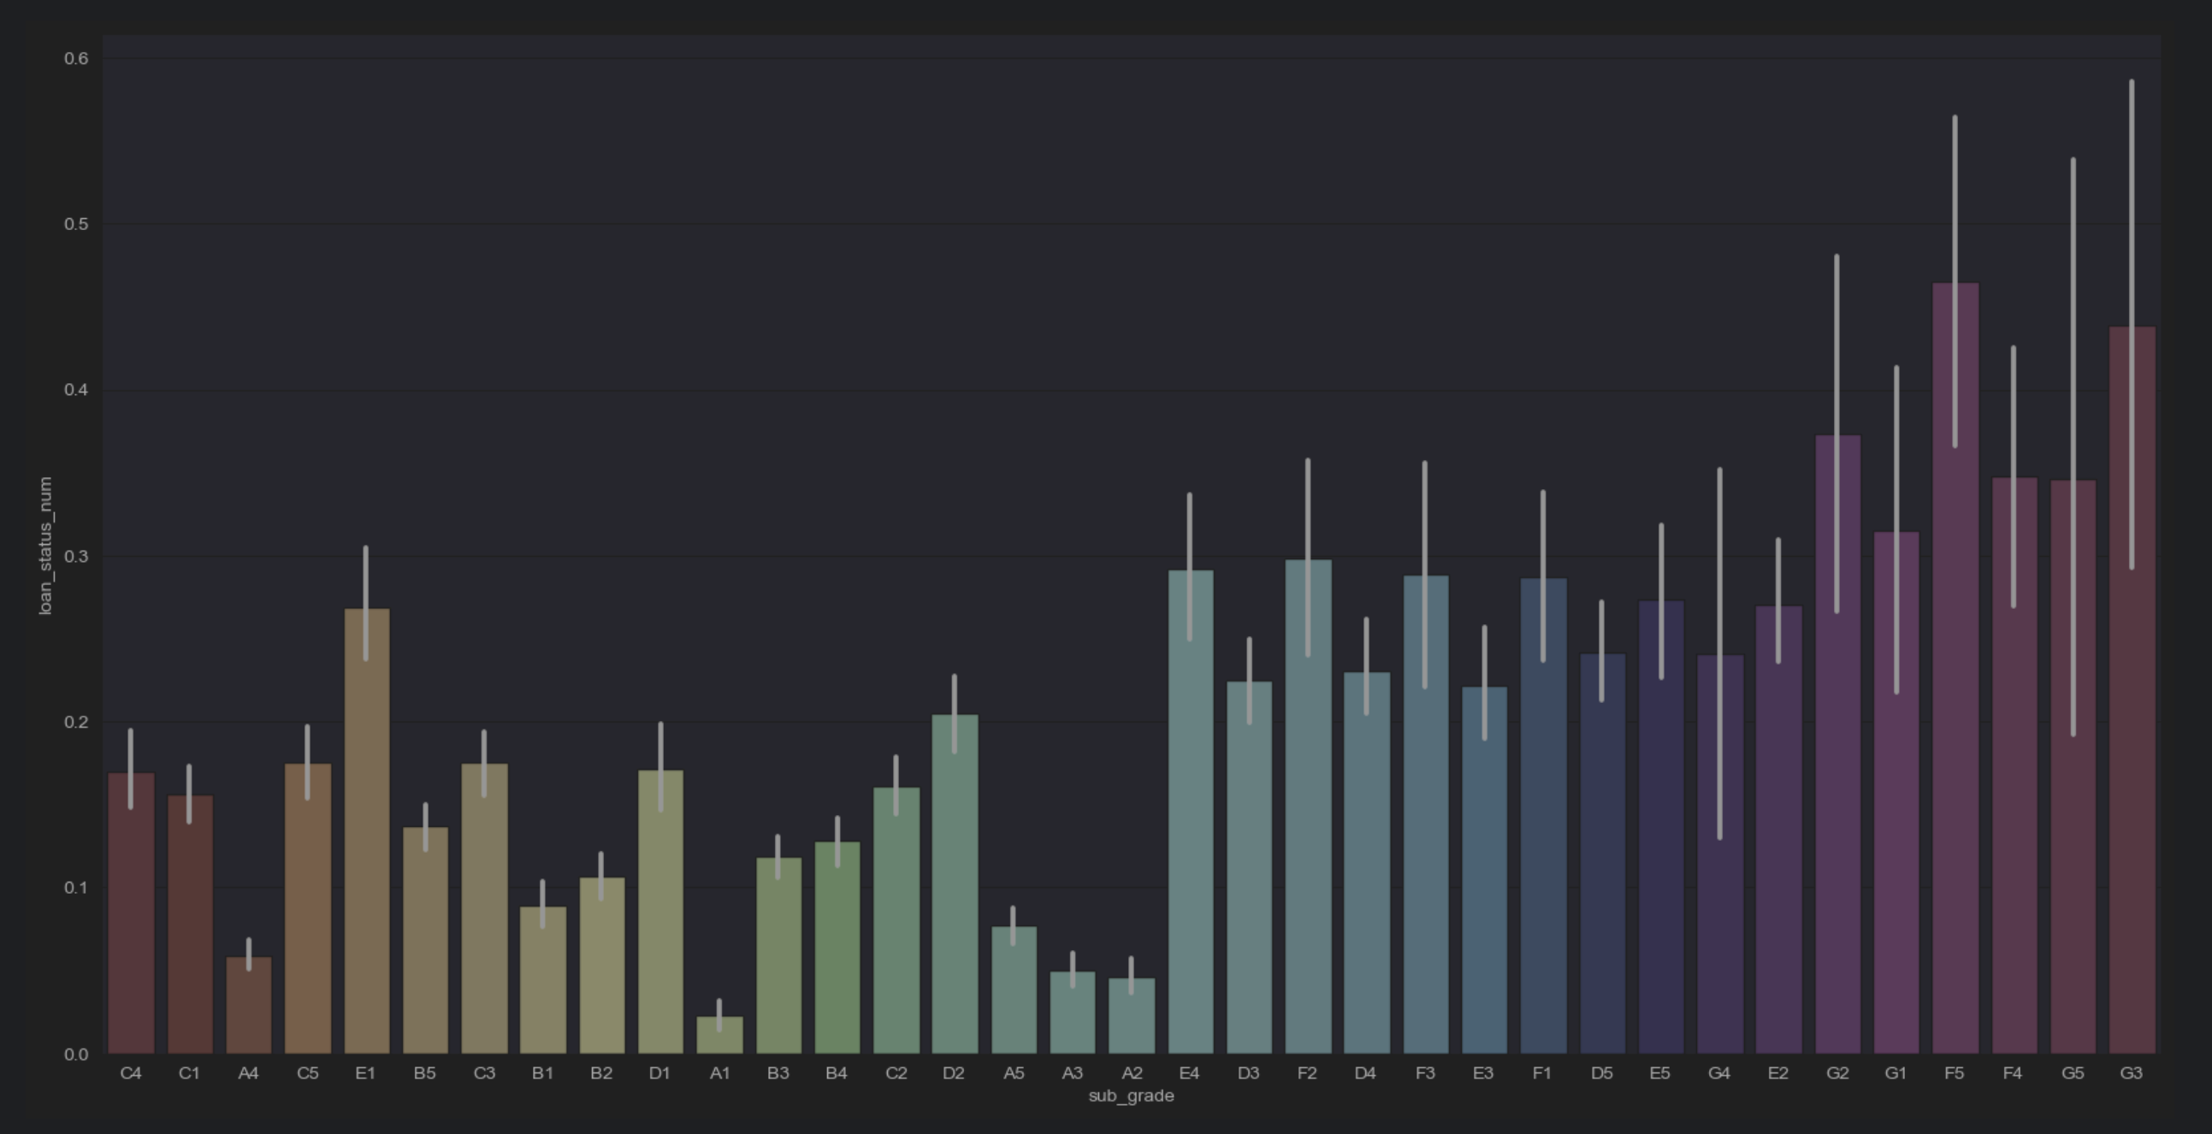
Loan Status by Sub-Grade
As seen with grade, similar observation seen here.
Recommendation – More loans of type A1/A2 should be considered.

Slide 8
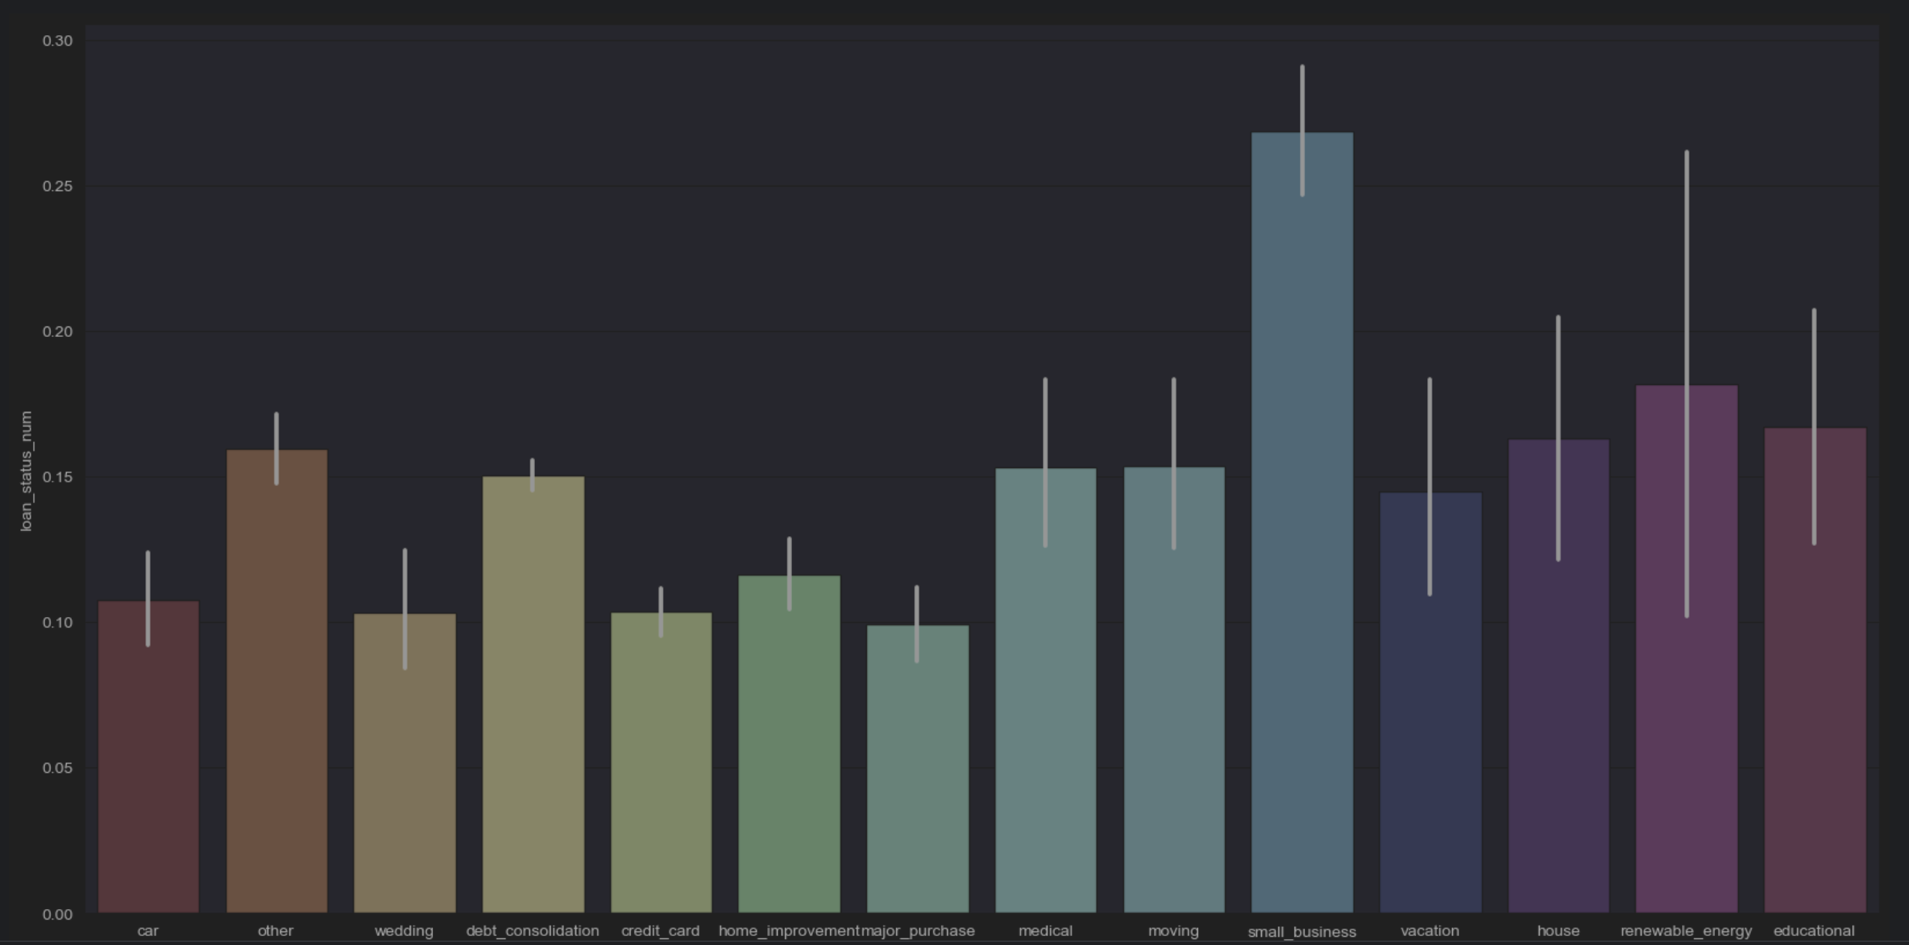
Loan Status by Purpose
Small businesses have a very high frequency of defaulting compared to other purposes

Slide 9
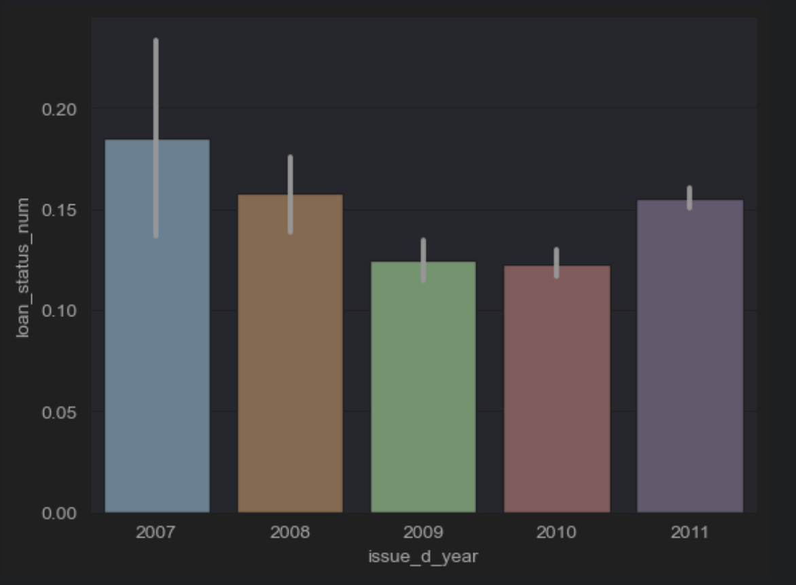
Loan Status by Issued year
Loan Default was high in 2007 but it got at same levels between 2009 and 2010, reduced from 2007 peak
Suddenly, in 2011, the load default rate again went up.

Slide 10
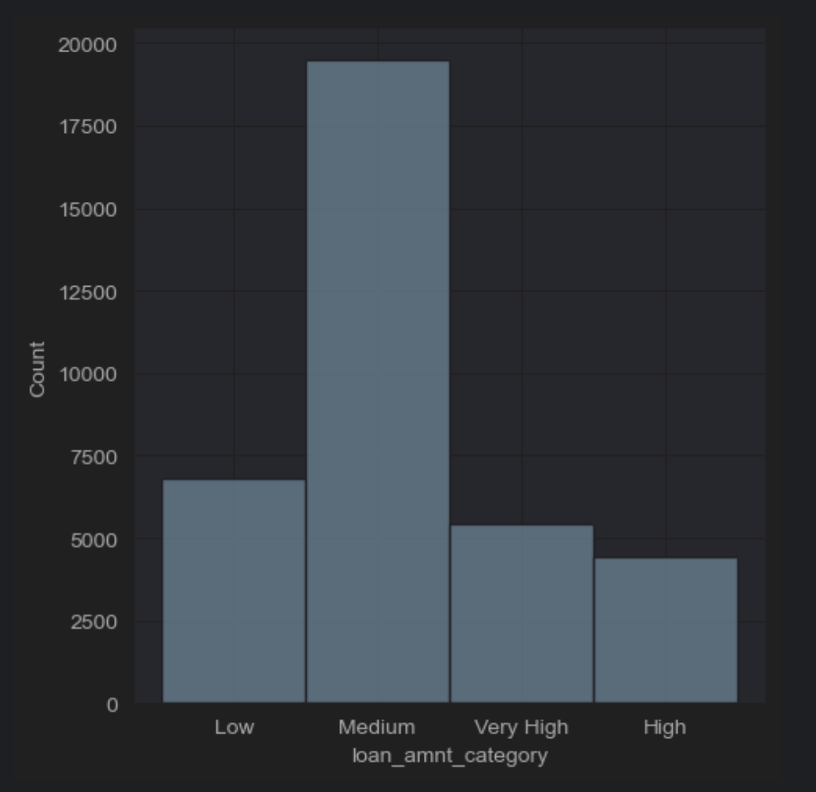
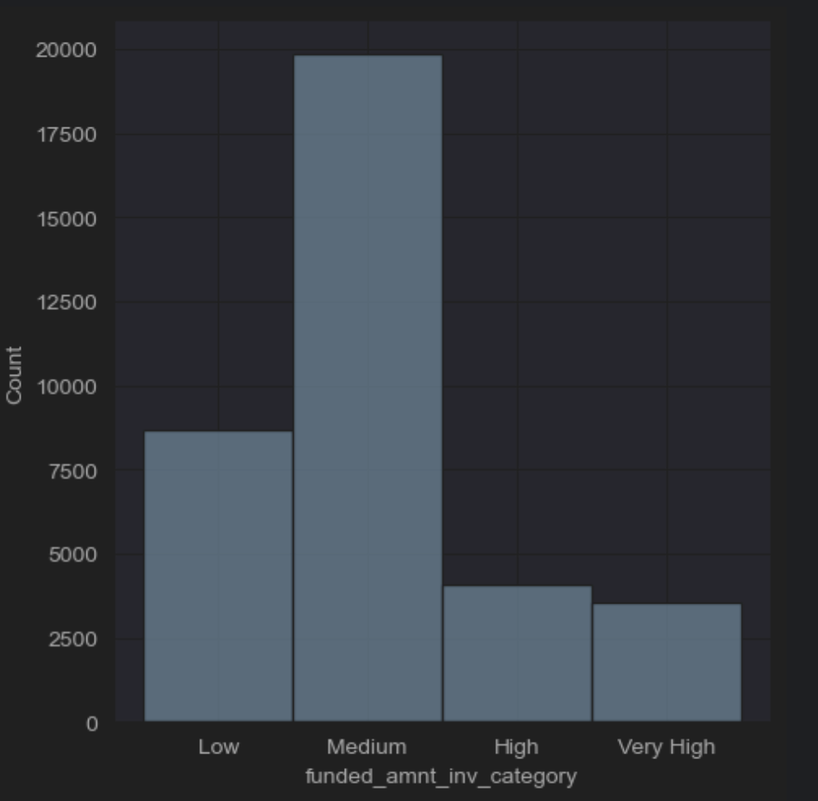
Understanding users – by loan amount and funded amount inv

Slide 11
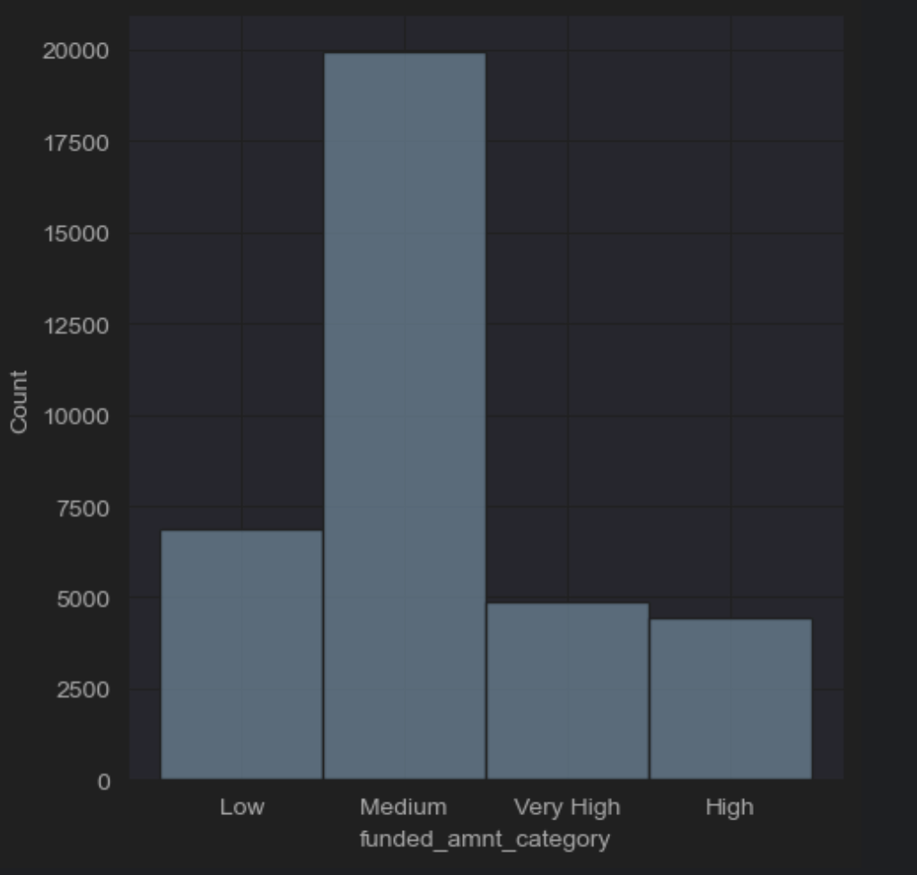
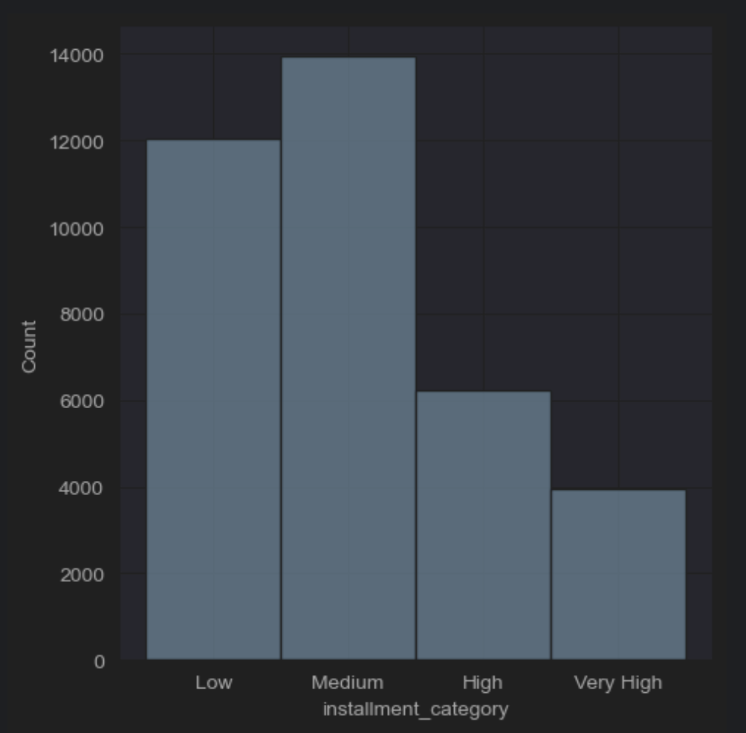
Understanding users – by Funded Amount and Installment

Slide 12
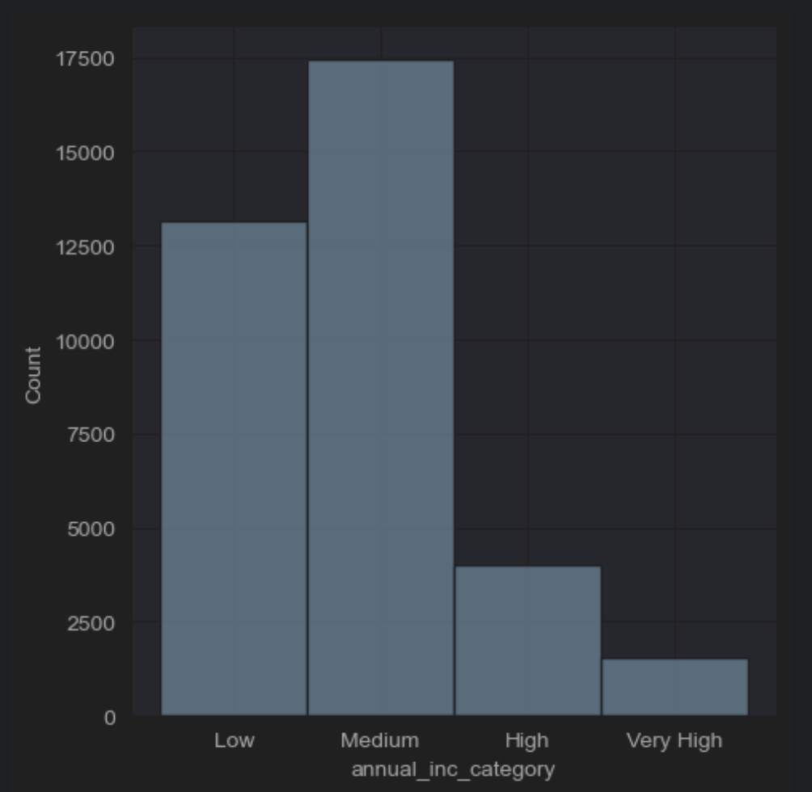
Understanding users – by Annual Income

Slide 13
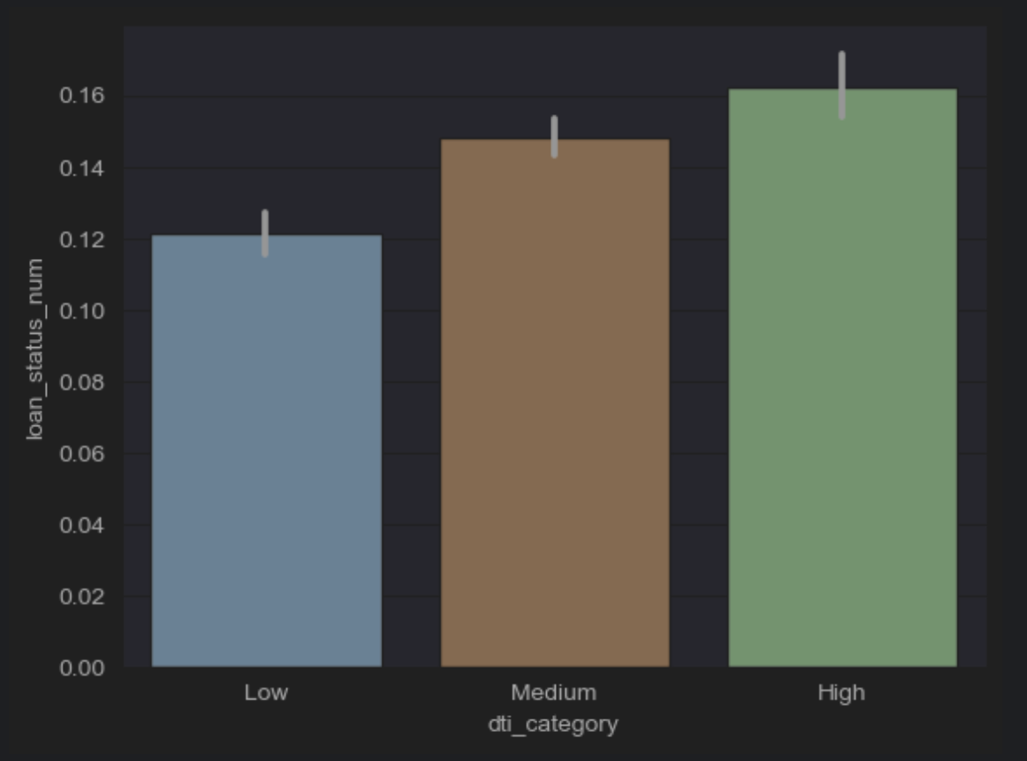
Debt to Income Ratio
High DTI (debt to Income ratio) translates into higher default rates.

Slide 14
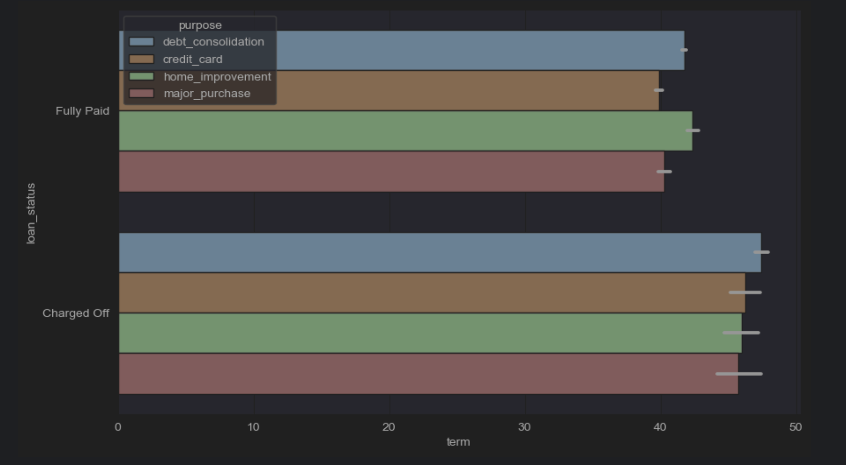
Understanding users – by Loan Fully Paid vs. Charged Off
Debt collection seems to be the biggest contributor in both Fully vs Charged Off categories.

Slide 15
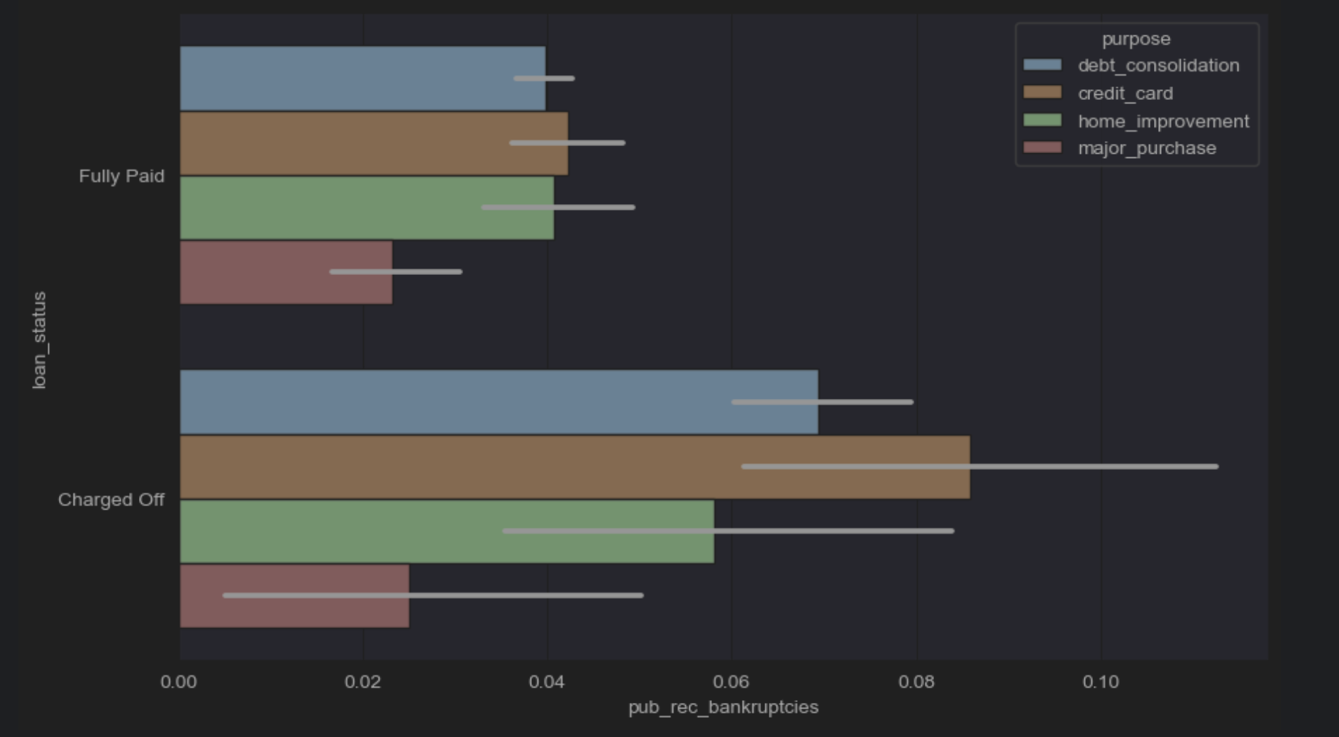
Loan Status by Publicly Known Bankruptcies of the users
Credit card is the biggest contributor.
Credit card has the highest “Charged Off” bucket followed by ”Debt Consolidation”

Slide 16
Conclusion
As per the analysis, I conclude that the below variables are driving factors for predicting the defaulting of loans –
Term → Shorter loan tenures are at a higher risk of defaulting
Grade → Lending Club should provide more Grade A loans. G Grade loans are at a much higher risk.
Purpose → Loans for Small businesses default more than any other purpose
Annual income classification → Explains which income group consumer can have more loan default
Loan Amount → Explains that medium loan amount usually has a higher loan default rate

