Slide 1
The wonderful and terrifying implications of computer that can learn

Slide 2
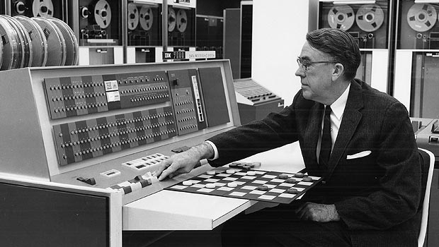
Arthur Samuel, an American pioneer in the field of computer gaming and artificial intelligence,
coined the term “Machine Learning” in 1959 while at IBM.

Slide 3
Machine Learning
Machine Learning is a field of computer science that gives computers the ability to learn without being explicitly programmed.
It is closely related to computational statistics which also focuses on prediction-making through the use of computers.
It has strong ties to mathematical optimization which delivers methods, theory and application domains to the field.

Slide 4
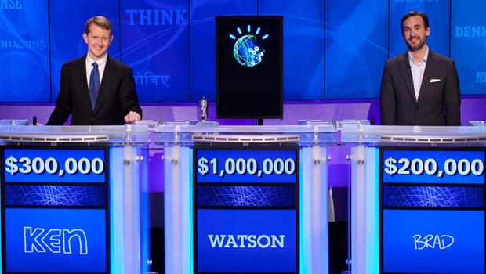
In 2011, the watson computer system competed on Jeopardy against former winners Brad Rutter
and Ken Jennings winning the first place prize of $1 million.

Slide 5
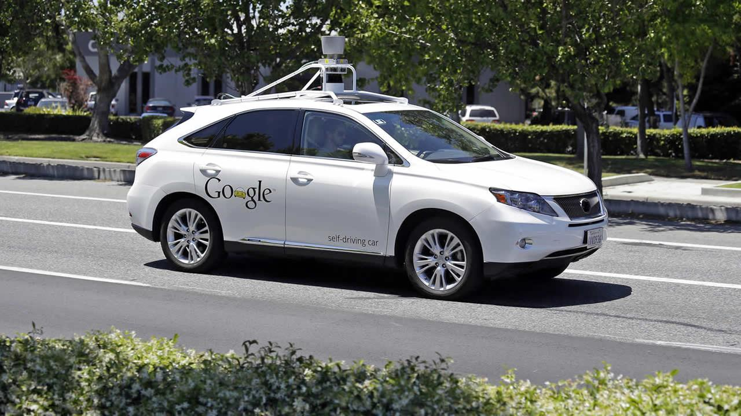
As of June 2016, Google had test driven their fleet of vehicles, in autonomous
mode, a total of 1,725,911 mi (2,777,585 km)

Slide 6
Deep Learning
Deep Learning also known as hierarchical learning is part of broader family of machine learning methods based on learning data representations as opposed to task specific algorithms.
Learning can be supervised, partially supervised or unsupervised

Slide 7
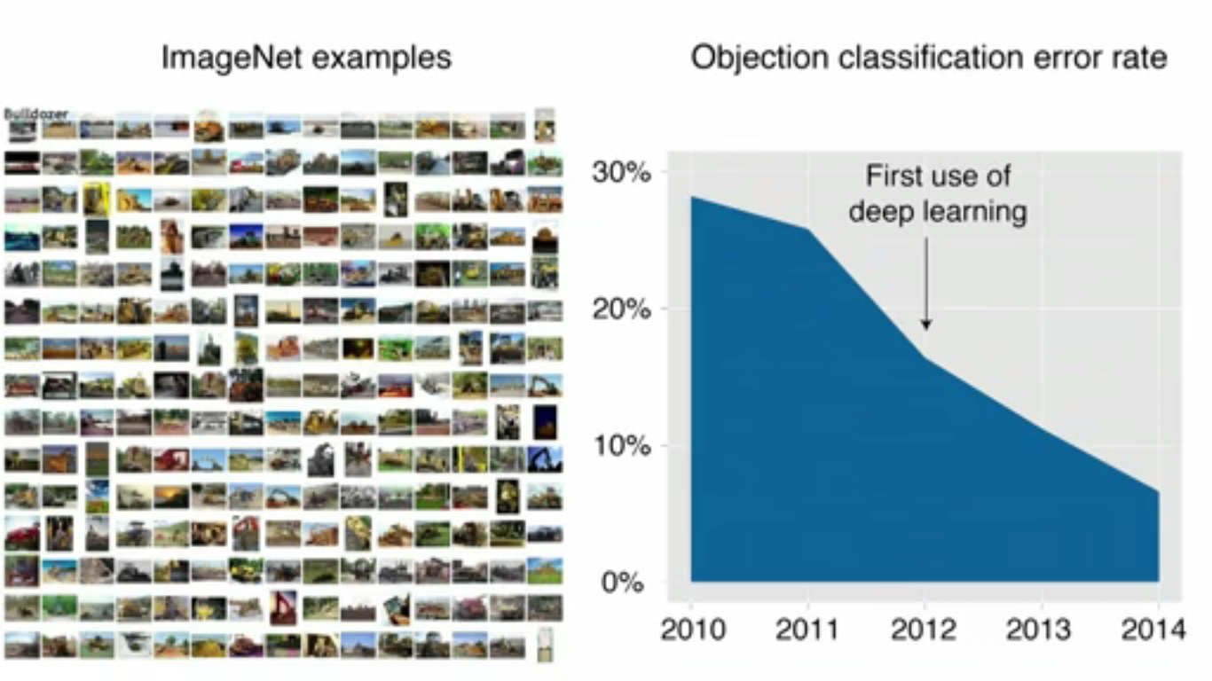

Slide 8


