Slide 1
The Wonderful and Terrifying Implications of Computer
-A TEDx TALK BY JEREMY HOWARD

Slide 2
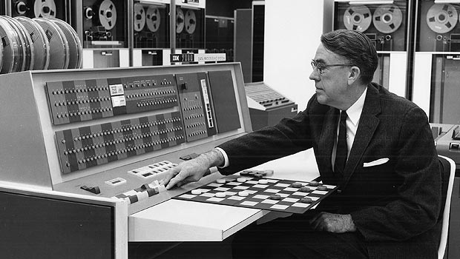
Arthur Samuel, an American pioneer in the field of computer gaming and artificial intelligence,
coined the term “Machine Learning” in 1959 while at IBM.

Slide 3
Machine Learning
Machine Learning is a field of computer science that gives computers the ability to learn without being explicitly programmed.
It is closely related to computational statistics which also focuses on prediction-making through the use of computers.
It has strong ties to mathematical optimization which delivers methods, theory and application domains to the field.

Slide 4
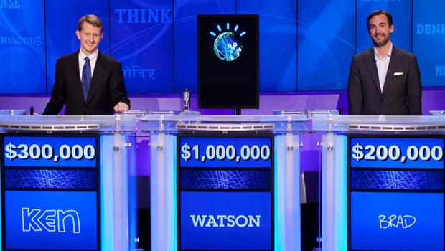
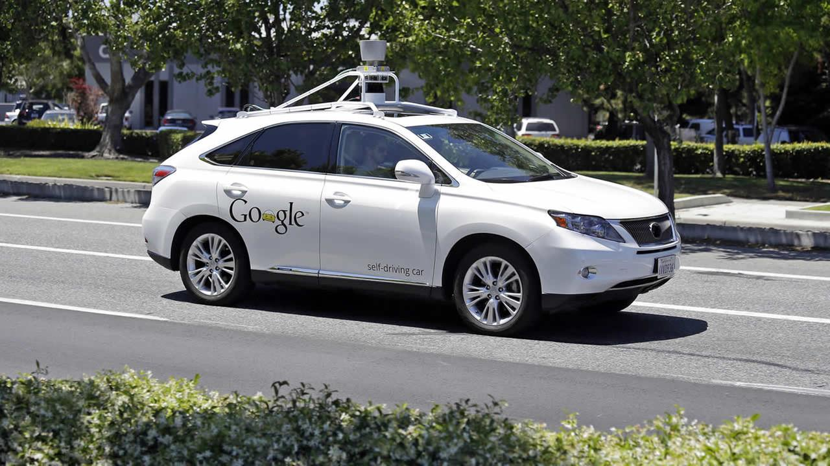
Computers Can Learn

Slide 5
Deep Learning
Deep Learning also known as hierarchical learning is part of broader family of machine learning methods based on learning data representations as opposed to task specific algorithms.
Learning can be supervised, partially supervised or unsupervised

Slide 6
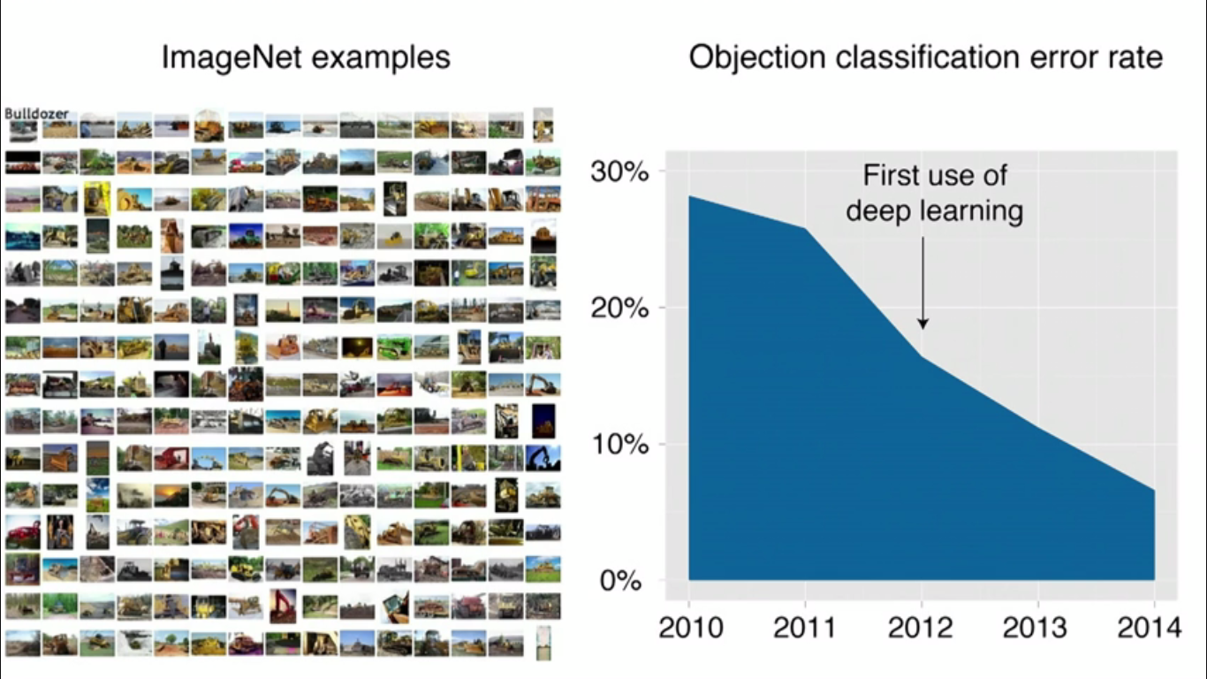

Slide 7

Computers Can See

Slide 8
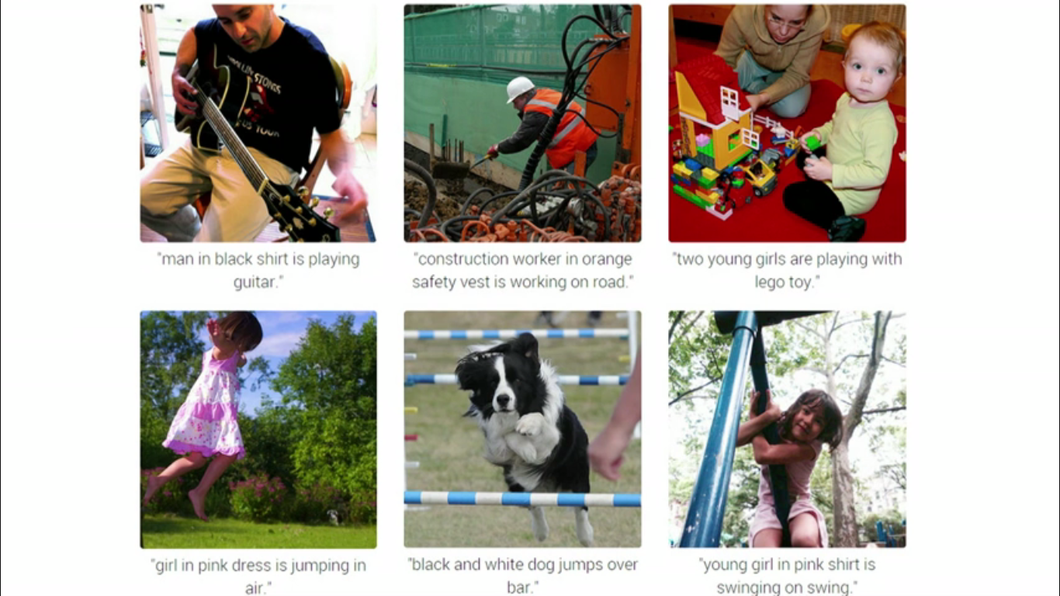
Computers Can Write

Slide 9
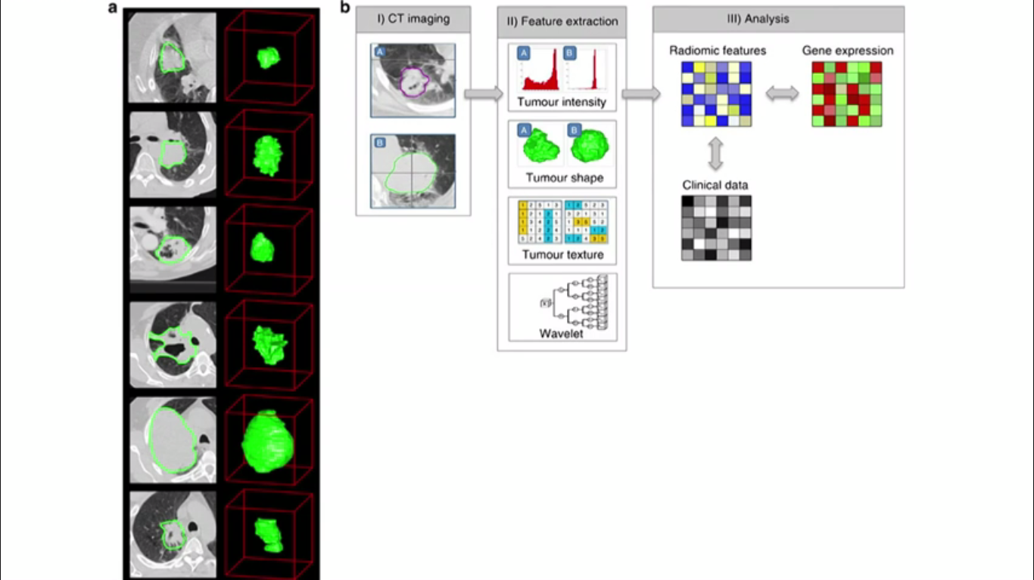

Slide 10
THANK YOU

