Slide 1
Just One: SoPra FS2020 Milestone 2
A Presentation from Group 15
Charlotte Eder, 17-826-090 Minh Phuong Vu, 18-730-788 Kai Mitiyamulle Arachchige, 18-705-434 Jordan Cedeño, 14-713-440 Raphael Haemmerli, 17-714-593

Slide 2
Table of Contents
User Interface Design Mock-ups
Diagrams
User Stories and Sprints
REST Specifications and Test Cases

Slide 3
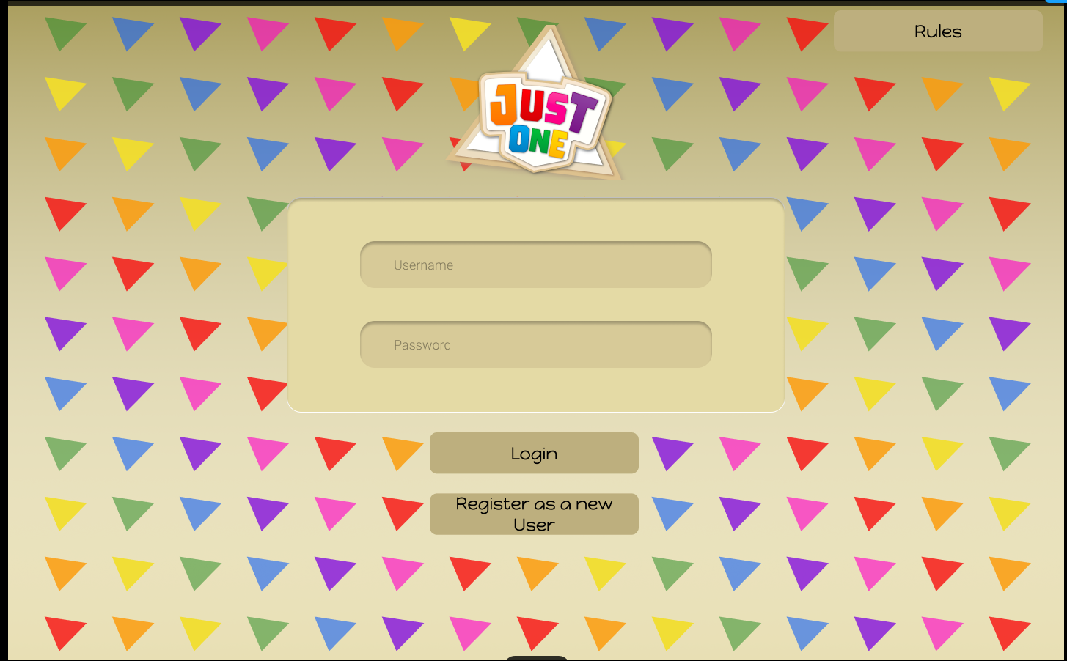
User Interface Design Mock-ups
Login Page

Slide 4
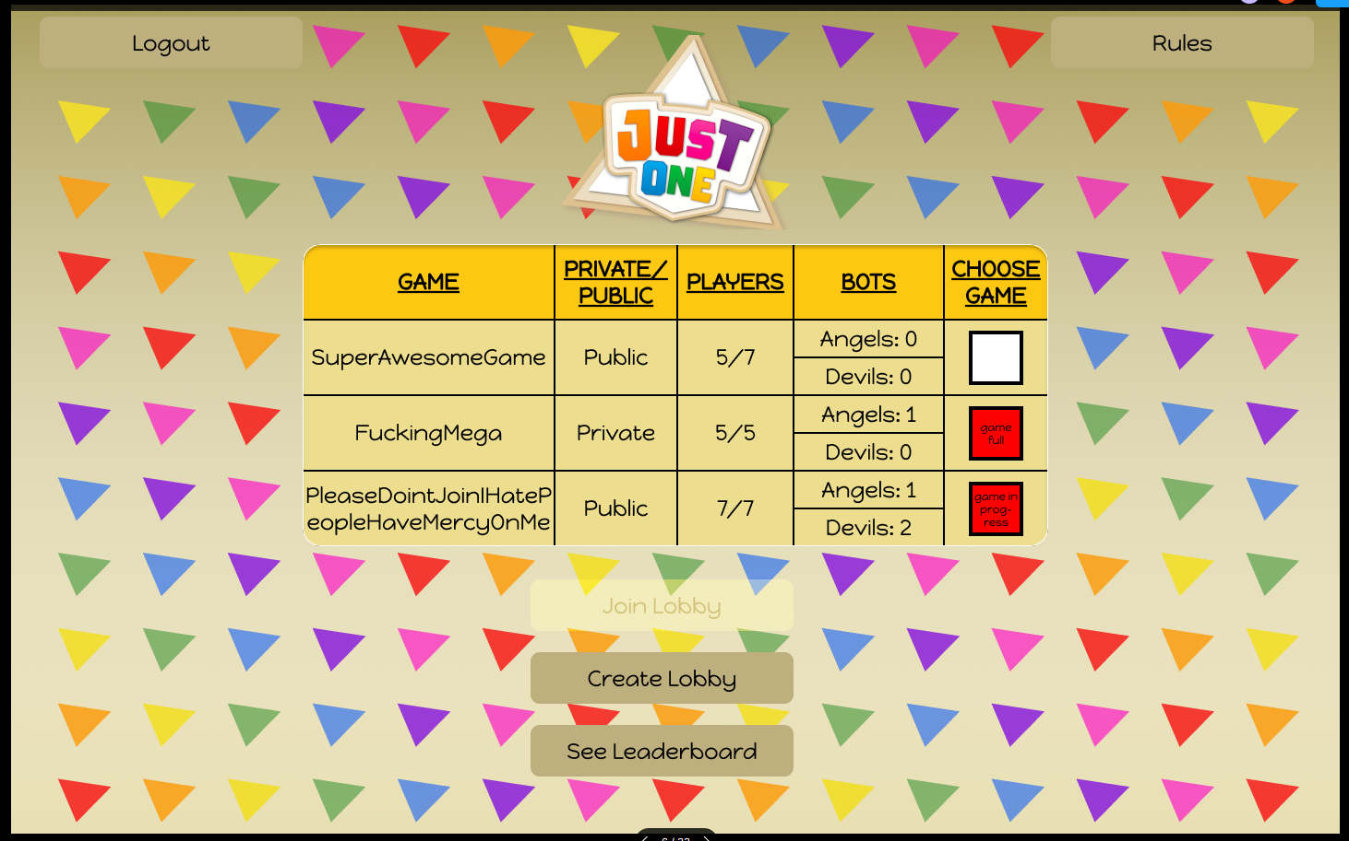
User Interface Design Mock-ups
Lobby Page

Slide 5
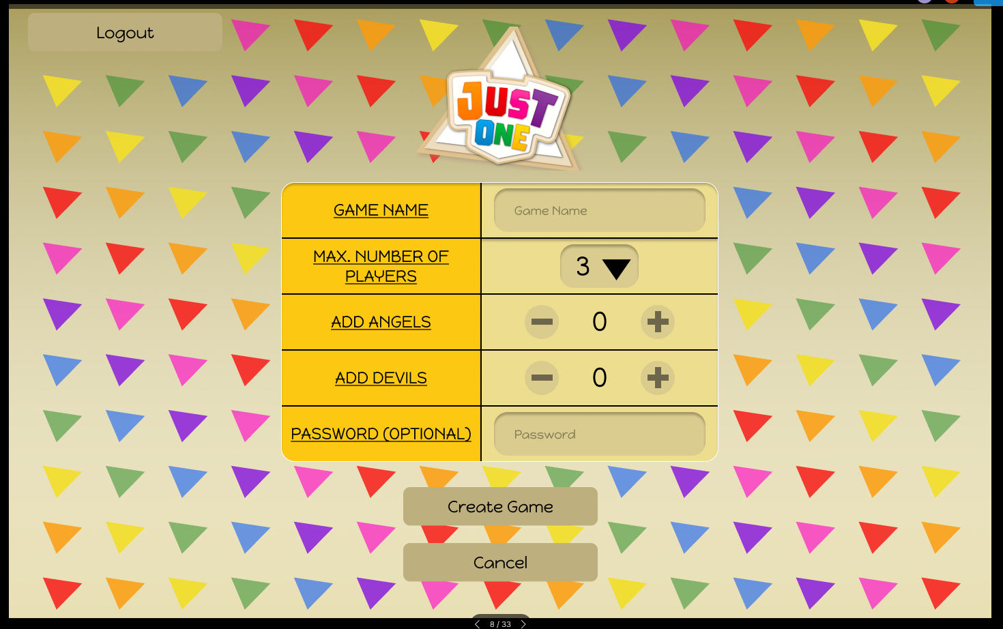
User Interface Design Mock-ups
Game Creation Page

Slide 6
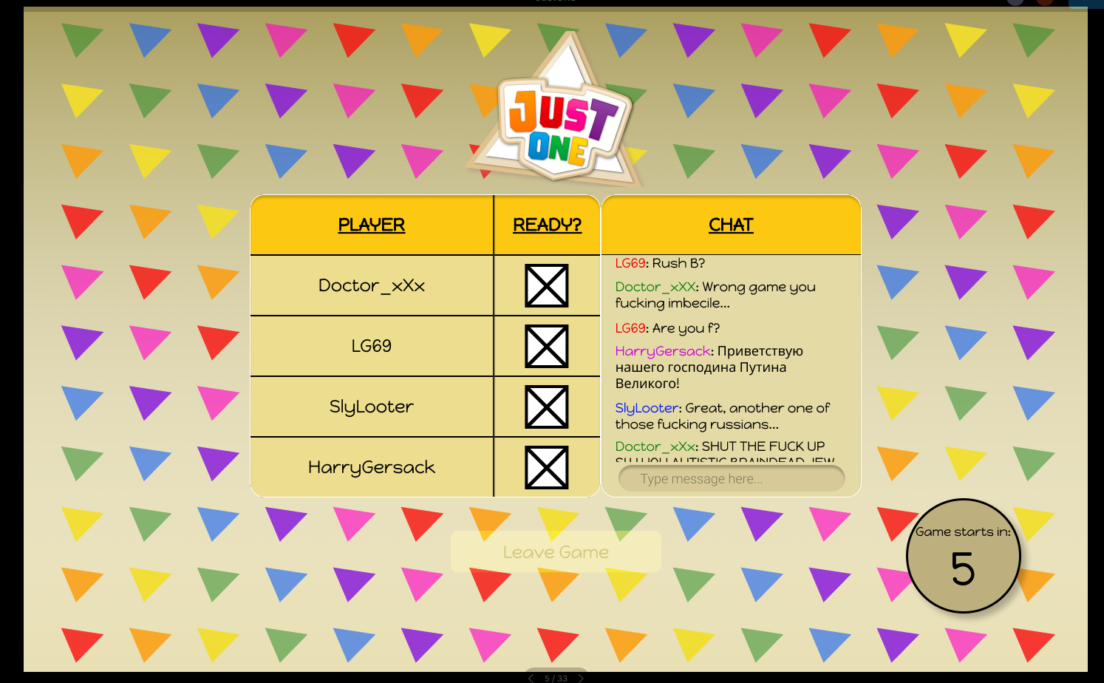
User Interface Design Mock-ups
Game Lobby Page

Slide 7
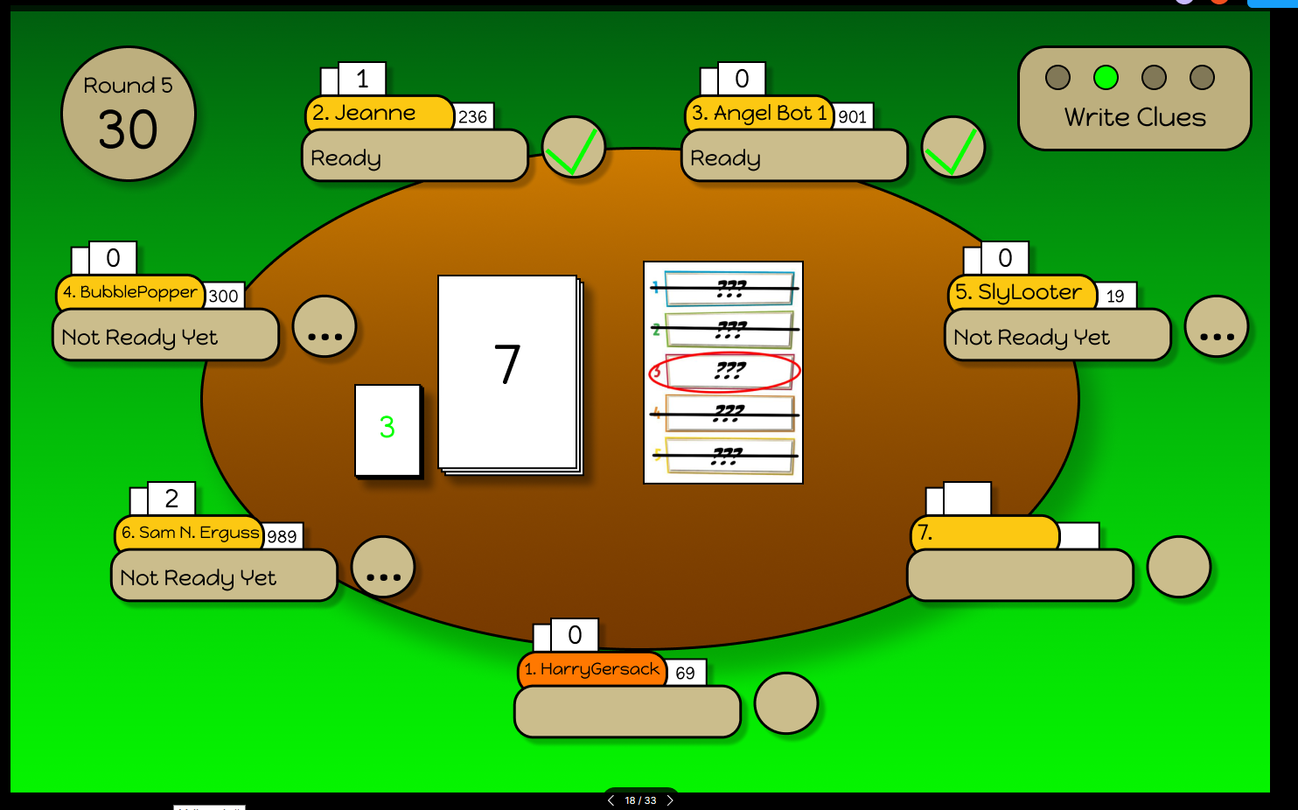
User Interface Design Mock-ups
Game Page: Write Clues

Slide 8
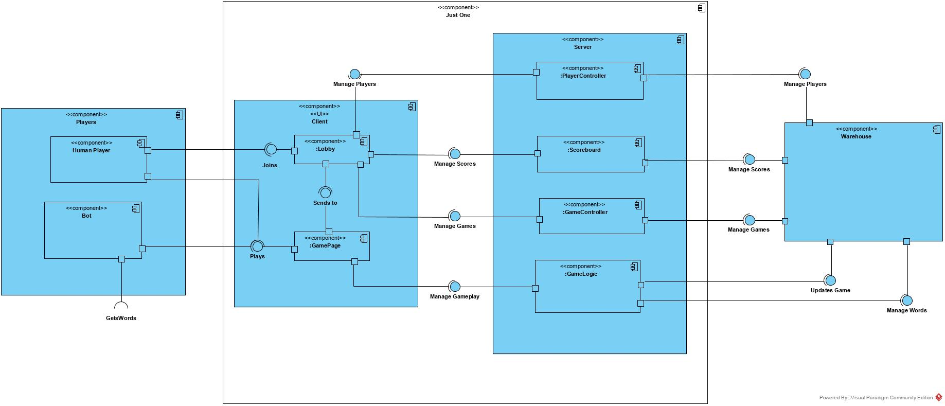
Diagrams
Component Diagram

Slide 9
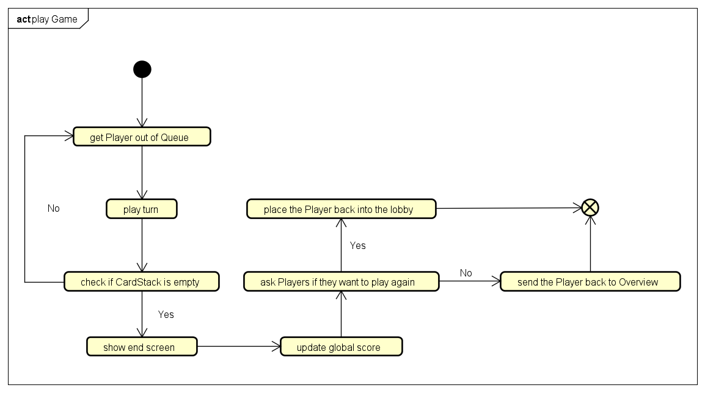
Diagrams
Activity Diagram (Game)

Slide 10
User Stories and Sprints
User Stories can be grouped into six categories.
Game-Logic
Game-Control
Player-Control
Non-Human Players
Information
Further Ideas

Slide 11
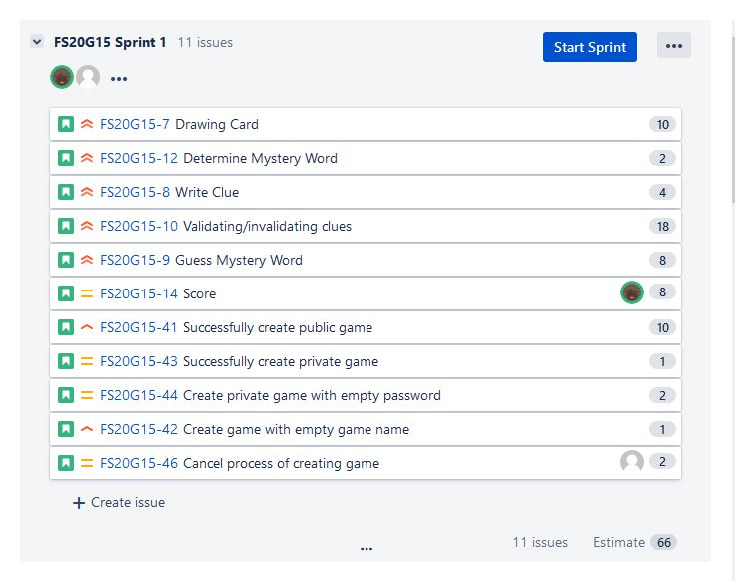
User Stories and Sprints
Five Sprints:
Game-Logic and Game-Control
Non-Human-Players and Game-Control
Game-Control and Player-Control
Information
Further Ideas
Frontend Team: Kai, Minh Phuong
Backend Team: Charlotte, Jordan, Raphael

Slide 12
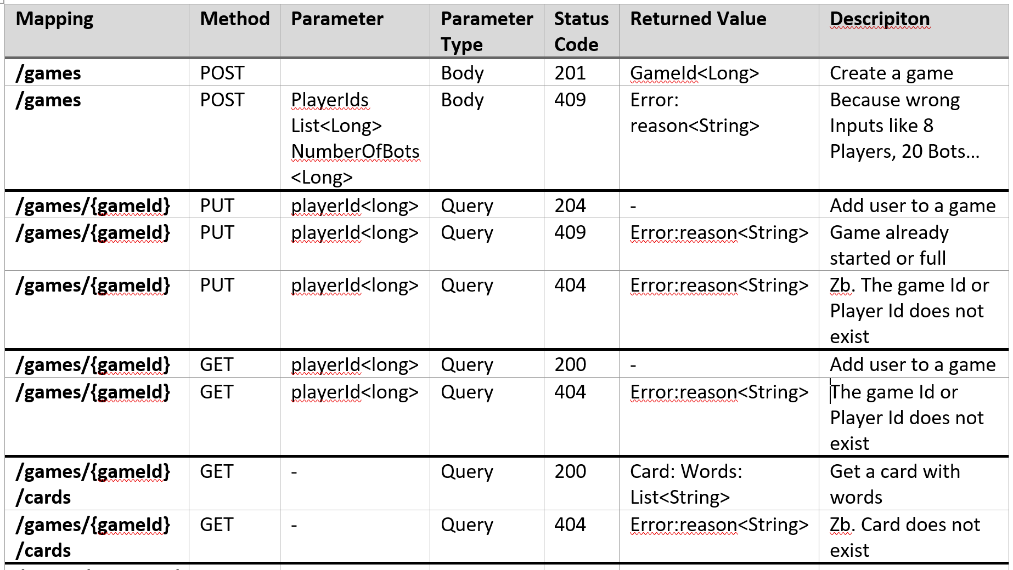
Rest Specifications

Slide 13
Test Cases
POST /games: Create a game
PUT /games/{gameId}: Put a player into a game-round
POST /games/{gameId}/clues: Give a clue
POST /games/{gameId}/guesses: Guess a mystery word
DELETE /games/{gameId}: Delete a game

