Slide 1
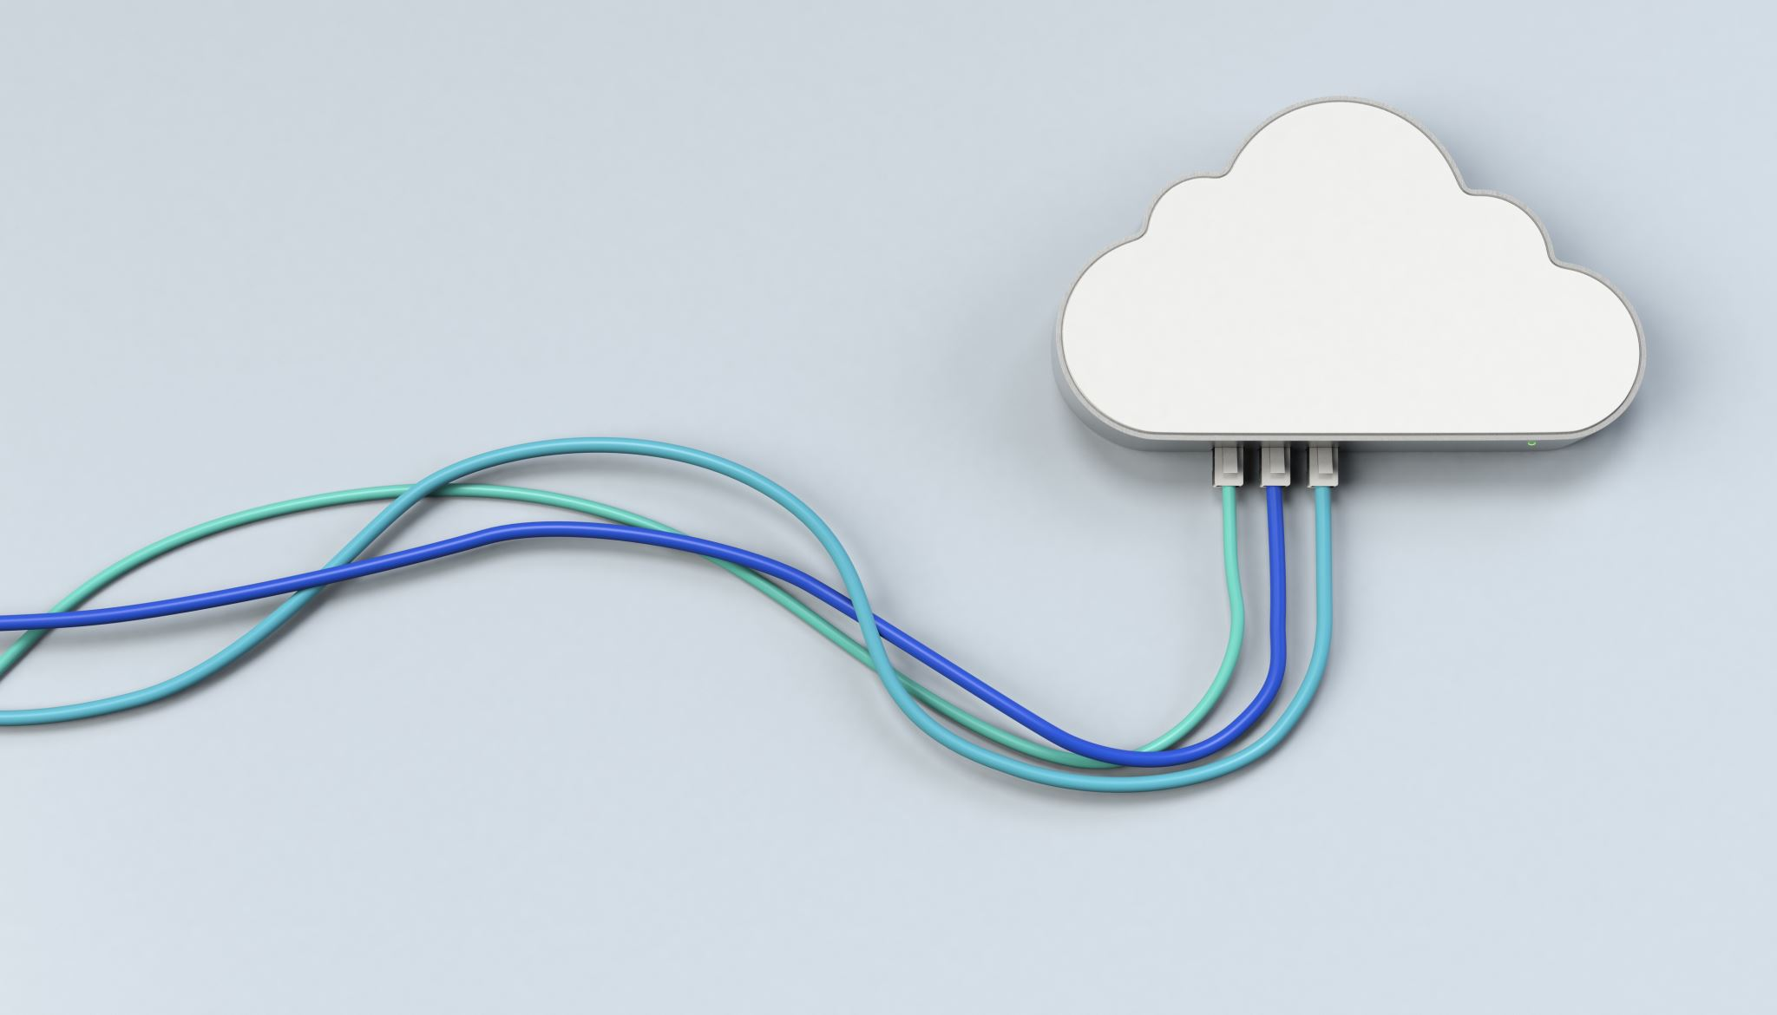
Cloud computing final project report
under the supervision of
Dr.Amira & Eng.Sara

Slide 2
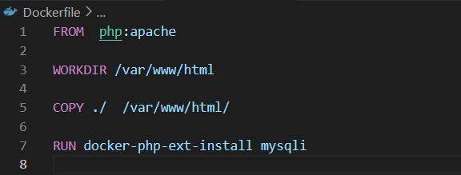
The base image for our first container(the official PHP image ).
Set the working directory inside the docker container.
Taking a copy of our file to the container directory.
installing php extension we need to solve upcoming problem.

Slide 3
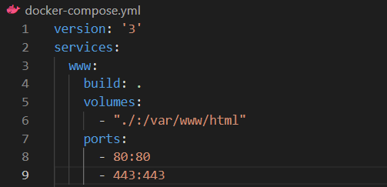
To specifies the version of the docker compose file.
Services within the docker compose file.
The name of first service.
to build the docker file we need to use.
To share the files between host machine and docker container.
The current directory on the host machine : the directory on docker container.
To expose ports from the docker container to the host machine, enable the communication between the container and the outside world.
Container port : host machine port (port 80 commonly used for HTTP).
Port 443 commonly used for HTTPS traffic.

Slide 4
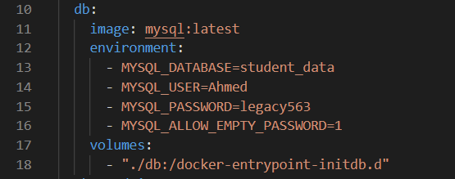
the name of the second service.
the image of the service (latest version of MySQL pulled from docker hub ).
to define variables needed to configure the container.
the database name.
set the user name of mysql Ahmed.
password to legacy563.
allows mysql to start without password.
to share the database file.
share all in the folder db(file.sql) : to the directory in the mysql container this is a special directory in the docker mysql image where sql scripts placed within it will be automatically executed when the container starts.
Note that : at this point we can run the file and we can access the server without problem.

Slide 5
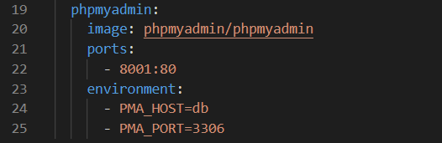
If we need to change something in the database we need to let the containers down and makes the changes on the database script after that compose up again , because of this slow process we choose to create another service to access the database faster(phpmyadmin).

Slide 6
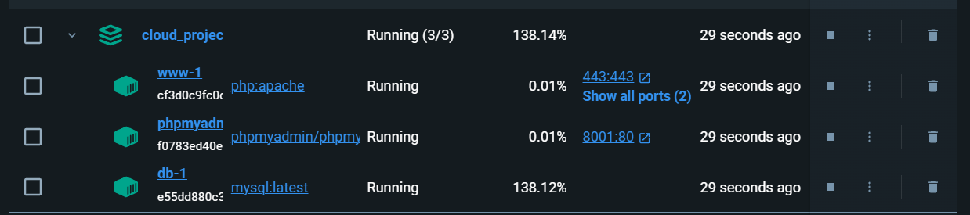
now we need to create the containers => docker-compose up

Slide 7

Before that let's check if we can access our database :

Slide 8
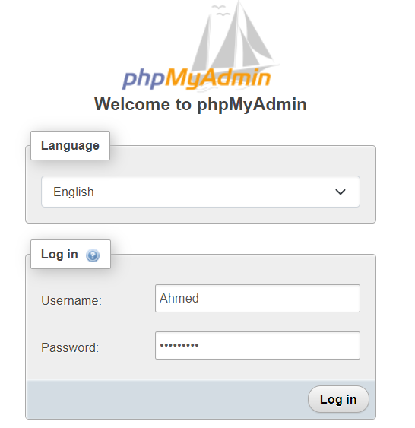
To get phpMyAdmin open chrome then write=> localhost:8001

Slide 9
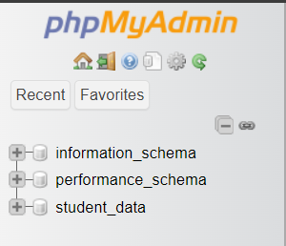
Enter your data = enjoy your database

Slide 10
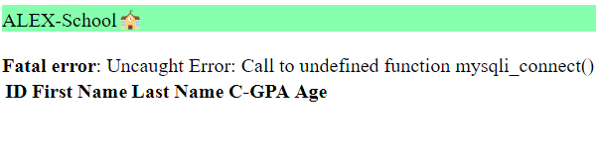
Ok, now time to access the server => localhost:80/name_of_the_file.php

Slide 11

The bad thing We have a small problem here ☹, but the good thing we have it’s solution 😊 .
We need to define the function mysqli_connect() :-
Open docker and click on php:apache container
Open it’s terminal and write
Another way to solve in slide 2
3)After downloading restart the container
4)Now you can get to the web server without any trouble.

Slide 12
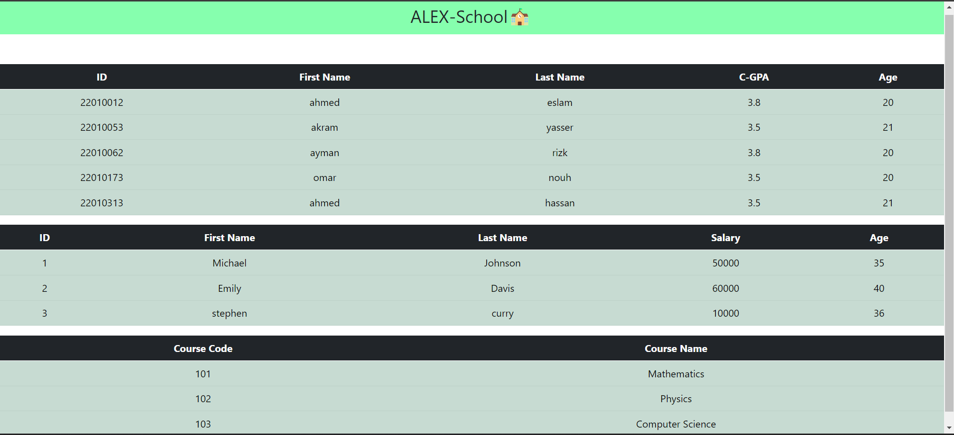

Slide 13
Finally, we thank you for your efforts with us and wish you all the best

