Slide 1



SOFTWARE TESTING - ソフトウェアテスト

Slide 2
Testing
01
Test Plan
02
Test Cases
03
Test Report

Slide 3
Testing
Test Plan
Testing Strategy
Test stage:
Integration test
System test
Test type:
Function test
GUI test

Slide 4



Testing Environment and Tools
Testing
Test Plan
Microsoft Windows 10 Professional 64 bit
Google Chrome
Microsoft Office Word, Excel 2007

Slide 5
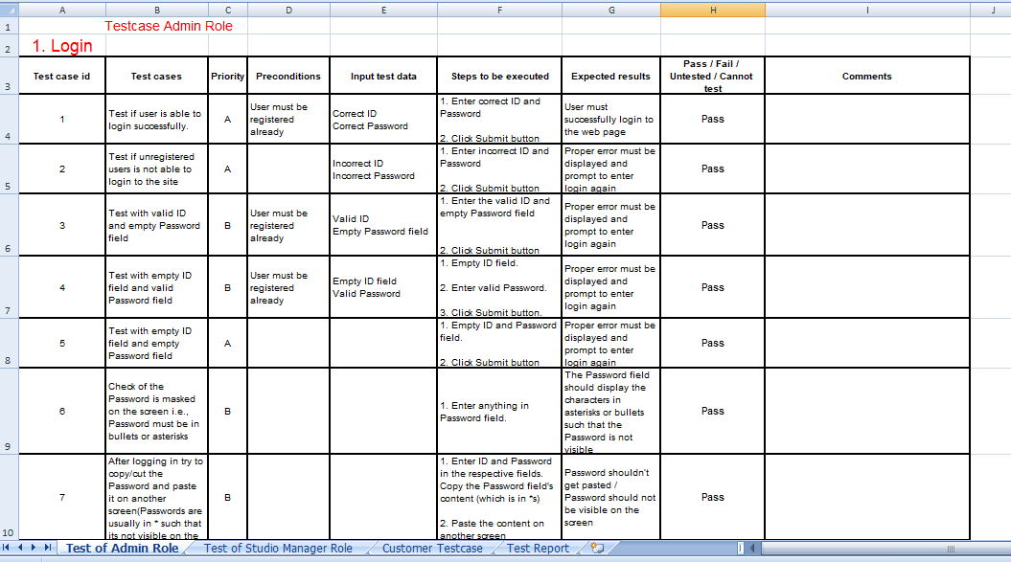
Testing
Test Case
Integration Test

Slide 6
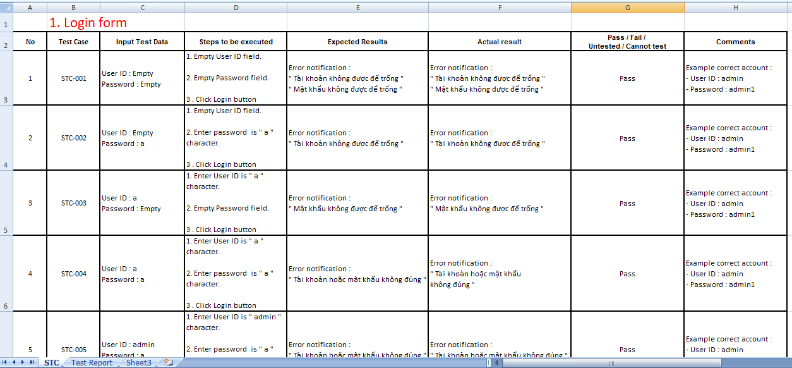
Testing
Test Case
System Test

Slide 7
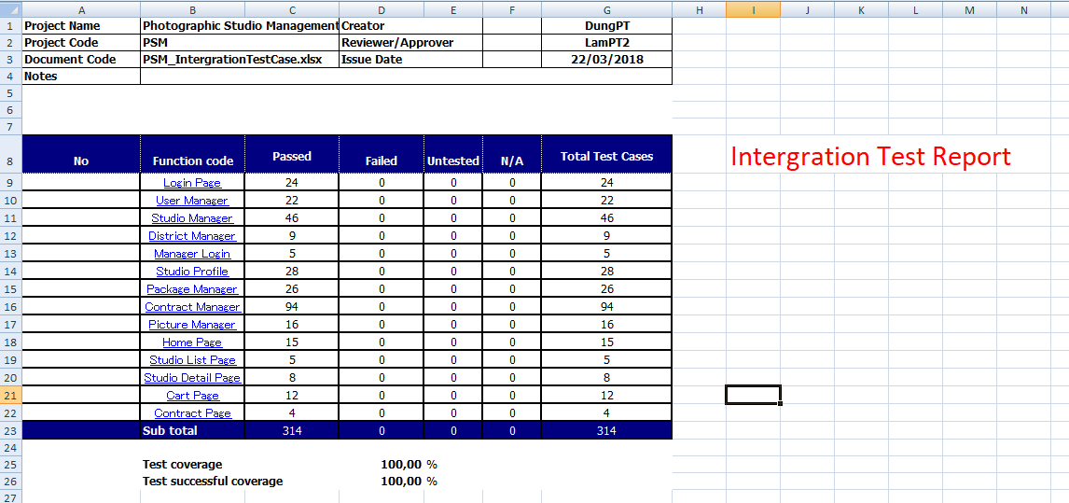
Testing
Test Report
Integration Test Report

Slide 8
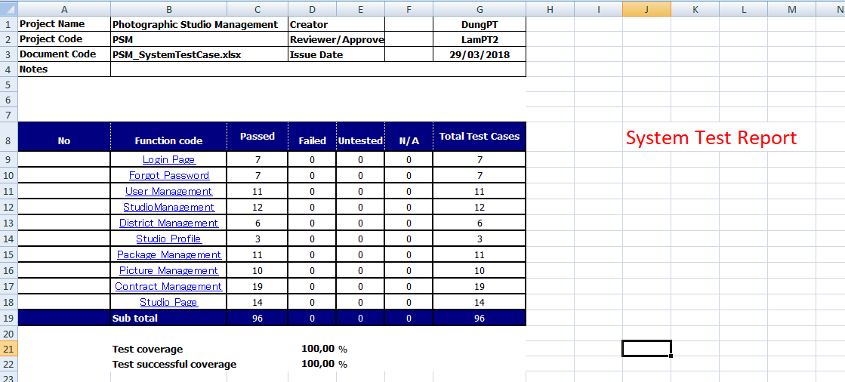
Testing
Test Report
System Test Report

