Slide 1
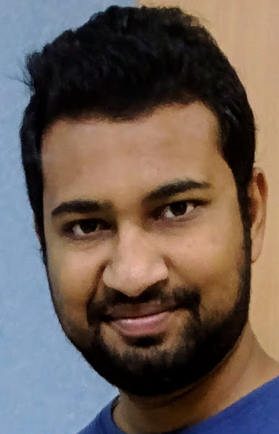
Saurabh Jain (Senior UI Developer)
Position: Senior UI Developer | Degree: Bachelors of Technology (Computer Science & Engineering)
Nationality: Indian | Language(s): English, Punjabi, Hindi
Location: Pune, India.
Personal scorecard | Over three years experience working as a professional UI Developer in IT industry. Broad exposure to a wide range of web technologies like AngularJS, Node.js, JavaScript, ES6, HTML5, CSS3, Bootstrap and Web services. Worked with established financial institutions like American Express, Royal bank of Scotland and Hong Kong and Shanghai bank corporation. Experienced in working with Agile based Software development model. Expert in developing user friendly, cross browser compatible and responsive front-end applications. A very good understanding of MVC architecture and other design patterns like Factory, Facade, Adapter and Orchestration. Excellent skills in building elegant professional websites while adhering to W3C standards. Involved in Understanding functional specifications and developing creative solutions to meet business requirements. Possess excellent communication and Problem Solving skills and the ability to work as a team member, as well as independently.
Professional experiences | Senior UI Developer with Infosys Ltd., India. Software Developer with Altruist Technologies Pvt. Ltd., India. Bachelors of Technology in Computer Science and Engineering.
Relevant project experiences | Multi Channel Appointment Booking – Hong Kong and Shanghai Bank Corporation: A classroom appointment booking application for customers of the bank. Single front-end application for end users as well as staff of the organization. As part of the scrum team, developed and delivered a cross browser responsive web application. Risk Management Platform(RMP) – Royal Bank of Scotland: The platform provides an estimation of risks involved in a transaction. A cluster of over 100 applications contributes to different aspects of transactional risks. These applications were deployed on WebSphere server version 6.1. The requirement was to upgrade the platform to support migration to WebSphere version 8.5. As a UI developer, upgraded the code base of the platform to support Java server faces version 2. Risk Decision Support System(RDSS) – American Express: RDSS is a middleware application, which provides risk and fraud related information for various American Express cards. As a part of the scrum team developed SOAP and RESTful web services. Also developed automation tools for encryption and decryption of requests and response. Developed a tool to extract logs of a particular transaction from cloud servers. Got appreciations for quick learning skills. Java e-cart - Infosys Ltd.: J-Cart is an internal e-commerce application developed and maintained by employees undergoing training and development course. The application covers all three layers of an enterprise application. As part of the team managed and fixed bugs reported from end-users of the application. Value Added Services – Vodafone: Value added services like Jobs on phone, voice chat, friends chat, sports alerts, jokes on demand and spiritual quotes provided as products to the telecom operator.

