Slide 1
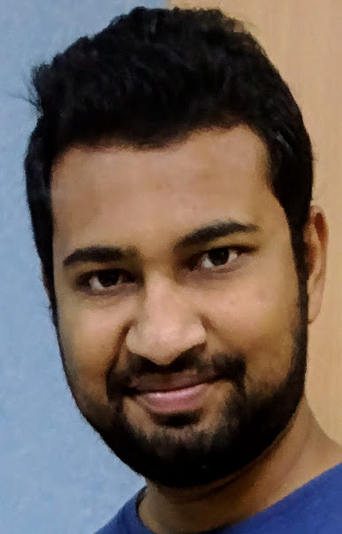
Saurabh Jain, Role: Senior UI Developer
Saurabh is an accomplished software professional expert in UI development. He has an overall experience of 4.0 years in IT industry mainly in developing web applications with AngularJS, NodeJS, HTML5, JavaScript, ES6, CSS3, Bootstrap and ExpressJS. He has also developed Restful web services using J2EE and Spring MVC. He has worked mainly on developing applications for Banks. Prior to Infosys, he has worked with Altruist technologies (experts in voice based mobile social network) and developed Interactive Voice Response products for telecom operators like TATA and Vodafone. He has a good experience of working in waterfall and Agile based development models. He has good analytic and problem solving skills.
Educational Background:
Bachelor of Technology (B.Tech)
Contact Details:
Email: saurabh_jain30@infosys.com
Mobile: 7837071512
Functional Expertise:
Ensure quality and timelines of implementation of activities related to design, build and testing.
Participated in scrum meetings, task estimation and daily calls.
Participated in writing test cases in projects.
Technologies:
Skills: AngularJS MVC framework, NodeJS, ExpressJS, HTML5, CSS3, JavaScript, ES6, Bootstrap, Gulp, J2EE, Spring MVC, Junit and Adobe Photoshop CS5.
IDE: Eclipse IDE, RAD, VS Code
Version Control: Git, SVN, TFS
Tools: Fiddler, SoapUI, Maven, Jenkins, Rally and JIRA
Servers: Apache tomcat, WAS, JBoss and nodeJS
Experience Snapshot:
MCAB - Multi channel appointment booking application for Hong Kong and Shanghai Bank Corporation. [Current Assignment]
This application facilitated customer to book a appointment with a relational manager of HSBC via mobile/tablet and desktop.
Technologies - AngularJS, HTML5, ES6, CSS3, NodeJS, Gulp, Babel and ExpressJS
As part of the scrum team, developed responsive single page application following a component based architecture.
RMP - Risk management platform for Royal Bank of Scotland
A group of 120 applications together forms the risk management platform which aids RBS to identify risks associated with transactions.
Technologies - JSP, HTML5, CSS3, J2EE, WAS 8.5 and Maven
As a developer upgrade applications to support the migration onto the upgraded server.
RDSS - Risk decision support system for American Express
This application provides risk and fraud related checks for applications hosted in different demographics.
Technologies - JSP, HTML5, J2EE, Spring MVC, SOAP and RESTful Web services, DB2 and JBoss

Slide 2
IVR - Interactive voice response products for TATA and Vodafone telecom operators
Provide value added services like Jobs on phone, caller tunes, sports updates and other voice and message based products to telecom operators.
Technologies - Voice XML, J2SE, J2EE, HTML5, MySQL, MS SQL and Apache Tomcat.
As a Junior Software developer, developed IVR applications and handled live servers and data.

