Slide 1
Neural Networks refresher: Simple NN, CNN, GAN

Slide 2
Project Goal & Motivation
Build a refresher on Deep Learning
The primary goal of this project is to build a tutorial/refresher on the utility of neural networks on image-based data and some EDA ideas.
Motivation
This course was a great learning for me and challenging at the same time since I came into this course with no experience of deep learning models. For my final project instead of solving a real-world problem, I wanted to take a step back and put together a quick tutorial/refresher on image based Deep Learning Models.
Plan
Create an online blog to hopefully help others also through their ML journey.

Slide 3
Dataset review and EDA

Slide 4
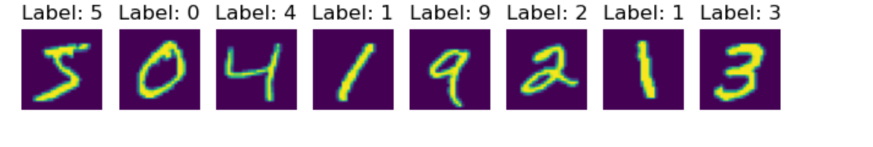
Dataset
MNIST Dataset:
It is an image classification dataset where each image is 28*28 pixel. The dataset has 70k records of handwritten digits out of which 60k are in the training dataset and 10k are in the test dataset.
Below is a sample of the dataset

Slide 5
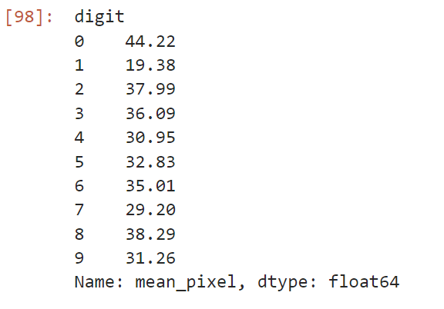
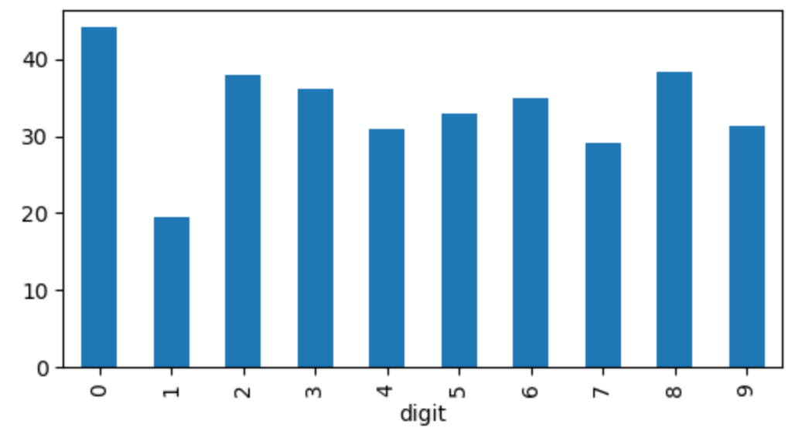
Quick analysis of the data
Mean Pixel Value by Digit

Slide 6
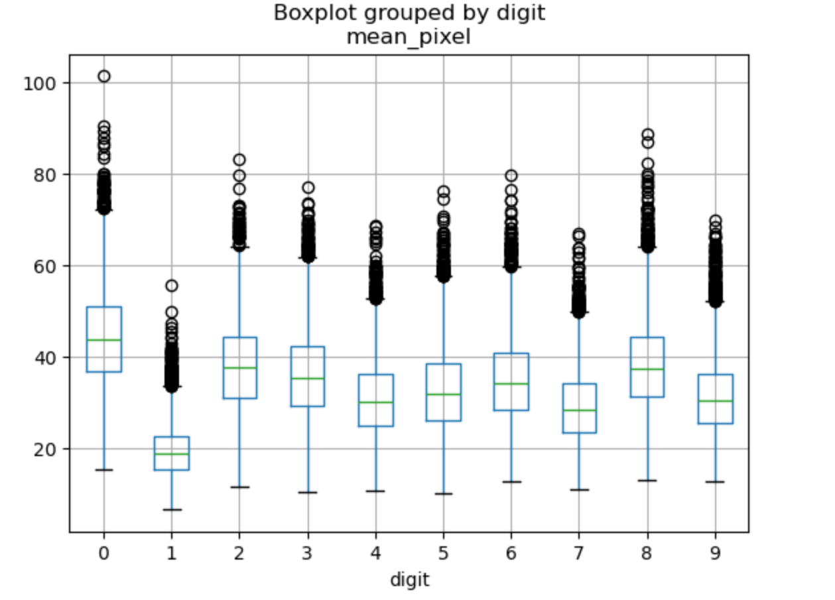



Quick analysis of the data contd.
Box Plot of mean pixel values by digit

Slide 7
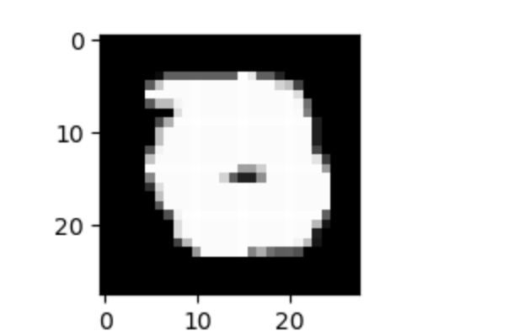
Review Outliers
0 with mean pixel value > 100

Slide 8
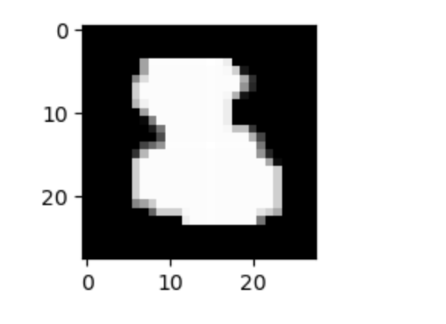
Review Outliers contd.
8 with mean pixel value > 85

Slide 9
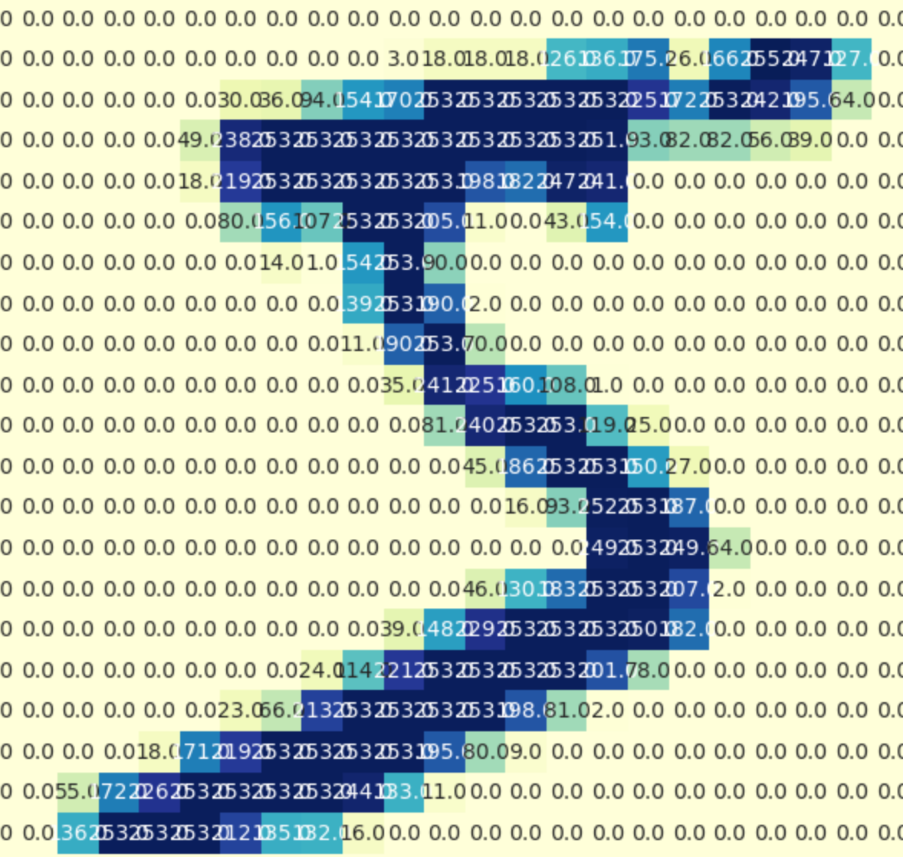
Heatmap: grid view of 5

Slide 10
Simple Neural Network

Slide 11
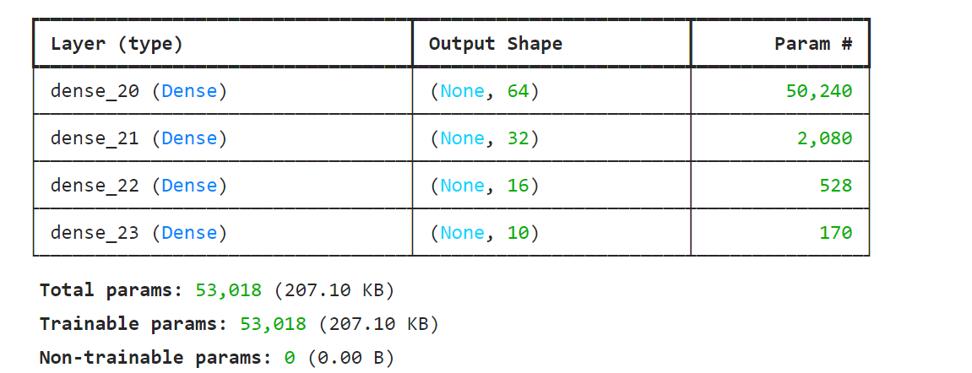
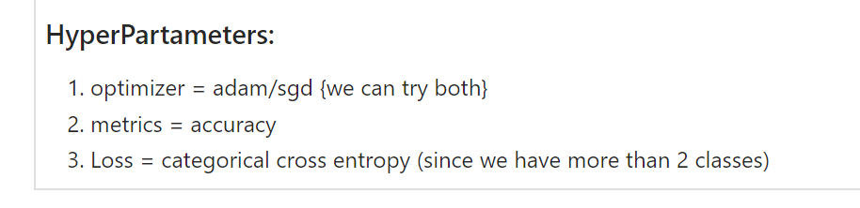
Model 1: Simple Neural Network

Slide 12
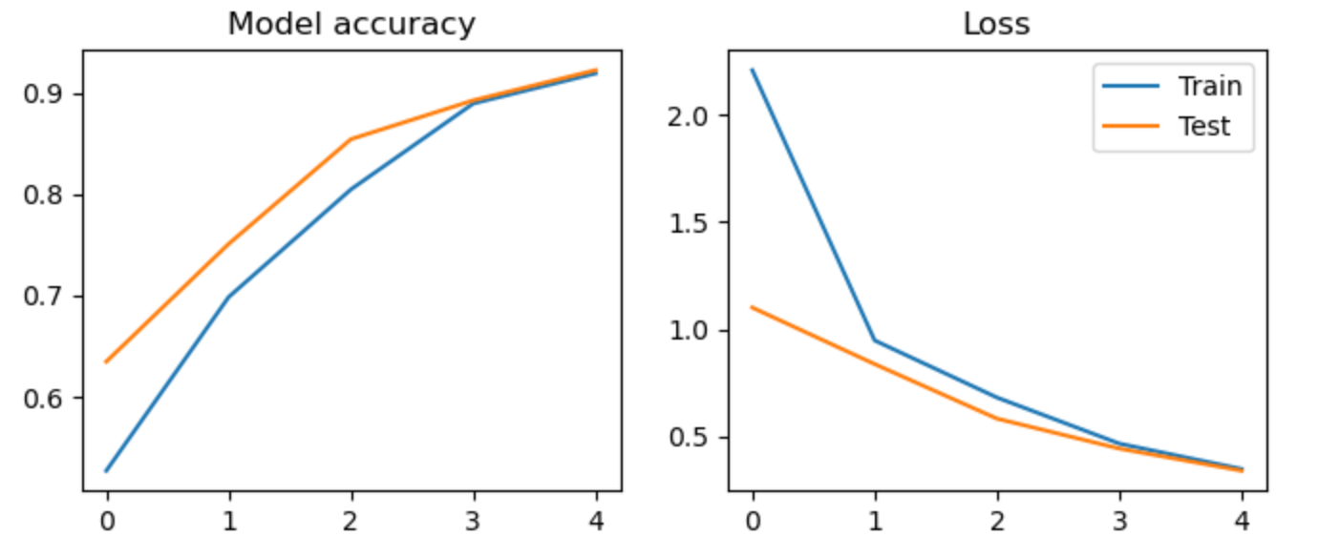
Results:

Slide 13
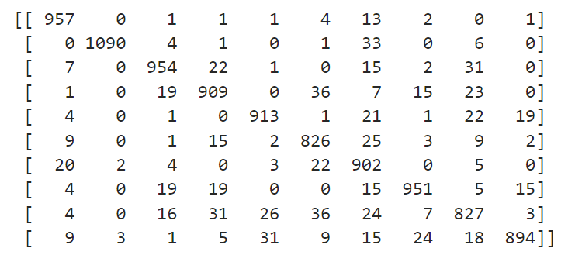





Results contd: confusion matrix

Slide 14
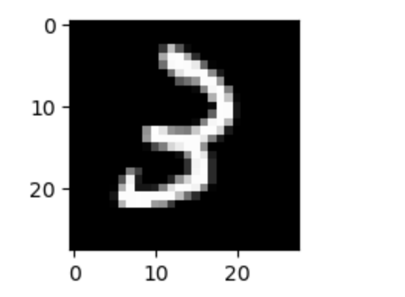
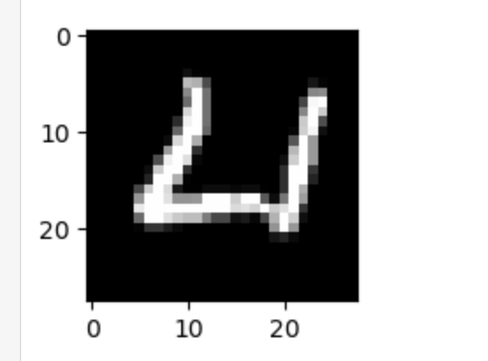
Results contd:
3 classified as 2 by the model
4 classified as 0 by the model

Slide 15
Convoluted Neural Network

Slide 16
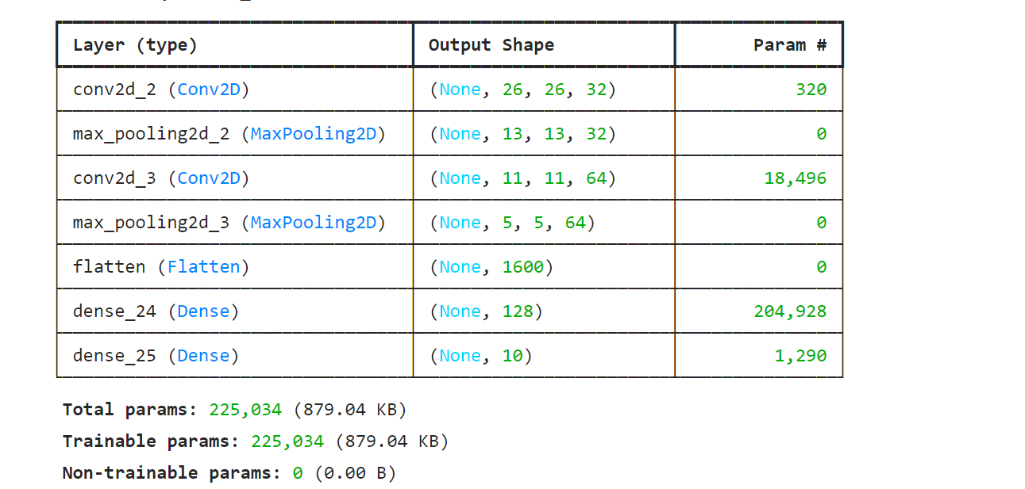
Model 2: CNN

Slide 17
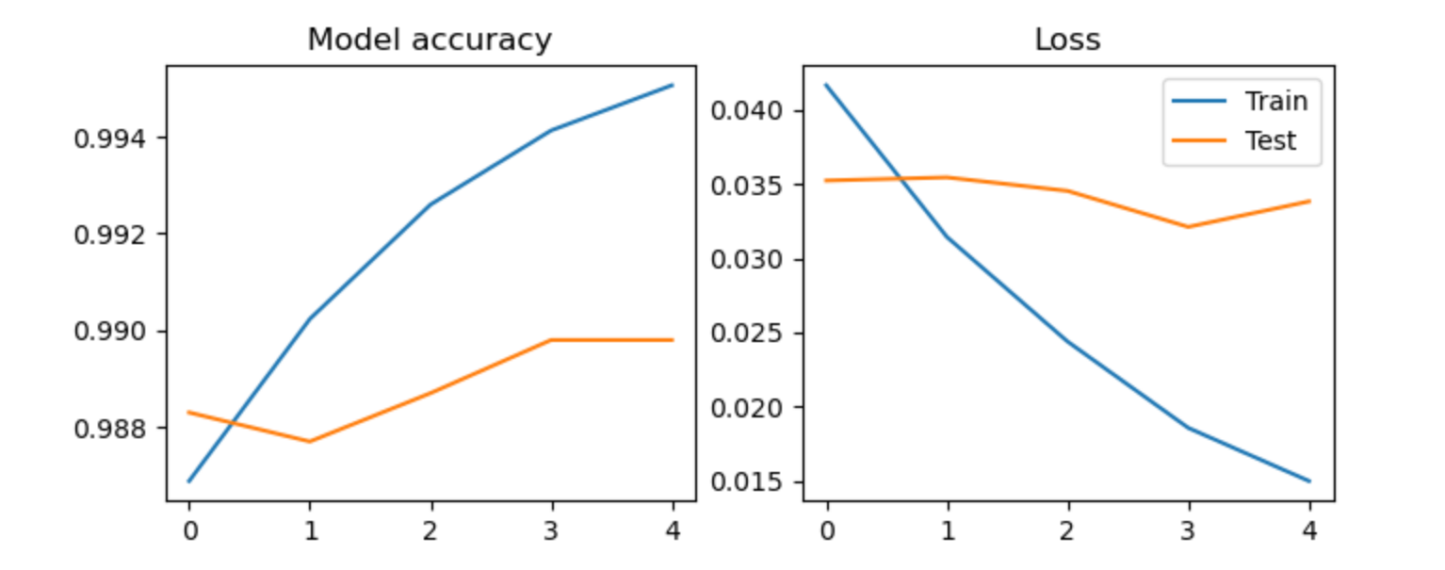
Results:
Note: Gap due to graph scaling

Slide 18
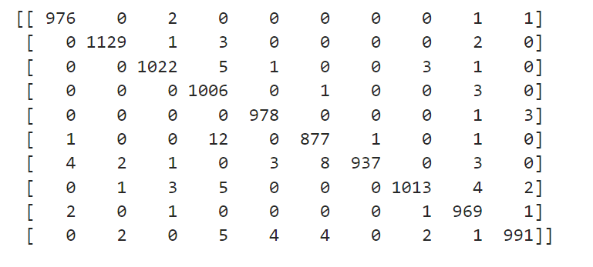
Results contd: confusion matrix

Slide 19
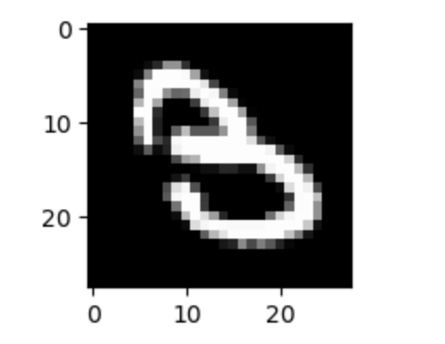
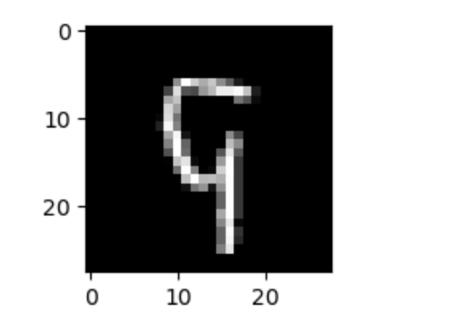
Results contd:
9 classified as 5 by the model
3 classified as 8 by the model

Slide 20
Generative Adversay Network (GAN)

Slide 21
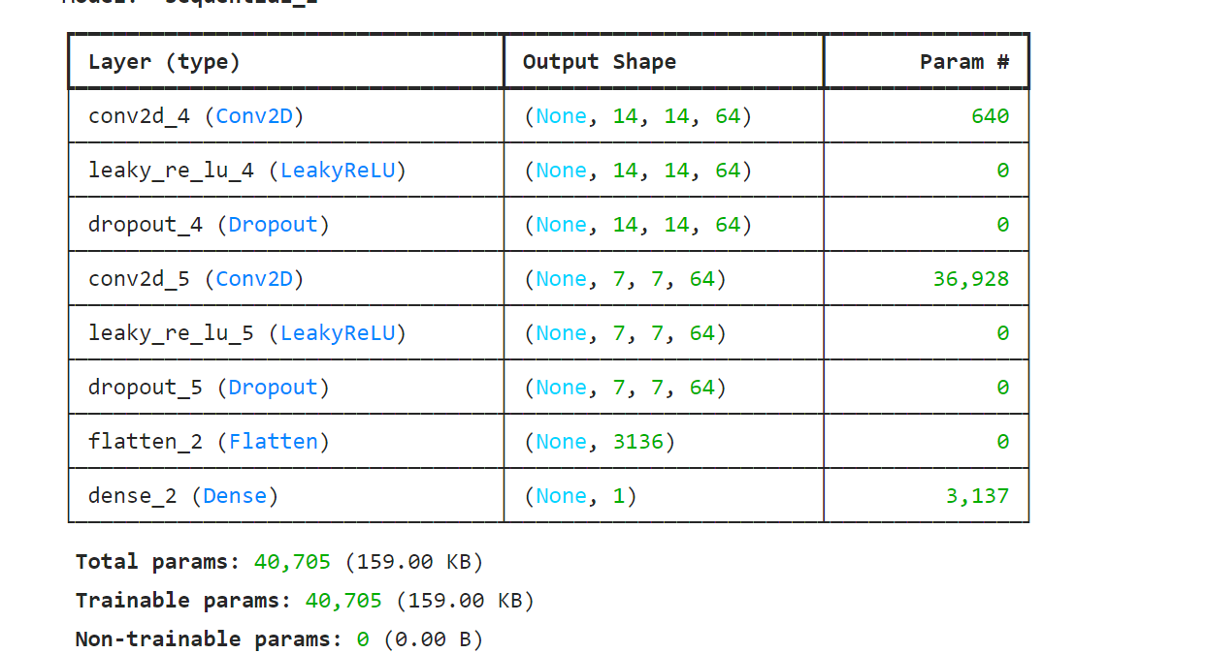
Discriminative Model

Slide 22
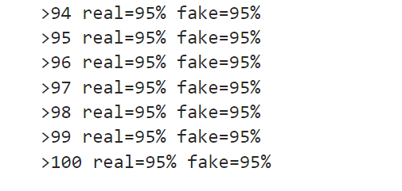
Discriminative Model Training Plan
Feed real images from the dataset labeled as 1 and fake random images labeled as 0. 100 batches of 128 real images and 128 fake images from a random image generator (since we don’t have the generator ready yet.)

Slide 23
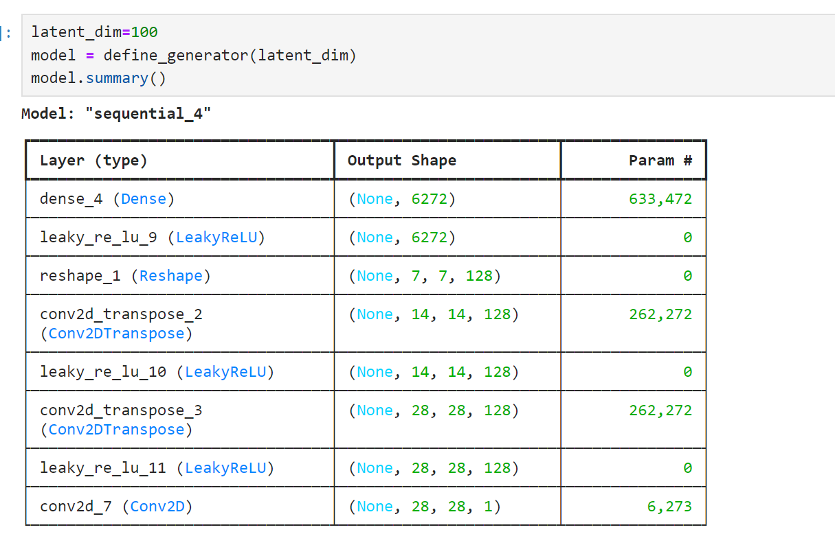
Generative Model
Input: 100 random numbers between 0 and 1
Output: scaled 28*28*1 image that will be input for the generator

Slide 24
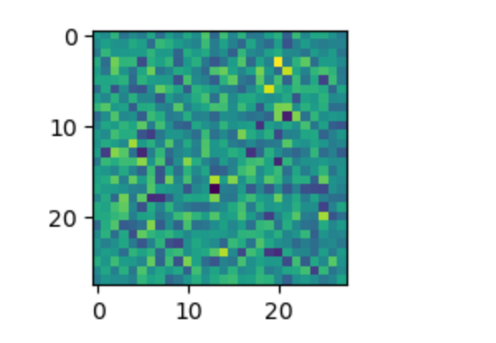
Generative Model: 1st images
Feed into the already trained discriminator model to classify as real or fake.
Binary loss function to modify weights for gradient descent.

Slide 25
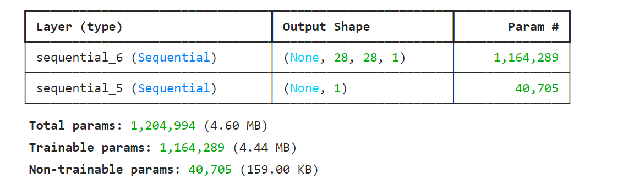
GAN Model

Slide 26
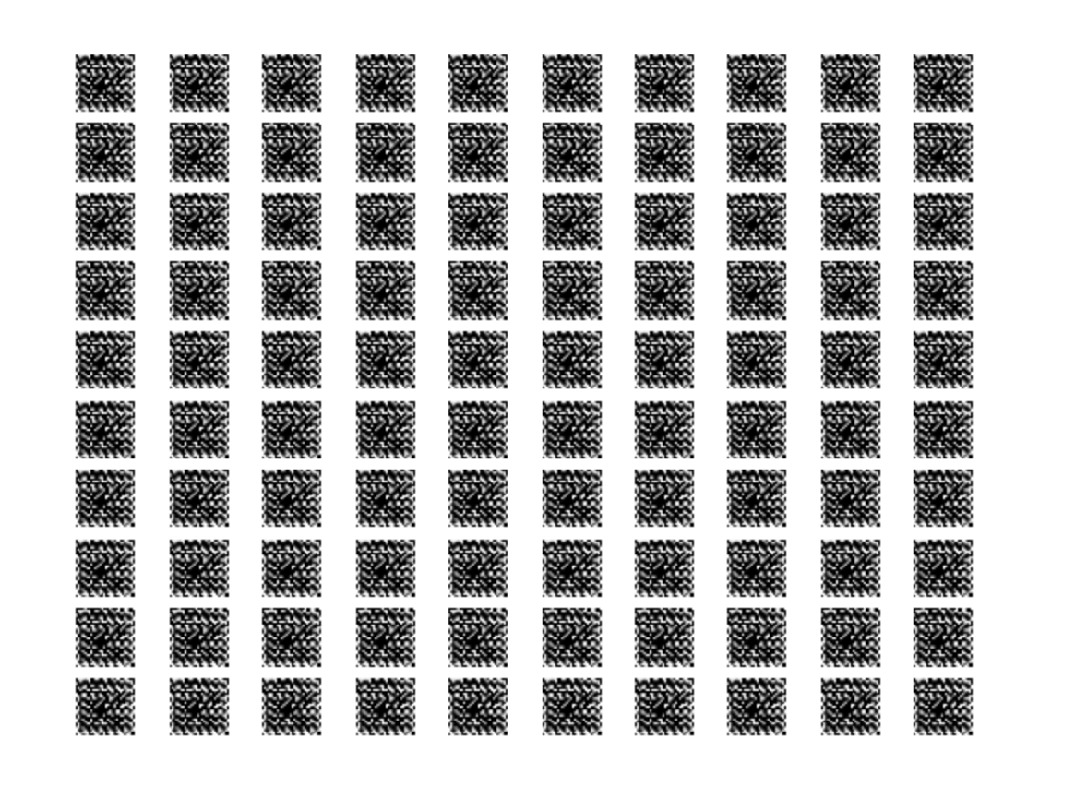
Images generated after 3 epochs

Slide 27
Summary and Conclusion

Slide 28
Summary and future work
Summary
In this project I took a stab at building a walk thru on 3 Neural Networks used for image based deep learning tasks: Simple NN, CNN and GAN. I kept the architecture simple and consistent for all the models and we could see the usage of different models.
Future Work
Neural Nets and CNN: Experiment with different datasets and different architectures/optimizers to see what works better for which tasks.
GAN: Train the GAN model with more epochs & build strategy for initial weights (ex: borrow from a model that classifies an image as a number from 0 – 9). “ Get more computing power”

