Slide 1
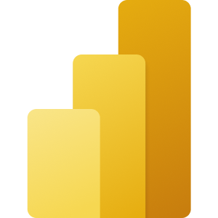
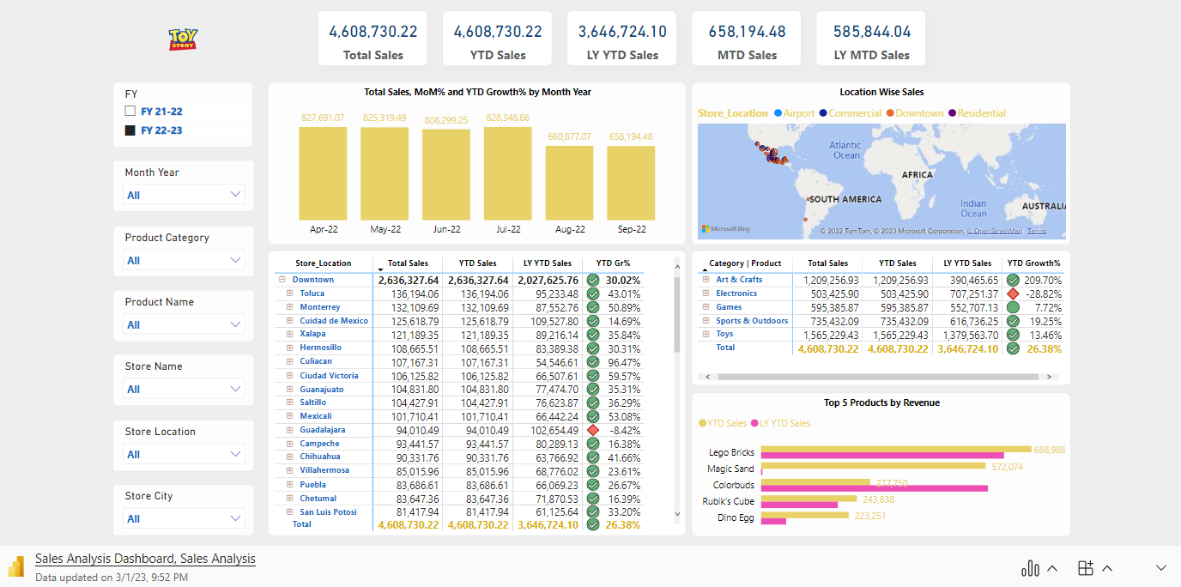
Microsoft Power BI: Toy Story Sales Dashboard

