Slide 1
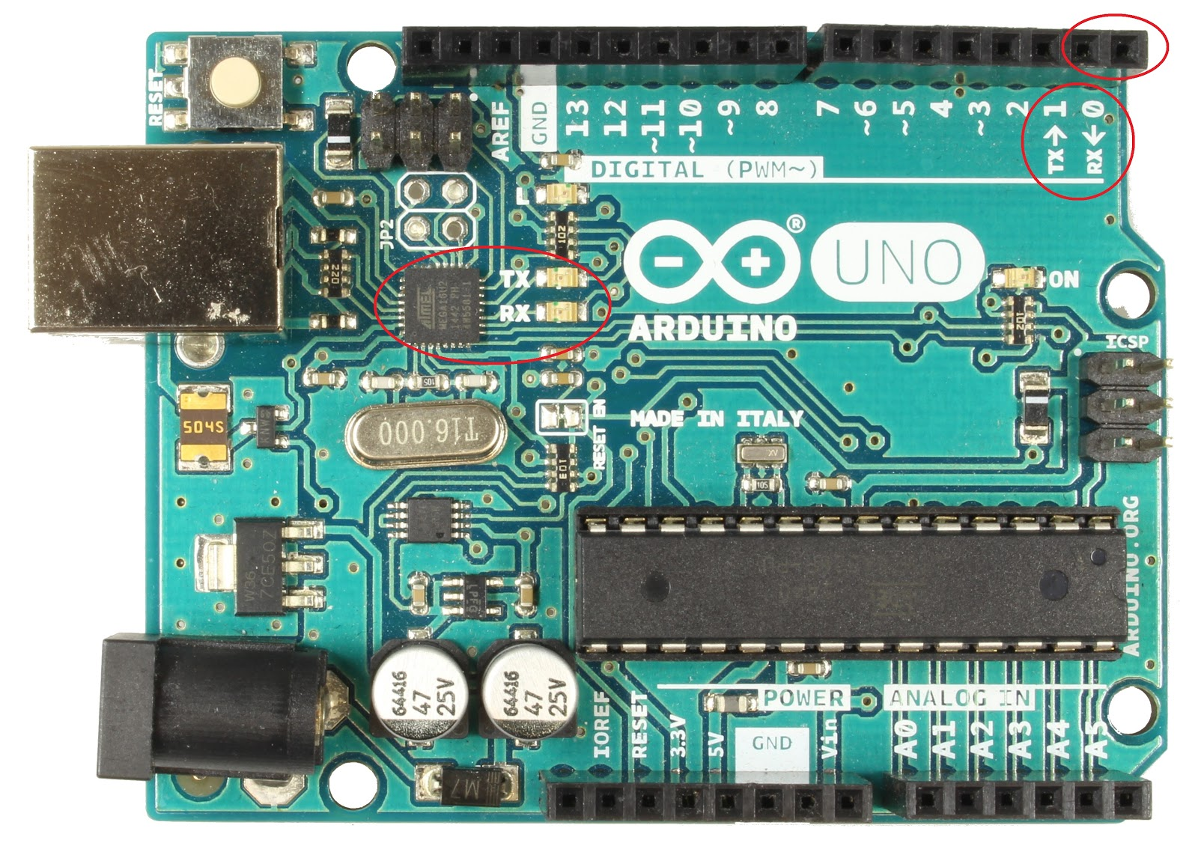
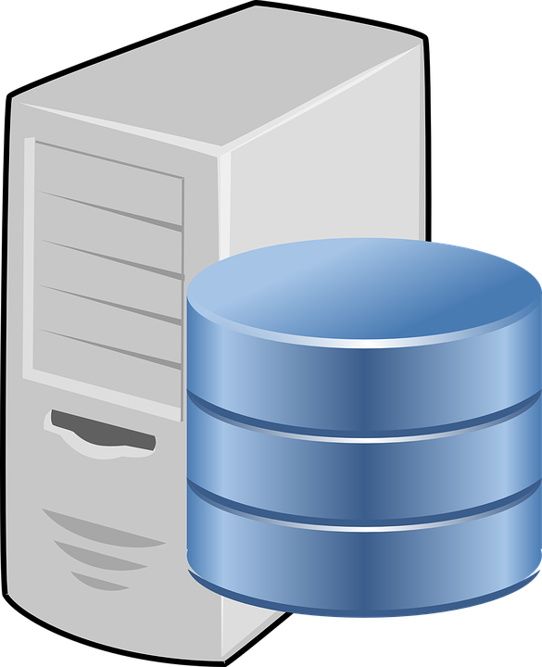
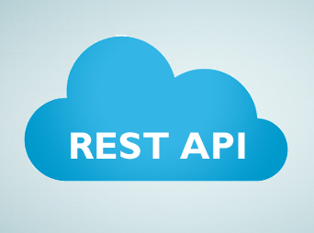
For Insert Data To Database
API Insert Data to Database
Send Data to API
Arduino1 and Sensor
For Get Data From Database
Request Data From API
API Get Data from Database
Arduino2
Send Data to Arduino
Response Data to API

