Slide 1
* WAN= A Collection of LANs
대전지사
서울본사
(KT, LG U+, SKB)
광주지사
Notes:
SP : Service Provider

Slide 2
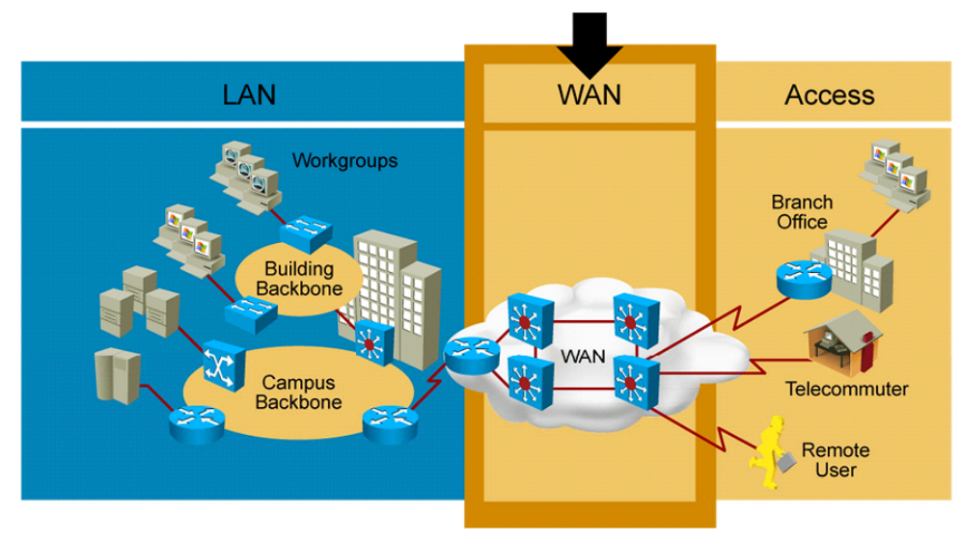

Slide 3
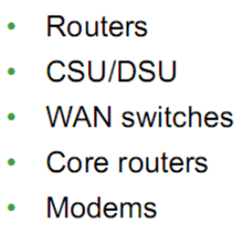
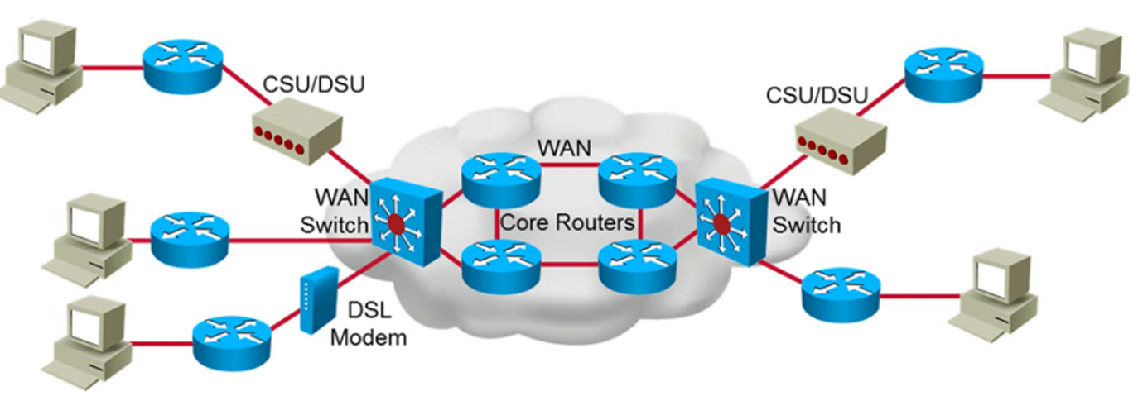
WAN Devices

Slide 4
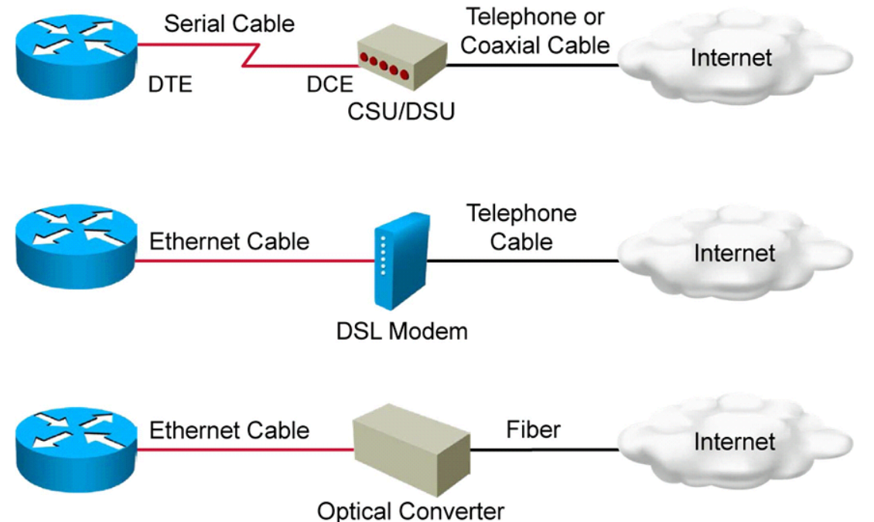
WAN Devices

Slide 5
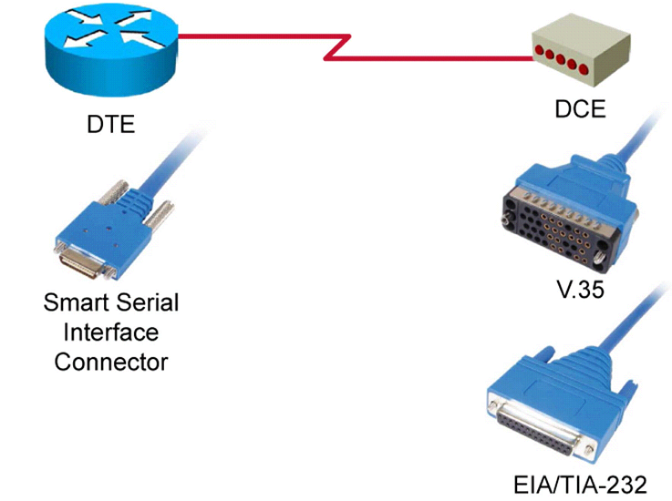
WAN Serial Cable

Slide 6
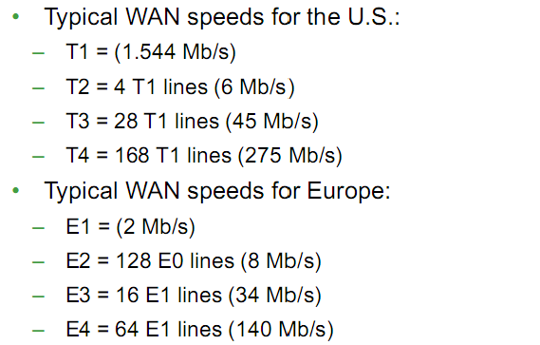
Serial Communication Links

Slide 7
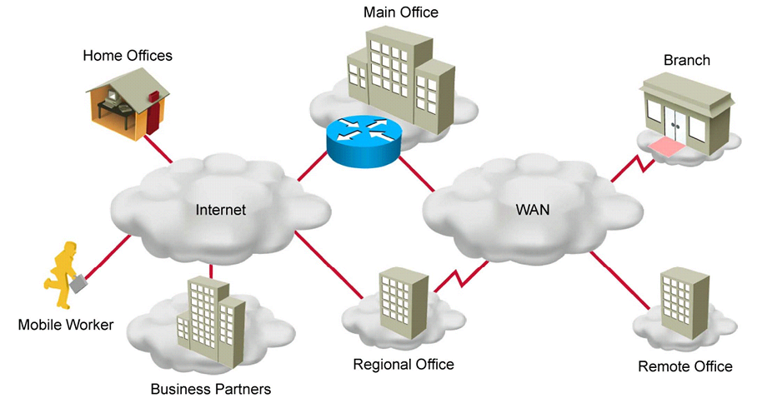
Internet & WAN
WAN= A Collection of LANs

Slide 8
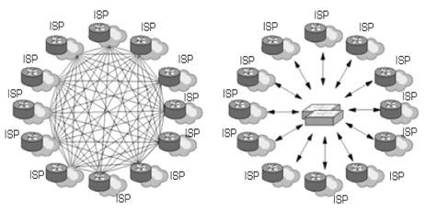
IX(Internet eXchange)
IX
IX(Internet eXchange) –인터넷 트래픽을 상호 교환 시켜주는 역할 수행

Slide 9
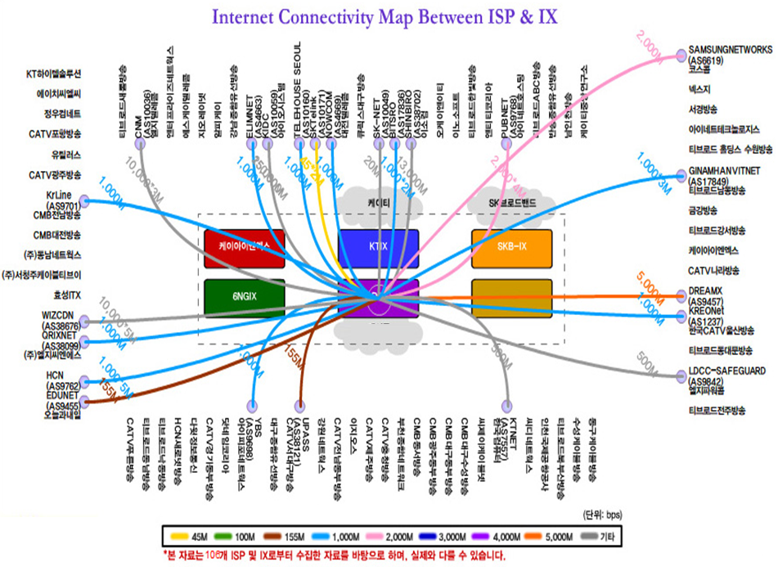
LG U+

Slide 10
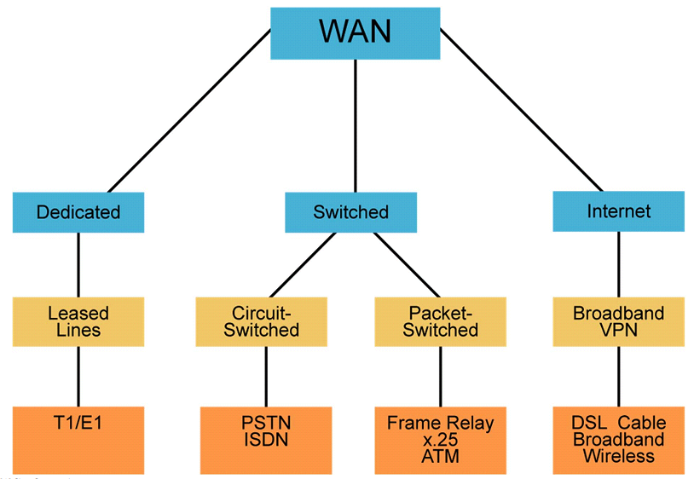
WAN(Wide Area Network) 구축 형태

Slide 11
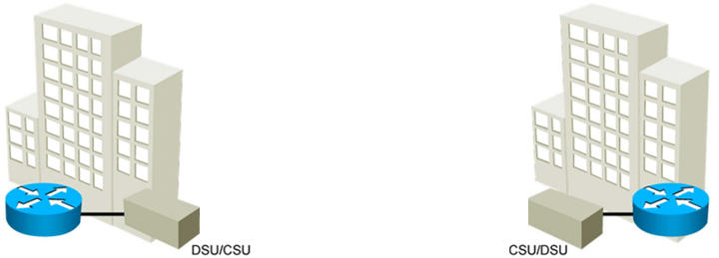
Dedicated(Leased lines)

Slide 12
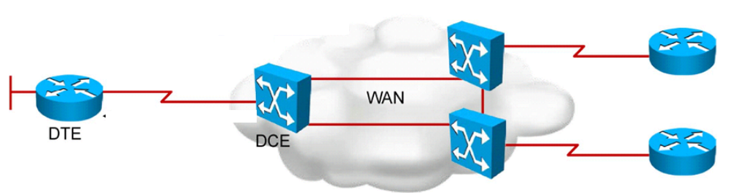
Switched

Slide 13
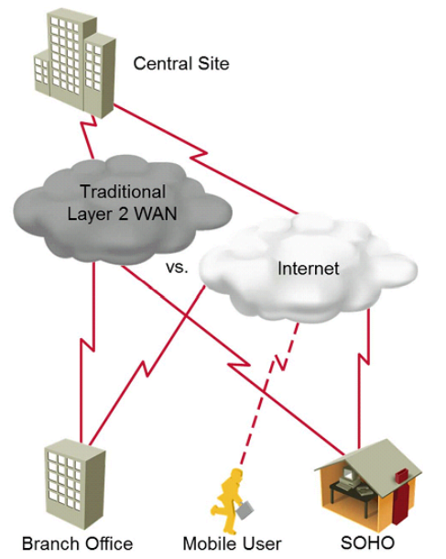
Internet

Slide 14
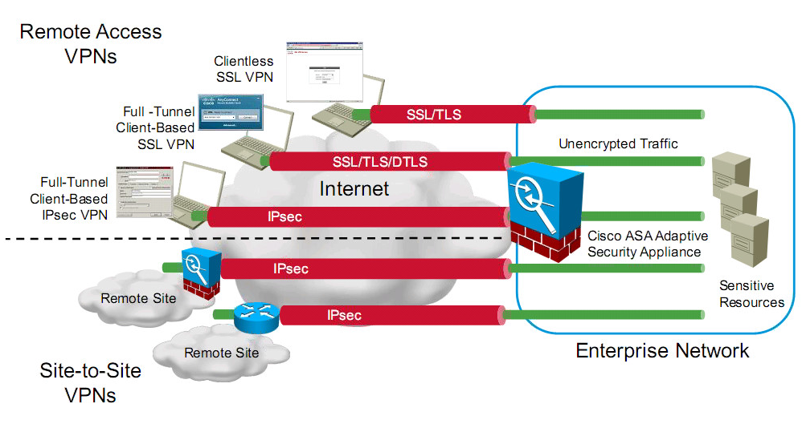
Virtual Private Networks (VPNs)

