Slide 1
NAT 기능
네트워크 주소 변환 (Network Address Translation)
송신지 또는 수신지 IP address를 다른 주소로 변환
Source NAT(SNAT)와 Destination NAT(DNAT)
송신지 IP
수신지 IP
송신지 IP
수신지 IP
192.168.1.10 | 200.10.10.10
192.168.1.10 | 200.10.10.10
❶ SNAT
❷ DNAT
172.16.1.10 | 200.10.10.10
192.168.1.10 | 10.10.10.10
Notes:
변환하는 주소 필드가 무엇이냐에 따라 SNAT와 DNAT로 분류
- SNAT는 송신지IP 필드에 주소를 다른 주소로 변환
- DNAT는 수신지 IP 필드에 주소를 다른 주소으로 변환

Slide 2
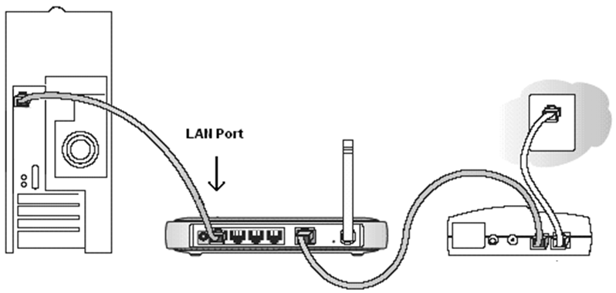
SoHo(Small office/home office)에서의 NAT
공유기 기능
패킷 전달
DHCP
NAT
❶ 컴퓨터
❷ 유/무선 공유기
❸ 모뎀
Notes:
2

Slide 3
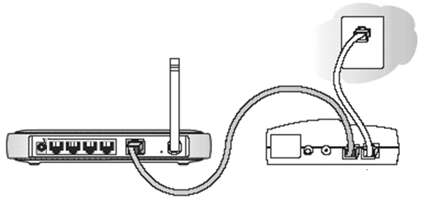
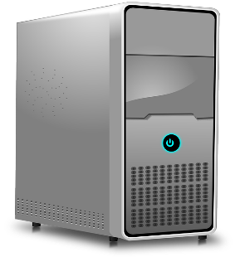
Internet
DHCP
사설망
www.test.com
200.10.10.10
192.168.1.30
192.168.1.10
192.168.1.20

Slide 4
Internet
NAT 테이블
변환 전 | 변환 후
192.168.1.10 | 30.1.120.8
192.168.1.20
192.168.1.30
30.1.120.8 | 200.10.10.10
NAT
송신지IP(B) 수신지 IP
송신지IP(A) 수신지 IP
192.168.1.30 | 200.10.10.10
www.test.com
200.10.10.10
192.168.1.30
192.168.1.10
192.168.1.20
사설망
사설 IP 주소를 공인 IP 주소로 변환
Notes:
192.168.1.30이라는 사설IP주소는 30.1.120.8이라는 공인IP로 변환하여 웹서버에 서비스를 받게 된다.

Slide 5
Source NAT
NAT Table
수Port 송Port 수IP 송IP
192.168.1.10 → 11.11.11.11
80 | 50030 | 22.22.22.22 | 11.11.11.11
NAT
ROUTER
ROUTER
192.168.1.10/24
22.22.22.22/24
80 | 50030 | 22.22.22.22 | 192.168.1.10
수Port 송Port 수IP 송IP
NAT
ROUTER
ROUTER
NAT
192.168.1.10/24
192.168.2.20/24

Slide 6
NAT Table
22.22.22.22 → 192.168.2.20
NAT
ROUTER
ROUTER
NAT
192.168.1.10/24
192.168.2.20/24
Destination NAT
NAT Table
NAT Table
192.168.1.10 → 11.11.11.11
22.22.22.22 → 192.168.2.20
NAT
ROUTER
ROUTER
NAT
192.168.1.10/24
192.168.2.20/24
80 | 50030 | 22.22.22.22 | 11.11.11.11
80 | 50030 | 192.168.2.20 | 11.11.11.11
수Port 송Port 수IP 송IP
수Port 송Port 수IP 송IP

Slide 7
NAT Port Mapping (Port Forwarding)
NAT Table
NAT Table(Port Mapping)
192.168.1.10 → 11.11.11.11
80 → 192.168.2.20 : 443
NAT
ROUTER
ROUTER
NAT
192.168.1.10/24
192.168.2.20:443
80 | 50030 | 22.22.22.22 | 11.11.11.11
443 | 50030 | 192.168.2.20 | 11.11.11.11
수Port 송Port 수IP 송IP
수Port 송Port 수IP 송IP

Slide 8
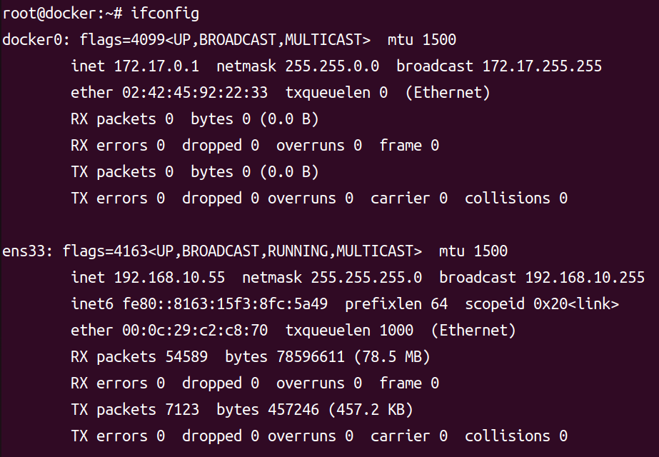



Docker0 Bridge Network
Bridge
Docker0
172.17.0.1/16
192.168.10.55/24

Slide 9
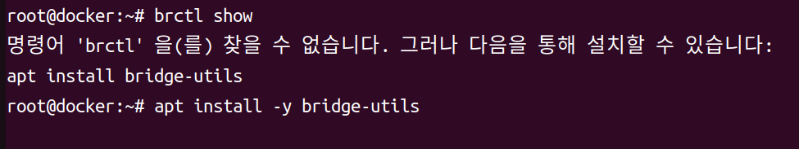
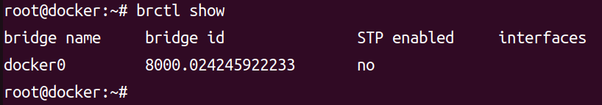
brctl 설치와 확인
* brctl : 이더넷 브리지 관리 도구
#apt install –y bridge-utils
#dpkb -1 | grep bridge-utils
#brctl show
Bridge
Docker0
Bridge ID :8000.024245922233

Slide 10
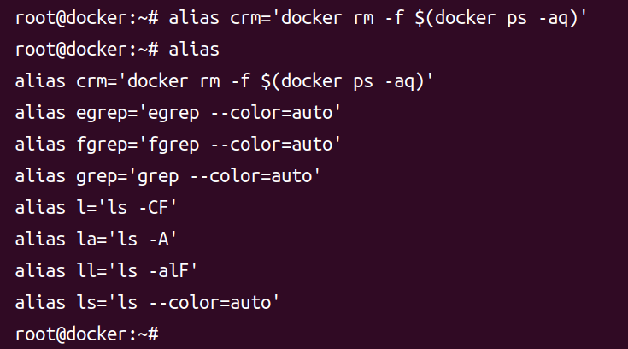
Alias 등록
#alias drm=‘docker rm –f $(docker ps –aq)’
#alias

Slide 11
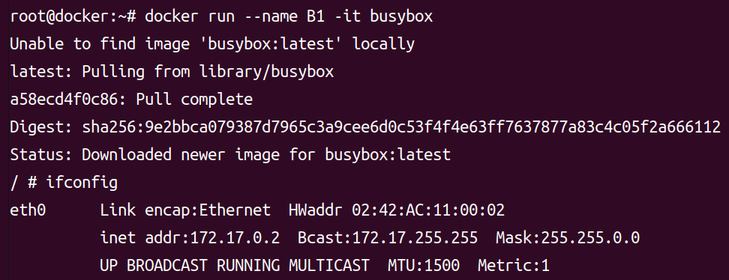
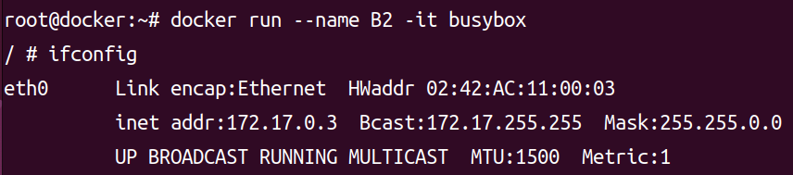
LAB 1.
#docker run -name B1 -it busybox
#ifconfig
B1
B2
172.17.0.2/16
172.17.0.3/16
Bridge
Docker0
172.17.0.1/16
#docker run -name B2 -it busybox
#ifconfig

Slide 12
#docker run -name B1 -it busybox
#ifconfig
B1
B2
172.17.0.2/16
172.17.0.3/16
Bridge
Docker0
172.17.0.1/16
#docker run -name B2 -it busybox
#ifconfig

Slide 13
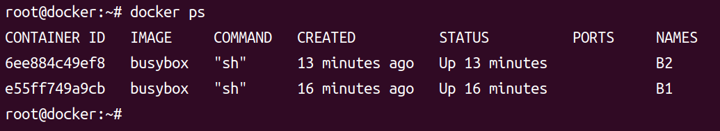
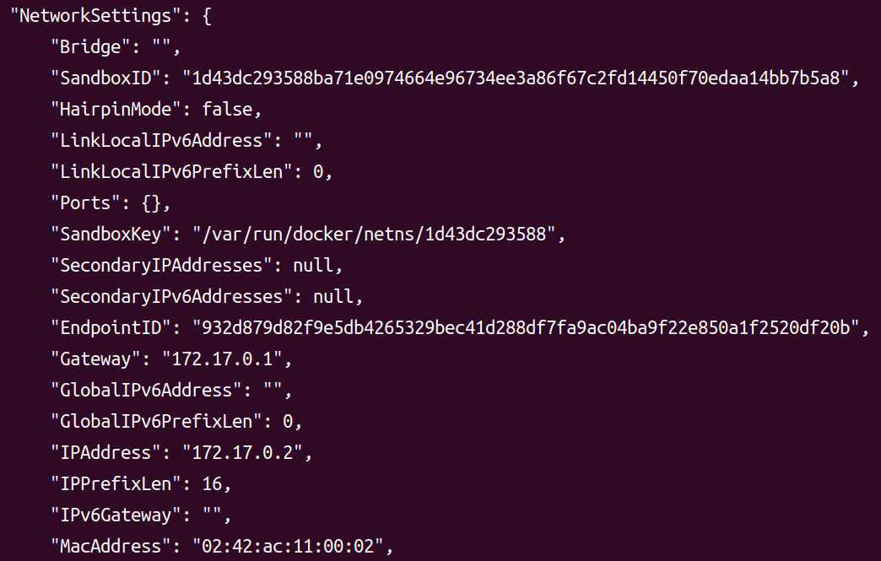
#docker ps
#docker inspect B1

Slide 14
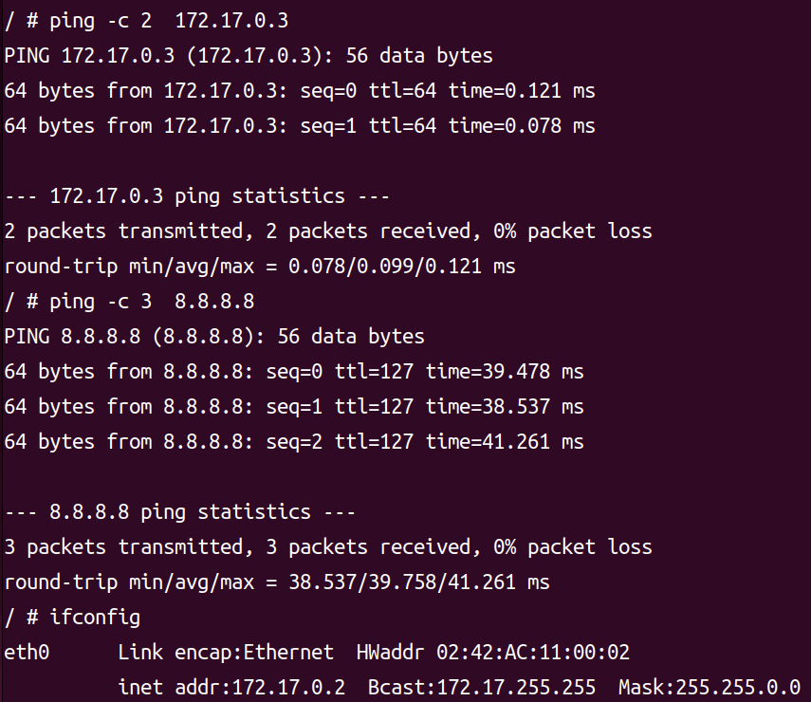
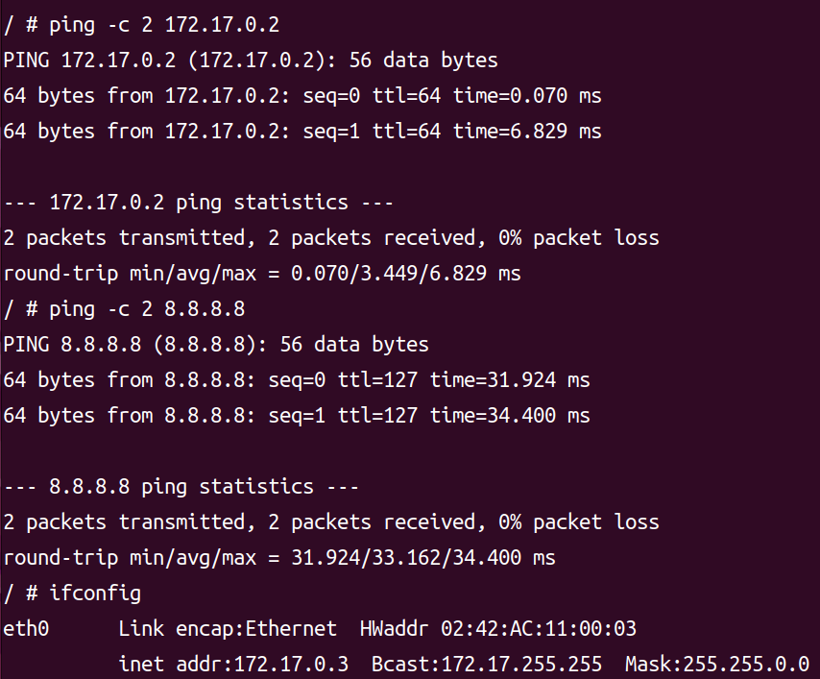
#ifconfig
#ping –c 2 172.17.0.3
#ping –c 2 8.8.8.8
#ifconfig
#ping –c 2 172.17.0.2
#ping –c 2 8.8.8.8

Slide 15
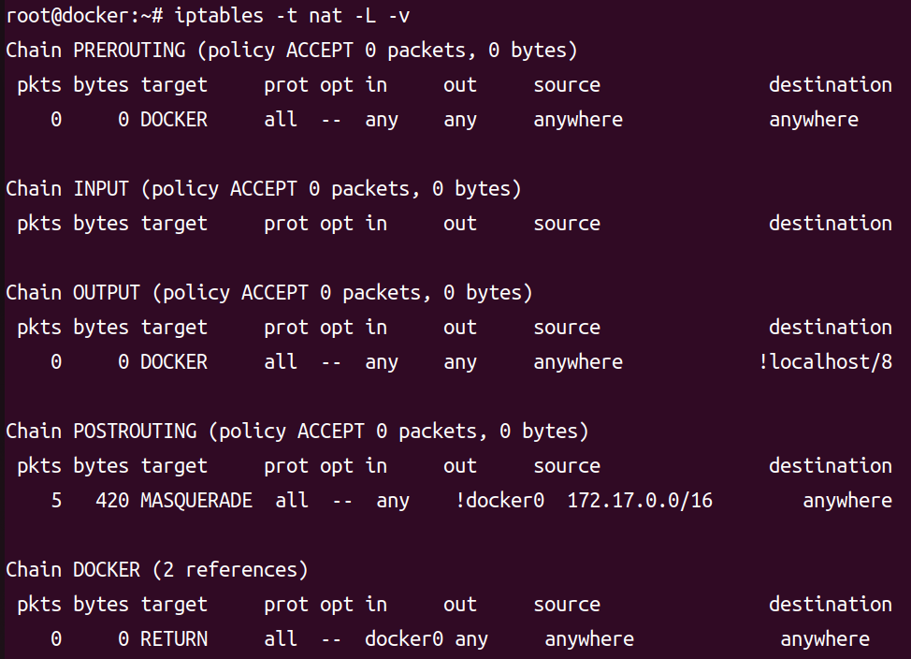
NAT 설정 확인
B1
B2
#iptables -t nat -L -v
172.17.0.2/16
Bridge
Docker0
172.17.0.1/16
NAT Setting

Slide 16
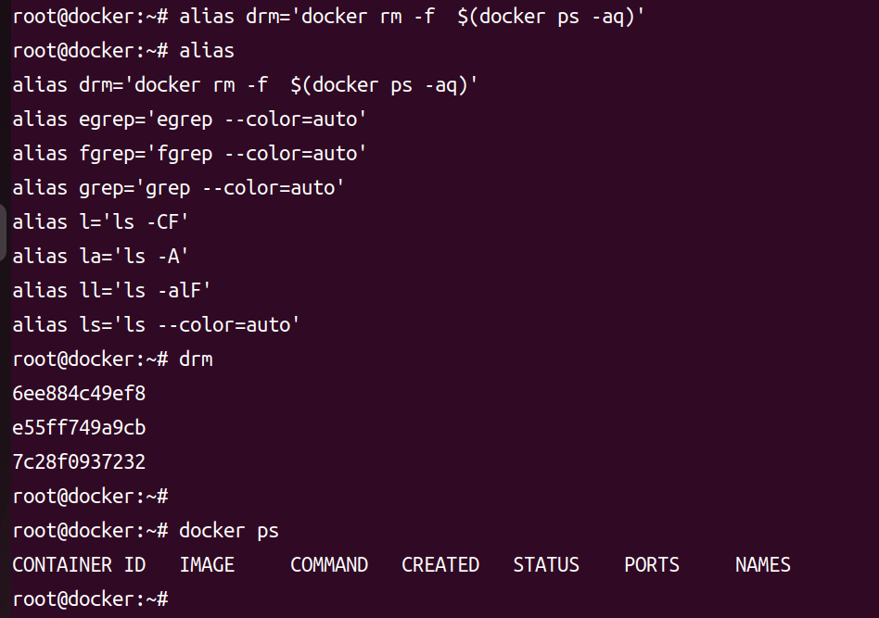
Alias 등록과 Docker container 일괄 삭제
#alias drm=‘docker rm –f $(docker ps –aq)’
#alias
#drm
#docker ps

Slide 17
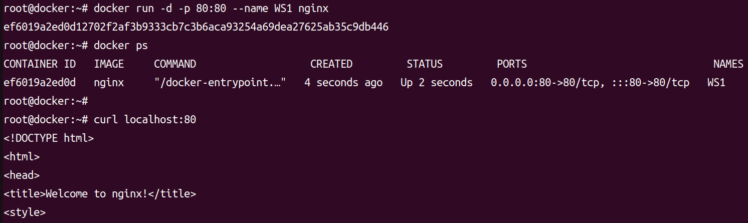
LAB 2. Port forwarding (1)
#docker run –d –p 80:80 –name WS1 nginx
#docker ps
#curl 172.17.0.2
# curl localhost :80
Nginx
172.17.0.2:80
172.17.0.2/16
Bridge
Docker0
172.17.0.1/16
192.168.10.55/24
192.168.10.55:80

Slide 18
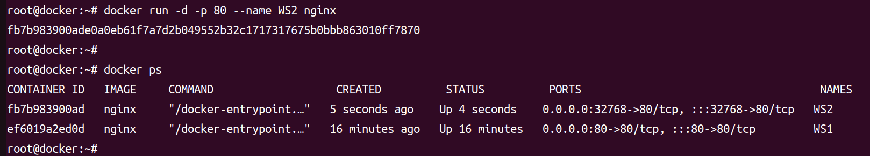
LAB 2. Port forwarding (2)
172.17.0.2:80
172.17.0.3:80
Nginx
Nginx
#docker run –d –p 80 –name WS2 nginx
#docker ps
#curl 172.17.0.3
#curl localhost :80
172.17.0.2/16
172.17.0.3/16
Bridge
Docker0
172.17.0.1/16
192.168.10.55/24
192.168.10.55:80
192.168.10.55:32768

Slide 19
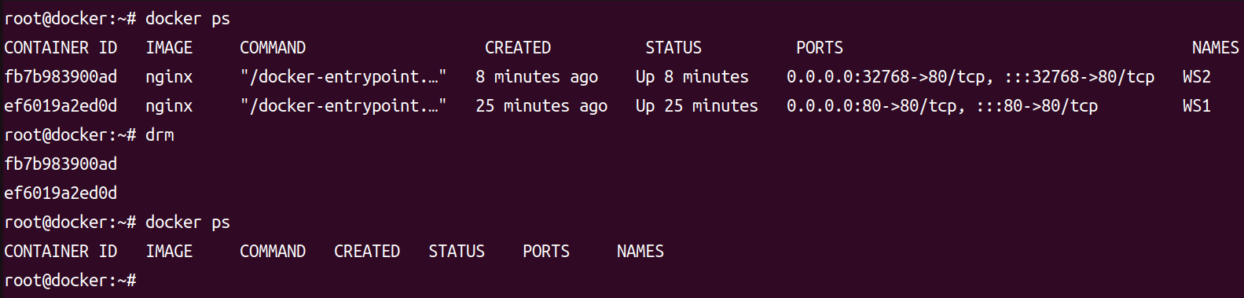
Docker container 일괄 삭제
#drm
#docker ps

Slide 20
LAB 3. User-Defined Bride Network
B1
B2
172.17.0.2/16
172.17.0.3/16
192.168.20.X/24
192.168.20.20/24
Bridge
Bridge
Docker0
INFOnet
172.17.0.1/16
192.168.20.0/24
192.168.10.55/24

Slide 21
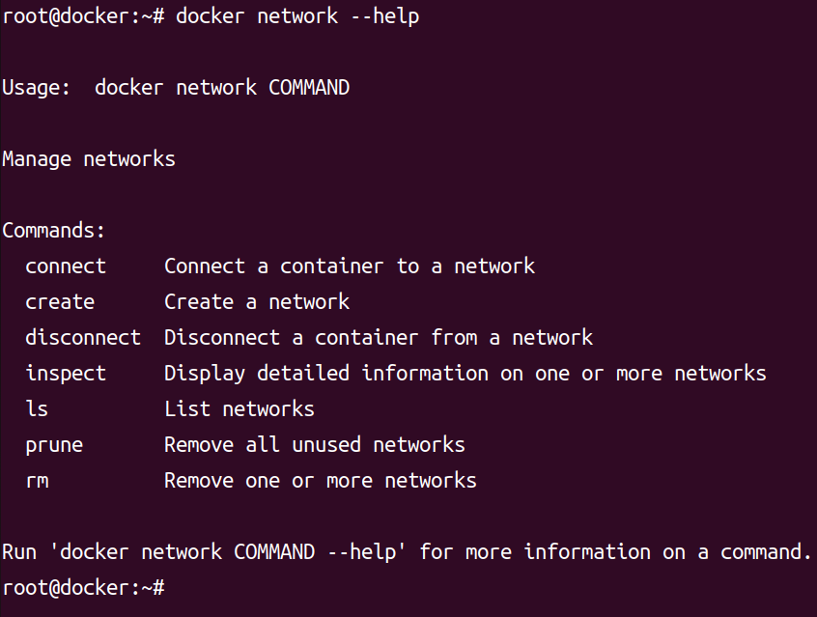
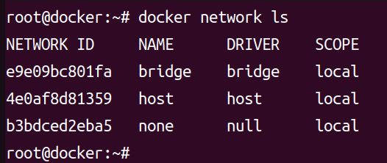
#docker network ls

Slide 22
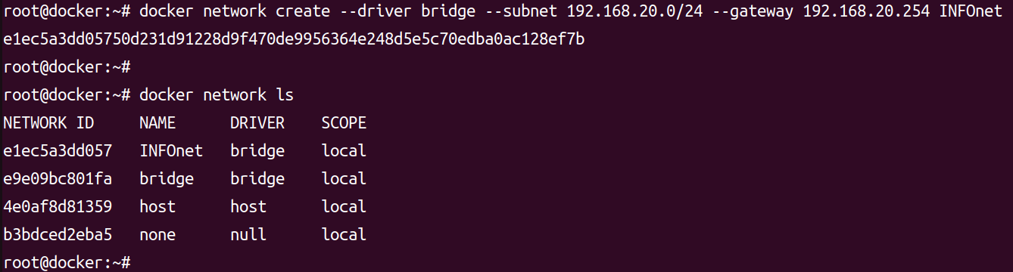
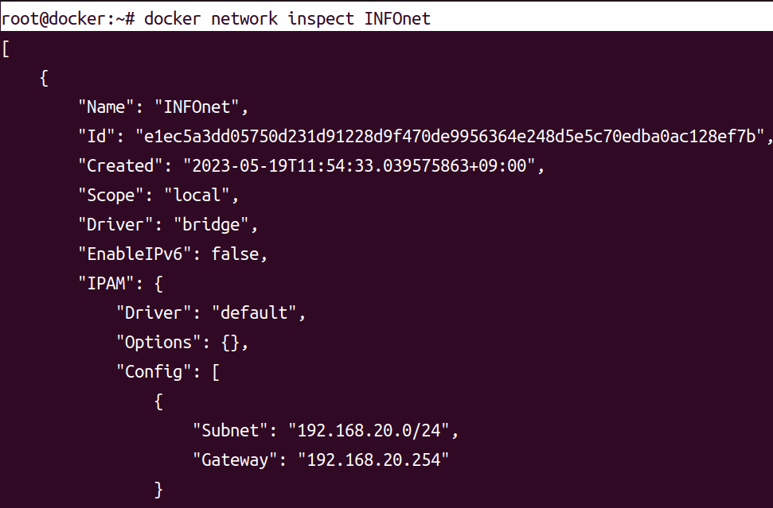
#docker network create --deriver bridge --subnet 192.168.20.0/24 --gateway 192.168.20.254 INFOnet
#docker network inspect INFOnet

Slide 23
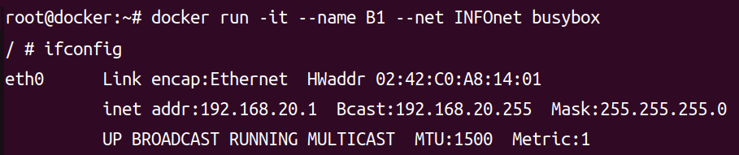
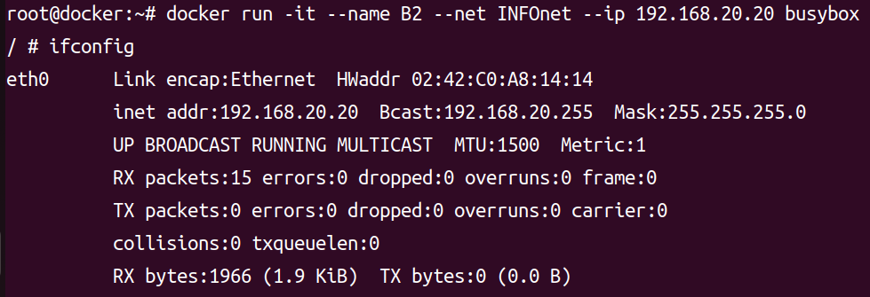
#docker run -it --name B1 --net INFOnet busybox
#ifconfig
#docker run -it --name B2 --net INFOnet --ip 192.168.20.10 busybox
#ifconfig

Slide 24
B1
B2
192.168.20.1/24
192.168.20.20/24
Bridge
Bridge
Docker0
INFOnet
172.17.0.1/16
192.168.20.0/24
192.168.10.55/24

Slide 25
LAB 4. Container 사이의 통신
Word
press
mysql
/var/lib/mysql
172.17.0.2/16
172.17.0.3/16
Bridge
Docker0
172.17.0.1/16
192.168.10.55/24
/dbdata

Slide 26
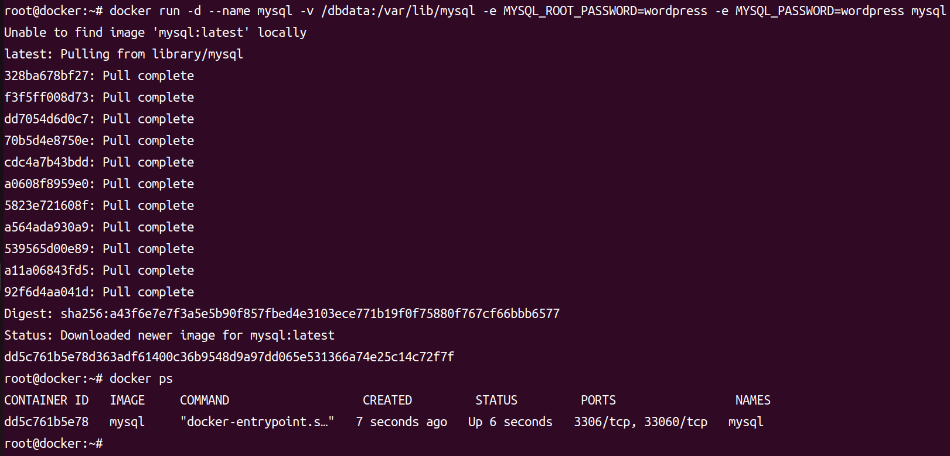
#docker run -d --name mysql -v /dbdata:/var/lib/mysql -e MYSQL_ROOT_PASSWORD=wordpress
-e MYSQL_PASSWORD=wordpress mysql:5.7
#docker ps
#ls /dbdata

Slide 27
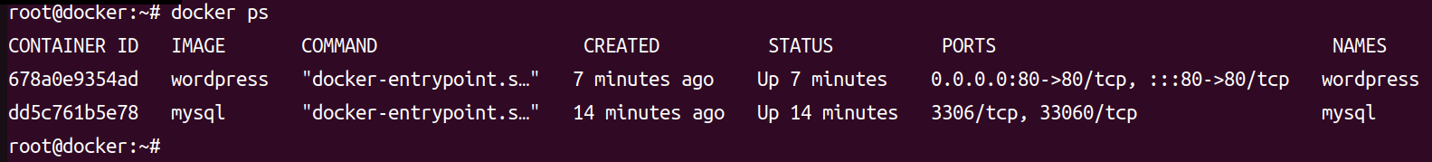
#docker run -d --name wordpress --link mysql:DBmysq -e WORDPRESS_DB_PASSWORD=wordpress
-p 80:80 wordpress:4
#docker ps

