Slide 1


Build
#include <stdio.h>
int main(void)
{
printf("Hello, World/n");
}
1100 1000101110
010111101110111
010111101111010
Compiler
Linker
hello.exe
hello.obj
hello.c
Hello, World
hello.exe
hello.exe
RAM+CPU

Slide 2

print("Hello, World/n");
hello.py
hello.py
Interpreter
Hello, World
hello.py
0010 110010
11101010111
Virtual execute
RAM+CPU

Slide 3
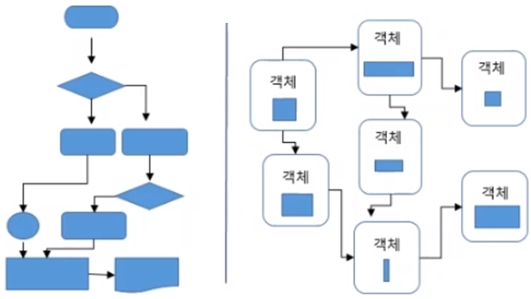
객체 지향 언어 vs. 절차 지향 언어

