Slide 1
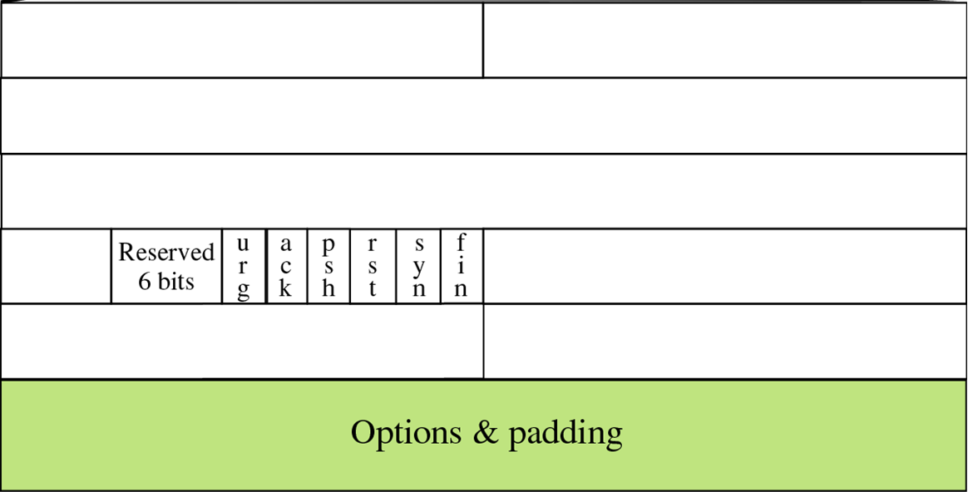

Slide 2
Source Port Number

Slide 3


