Slide 1
Zeek Installation
1) [Ubuntu Zeek] Zeek Installation
2) [zeek & Splunk server] scp installation

Slide 2
Zeek(p.181)
네트워크 침입탐지시스템(NIDS)
- Bro 또는 프로토콜 분석
- 네트워크를 모니터링 할 수 있는 오픈 소스 프로그램
IP헤더와 TCP 헤더를 분석하여 로그 생성
응용 프로토콜의 헤더를 분석하여 로그 생성
- FTP, HTTP, SMTP, X.509 ..

Slide 3


Zeek 설치 방법(p.182)
Gateway
Firewall
SPAN 또는 Port Mirroring
SWITCH

Slide 4
Zeek 설치 방법(p.182)
Gateway
Firewall
TAP
SWITCH

Slide 5
Zeek 설치 환경
openssh : scp
SplunkServer(Ubuntu)
192.168.10.10/24
HUB/NAT
openssh : scp
ZeekIDS(Ubuntu)
192.168.10.20/24
WebServer(CentOS)
192.168.10.30/24
Sysmon(Win10)
192.168.10.40/24

Slide 6
1) [Ubuntu Zeek] Zeek Installation
❶ 설치 전 환경 설정
#apt update
#apt-get install curl gnupg2 wget –y
#curl -fsSL https://download.opensuse.org/repositories/security:zeek/xUbuntu_20.04/Release.key | gpg --dearmor | tee /etc/apt/trusted.gpg.d/security_zeek.gpg
#echo 'deb http://download.opensuse.org/repositories/security:/zeek/xUbuntu_20.04/ /' | tee /etc/apt/sources.list.d/security:zeek.list

Slide 7
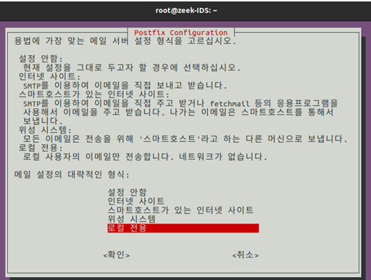
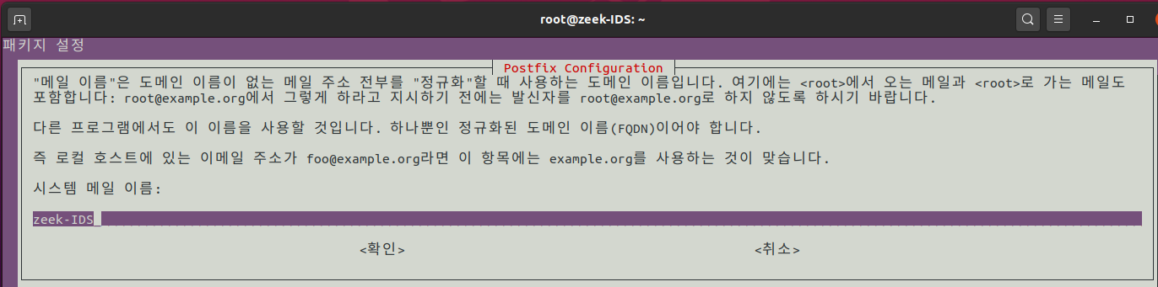
❷ Zeek Installation
#apt update -y
#apt-get install zeek -y
Notes:
atlantic.net/dedicated-server-hosting/how-to-install-zeek-network-security-monitoring-tool-in-ubuntu-20-04/

Slide 8

❸ PATH 설정
#echo "export PATH=$PATH:/opt/zeek/bin" >> ~/.bashrc
#source ~/.bashrc
#zeek --version

Slide 9
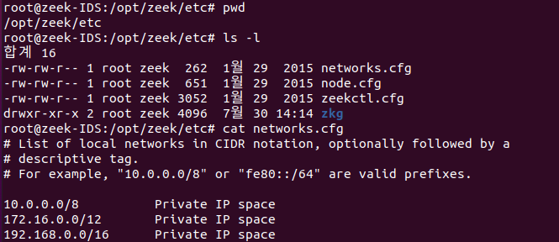
❹ Zeek Configuration
#cd /opt/zeek/etc
#cat /opt/zeek/etc/networks.cfg

Slide 10
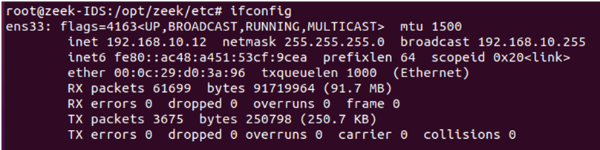
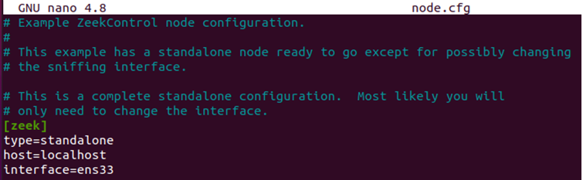
#ifconfig
#nano /opt/zeek/etc/node.cfg
[zeek]
type=standalone
host=localhost
interface=ens33

Slide 11
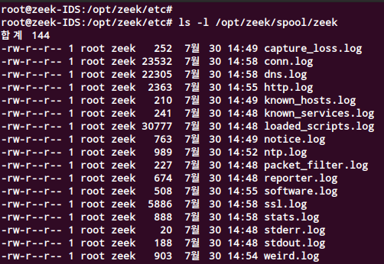
#zeekctl check
#zeekctl deploy
#zeekctl status
#ls –l /opt/zeek/spool/zeek
❹ Zeek 활성화

Slide 12
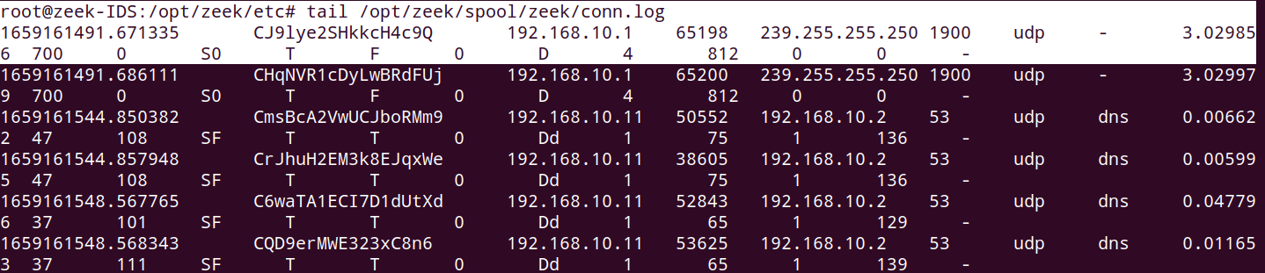
#tail /opt/zeek/spool/zeek/conn.log

Slide 13
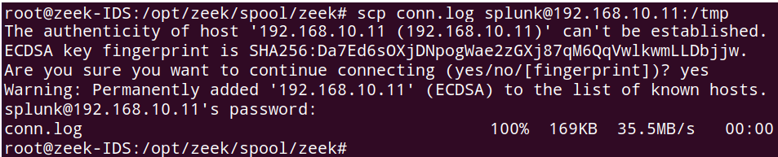
2) [zeek & Splunk server] scp installation
SCP를 이용하기 위해서는 SSH 서비스가 활성화 되어있어야 함
#apt-get install –y openssh-server
#ufw allow 22/tcp
*scp [전송파일명] [서버계정명]@[전송받을 서버]:[전송받을 서버 디렉터리]
Notes:
https://programmers-so.tistory.com/8
https://wlsvud84.tistory.com/11

Slide 14
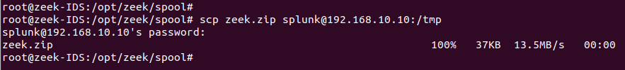
SCP를 이용해 Zeek log file을 Splunk Server 전송
#scp zeek.zip splunk@192.168.10.10:/tmp

Slide 15
