Slide 1
Lighting for Computer Graphics
CAS 741 | Sasha Soraine
Notes:
I need your help – because I’m having a hard time separating implementation details, and specifically approximation and design decisions made for implementation reasons, from the abstract details I’m looking to document here.

Slide 2
Topic Refresher
Understand how light interacts with objects with different material properties and model it for virtual environments.
Words to know:
Computer graphics
Virtual environment
Material Properties

Slide 3
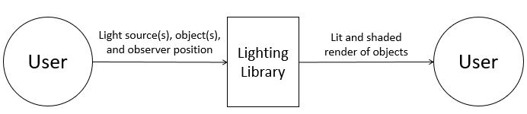
Unity
Words to know:
Light source
Observer
Render
Shaded/Shader
Lit

Slide 4
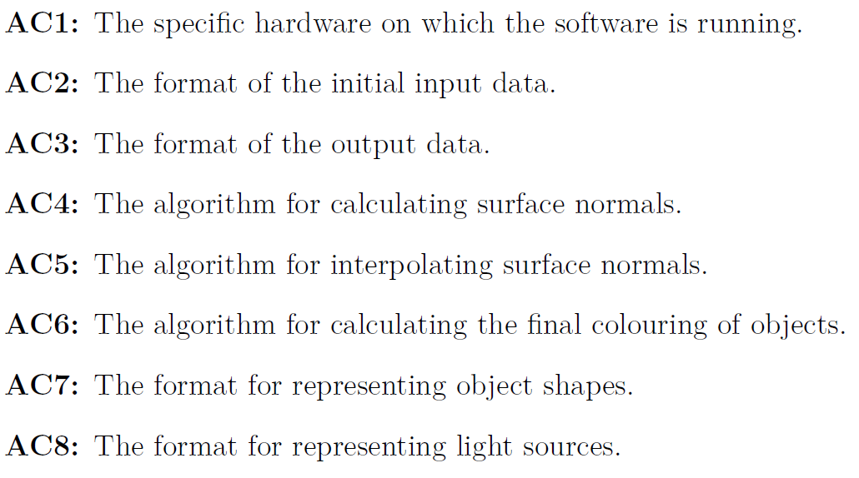
Notes:
I specifically want to discuss these with you so keep these in mind but we’ll come back to them.

Slide 5
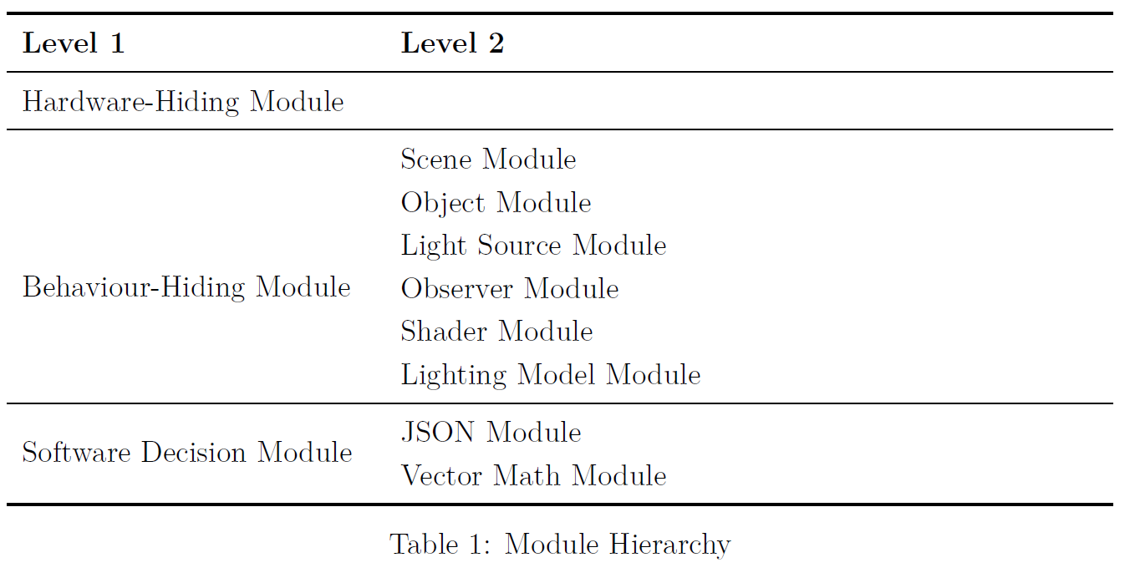
Notes:
So jumping into this module hierarchy I have 6 behaviour modules, and 2 software decision modules.
Scene module – handles the environment that’s being rendered (i.e. the room) and sets the boundaries (and constraints) for other properties; it also keeps track of the objects, light sources, and observer in the scene.
Object module – handles the objects being rendered in a scene
Light Source Module – handles the light source
Observer Module – handles the observer information
Shader Module – handles the shading calculations
Lighting Model Module – handles the lighting and colouring calculations
JSON Module – handles interpreting the input and sending that information in properly formatted ways to the other modules as well as turning that same data into output
Here’s where I’m not sure if this should be listed – but I need a Vector Calculus module; something that handles the implementation of things like normalizing vectors, adding, subtracting, getting the dot product and cross product that sort of thing.

Slide 6
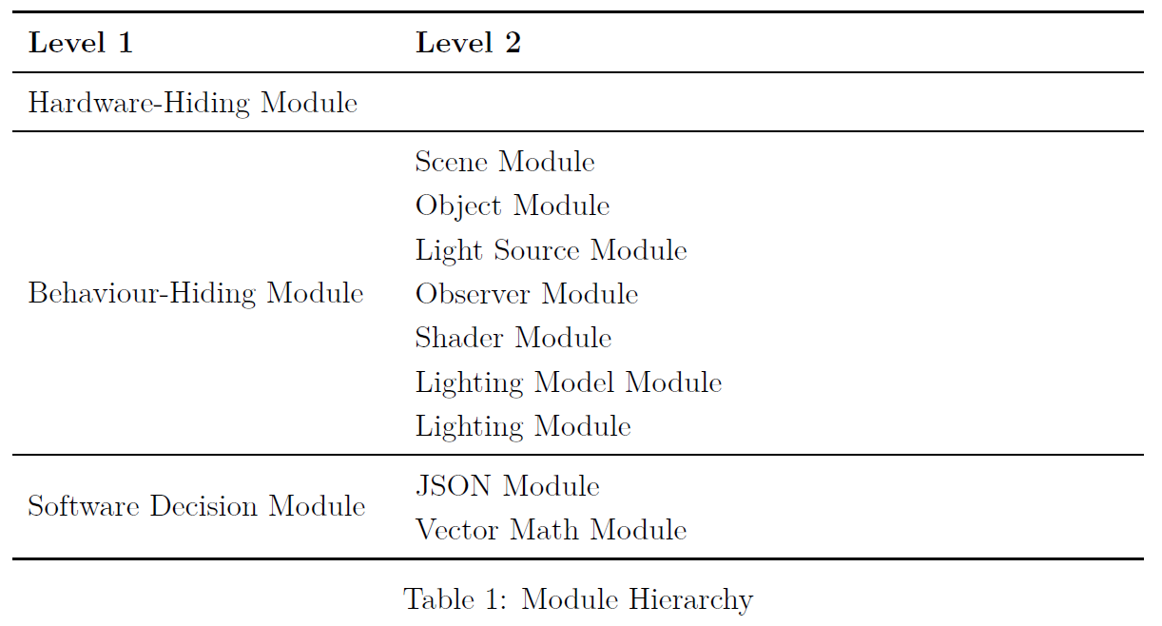
Notes:
So I have conceptual issues.
The first is the one module one secret rule – this is where those boxed anticipated changes come back.
So the input and output data are JSON files; the format changing would result in a different type of file module – does this justify having the two changes point to one module, or should these changes be written together.
It’s possible that the input and output data may have different types. Thoughts?
The information about surface normals are used exclusively in the shader construction and services; for a refresher shaders basically tell the lighting models what the surface normals are at all the points where the light is going to interact with the object. So I think that they belong together because in the context of lighting, shader models are the only case where these are going to be discussed. So does that make sense in this case, and how/where do I document this thought process?
My last is that I don’t know what to do with these three modules; they’re necessary hold hold information about the Observer,

Slide 7
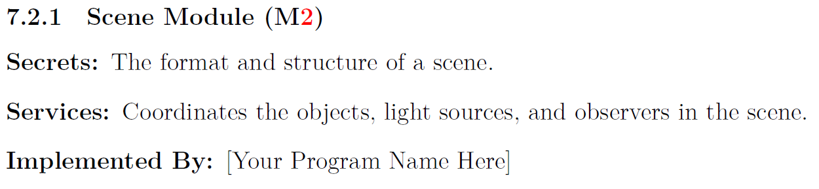
Scene Module

Slide 8
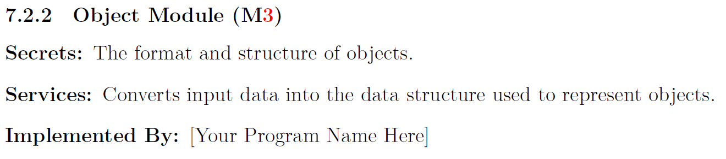

Slide 9
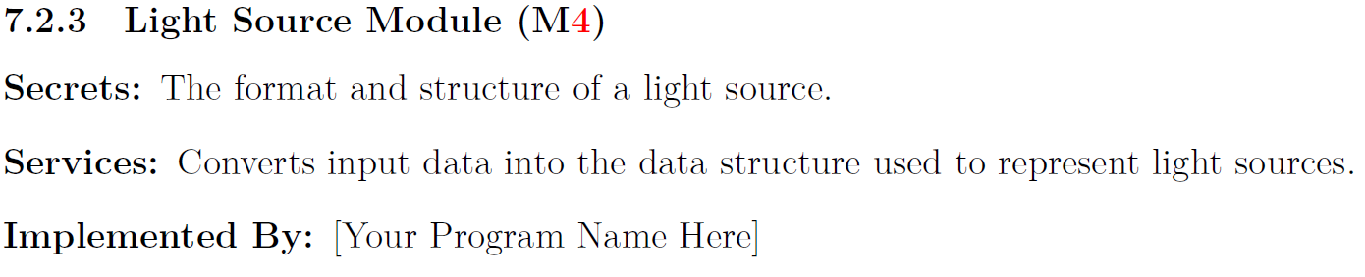

Slide 10
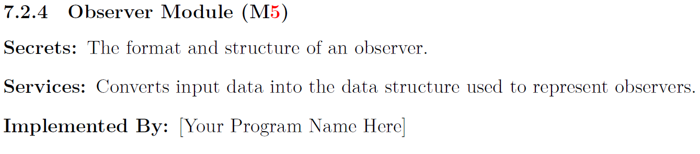

Slide 11
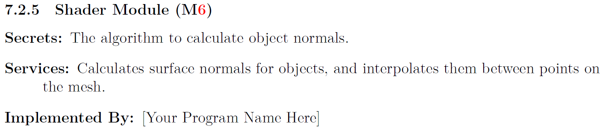

Slide 12
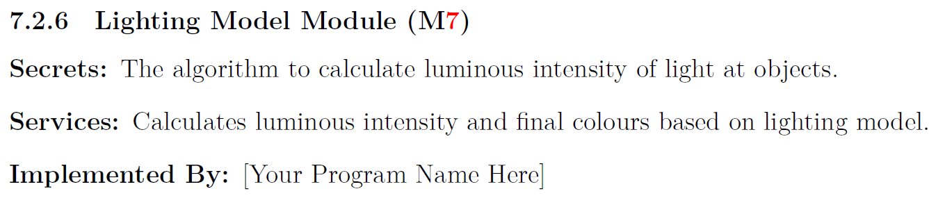

Slide 13
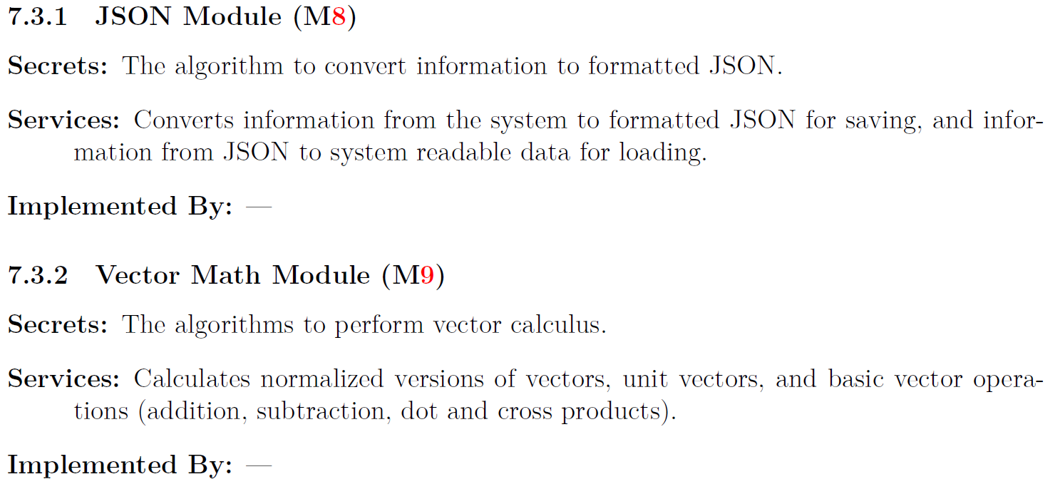
Software Decision Modules

