Slide 1
Lighting for Computer Graphics
CAS 741 | Sasha Soraine
Notes:
I need your help – because I’m having a hard time separating implementation details, and specifically approximation and design decisions made for implementation reasons, from the abstract details I’m looking to document here.

Slide 2
Topic Refresher
Understand how light interacts with objects with different material properties and model it for virtual environments.

Slide 3
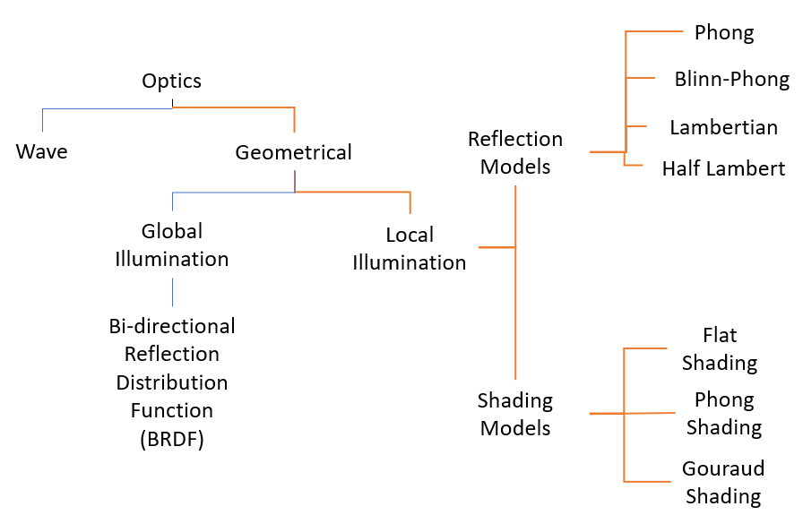
Notes:
I found that the problem domain was split up in a couple of different ways.
So for the scope of my project I decided to focus on understanding these aspects of modeling light in 3D graphics.

Slide 4
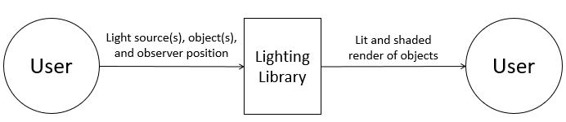
Unity

Slide 5
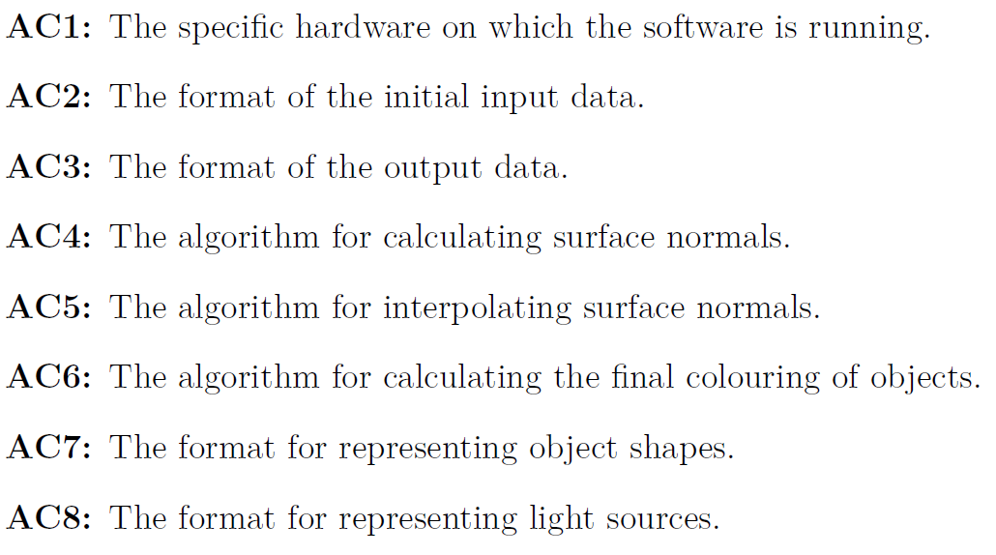
Notes:
I made some more modifications to my document last night and added modules we’ll see in the next slide which are directly related to some new anticipated changes that I forgot to add here.
There are that the format of polygon meshes
I specifically want to discuss these with you so keep these in mind but we’ll come back to them.

Slide 6
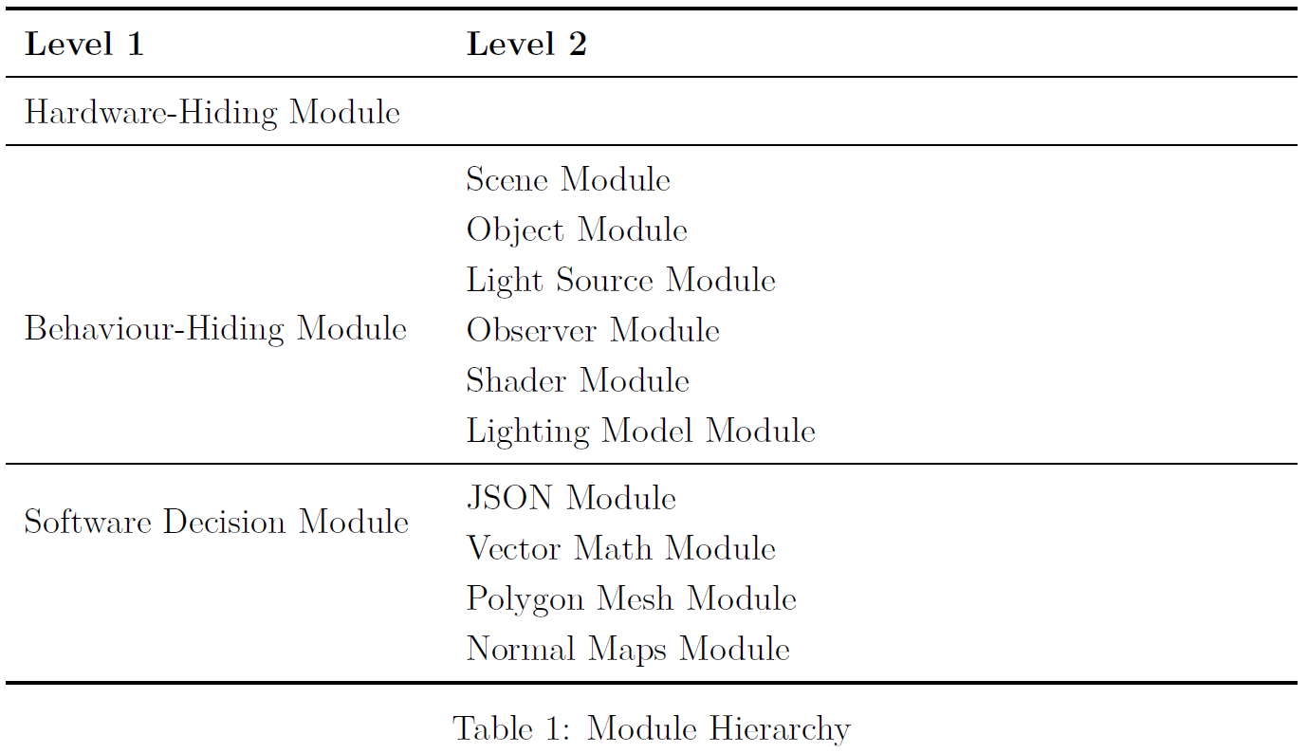
Notes:
So jumping into this module hierarchy I have 6 behaviour modules, and 2 software decision modules.
Scene module – handles the environment that’s being rendered (i.e. the room) and sets the boundaries (and constraints) for other properties; it also keeps track of the objects, light sources, and observer in the scene.
Object module – handles the objects being rendered in a scene
Light Source Module – handles the light source
Observer Module – handles the observer information
Shader Module – handles the shading calculations
Lighting Model Module – handles the lighting and colouring calculations
JSON Module – handles interpreting the input and sending that information in properly formatted ways to the other modules as well as turning that same data into output
Here’s where I’m not sure if this should be listed – but I need a Vector Calculus module; something that handles the implementation of things like normalizing vectors, adding, subtracting, getting the dot product and cross product that sort of thing.

Slide 7
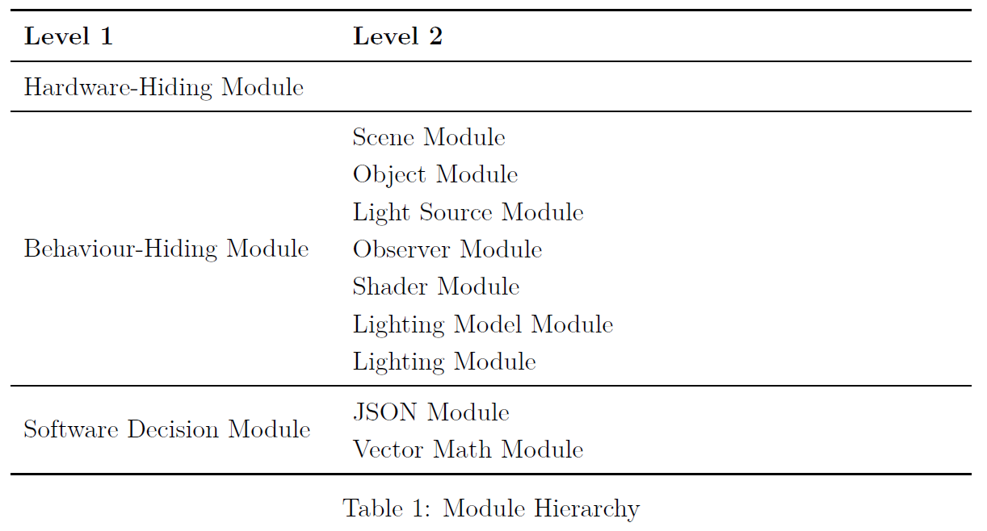
Notes:
So I have conceptual issues.
The first is the one module one secret rule – this is where those boxed anticipated changes come back.
So the input and output data are JSON files; the format changing would result in a different type of file module – does this justify having the two changes point to one module, or should these changes be written together.
It’s possible that the input and output data may have different types. Thoughts?
The information about surface normals are used exclusively in the shader construction and services; for a refresher shaders basically tell the lighting models what the surface normals are at all the points where the light is going to interact with the object. So I think that they belong together because in the context of lighting, shader models are the only case where these are going to be discussed. So does that make sense in this case, and how/where do I document this thought process?
My last is that I don’t know what to do with these two modules; they’re necessary to hold information about the Observer, Scene, and other data structures that will be used by the modules associated to my changes.
I suppose I could have an anticipated change associated with the scene format; because the current scene format is based around my design decisions from the CA.
However I don’t see how the observer module is likely to change as it represents the data structure that contains observer information, but there are only 2 pieces of information (position and direction) which I can’t think about other ways this might change.
The other two (polygon and normal maps) will be associated to likely changes, I just forgot to add them.

Slide 8
Notes:
So this messy diagram is my current iteration of the uses hierarchy.
Basically my main module is the scene module. It’s where all the information about the objects, observers, and light sources are stored.
It’s also where final calculations from the lighting and shading models get applied to these objects.
It is the only module that interfaces with the JSON module, as it’s the only one that reads input and writes output.
Observer, Object, and Light Source are all abstract object modules; they’re basically just data types.
The lighting and shading models are where calculations happen.
Does this make sense?

Slide 9
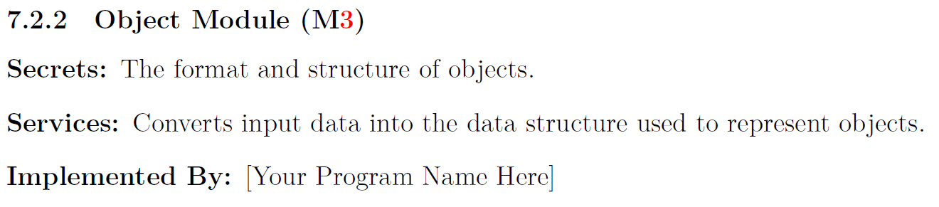
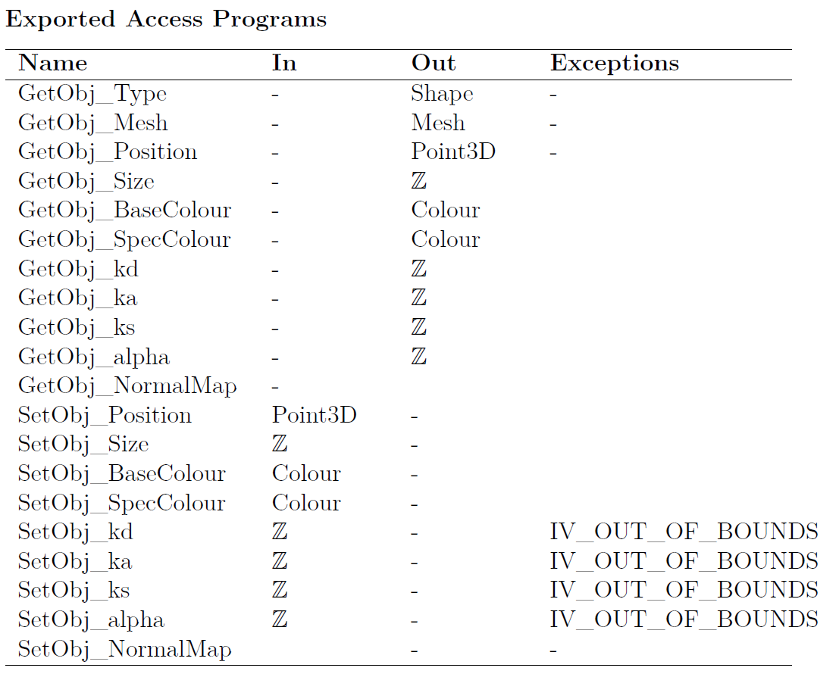
Notes:
So for the object module it’s just an abstract object – we’re only looking to store data in it about objects that we can then access with our other modules to make their calculations.
I want to clarify with the class (and Dr. Smith) that MIS are the access programs – but that means even the internal access right?

Slide 10
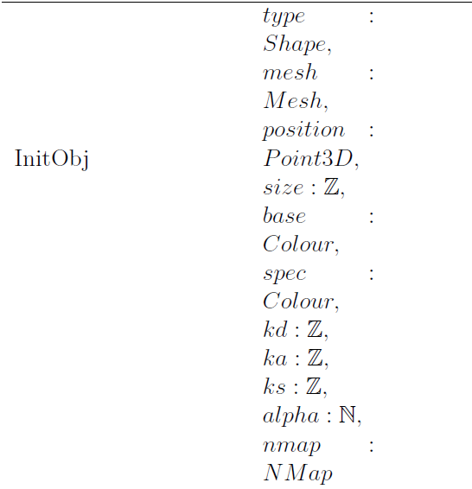

Slide 11
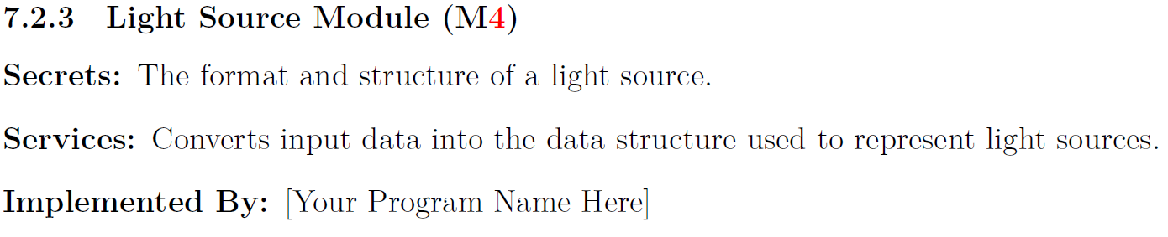
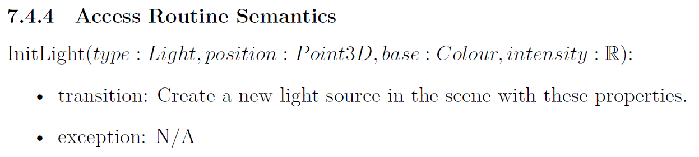
Notes:
So I don’t want to bore you with repeating the same getters and setters over again.
The specific wording is in my document, but to explain more about this particular module we’ll take a look at the object creation functions Init.
So I’m not sure if I’m using the transition line in the right sense – I interpreted it as changes to the system that aren’t necessarily output; so I put object creation here – is this correct?

Slide 12
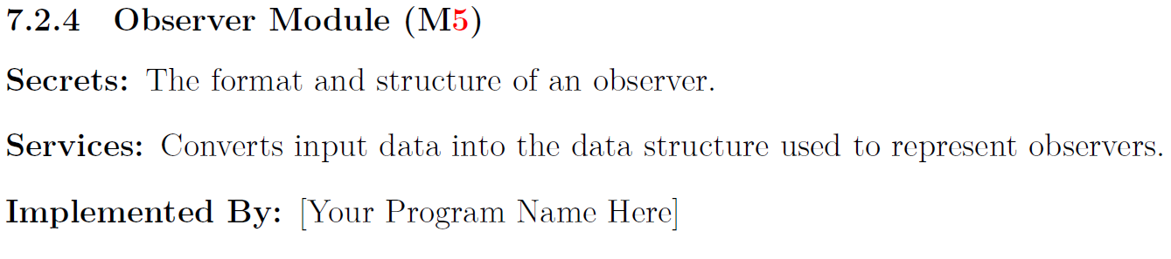
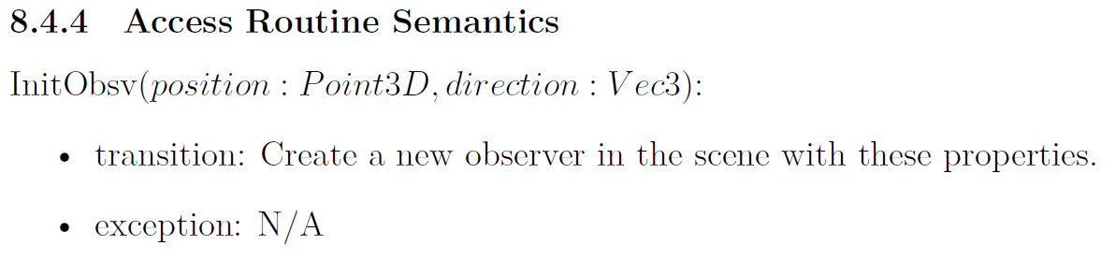

Slide 13
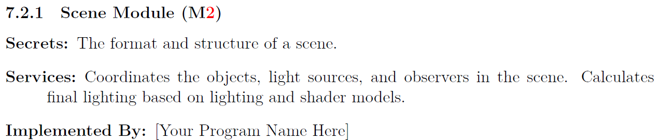
Notes:
I’m still in the process of creating the MIS so I haven’t gotten to this part yet.
Based on the uses diagram I showed earlier we know that this scene module handles the actual application of the light on the scene.

Slide 14
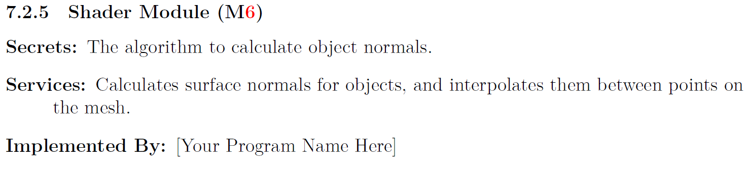
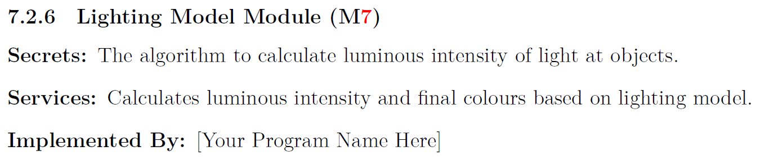

Slide 15
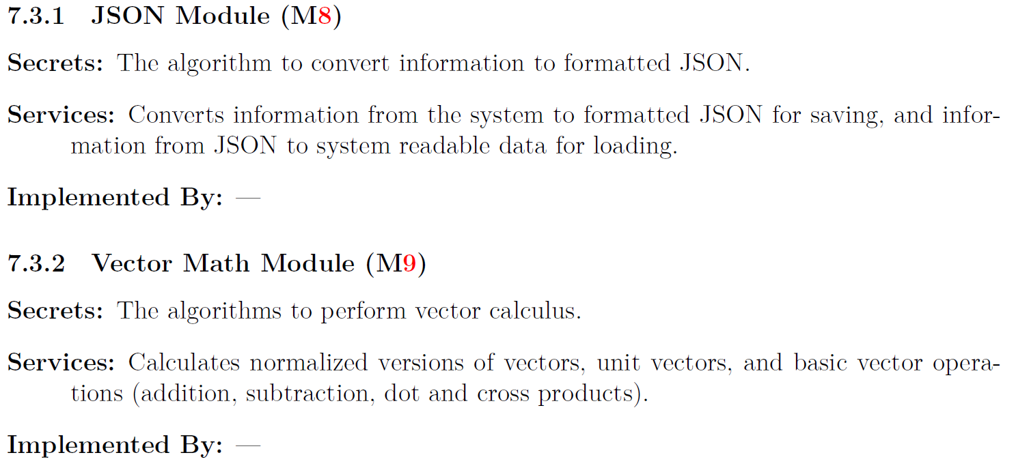
Software Decision Modules

Slide 16
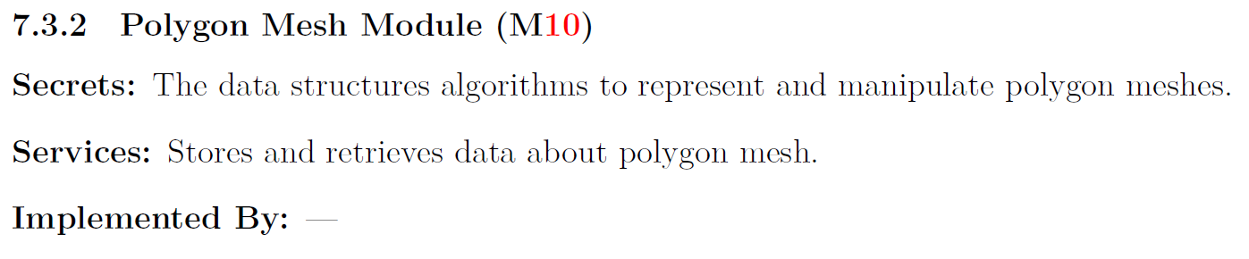
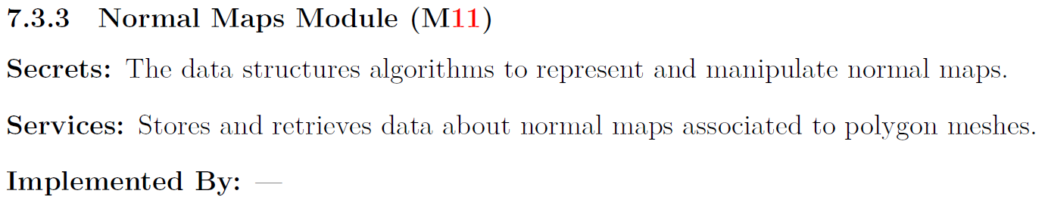
Software Decision Modules

