Slide 1
Tutoring Service Application
Chad Callender, Patrick Mitchell
May 4, 2023

Slide 2
Application Background
Allows students and faculty to keep track of tutoring sessions
Students can see what courses the tutoring centers offer
Recorded sessions can be accessed on request
Course information also visible

Slide 3
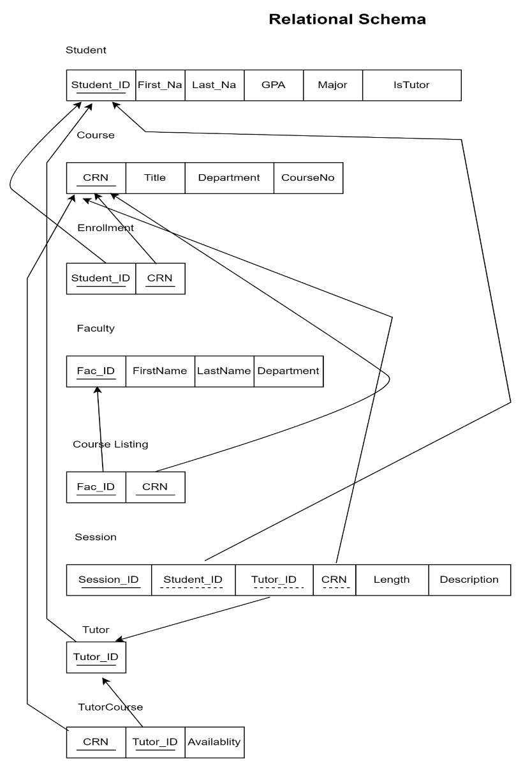
Logical Design

Slide 4
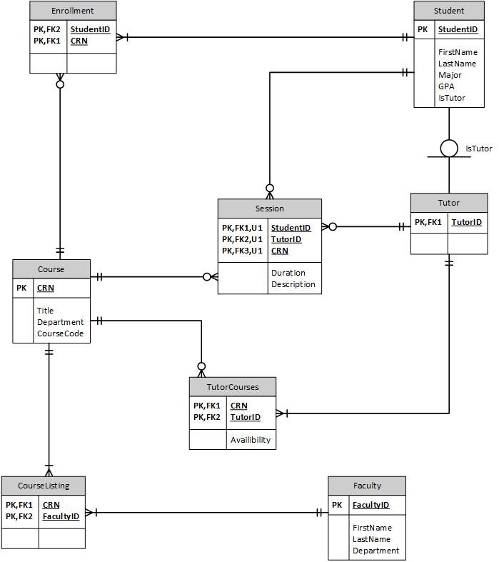
ERD
Relationships
Student must be enrolled in at least one course
A tutor is a student; there may be other types
A tutor must offer tutoring in at least one course
A student may have multiple sessions with multiple tutors for multiple courses
A faculty member must teach at least one course

Slide 5
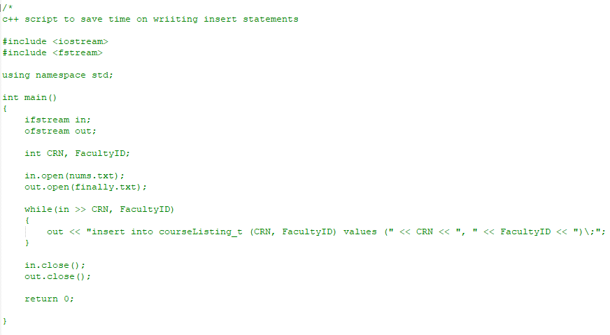
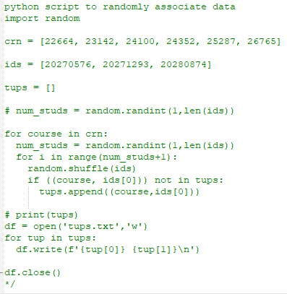
Before we get to it…
Honorable mention to the scripts that saved us time (They’re the real MVPs here)

Slide 6
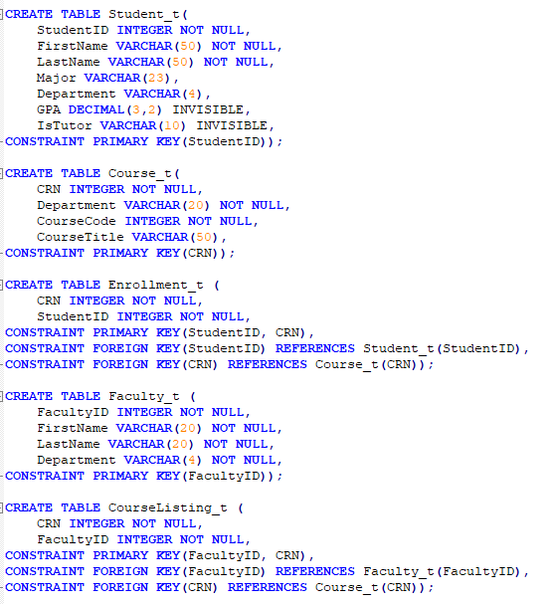
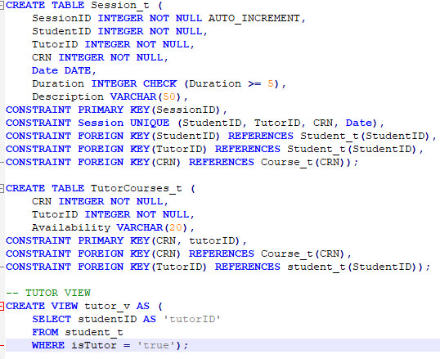
Data Defintion

Slide 7

Data Defintion

Slide 8

Data Defintion

Slide 9
Data Defintion

Slide 10
Data Defintion

Slide 11
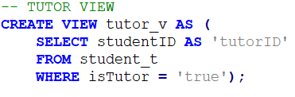
Data Defintion

Slide 12
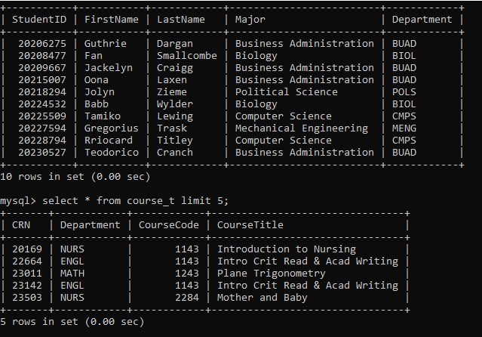
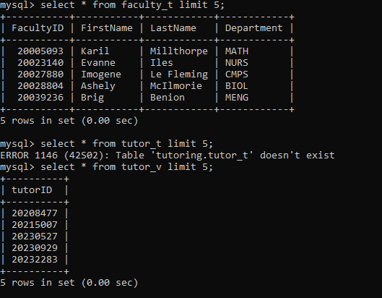
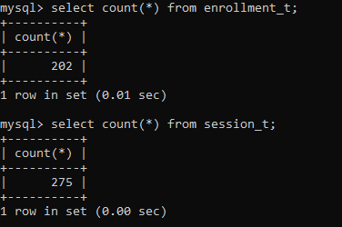
Tables and Views
Student_t, course_t
Faculty_t, tutor_v
Enrollment_t, session_t counts

Slide 13
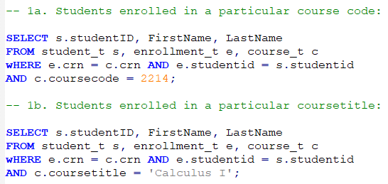
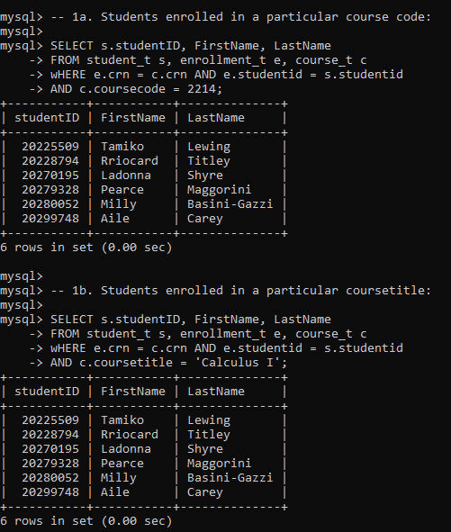
Data Manipulation (SQL Queries)
Students enrolled in Calculus I by course title and course code

Slide 14
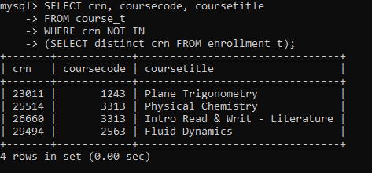
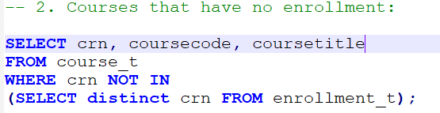
Courses with no students enrolled

Slide 15
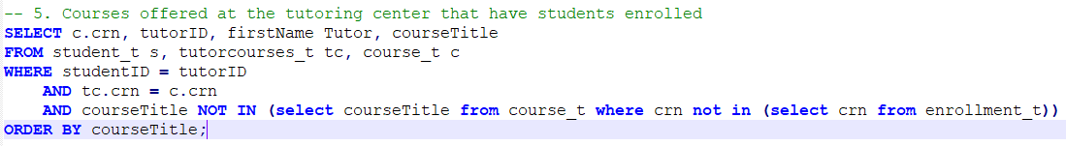
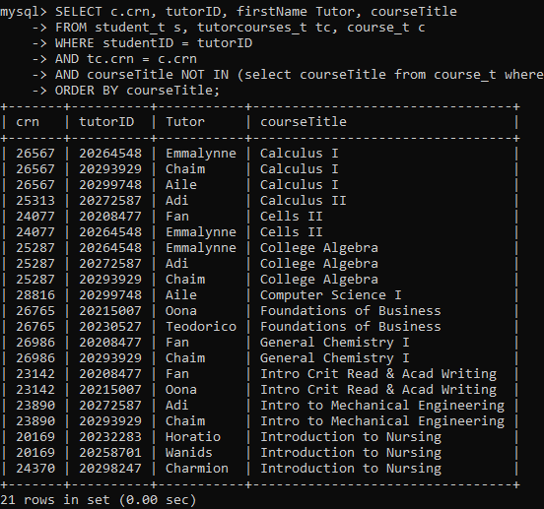
Tutor courses with students enrolled

Slide 16
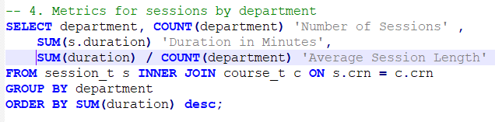
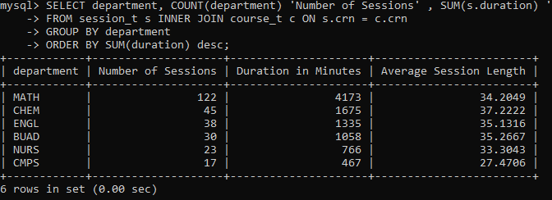
Number of sessions by department

Slide 17
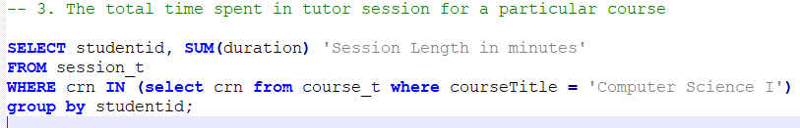
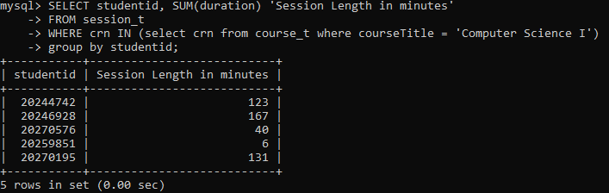
Total time students spent in tutoring for a particular course

