Slide 2
sdfsdf
Signaling
Service
Establish Socket Connection
ICE Negotiation
sdfsdf

Slide 3
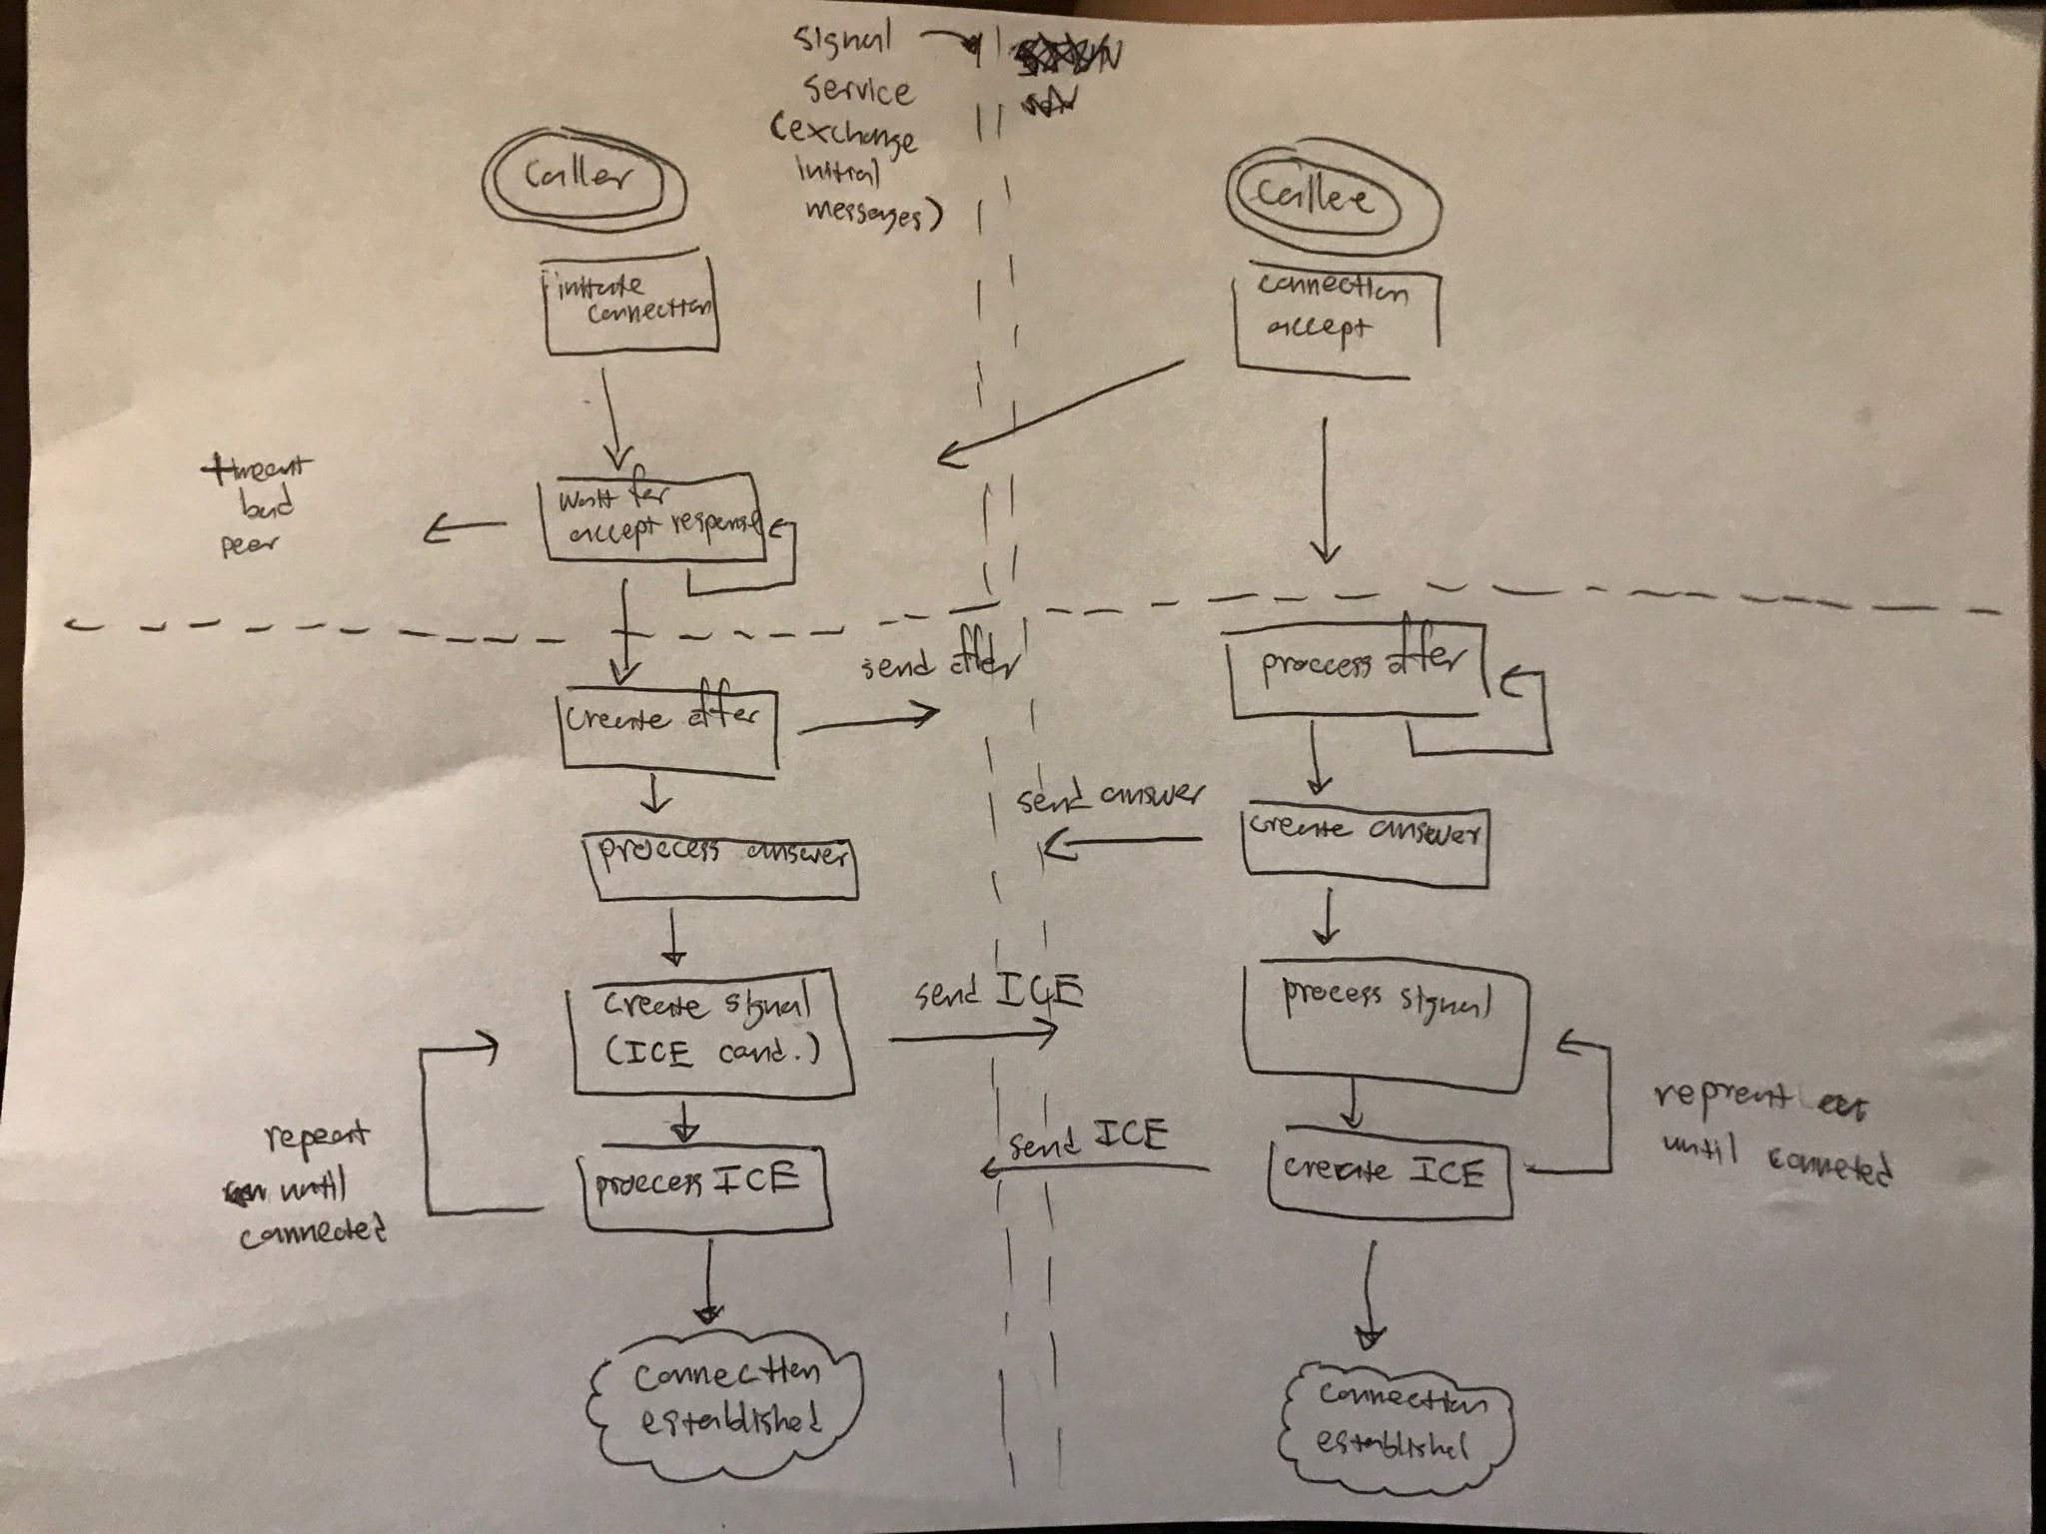

Slide 4
Peer (Caller)
- Generates caller SDP, ICE candidate s
Connection
- information exchange service
Peer (Callee)
- Generates callee SDP, ICE candidates
Connection
onCallerMsg(id, roomId, payload)
onCalleeMsg(id, roomId, payload)
initiateConnection(src, dst, payload)
sendCallerAResponse(from, data)
sendCalleeAResponse(to, data)

Slide 5
TODO
Conversion to TypeScript
Track number of bytes exchanged
Convert to RealTime Database
User Presence
Chat
Audio

