Slide 1
IST707: Applied Machine Learning
Week 2
Professor Joshua Introne
jeintron@syr.edu

Slide 2
Outline
Introduction to model evaluation.
Supervised
Regression Models
Classification Models
Sampling Methods
Unsupervised
Clustering

Slide 3
The Importance of Model Evaluation in Machine Learning
Ensures model reliability
Helps in model selection
Identifies model limitations

Slide 4
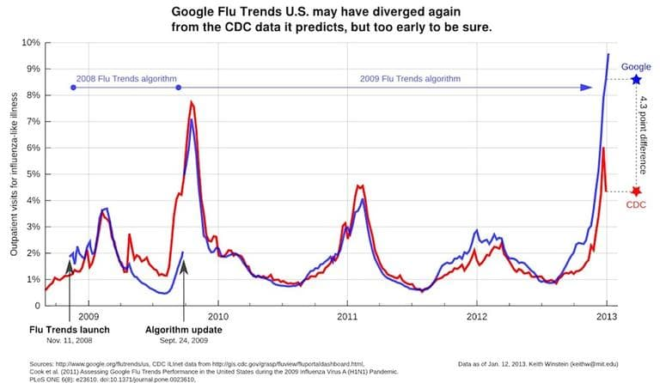
Example: Google Flu Trends
Notes:
Data Drift: The behavior of people making search queries can change over time, which may not necessarily correlate with the actual incidence of flu. For example, media hype could lead to an increase in flu-related searches without an actual increase in flu cases.
Overfitting: The model was fine-tuned to the data it was trained on but failed to generalize well to new, unseen data. It was sensitive to the noise and seasonal trends in the training data, which led it to overestimate flu prevalence.
Lack of Domain Knowledge: While the model was data-driven, it could have benefited from incorporating more medical and epidemiological expertise. A more hybrid approach combining data-driven techniques with domain-specific models might have yielded more accurate and reliable results.

Slide 5

Training Error vs. Generalization Error
Training Error : Error on the data the model was trained on
Generalization Error : Error on new unseen data
Goal : Minimize training error without increasing generalization error

Slide 6
Accuracy is Not Always Enough
Accuracy can be misleading in unbalanced classes
Precision and Recall discriminate between false positive and false negatives
Domain knowledge is crucial for selecting the right metric

Slide 7
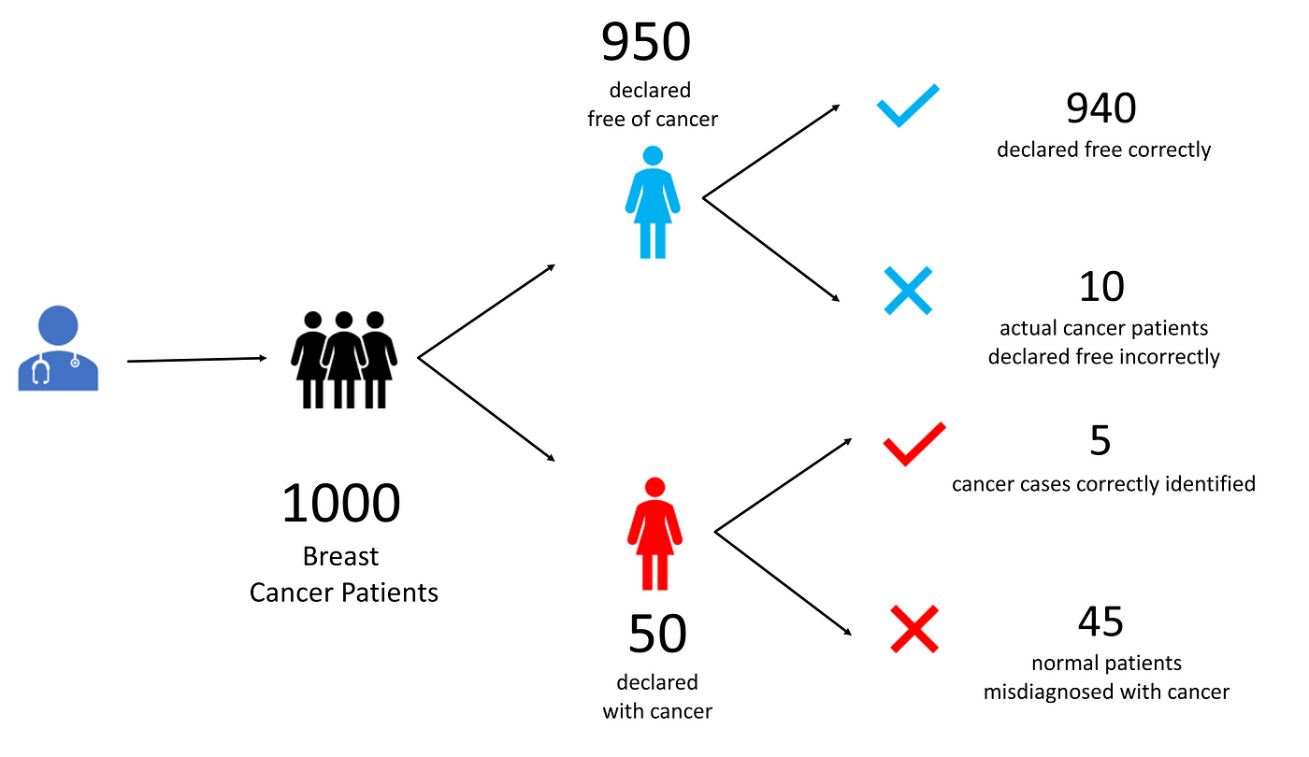
Example: Medical Diagnoses
945 / 1000 = 94.5% accuracy!!!!
45 / 50 = 90% of patients unnecessarily alarmed!

Slide 8
The Perils of Ignoring Domain Knowledge
Data-driven doesn’t mean unbiased
Context and domain knowledge are crucial for fair and accurate models

Slide 9

Notes:
Discuss the importance of domain knowledge in machine learning, particularly for tasks that have societal and ethical implications.
Introduce the example of Apple Card, where the credit scoring algorithm reportedly offered lower credit limits to women compared to men with similar financial backgrounds.
Point out that the New York Department of Financial Services launched an investigation into the algorithm.
Although the investigation concluded that there was no intentional discrimination, the incident highlighted the risk of unintentional biases in machine learning models that lack domain oversight.
Conclude by emphasizing the need for domain expertise to guide data selection, feature engineering, and model interpretation to ensure ethical and fair outcomes.

Slide 10


Slide 11
Takeaways
Rigorous model evaluation is critical, BUT
Different metrics have different benefits and limitations
Numbers shed light but can obscure important nuances!
TAKEAWAY: Always use a blend of metrics, tests, and domain expertise to truly understand your model's performance and limitations.

Slide 12
Evaluating Regressions

Slide 13
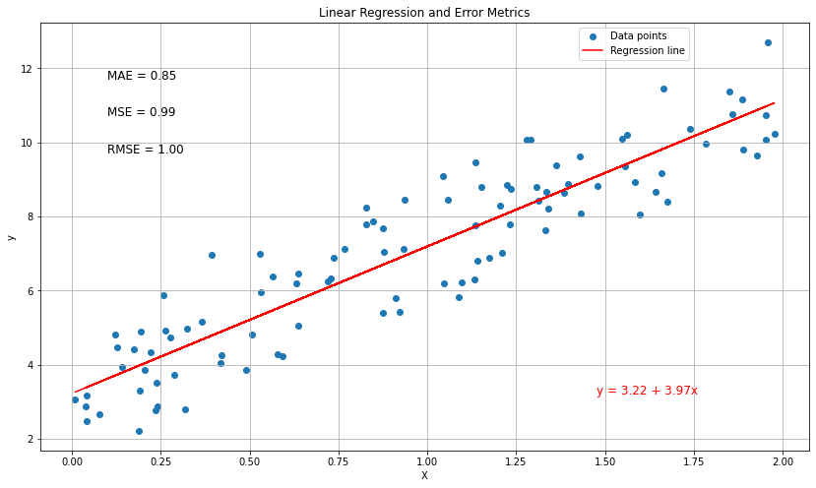

Slide 14
Common Measures of Regression Accuracy
Mean Absolute Error (MAE)
Mean Squared Error (MSE)
Root Mean Squared Error (RMSE)
Notes:
Mean Absolute Error (MAE)
Interpretability: MAE measures the average absolute errors, making it easy to interpret. One unit of MAE corresponds directly to one unit of the target variable.
Outliers: MAE is more robust to outliers compared to MSE. Outliers have a smaller effect on MAE than they do on MSE.
Linear Errors: Each error contributes linearly to the total error, meaning that all errors are weighted equally.
Mean Squared Error (MSE)
Sensitivity to Outliers: MSE is sensitive to outliers. Large errors contribute quadratically to the total error, which can be either good or bad depending on the specific problem.
Differentiable: The square function is differentiable, which can make optimization easier in machine learning contexts.
Common in Theory: MSE has a strong foundational basis in statistical theory, making it prevalent in many theoretical contexts.
Root Mean Squared Error (RMSE)
Interpretability: Like MAE, RMSE is in the same units as the target variable, making it relatively interpretable.
Sensitivity to Outliers: RMSE is also sensitive to outliers, similar to MSE.
Common in Practice: RMSE is widely used in practical applications where the distribution of error terms is Gaussian and the interest lies in penalizing large errors.
Trade-offs and Considerations
Outliers: If your data contains many outliers, using MSE or RMSE may lead to overestimation of the model's badness-of-fit. MAE is more robust in such cases.
Optimization: If you're using algorithms that rely on gradient descent for optimization, MSE and RMSE are more appropriate because they are differentiable.
Interpretability vs. Sensitivity: If you want a more interpretable metric, MAE might be better. If you want to penalize larger errors more heavily, then MSE or RMSE might be more appropriate.
Domain-Specific: Sometimes the choice of metric is dictated by the domain of the problem. For example, in finance, a small error in predicting a stock's price could result in a significant loss, so you might prefer MSE or RMSE to heavily penalize larger errors.

Slide 15
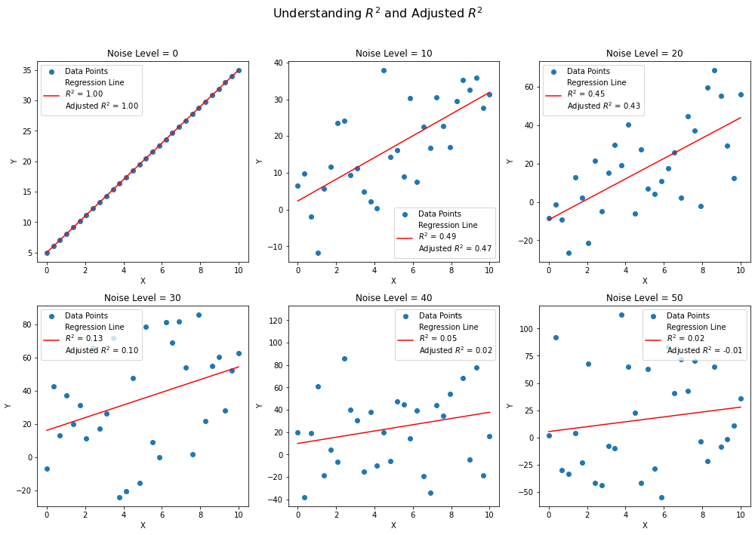

Slide 16
Coefficients of Determination
R^2 – proportion of variance explained
Adj. R^2 – adjusted to penalize more covariates
residuals
variance
Sample size
Number of predictors
Notes:
R2 measures the proportion of the variance in the dependent variable that is predictable from the independent variable(s).
Ranges from 0 to 1: A higher �2R2 indicates a better fit and explains more of the variability.
Speaker Notes:
Think of �2R2 as the proportion of the response variable that's explained by the model.
While a higher �2R2 is generally better, a perfect �2R2 of 1 is often unrealistic and could indicate overfitting.
Adjusts �2R2 based on the number of predictors in the model, �p, and the sample size, �n.
Unlike �2R2, it penalizes for adding predictors that do not improve the model.
Justification for Adjusted �2R2:
Prevents the "illusion" of a better model when adding more variables.
Provides a more honest picture of the model's explanatory power.
Speaker Notes:
Adjusted �2R2 is especially useful when comparing models with different numbers of predictors.
It helps you make a more informed choice about which variables are truly adding value to your model.

Slide 17
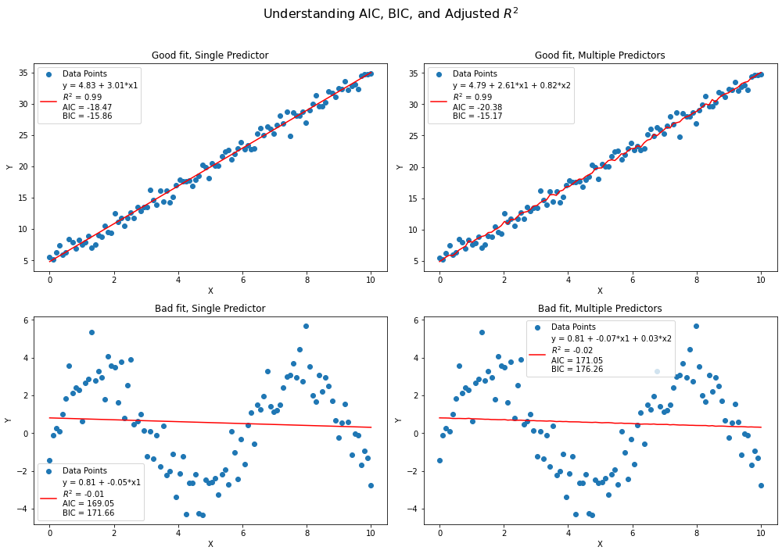

Slide 18
Model Comparison and selection
Akaike Information Criterion (AIC) and Bayesian Information Criterion (BIC)
Information theoretic measures balancing fit and model complexity.
Based on likelihood (L) of model
model
parameters
In the case of linear regression, assuming residuals are normally distributed:
Normal distribution
intercept
slope
variance
In practice, it is common to work with log-likelihood, because it is easier to work with analytically and numerically

Slide 19
Akaike Information Criterion
Number of parameters
Estimator of the relative quality of the model
Penalty for the number of model parameters
LOWER AIC indicates better fit, but is a relative measure

Slide 20
Bayesian Information Criterion
Number of observations
Like AIC, but penalizes model complexity differently
More conservative about adding parameters as sample size grows; sensitive to overfitting
Focuses on quality of probabilistic model, rather than predictive accuracy
Notes:
AIC: Focus on Predictive Accuracy
AIC is motivated by a desire for a model that predicts well. It seeks to select the model that will have the best out-of-sample prediction accuracy. The likelihood term in AIC captures how well the model fits the data, while the penalty term discourages overfitting by adding a cost for each additional parameter. AIC doesn't take into account the number of observations directly, which makes it less stringent about adding extra parameters. This might lead AIC to prefer more complex models if those models offer even a slight improvement in fit.
BIC: Focus on Model Selection
On the other hand, BIC is derived from a Bayesian point of view, aiming to find the true model among the set of candidates. It incorporates a penalty term that grows logarithmically with the number of observations, which makes it more conservative about adding additional parameters as the sample size grows. This penalty term reflects a desire to find simpler models that explain the data-generation process well. In a Bayesian framework, simpler models often have higher prior probabilities.
The Key Difference
The key difference lies in their philosophical approaches:
AIC is concerned with predictive accuracy and aims to select a model that minimizes the future prediction error.
BIC is concerned with the goodness of fit and aims to select the model that is most likely to have generated the observed data.

Slide 21
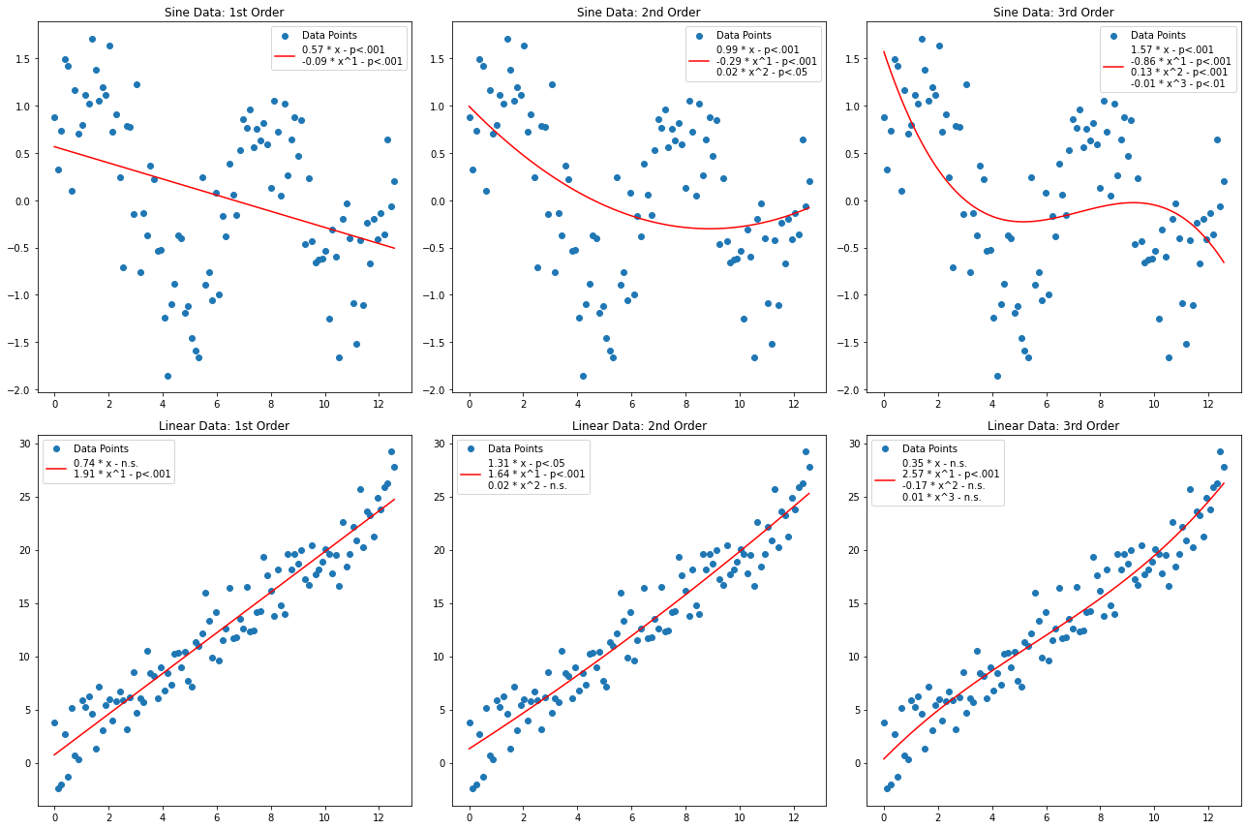

Slide 22
P-values and significance
A p-value is a measure of the evidence against a null hypothesis (e.g. the hypothesis that a variable plays a role in a model).
It quantifies the probability of observing a statistic as extreme as the one computed from the sample data, assuming the null hypothesis is true.

Slide 23
Calculating p
For each coefficient β, the p-value is calculated using a t-test
The calculated statistic is compared to the t-distribution and the p-value obtained from the area under the distribution
Number of observations
Number of parameters

Slide 24
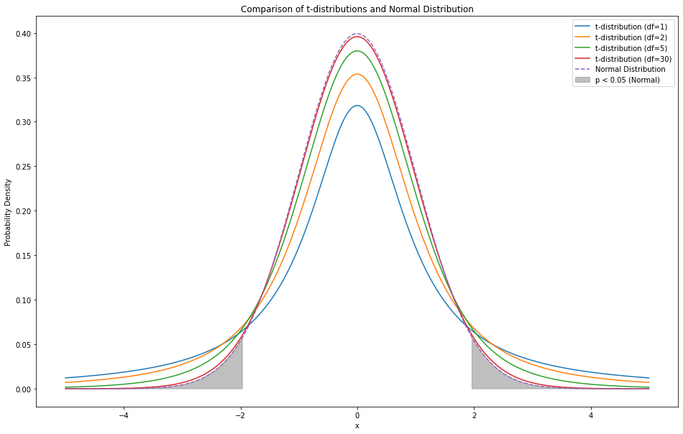
Comparing t-distributions to z-distributions
“Significant” regions
p > .05 – not significant p < .05 – significant p < .01 – highly significant
AUC = 0.025
Notes:
Explain that a low p-value (< 0.05) indicates that you can reject the null hypothesis. In other words, a predictor that has a low p-value is likely to be a meaningful addition to your model because changes in the predictor's value are related to changes in the response variable.
Conversely, a larger p-value suggests that changes in the predictor are not associated with changes in the response.

Slide 25
Be careful with p
P-values reflect the significance of a correlation, but not a causal relationship or “truth” of a model!
P-values do not convey the size of an effect
Multiple testing can lead to p-hacking – in other words, reusing the data to find configurations that achieve a p-value below the 0.05 threshold.

Slide 26
Evaluating CLASSIFIERS

Slide 27
Confusion Matrices
A confusion matrix is a table layout that allows visualization of the performance of an algorithm.
True Positives (TP): These are the correctly predicted positive observations.
True Negatives (TN): These are the correctly predicted negative observations.
False Positives (FP): Incorrectly predicted positive observations (Type I error).
False Negatives (FN): Incorrectly predicted negative observations (Type II error).

Slide 28
Example
Online store that sells video games.
Model predicts whether a visitor will buy a game or not.
Model performance dictates allocation of marketing resources.
 | predictions
Ground Truth | buy_game = yes | buy_game = no | total
buy_game = yes | 6700 (TP) | 300 (FN) | 7000
buy_game = no | 900 (FP) | 100 (TN) | 1000
total | 7600 | 400 | 8000

Slide 29
Accuracy
Simplest ways to measure the effectiveness of a classification model
For our example:
8.5 out of 10 times the model correctly predicts whether a customer will buy a computer game or not.

Slide 30
However…
Accuracy can be misleading, especially when data is “unbalanced”
Balanced data is that which has a similar number of examples in each category
Otherwise “unbalanced” or “skewed”
Why is this a problem?

Slide 31
Accuracy limitations
Is 85% accuracy a good outcome?
Naïve Model Comparion – In our case, a “naïve model” (predicting people purchase a game 100% of the time) is 87.5% accurate!
Performance Across Classes –
The “yes” case - 6700(TP)/7000(TP+FN) ~ 96%
The ”no” case – 100(TN)/1000(TN+FP) = 10% !
What do we do?
“Impute” data
More sophisticated measures (e.g., weighted metrics, Matthews correlation coefficient, cross-entropy loss)

Slide 32
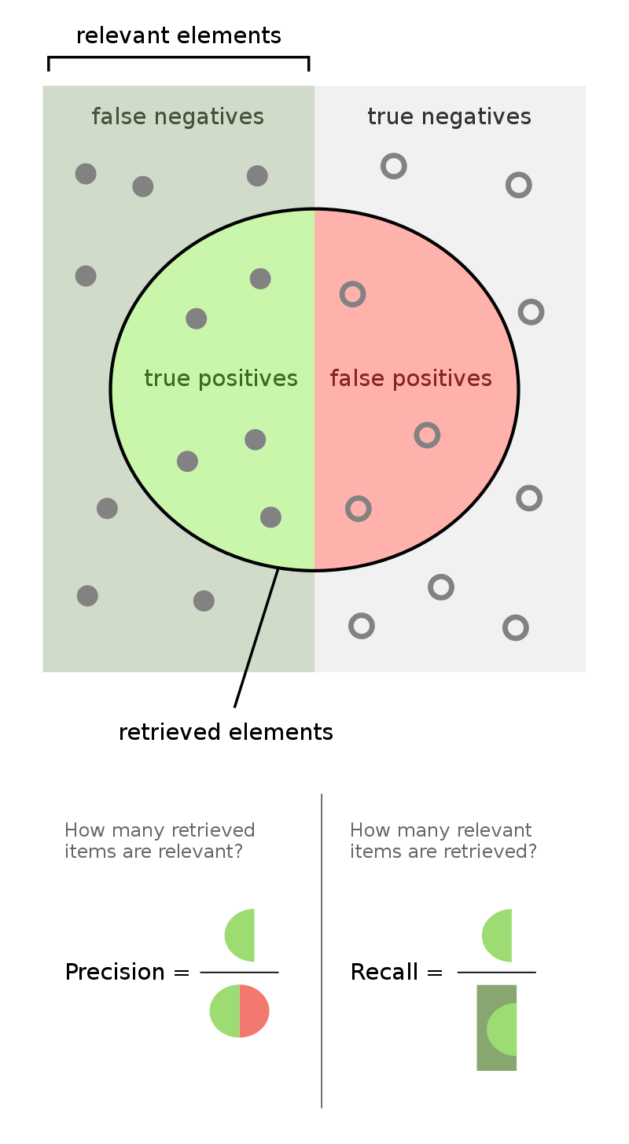
Precision, Recall, and F1 Score
*
Precision: Measures how many of the items identified as positive are actually positive. High precision means low false positive rate.
Recall: Measures how many of the actual positive cases we caught through our classification.
* By Walber - Own work, CC BY-SA 4.0, https://commons.wikimedia.org/w/index.php?curid=36926283

Slide 33
Example
 | predictions
Ground Truth | buy_game = yes | buy_game = no | total
buy_game = yes | 6700 (TP) | 300 (FN) | 7000
buy_game = no | 900 (FP) | 100 (TN) | 1000
total | 7600 | 400 | 8000
The “yes” case
The “no” case
Precision: 6700/7600 = .88
Recall: 6700 / 7000 = .96
F1-Score: 2*(.96+.88)/(.96*.88)=.92
Precision: 100/400 = .25
Recall: 100 / 1000 = .1
F1-Score: 2*(.25+.1)/(.25*.1)=.14
Average F1 across classes = .53

Slide 34
ROC and AUC
ROC (Receiver Operating Characteristic) Curve: A graphical plot that illustrates the performance of a binary classification system.
AUC (Area Under the Curve): A single number summarizing the overall ability of the test to discriminate between positive and negative classes.
These measures are constructed by varying the decision threshold for classification, so not as meaningful in the case of hard classifications

Slide 35
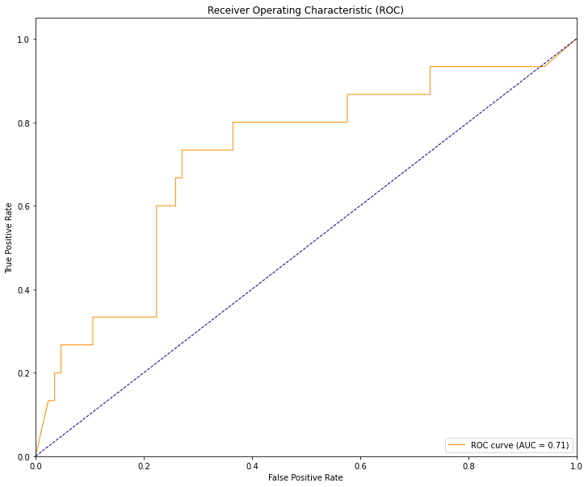
Example
A probabilistic classifier for predicting diabetes based on blood glucose levels
Random guess
Area Under the Curve
Notes:
ROC Curve: The ROC curve allows us to see the trade-off between sensitivity (or TPR) and specificity (1 - FPR). The curve plots TPR vs FPR at various classification thresholds. A model with good classification ability will have a curve that hugs the upper left corner of the plot.
AUC: The AUC is an effective way to summarize the overall diagnostic accuracy of the test. It is a single number that ranges from 0.5 to 1.0, with a higher number indicating better classification performance. A model whose predictions are 100% wrong has an AUC of 0.0; one whose predictions are 100% correct has an AUC of 1.0.

Slide 36
Calculating AUC
Trapezoidal Rule
N is the number of threshold values – usually the number of unique probabilities in your set of predictions

Slide 37
SAMPLING METHODS

Slide 38
Train-Test Split
Basic Idea: Separate your data into two sets – one for “training” the model, and the other for “testing” the model
Important Considerations
The training set must be completely independent and highly representative of the test set to get an unbiased estimate of performance
Performance can vary depending on the split, and a bad-split could result in poorer performance
Examples
Binary classification with a rare positive class (e.g., disease detection where only 5% samples are positive)
Time-series data where future data points are used in the training, and past data points in the training
Using data from one geographic region in the training data and another region in the test set

Slide 39
Stratification
Stratification ensures that each fold or subset of data has a similar distribution of a particular variable (or variables).
Primarily focused on output classes and is used to make sure the test set has the same distribution over these classes.
Can also be applied to features, though this is a less conventional interpretation.
DATA
10 % SAMPLE (NOT STRATIFIED)
10 % SAMPLE (STRATIFIED)
Class A
Class B
Class C

Slide 40
Cross-validation
K-Fold Cross validation:
Partition data into k subsets or "folds."
Train on k−1 of these folds and test on the remaining fold
Repeat this process k times, average performance metrics
Leave-one-out:
Extreme cross-validation - train on all available data, holding back just one case for testing
Computationally very expensive
Stratified K-Fold Cross-Validation:
Each fold is stratified
Considerations:
Not appropriate for time-series data (use time-series specific cross-validation)
A greater number of folds increases available training data but
Increases processing time and performance variance
Reduces representativeness of test samples
Data leakage if any preprocessing / feature selection is done after splitting but before training. All such operations need to take place on the training set.

Slide 41
Cross-validation (cont’d)
Validation Set for Hyperparameter Tuning
Might need to tune hyperparameters
Using the same cross-validation process for both can lead to overfitting
Approach: reserve a separate “validation set” for hyperparameter tuning in each fold
Nested Cross-Validation
Outer Loop: Data is split into training and test sets. These test sets serve as the ultimate evaluation of the model.
Inner Loop: Within each fold of the outer loop, an inner cross-validation loop is used on the training data to tune the hyperparameters and select the best model.
Model Evaluation: After hyperparameters are found model is trained on the entire training set of the outer loop and evaluated on the corresponding test set of the outer loop
Final Performance: The performances from the test sets in the outer loop are averaged to get a final performance metric.

Slide 42
RESAMPLING

Slide 43
Common Techniques
Imbalanced / skewed data can create performance problems for learners, which may become optimized for majority classes. Several techniques are available.
Random Over Sampling (ROS): Randomly duplicate examples in the minority class
Random Under Sampling (RUS): Randomly remove examples in the majority class
Synthetic Minority Over-sampling Technique (SMOTE): Generate new examples in the minority class by interpolating between existing examples.
Notes:
Mention that these methods can introduce bias or noise
Explain that you should perform resampling techniques within the folds of cross-validation to avoid leakage (otherwise, you can "cheat" and artificially boost performance metrics)
Discuss how domain knowledge is crucial in choosing the right resampling method

Slide 44
SMOTE
Approach
Randomly pick a point from the minority class.
Calculate the k-nearest neighbors (for some pre-specified �k) for this point.
Choose one of the k-nearest neighbors and place a synthetic point anywhere on the line joining the point under consideration and its chosen neighbor.
Benefits
Alleviates Overfitting
Class Separability:
Improved Accuracy
Limitations
Introduces noise
Computational complexity
Over-generalization
High-dimensional data
Distorting data distribution
Notes:
Alleviates Overfitting: Unlike random oversampling, SMOTE generates synthetic examples, reducing the risk of overfitting that comes with duplicating minority class examples.
Class Separability: It can enhance the decision boundary by filling in the gaps between minority examples, making it easier for classifiers to differentiate between classes.
Improved Accuracy: Often results in better classifier performance when compared to random undersampling or oversampling.
Introduces Noise: The synthetic examples created can be noisy and may not always correspond to valid examples, especially when the feature space is not continuous.
Computational Complexity: SMOTE is computationally expensive as it requires the calculation of k-nearest neighbors.
Risk of Over-generalization: It can cause the classifier to over-generalize on the minority class, making it too sensitive and leading to higher false positives for the majority class.
Not Ideal for High-Dimensional Data: SMOTE might not be effective for high-dimensional data as the concept of "neighbor" becomes less distinct in higher dimensions.
May Distort Data Distribution: It can change the underlying distribution of the minority class and introduce a bias.
Not Suitable for All Datasets: For some imbalanced datasets, using SMOTE may not lead to a significant improvement in performance.

Slide 45
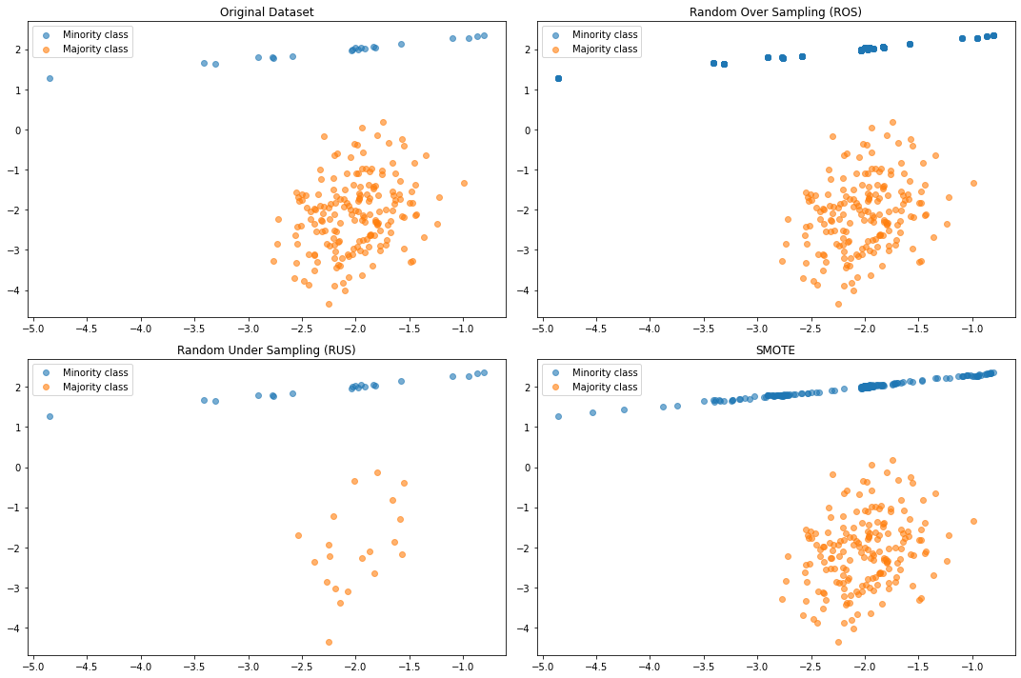
Comparing methods

Slide 46
Considerations when resampling
Resampling by over-sampling can yield “brittle” classifiers, that do not generalize the minority class.
Do not resample with test data included! This can lead to data leakage.
Whether or not to report results on resampled data depends on your goals:
YES: when comparing different classifiers, or different resampling methods, or consider new algorithms
NO: when trying to show generalization, or in safety critical scenarios
Oftentimes, a good strategy is to report both!

Slide 47
IMPUTATION

Slide 48
Missing Data
In general, “missingness” refers to missing variables in your data.
MCAR (Missing Completely At Random): The missingness is entirely random and not related to any observed or unobserved data.
MAR (Missing At Random): The missingness is random but could be related to some observed data.
MNAR (Missing Not At Random): The missingness is related to unobserved data or the value itself.
Different types of missingness require different strategies

Slide 49
Strategies for missing data
Discard incomplete cases: Appropriate for MCAR and possibly MAR, when data is plentiful.
Mean/Median/Mode Imputation: Replace missing values with the mean (for continuous variables) or mode (for categorical variables). This method doesn't account for the inherent variability in the data. Appropriate for MCAR
K-Nearest Neighbors (KNN) Imputation: Replace missing values with values from "similar" instances. Appropriate for MCAR.
Multiple Imputation: Generates multiple imputations for the missing data, creating several complete datasets. These datasets are analyzed separately, and the results are pooled. Good for MAR and MNAR.
Model-based Imputation: Use regression, decision trees, or other models to predict and replace missing values. Good for MAR and MNAR.
Iterative Imputation: Impute variables using other variables in an iterative manner, a popular method being the MICE (Multiple Imputation by Chained Equations) algorithm. Good for MAR and possibly MNAR.

Slide 50
MICE (Multiple Imputation by Chained Equations)
Initialization: Start by filling in the missing values with a simple imputation method like mean imputation.
Iterative Imputation:
For each variable with missing data:
Set its missing values back to missing.
Model this variable using the other variables.
Use this model to impute the missing values.
Repeat this process for several iterations to make the imputations more robust.
Multiple Datasets: This process is repeated to create multiple datasets, and analyses are performed on each.
Pooling: Results from these multiple analyses are pooled together to get final estimates.
Notes:
Chained Equations: Each variable with missing data gets its own imputation model. This allows for different types of variables (e.g., continuous, ordinal, nominal).
Uncertainty: By creating multiple datasets, MICE captures the uncertainty of missing values, thus providing a more accurate estimate of standard errors.
Flexibility: You can specify different imputation models for different variables.

Slide 51
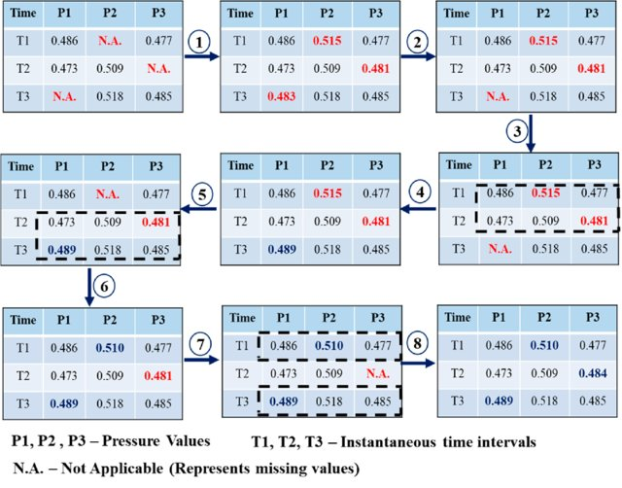
Kim, Bubryur & Yuvaraj, N. & Ramasamy, Sri & Hu, Gang & Lee, Dong-Eun. (2021). Wind-Induced Pressure Prediction on Tall Buildings Using Generative Adversarial Imputation Network. Sensors. 21. 2515. 10.3390/s21072515.

Slide 52
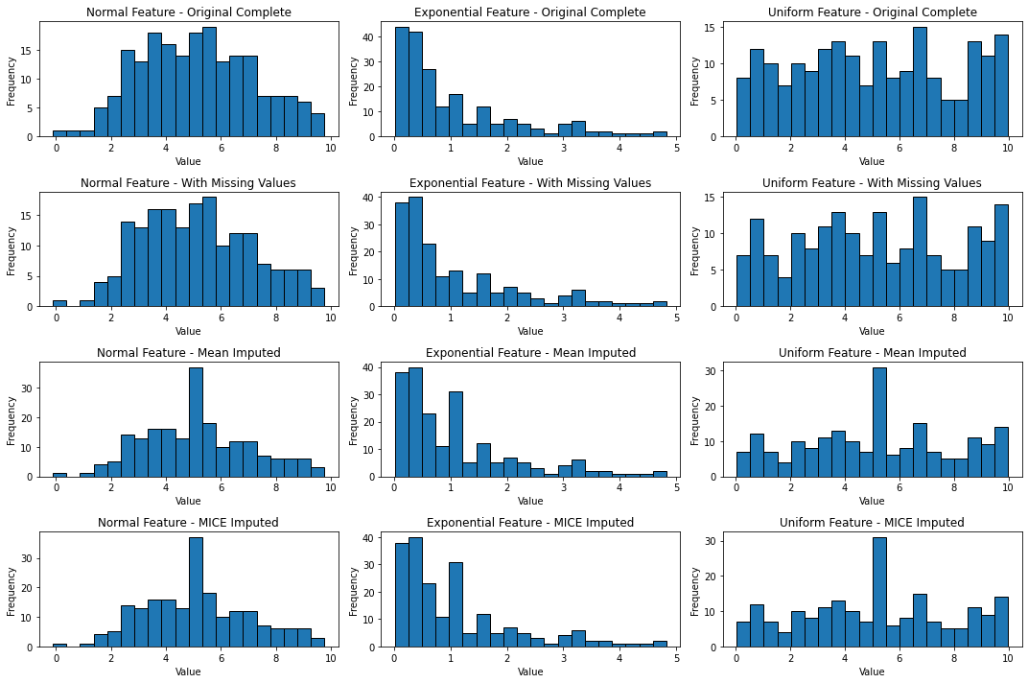
MCAR – Mean vs. MICE

Slide 53
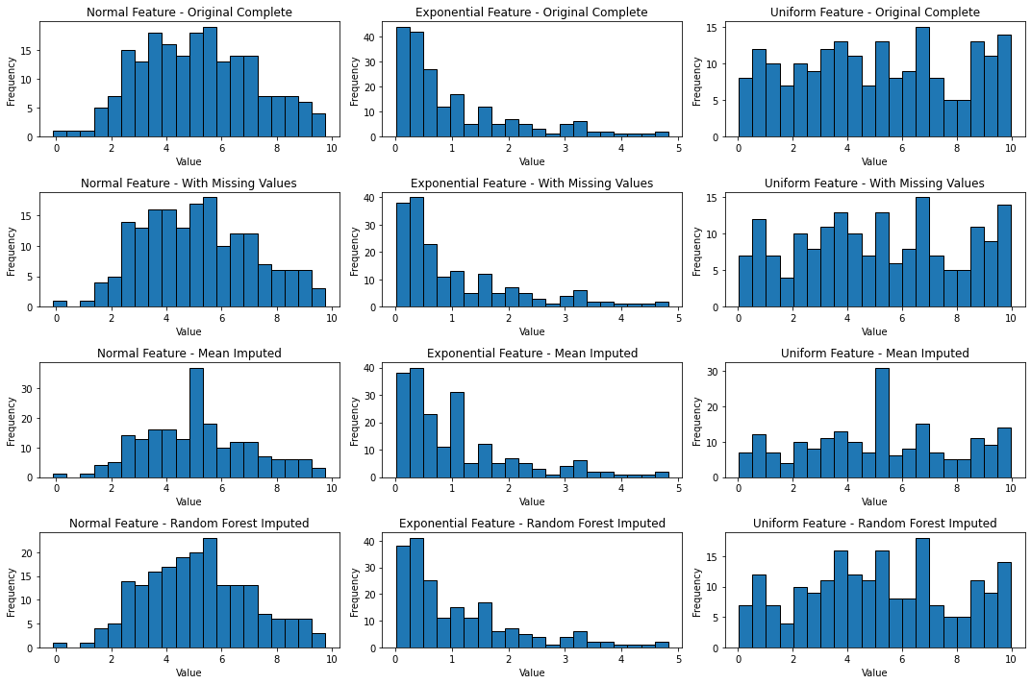
MCAR – Mean vs. Random Forest

Slide 54
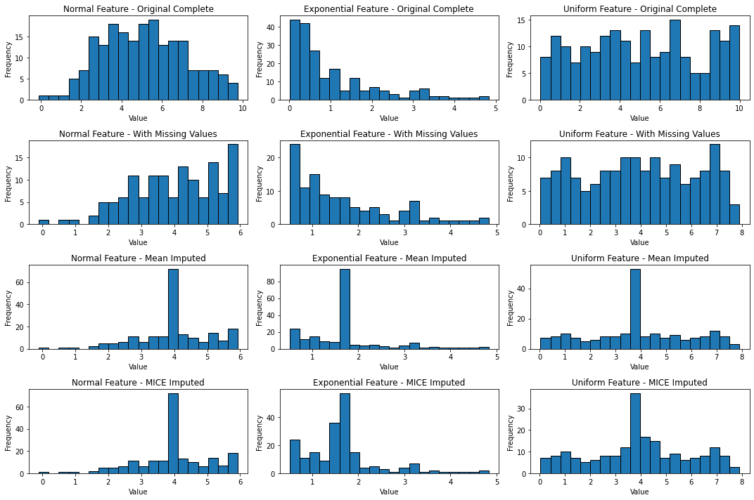
MNAR – Mean vs. MICE

Slide 55
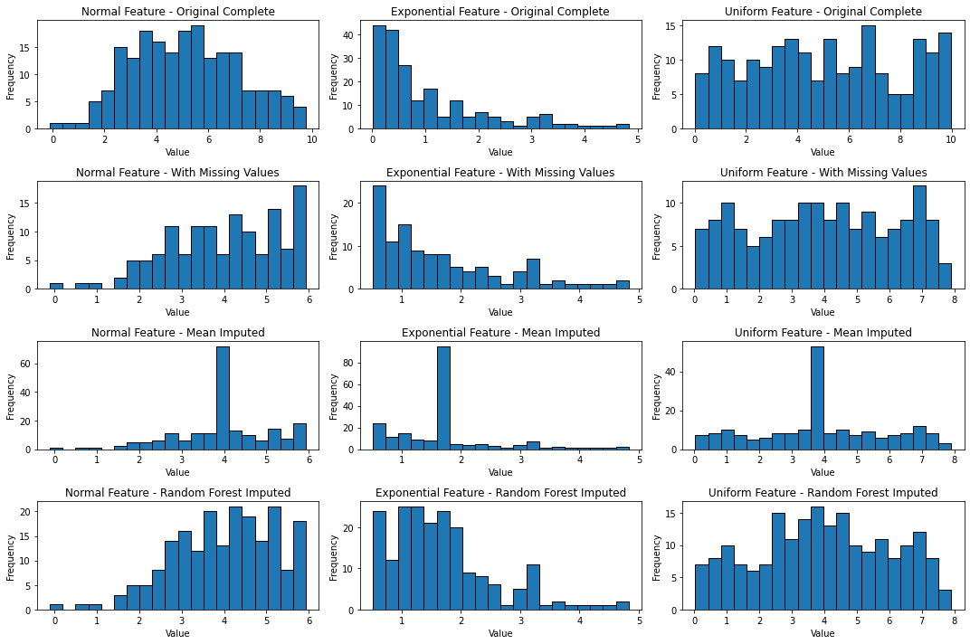
MNAR – Mean vs. Random Forest

Slide 56
Considerations for Imputation
Model Evaluation
Evaluate on Complete Cases Only: After imputation, evaluate the model's performance using only the records where the target variable is observed, and attempt to build validation sets with no missing features. This ensures that your evaluation is based on actual, known values.
Sensitivity Analysis: Check how sensitive your model's performance is to different imputation methods. Train and evaluate your model using different imputation techniques and compare the results.
Include an "Imputed" Feature: Add a binary variable that indicates whether the data was imputed for each record. This can sometimes help the model account for any potential bias introduced by imputation.
Consider the Impact of the Missing Data
Importance of the Variable: If the variable with missing data (e.g., gender) is crucial for the prediction task, imputation becomes even more critical. In such cases, more advanced imputation methods might be worth exploring.
Amount of Missing Data: High levels of missing data can make imputation more challenging and can increase the potential for bias.
Transparency and Reporting
Always document and report the percentage of missing data, the imputation method used, and any sensitivity analyses conducted. Transparency is key, especially when the model is used for decision-making.
Notes:
Conside

Slide 57
Cluster evaluation

Slide 58
Generally speaking, there is no truth
Clustering is an unsupervised machine learning task that aims to group similar data points together. Since there's no "ground truth" to compare against, evaluating the effectiveness of a clustering method can be challenging.
Data-Driven Methods: Algorithms and metrics like the Elbow method, Silhouette Analysis, and Davies-Bouldin Index provide a quantitative way to evaluate clustering. These methods are useful but only offer heuristics.
Multiple Metrics: It's advisable to use more than one evaluation metric to get a comprehensive understanding of the clustering's performance.
Visual Inspection: Visualization tools can offer an intuitive understanding of the clustering results, allowing for easy identification of patterns or anomalies.
Domain Knowledge: Often, the "best" number of clusters is guided by domain-specific knowledge rather than just data-driven methods.

Slide 59
The Elbow Method
One of the most popular techniques for determining the optimal number of clusters. It involves running the clustering algorithm for a range of cluster numbers and calculating the sum of squared errors (SSE) for each.
Sum of Squared Errors
Num Data Points
Num Clusters
Cluster centroid
1 if x_i belongs to j, else 0
Distance (Euclidean)
Notes:
How to Use the Elbow Method
Run Clustering: Perform clustering for different numbers of clusters
Calculate SSE: Compute the sum of squared errors for each clustering.
Plot SSE vs �k: Create a scree plot where the x-axis represents the number of clusters and the y-axis represents the corresponding SSE.
Identify the Elbow: Look for the point where the SSE starts to decrease more slowly, resembling an "elbow."
Limitations
Does not always provide a clear "elbow," making it ambiguous.
Not useful for data that inherently does not cluster well.

Slide 60
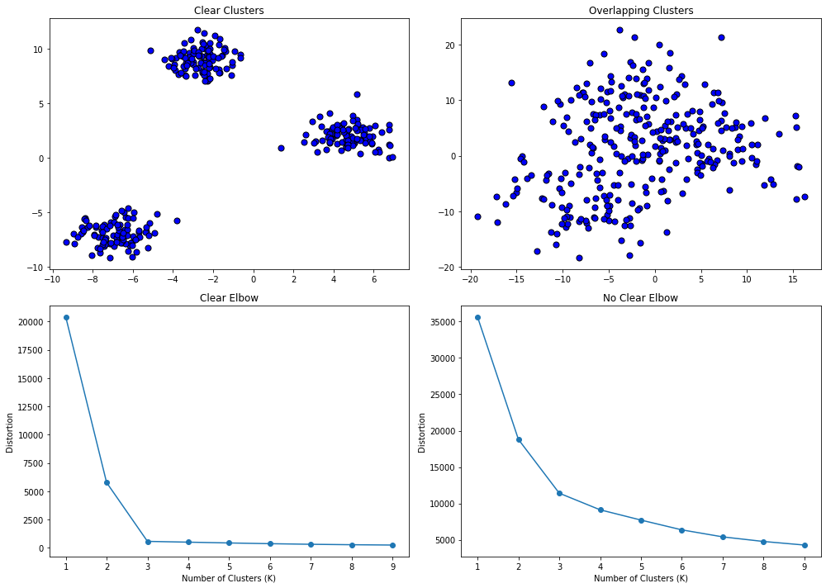
The Elbow Method

Slide 61
Silhouette Analysis
Silhouette Analysis provides insight into the separation distance between the resulting clusters. More distant clusters lead to better clusterings.
Silhouette Scores for each data point
Lowest avg. distance to points in other clusters
Average distance points in same cluster

Slide 62
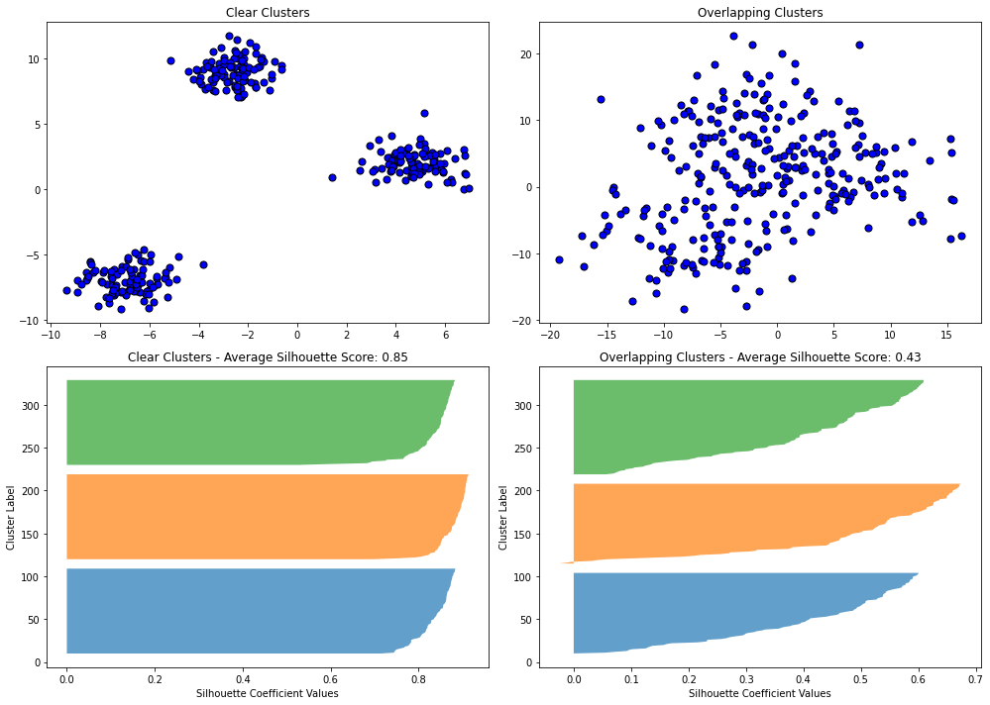
Silhouette Analysis

Slide 63
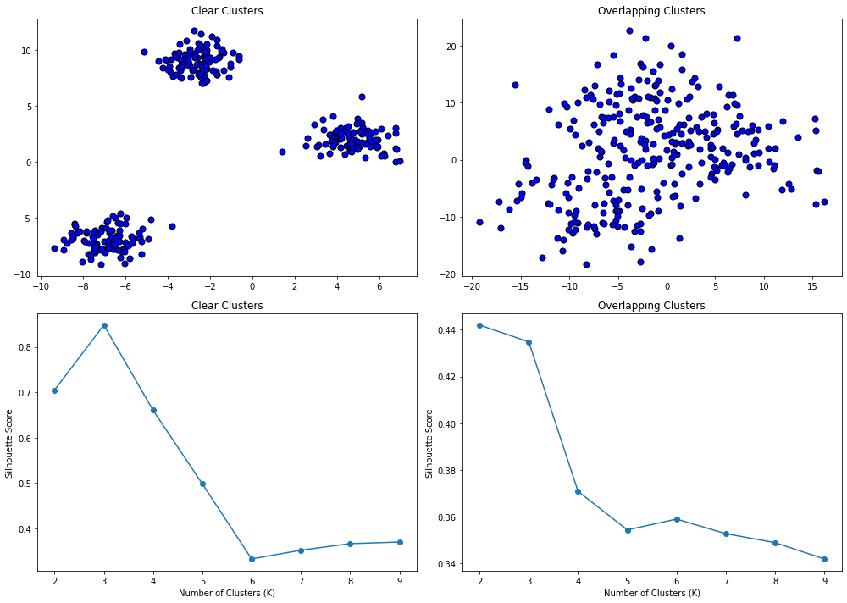
Silhouette Analysis

Slide 64
Davies-Bouldin Method
The Davies-Bouldin Index is another metric used to evaluate the quality of a clustering algorithm. Unlike the Silhouette Score, lower values of the Davies-Bouldin Index indicate better clustering. Calculation is:
Within-cluster Distance:
Between-cluster Distance: For each pair of clusters i,j, calculate distance d(c_i,c_j) between centroids.
Davies Bouldin value for a Pair.
Maximal DB value for each Cluster:
Average over all clusters:
Each cluster
Centroid for each cluster

Slide 65
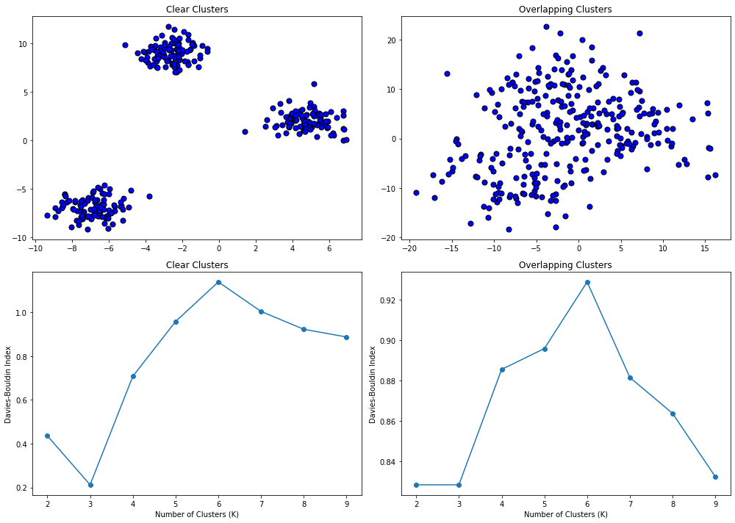
Davies-Bouldin Method

Slide 66
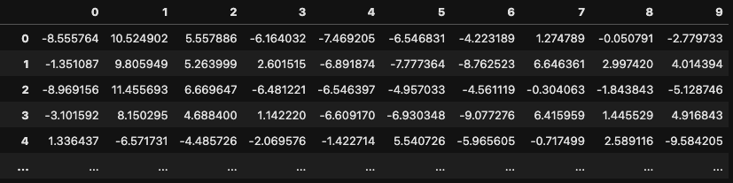
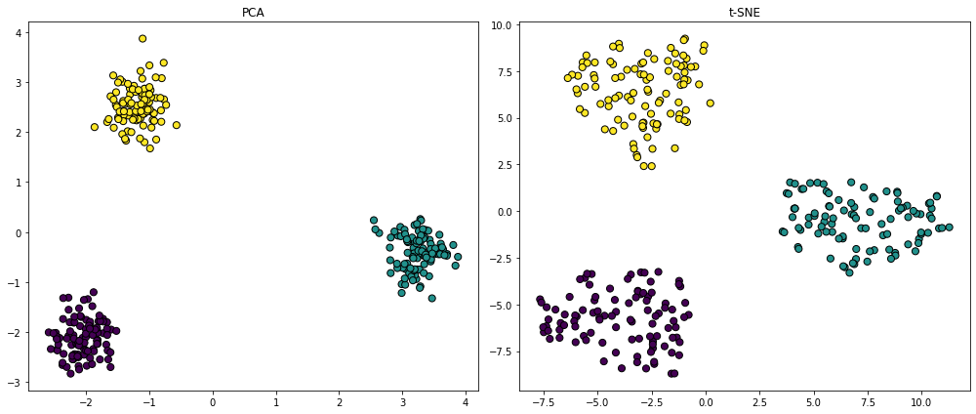
Visualizing high dimensional clustering

Slide 67
Visualizing high dimensional clustering
Visualizing high dimensional data presents a challenge, because more than 3 dimensions cannot be readily examined
One strategy is to reduce the dimensionality using PCA, tSNE, or UMAP.
Considerations:
Always standardize your data before reducing dimensionality!
Try different techniques – different dimensionality reduction schemes optimize for different things, yielding different views.
Always pair visualization with other methods

Slide 68
Comparing clusterings
Sometimes it is useful to compare different clusterings
When the “truth” is in fact known
When comparing clustering methods, parameters, etc.
Several methods are available, including the Adjusted Rand Index and Variation of Information score.

Slide 69
Adjusted Rand Index
A measure of the similarity between two data clusterings, adjusted for chance.
Takes values between -1 and 1.
ARI = 1: Perfect match
ARI > .65: Marginally acceptable
ARI = 0: Random clustering
ARI < 0: Poor clustering
Does not require the same labels, or even the same number of clusters

Slide 70
Adjusted Rand Index
It is possible to calculate a p-value for ARI, as follows:
Compute the ARI for your actual data: This will be the value you're testing for significance.
Random Permutations: Shuffle the labels of one of the two clusterings (either true or predicted) randomly, while keeping the other clustering fixed. Compute the ARI for each of these permuted sets.
Generate a Null Distribution: Repeat step 2 a large number of times (e.g., 1000 or 10,000 times) to generate a distribution of ARI scores that you would expect to see purely by chance.
Calculate p-value: The p-value is the proportion of permuted ARIs that are greater than or equal to the observed ARI. A small p-value indicates that the observed ARI is significantly different from what would be expected by random chance, thus suggesting that the clustering is meaningful.

Slide 71
Stability Analysis
Imagine you're trying to group your friends based on their favorite types of movies. If you ask them today and group them, you might find clear clusters: the action movie lovers, the rom-com aficionados, and the horror fans.
Stable Scenario: If you ask them again a week later and they give you almost the same answers, leading to almost the same groups, your clusters are stable.
Unstable Scenario: On the other hand, if you find that the groups change dramatically, maybe because you realized you forgot to consider documentaries and dramas, then your initial clustering would be considered unstable.
In both scenarios, stability analysis would help you assess how reliable your clusters are over time or against minor changes in the dataset.
Notes:
Other examples include trying to cluster many many points, or when doing dimensionality reduction *before* clustering.

Slide 72
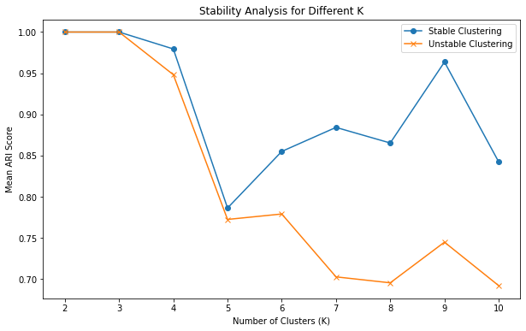
Stability Analysis
The general idea here is to calculate cluster assignments over multiple instances and then compare adjacent clusterings.
When instances follow an original parameter range, looking for a “plateau” can help identify a decent parameter range

Slide 73
Stability Analysis Considerations
Very good with lots of data
Too much to cluster at once, so take multiple samples!
General; informative for any clustering technique
Provides a general sense of algorithm performance
Does NOT necessarily guide you to the “truth”

