Slide 1



EqualEyes
IST-707 Applied Machine Learning – Professor Joshua Introne
Team 5
Shashank Guda
Soundarya Ravi
Ramya Chowdary Patchala
Vishnu Charugundla
Rithika Gurram

Slide 2
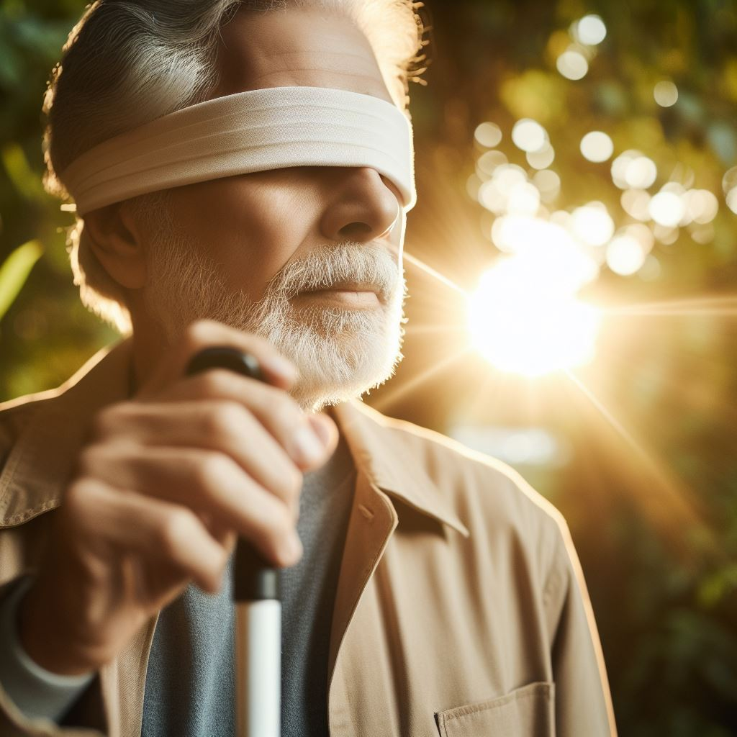
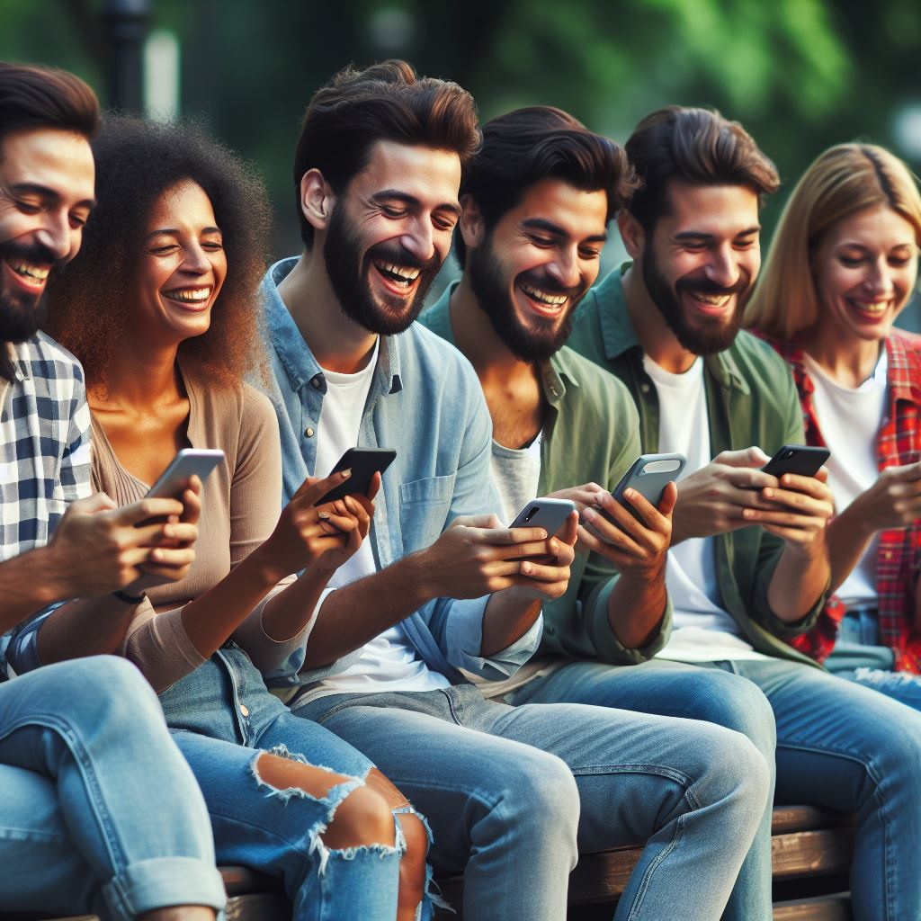

Introduction
Project Objective:
Develop a deep learning system to automatically accurate descriptive sentences/phrases for each image
Key Stakeholders:
Individuals with Visual Impairments
Rely on screen readers for image content access
Benefit from accurate descriptive captions
Social Media Users
Engage across Instagram, Twitter, Facebook etc.
Seek captions for enriched experiences
Teachers and Educators
Utilize technology for engaging learning
Support early literacy and language development

Slide 3


Data
CoCo Dataset
Train Images : 118289
Test Images : 40672
Validation Images: 1000
1.5 million object instances
80 object categories
91 stuff categories
250,000 people with key points
ImageNet Dataset
Training Images: 1,281,167
Validation Images: 50,000
Test Images: 100,000
ImageNet: 1,000 Object Classes
Annotations: Images are hand-annotated for objects and potentially bounding boxes (not all images).

Slide 4



Methods
Exploration
Preprocessing
Modelling
Image Size Distribution: Analyzing the distribution of image sizes in the dataset.
Image Orientation Analysis: Checking the orientation (landscape, portrait, etc.) of images in the dataset.
Image Quality Assessment (Sharpness): Assessing the quality of images in terms of sharpness or blur.
Caption Length Distribution: Examining the distribution of caption lengths (number of words) across images.
Word Frequency Analysis: Performing word frequency analysis on the captions to identify common and rare words.
Duplicate Image Detection: Identifying and handling duplicate images in the dataset using techniques like perceptual hashing.
Text Tokenization and Vectorization: Converting text captions into numerical representations (vectors) for model training.
Image Augmentation: Applying transformations (rotation, flipping, etc.) to artificially increase the diversity of training images.
CNN Encoder-Decoder (InceptionV3): This approach uses a convolutional neural network (CNN) like InceptionV3 as the encoder to extract image features, which are then decoded by a language model to generate captions.
Vision Transformer (ViT-GPT2): This model combines the vision transformer (ViT) for image encoding and a transformer-based language model like GPT-2 for caption generation, allowing for better capture of long-range dependencies.
BLIP (Bootstrapping Language-Image Pre-training): BLIP is a unified vision-language model pre-trained on a large dataset of image-caption pairs, enabling effective image understanding and caption generation through multi-modal learning.

Slide 5
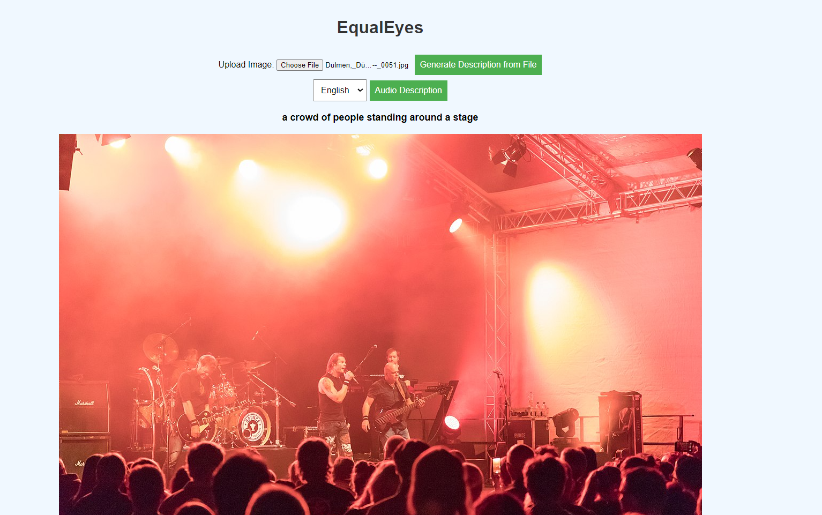
Current Results
The web app uses our Vision Transformer (ViT-GPT2) to generate descriptions and audio captions for user-uploaded images.

Slide 6
Next steps..
Work Remaining:
Translation: Exploring methods to translate generated captions into multiple languages for wider accessibility.
Using BLiP Model: Integrating BLiP model to generate more accurate and contextually relevant image captions.
Challenges:
CPU Idling Issue: CPU was idling out during model inference
GPU Processing Issue: GPU was not triggering, causing the model to run slowly.

