Slide 1
A New Method for ERP Implementation based on Business Function Analysis and Identification of Vocational Business Enterprises (BUMDes) in Toba
TA-10
Angelina I Purba 12S16010
Soraya M Gultom 12S16021
Adventina D Siahaan 12S16052

Slide 2
Overview
Preliminary
Background
Research Question
Purpose
Scope
Theoretical Basis
ERP System
Vocational Business Enterprises (BUMDes)

Slide 3
Overview
Analysis
Analysis of BUMDes
Analysis of ERP
Analisis Modules ERP
Analysis Business Function of ERP
Analysis Data of ERP
Design
System Requirement
Flowchart Diagram
Implementation
Implementation Environment
Implementation of ERP Recommendation Information System

Slide 4
Preliminary

Slide 5
Back Ground
BUMDes needs an integrated information system to be able to realize speed in service for the society and transparent financial information.
BUMDes needs the right method to implement the integrated system (Enterprise Resource Planning)

Slide 6
Research Question
How is the classification of BUMDes in Toba in accordance with Regulation of the Minister of Villages, Development of Disadvantaged Regions, and Transmigration of the Republic of Indonesia Number 4 of 2015 Article 19?
What ERP applications and ERP modules are appropriate to be implemented at BUMDes in Toba?
What is the method for implementing ERP on BUMDes in Toba based on ERP Life Cycle by Esteves and Pastor?

Slide 7
Purpose
Classifying BUMDes through types found in every BUMDes in Toba in accordance with Government Regulations, namely Regulation of the Minister of Villages, Development of Disadvantaged Areas, and Transmigration of the Republic of Indonesia Number 4 of 2015 Article 19.
Identifying ERP applications and ERP main modules to be implemented in accordance with the general BUMDes business function in Toba.
Generate an appropriate method for implementing ERP on BUMDes and evaluate the method through a case study on one of BUMDes classification results in Toba.

Slide 8
Scope
Evaluate the ERP implementation method on the main modules that have been identified based on the BUMDes business function in general in Toba.

Slide 9
Theoretical Basis

Slide 10
Enterprise Resource Planning (ERP) is a corporate resource planning system that aims to integrate the entire business function of the company
ERP is divided into two types, namely commercial-based ERP systems and ERP systems that are based on open source
The life cycle framework according to Esteves and Pastor is as follows
a. Adoptions Decision Phase
b. Acquisition Phase
c. Implementation Phase
d. Use and Maintanance Phase
e. Evolution Phase
f. Retirement Phase
ERP System

Slide 11
Vocational Business Enterprises (BUMDes)
Six business forms of BUMDes according to the Regulation of the Minister of Villages, Disadvantaged Regions and Transmigration of the Republic of Indonesia number 4 of 2015
  Social
  Rent
  Finance
  Trade
  Brokering
  Holding

Slide 12
Analysis

Slide 13
Analysis of BUMDes
1. Social
This BUMDes is used to serve the community in society.
An example of this BUMDes is the village drinking water service.
2. Rent
This BUMDes aims to serve the needs of the local community in terms of leasing goods and at the same time to obtain village income. Examples of BUMDes in the rental sector are: Agricultural Equipment Rental, Animal Husbandry Equipment Rental, Party Equipment.

Slide 14
Analysis of BUMDes
3. Finance
This BUMDes runs a savings and loan business to meet the financial needs of rural communities with lower or no interest rates for business loans.
Examples of BUMDes businesses in the financial sector are: Village Banks or Cooperatives and Village Financial Institutions that provide business loans to Village Communities at low interest rates even without interest.

Slide 15
Analysis of BUMDes
4. Trade
BUMDes can run a trading business by selling the products of the Village Community or certain goods to meet the needs of the Village Community.
Examples of BUMDes Enterprises in the field of Trade include: Village Agricultural Production Centers, Village Handicraft Centers, Village Processed Food Centers

Slide 16
Analysis of BUMDes
5. Brokering
BUMDes can also be an "intermediary institution" that connects the results of the productivity of the Village Community with the broad market.
Or it could also BUMDes sell services to the Village Community or business units of the Village community.
Examples of BUMDes Business Ideas in Brokering are: Electricity payment services, PAM, Tel, Motor Vehicle Tax Payment Service

Slide 17
Analysis of BUMDes
7. Holding
BUMDes as a "joint venture", or as a Main Business of business units in the village. Each unit stands alone, but is managed by the main BUMDes to be able to grow and develop together.

Slide 18
Analysis of BUMDes
The following is the classification of 102 BUMDes (131 units) in Toba (2020):
1. There are 25 units of BUMDes with the type of BUMDes Social Business
2. There are 11 BUMDes units in the BUMDes rental business type
3. There are 9 units of BUMDes with the type of BUMDes Brokerage / BUMDes
4. There is 1 unit of BUMDes with the type of Joint Venture BUMDes / Holding
5. There are 65 BUMDes units with the type of BUMDes Trading Business
6. There are 20 BUMDes with types of BUMDes Financial Business

Slide 19
Analysis of ERP System
Based on the results of the literature study ERP right to be implemented at SMEs is open source ERP, the ERP is :
  Odoo
  Adempiere
  Dolibarr

Slide 20
Analysis of Modules
Based on the results of the literature study the main modules of ERP which are often implemented at SMEs are:
  Accounting and Finance
  Sales Management
  Purchase
  Manufacturing
  Inventory
  Human Resource Management (HRM)
  Customer Relationship Management (CRM)

Slide 21
Analysis of Modules
1. Accounting and Finance
This module is used as a parameter for profit calculation, measuring company performance by referring to all transactions in all company departments
2. Sales Management
This module is used to manage and record sales.
Allows us to make new orders and review existing orders. Order confirmation can trigger delivery of goods, invoices and time determined by the arrangements in each order.

Slide 22
Analysis of Modules
3. Purchase
This module is used to manage and record purchase transactions such as determining purchase quota, making purchase orders and recording purchase returns
4. Manufacturing
This module is used to manage product design, material selection, process planning, production planning, management, marketing, which involves materials, machinery, tools, and labor.
Inventory

Slide 23
Analysis of Modules
5. Inventory
Inventory module is a module that manages all activities related to inventory, starting with data collection of goods along with categories, types, units, and specifications of goods, supplier data collection for inventory, procurement proposals, order items, receipt of orders, returning orders, labeling inventory, carry out inventory mutations to existing units, perform maintenance, inventory disposal, check inventory stock (hospitalization), until making reports

Slide 24
Analysis of Modules
6. Human Resource Management (HRM)
This module aims to manage existing HR data in the company, build an efficient recruitment and development system through career management.
7. Customer Relationship Management (CRM)
This module is used to ensure services arrive or not to the customer. Thus after the sale is complete, this application will automate the business functiones used for the company's sales, services and support. In other words, this module acts as a means of connecting between the company and its customers.

Slide 25
Analysis Business Function of ERP
Based on the results of the literature study there are 61 business functions from the main module list on erp, including:
1. There are 3 business functions in the CRM module
2. There are 5 business functions in the Sales Management module
3. There are 5 business functions in the Purchase Management
module
4. There are 11 business functions in the Inventory Management
module
5. There are 5 business functions in the Manufacturing module
6. There are 22 business functions in the Invoicing Management
module
7. There are 10 business functions in the HRM module

Slide 26
Analysis Data of ERP
Based on the results of the literature study there are 13 data needed to run a business function, including:
1. Data of Customer
2. Data of Vendor
3. Data of Sellable Products
4. Data of Purchasable Product
5. Data of Services Product
6. Data of Production Product
7. Data of Taxes
8. Data of Employee
9. Data of Asset
10. Data of Bank
11. Data of CoA
12. Data of Warehouse
13. Data of Budget
14. Rental Product

Slide 27
Desain

Slide 28
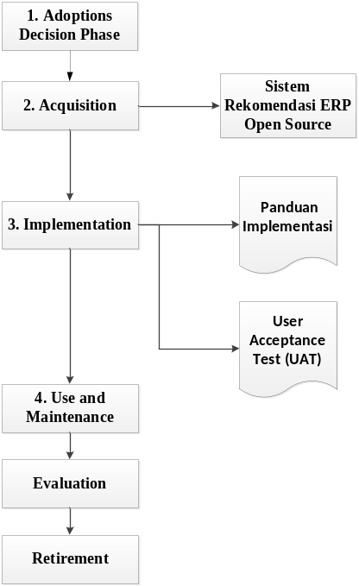
ERP Implementation
Method Design

Slide 29
Implementation
Implementation of ERP Recommendation Information System
The information system developed is the ERP Recommendation Information System and this information system was developed using the PHP. Information systems are built using Sublime Text 3 and use MySQL as a database.

Slide 30
DEMO

Slide 31
Conclusions and Recommendations

Slide 32
Conclusion
The research team has conducted BUMDes classification. In Toba Regency (2020) there are 102 BUMDes with 131 units in them.
1. There are 25 units of BUMDes with the type of BUMDes Social Business
2. There are 11 BUMDes units in the BUMDes rental business type
3. There are 9 units of BUMDes with the type of BUMDes Brokerage / BUMDes
4. There is 1 unit of BUMDes with the type of Joint Venture BUMDes / Holding
5. There are 65 BUMDes units with the type of BUMDes Trading Business
6. There are 20 BUMDes with types of BUMDes Financial Business

Slide 33
Conclusion
2. The research team has conducted an analysis of the top 3 most frequent and suitable ERPs for BUMDes namely
1. Odoo
2. Adempiere
3. Dolibarr.
7 Functional Area / Main module and 2 additional modules namely Invoicing, Manufacturing, Inventory, Sales, Purchase, CRM and HRM as the main module and Rental Management and Saving and Loan as additional modules.

Slide 34
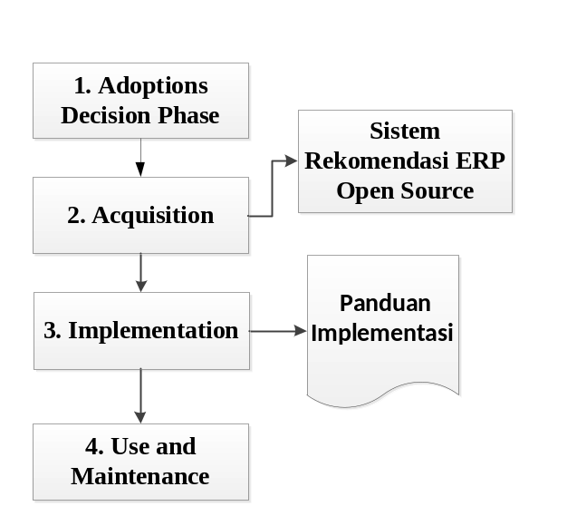
Conclusion
The results of the new method for BUMDes adopted by ERP Life Cycle Esteves and Pastors

Slide 35
Recommendations
In conducting research, the research team is still using literature studies to adjust the business functions of ERP on BUMDes. For further research, it is expected to conduct requirements on BUMDes as well as ERP analysis.
In conducting research, the research team implements implementation at the end of the study so that it cannot see the changes that occur in BUMDes after conducting the implementation. For further research, implementation is expected to be carried out at the beginning of the study in order to see changes in the BUMDes.

Slide 36
Question and Answer

Slide 37
Thank You

