Slide 1


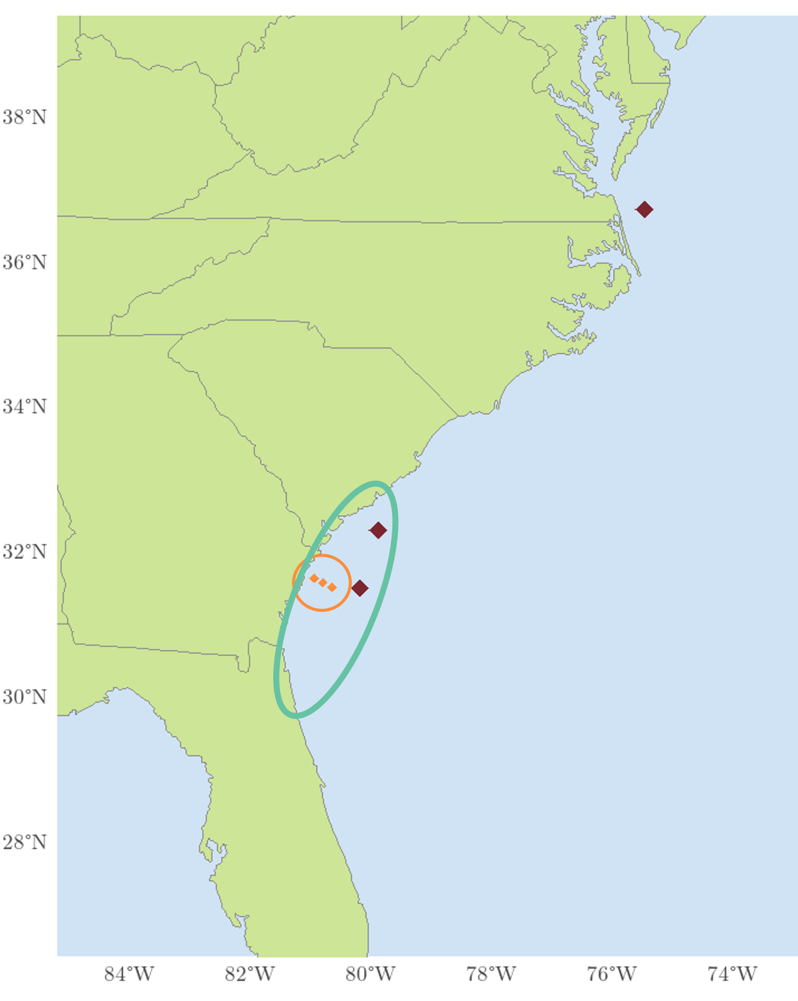
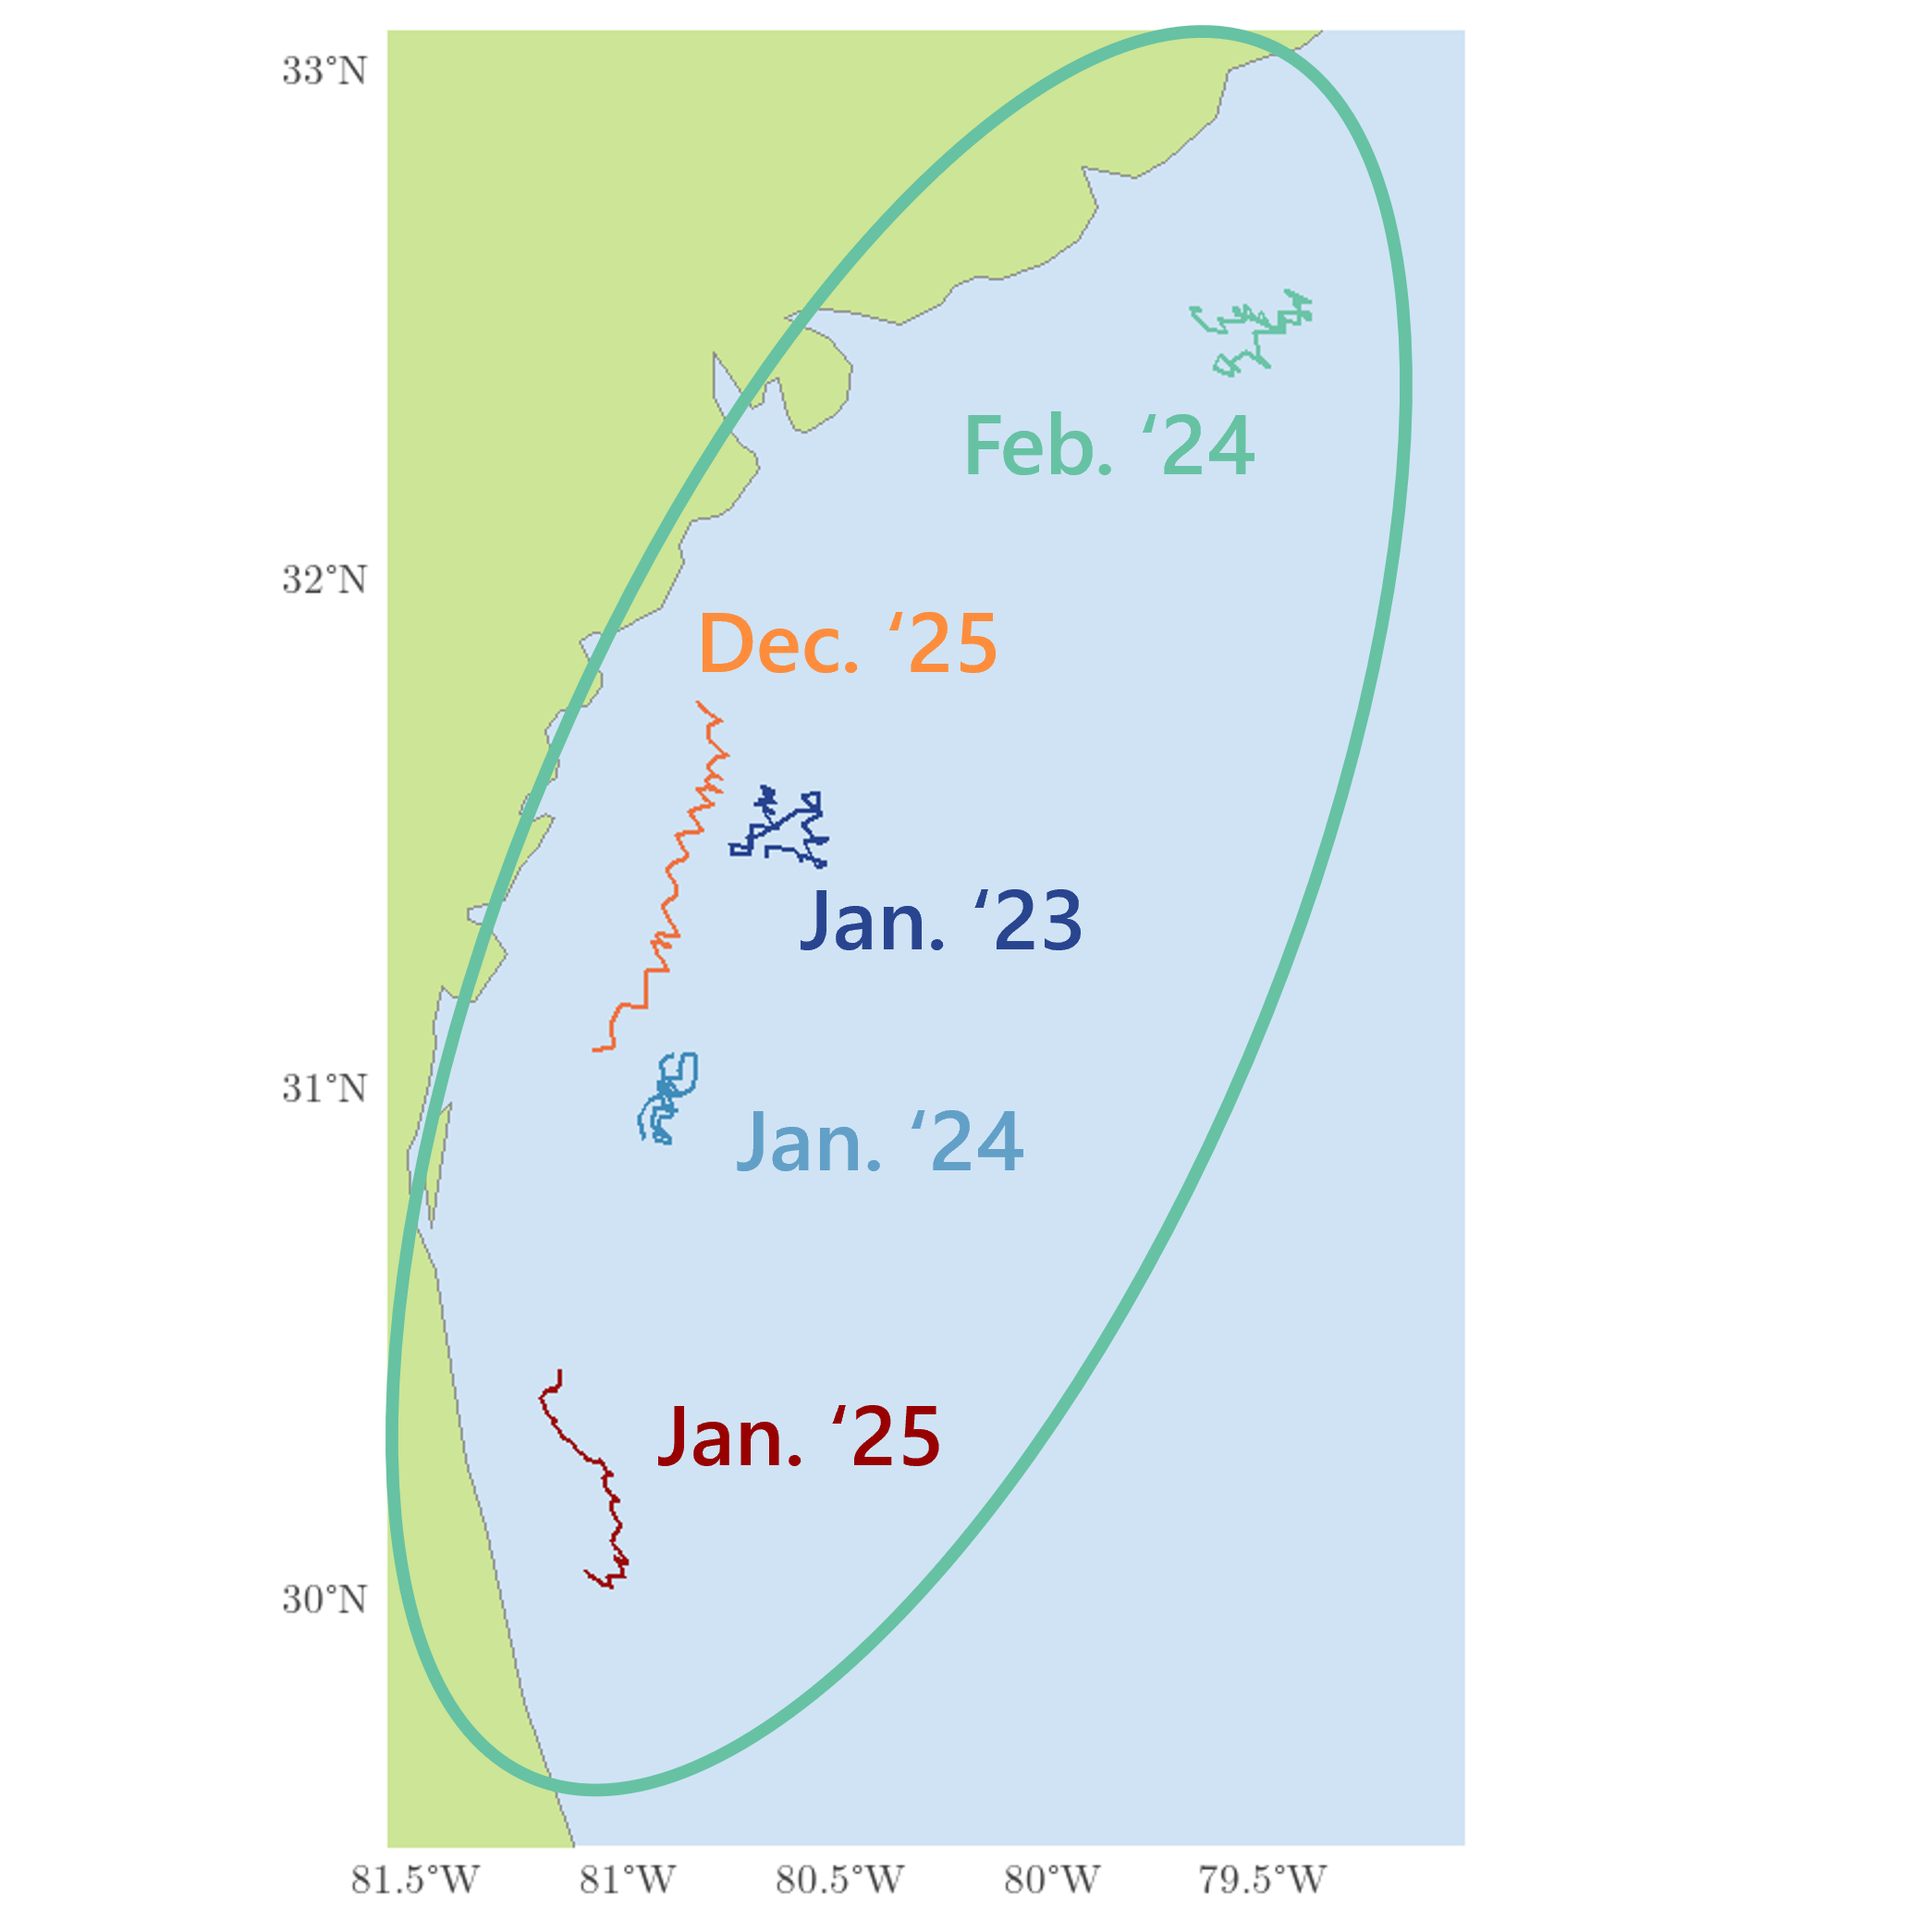
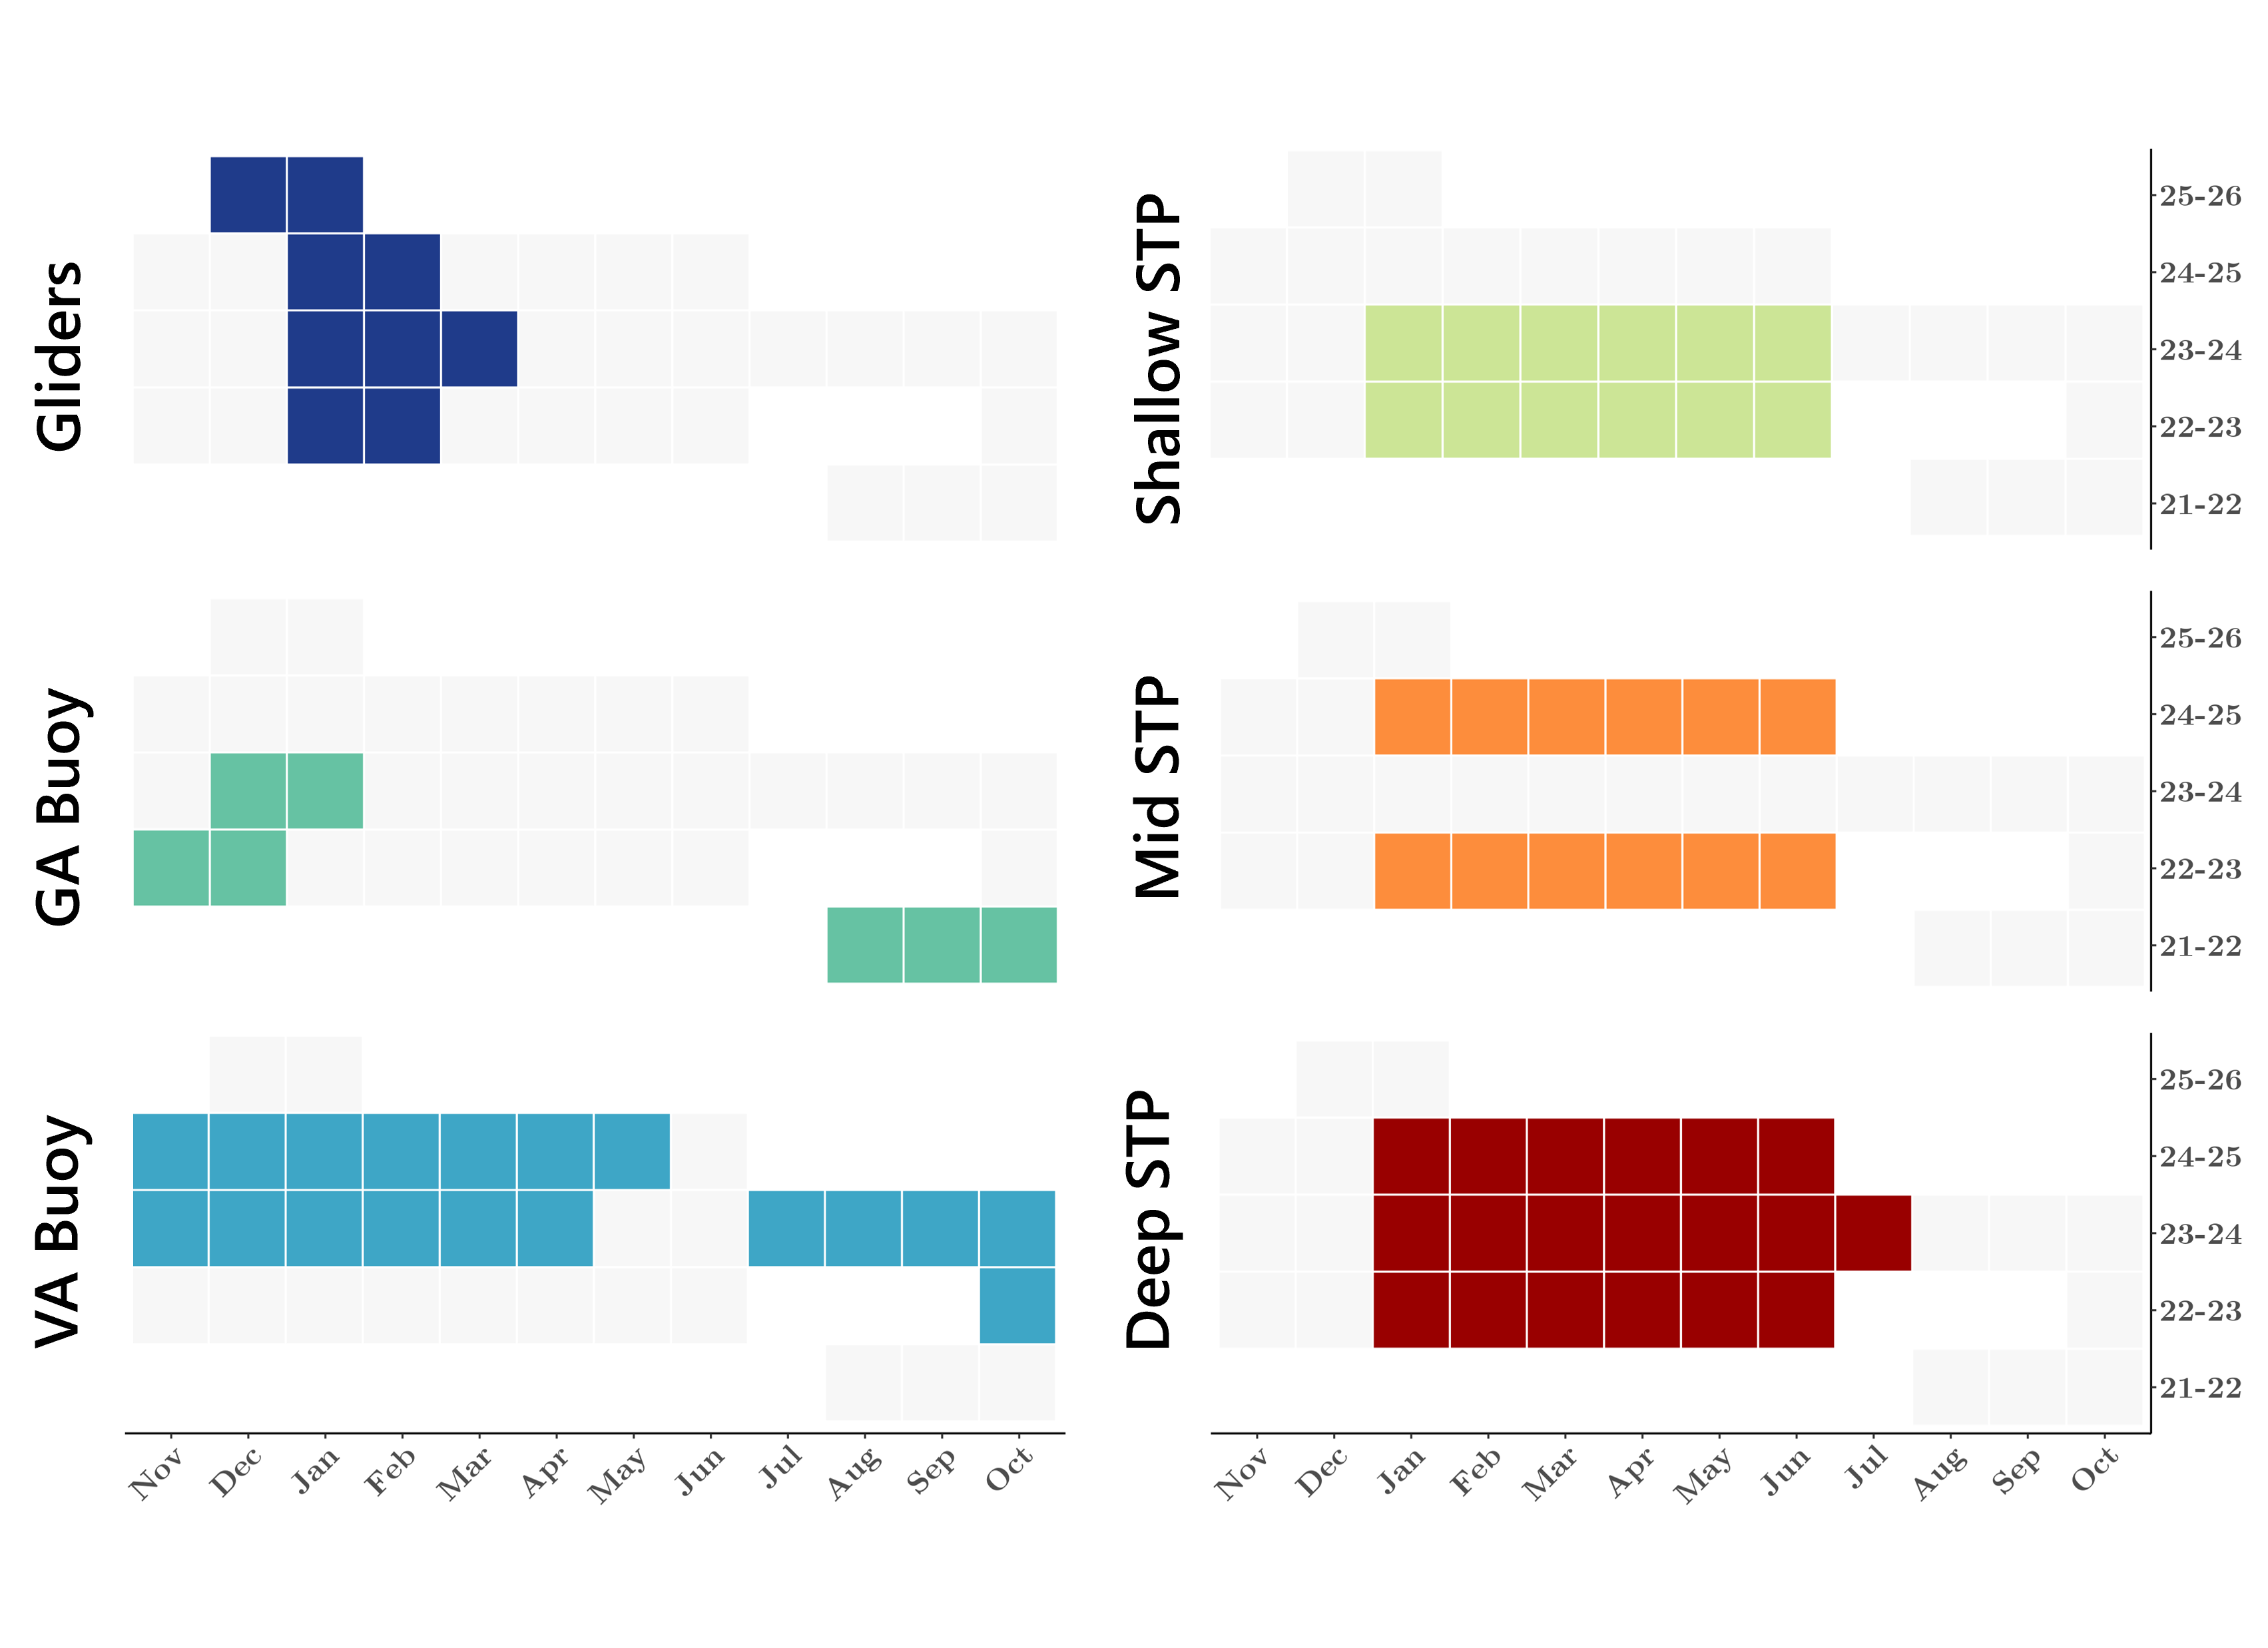
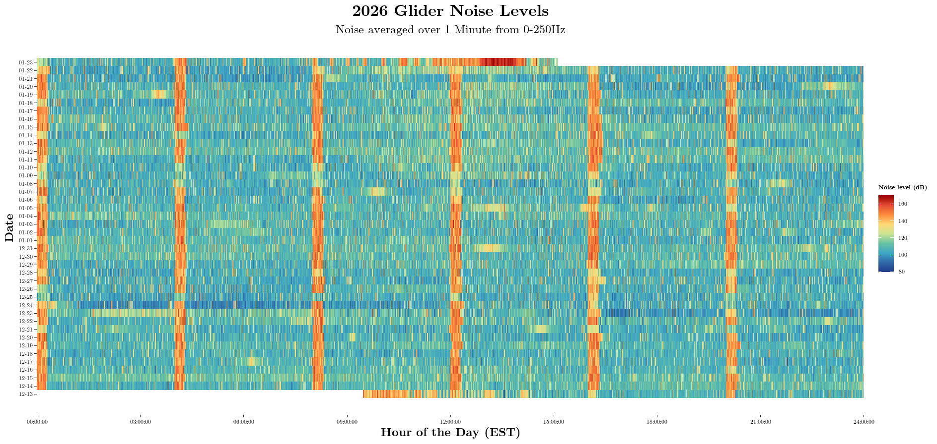
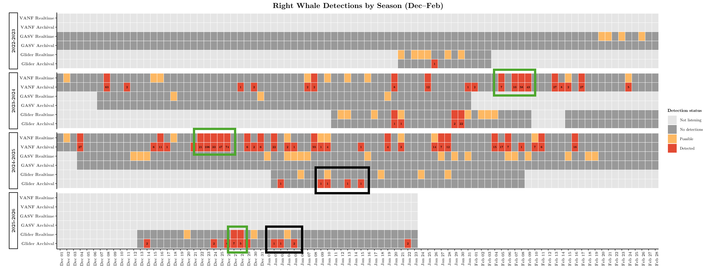
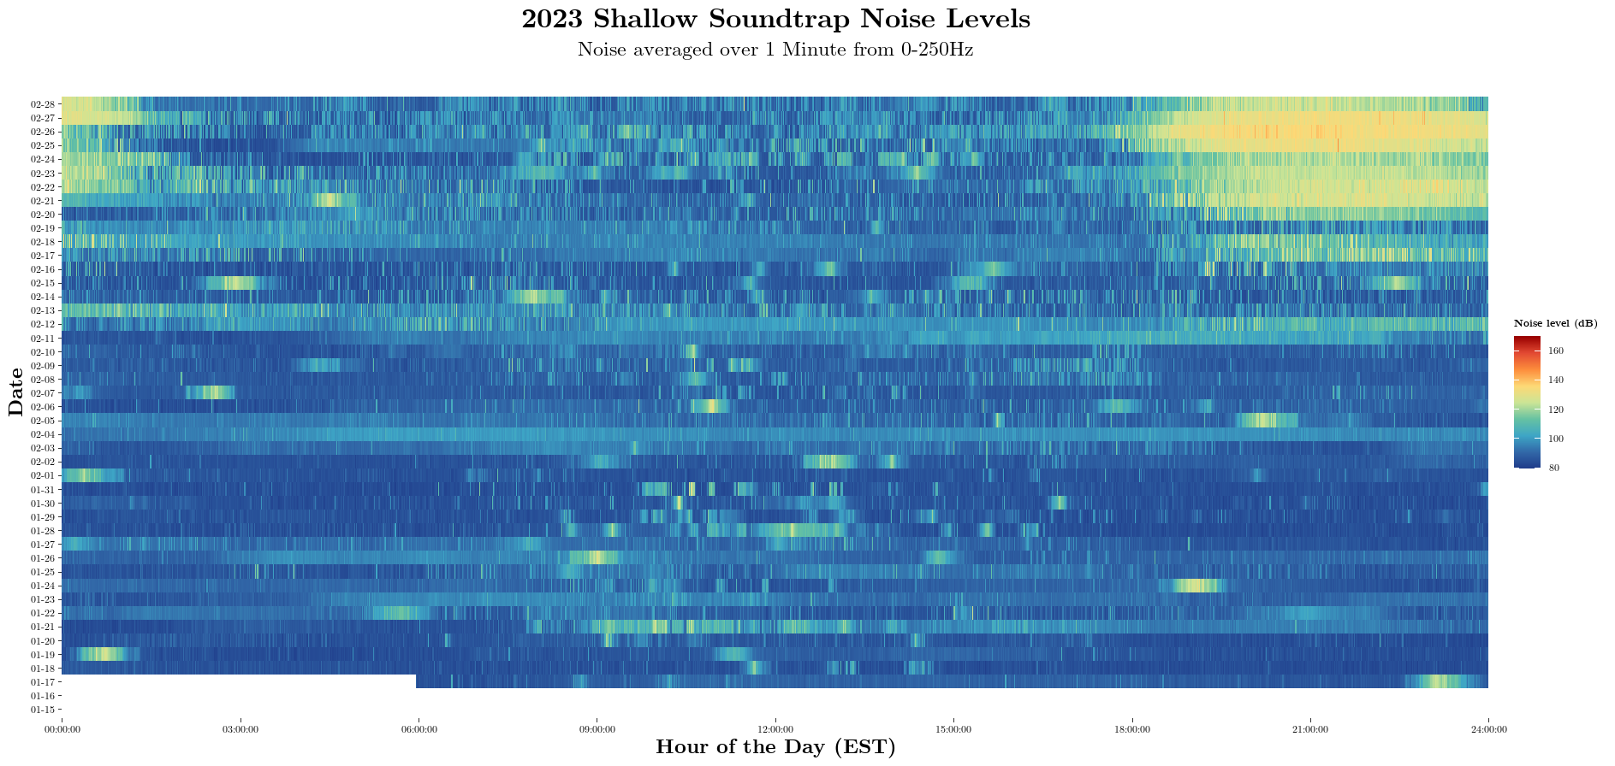
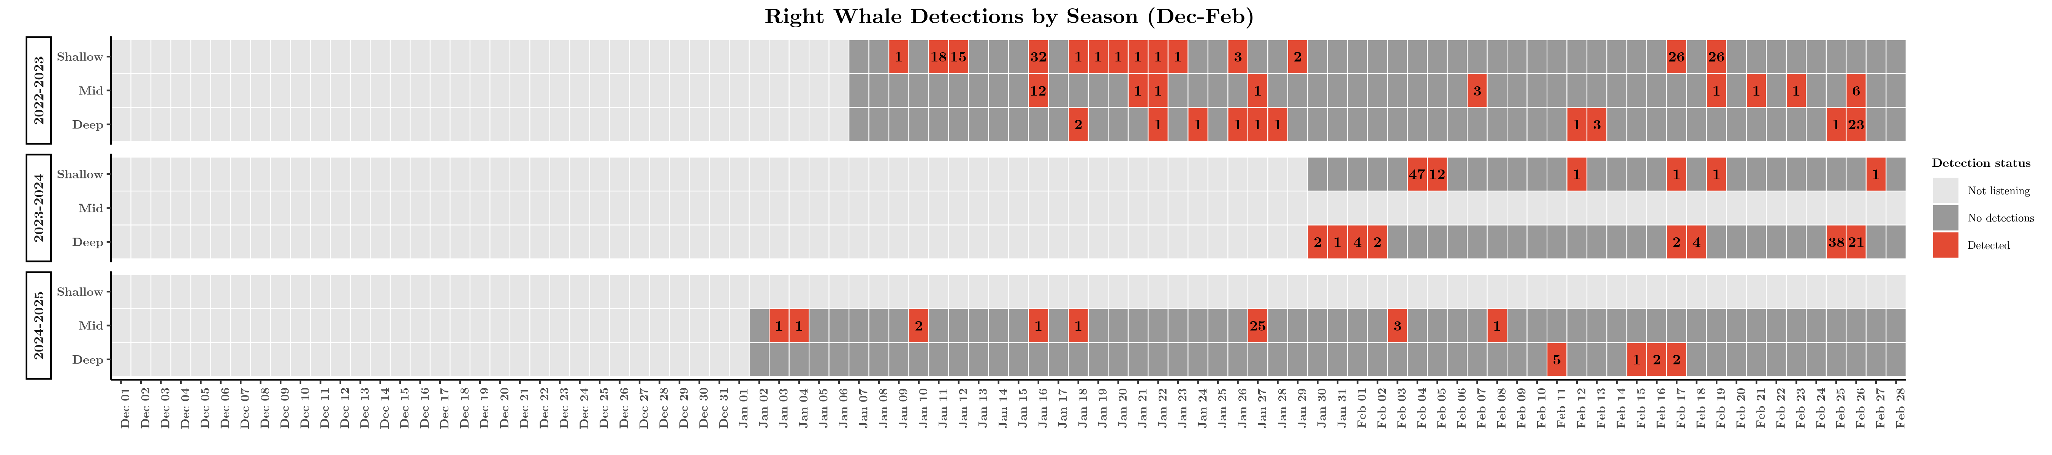
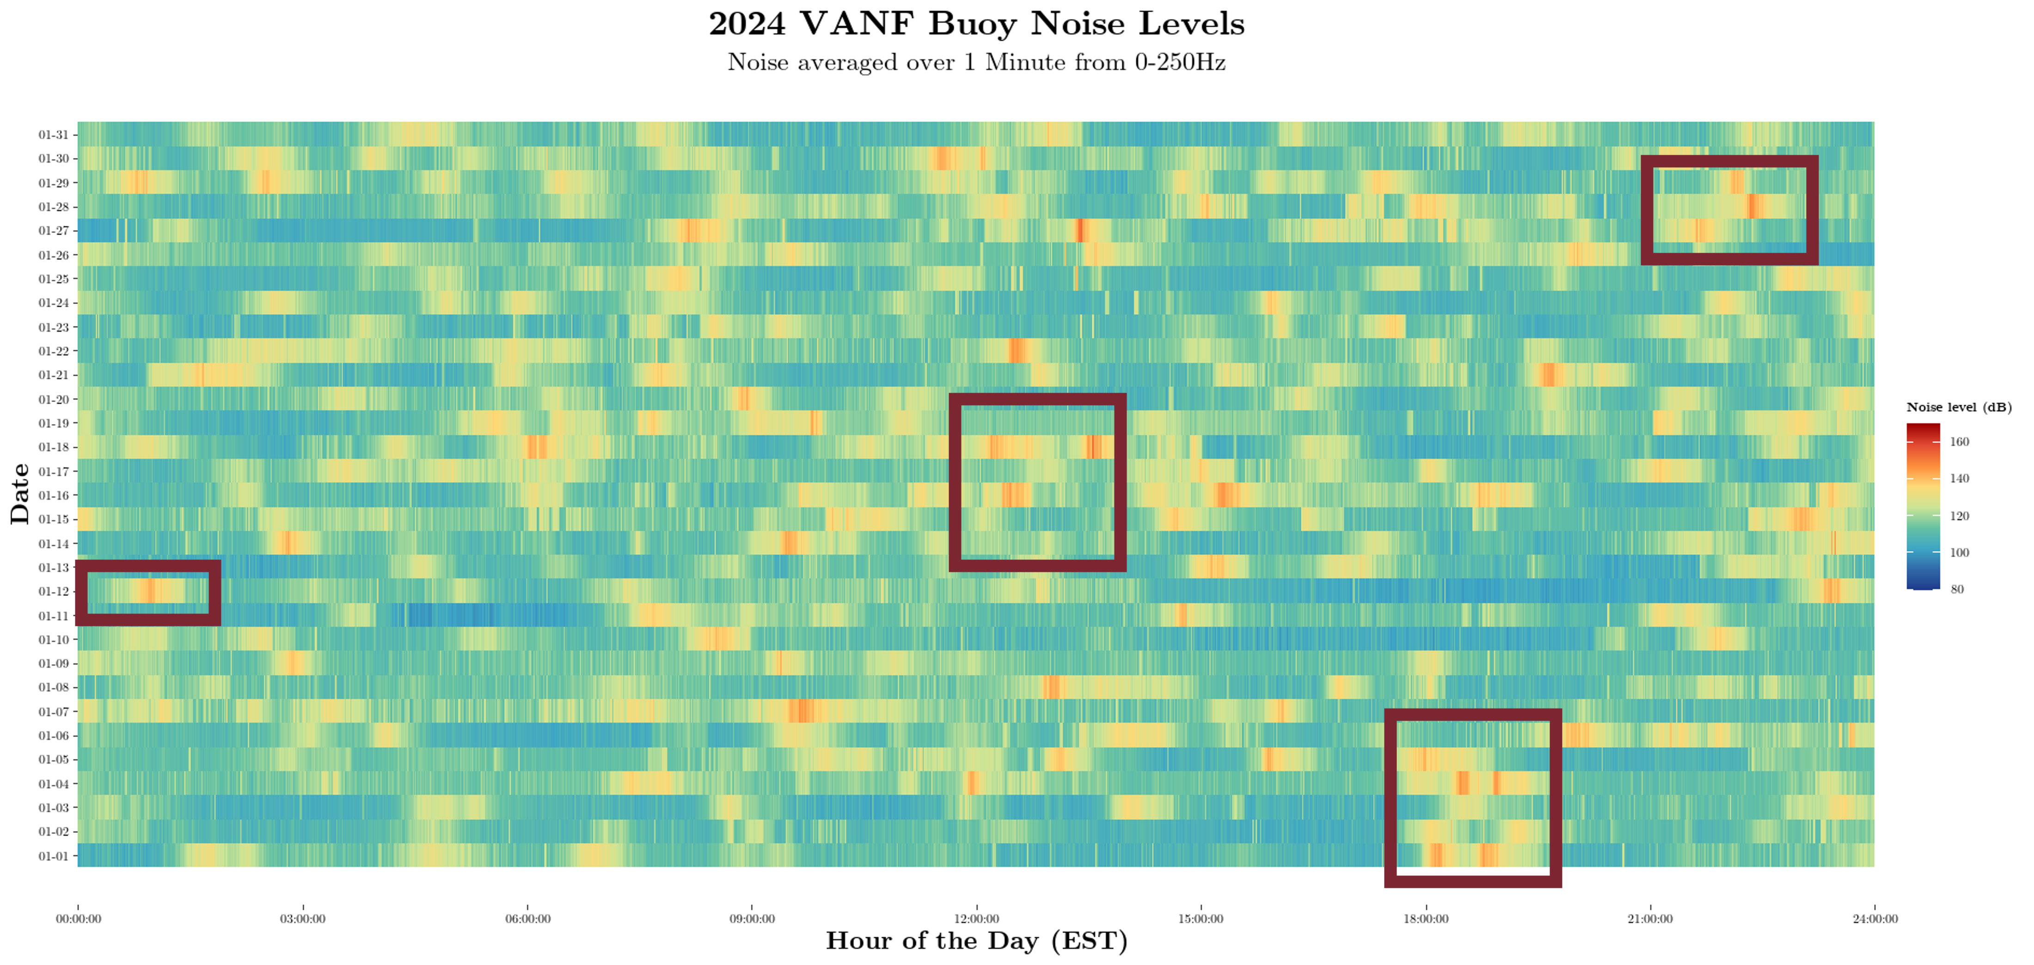
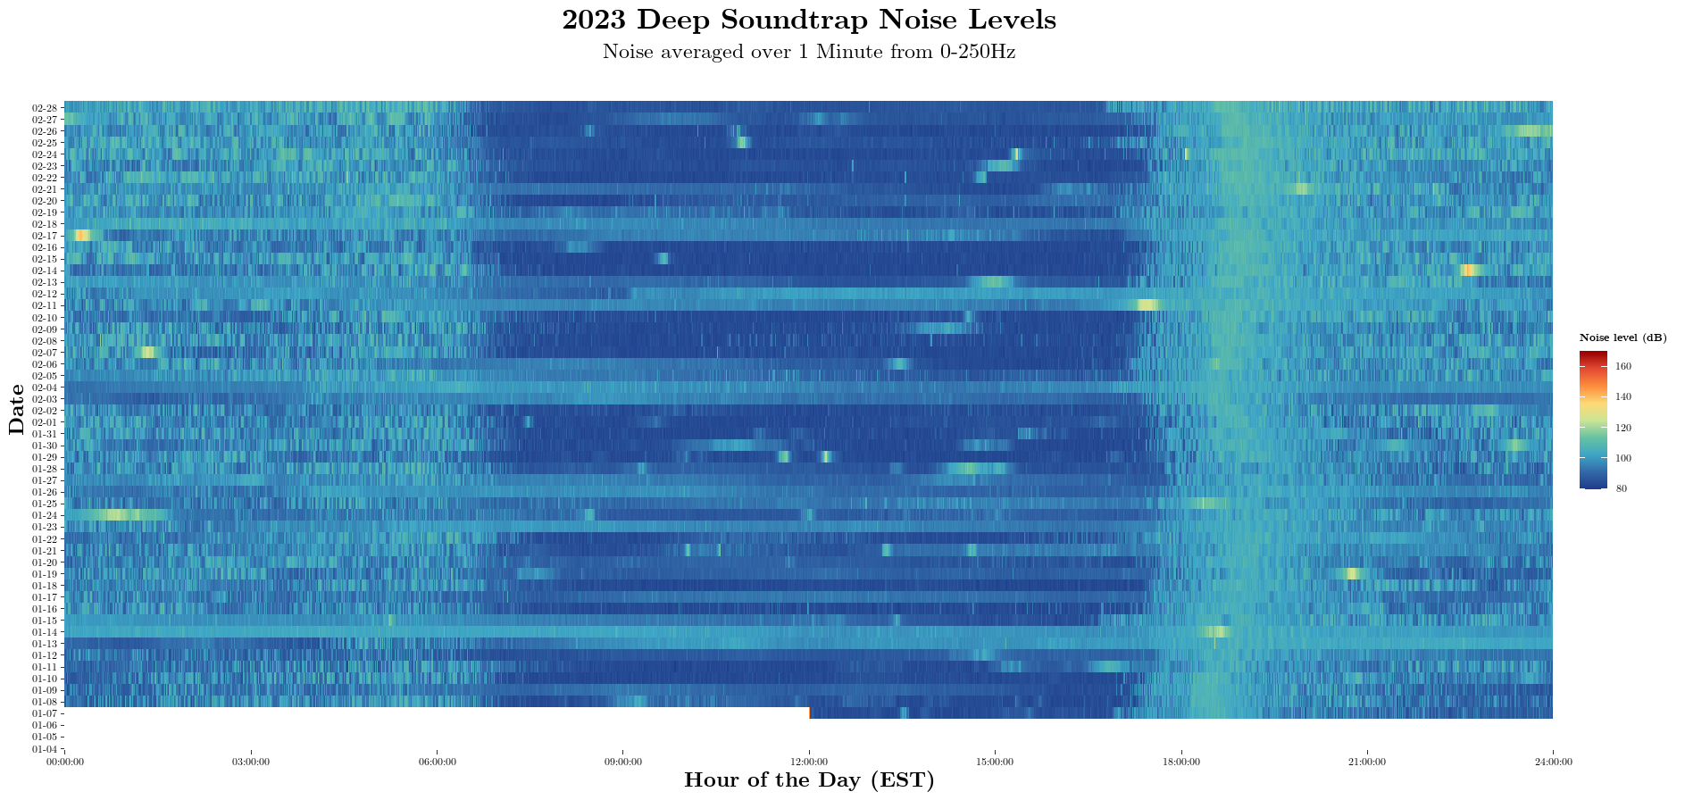
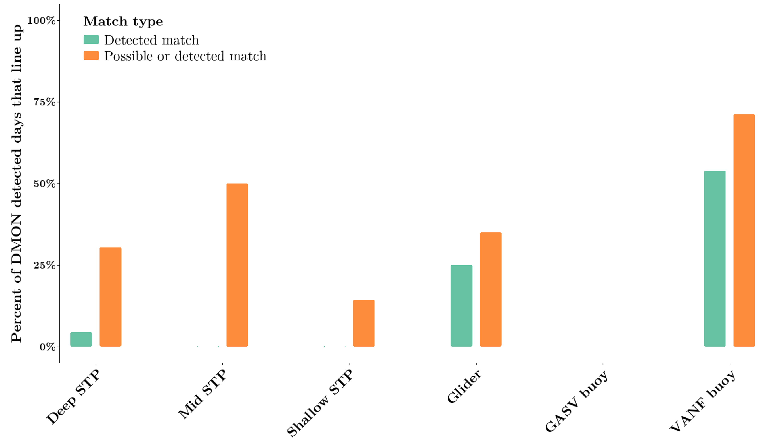
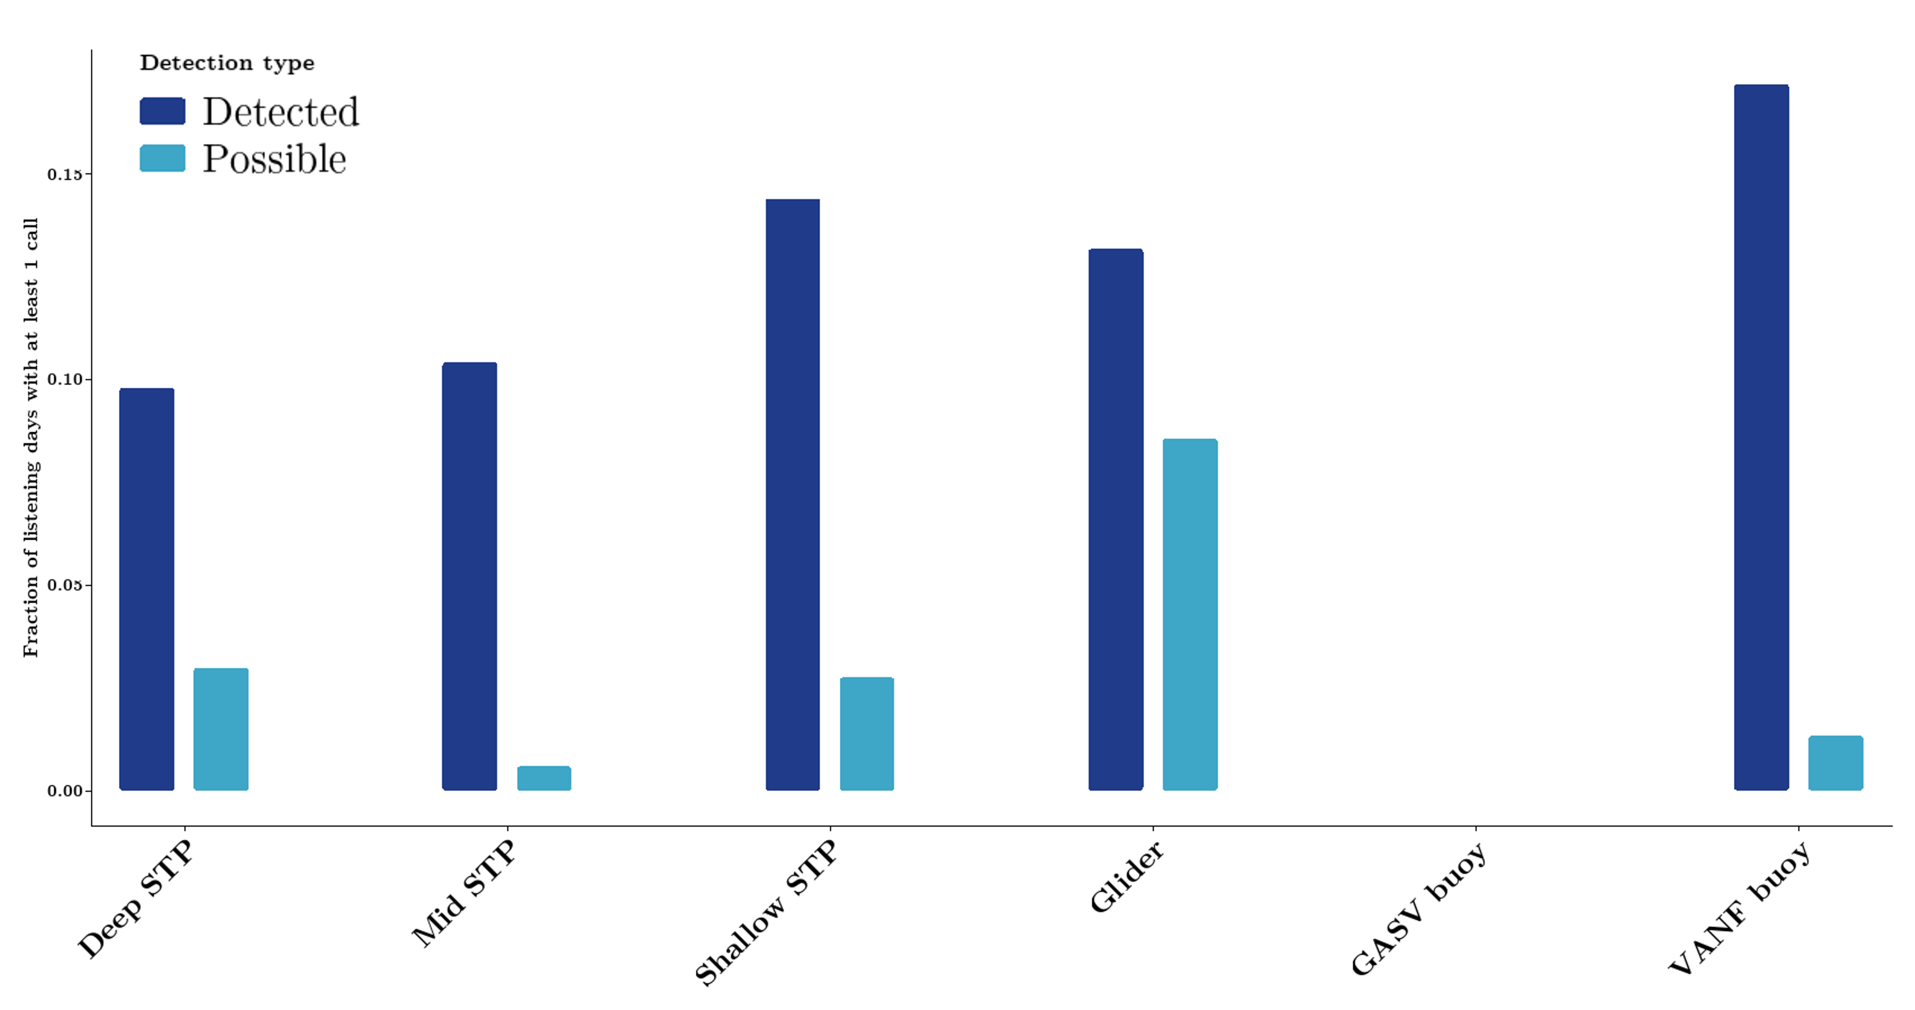
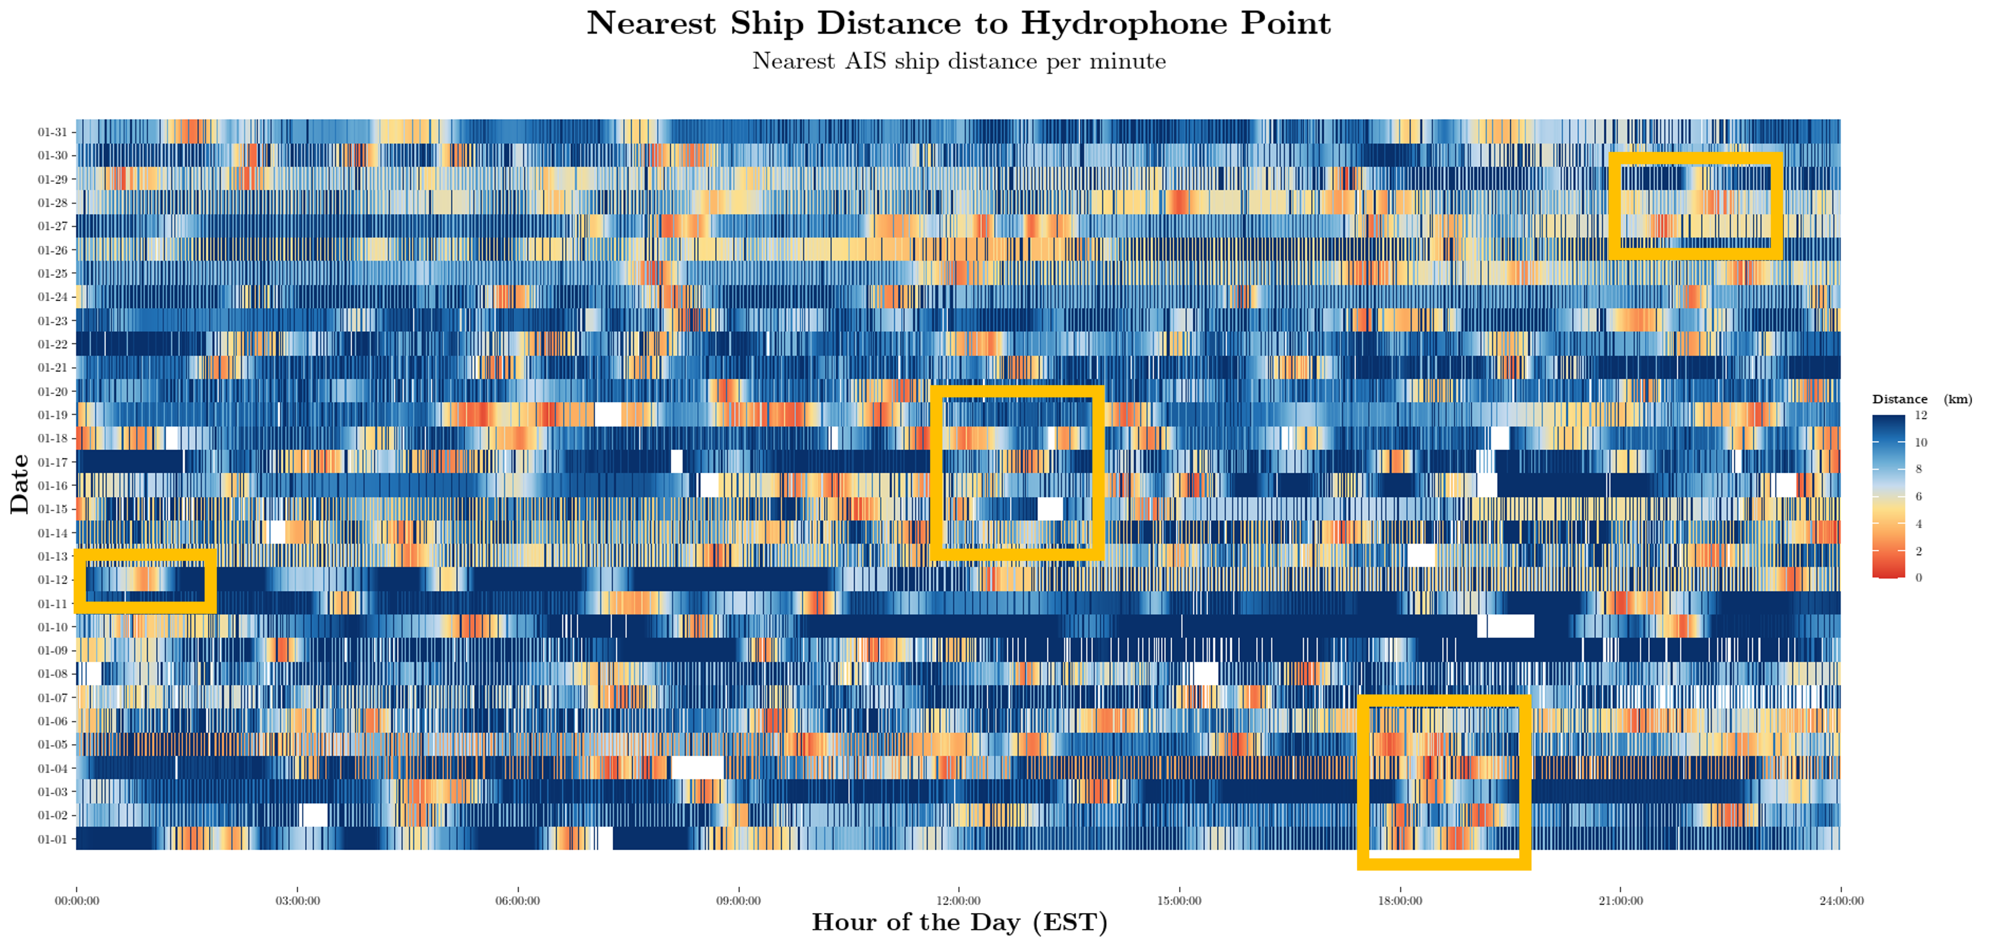
Lessons from Real-Time and Archival Acoustic Detections of North Atlantic Right Whales in the Southeast US across Three Types of Platforms
Soraya S. Remaili¹, Abigail M. Kreuser¹, Amadi A. Sefah-Twerefour¹,
Erin L. Meyer-Gutbrod¹, Catherine R. Edwards²
¹School of the Earth, Ocean and Environment, University of South Carolina, Columbia, SC 29208
²Skidaway Institute of Oceanography, Department of Marine Sciences, University of Georgia, Savannah, GA 31411
INTRODUCTION
METHODS
The critically endangered North Atlantic right whale (NARW) migrates seasonally along the US East coast to their winter calving grounds in the Southeast US.
In the shallow waters off the coasts of South Carolina, Georgia, and Florida, NARWs nurse, rest, and socialize near the surface, exposing whales and calves to a high risk of ship strike.
In NARW’s northern foraging grounds, real-time passive acoustic monitoring (PAM) using gliders and buoys is being used to inform monitoring efforts and communicate detections with vessel captains and managers to reduce risk of vessel strikes.
In the Southeast US, glider-based PAM may also be a useful monitoring tool for providing 24/7 coverage. However, the unique shallow environment creates uncertainty in the detectability of NARWs.
To better inform the deployment of real-time instruments in this region, we analyzed acoustic data from three different platform types.
Three bottom-mounted, archival hydrophones were deployed at increasing depths (15.9m, 19.5m, 22m) and distances off the coast of Savannah, Georgia, from January-May 2023-2026.
Real-time PAM buoys were deployed off the coasts of Norfolk, Virginia and Savannah, Georgia at the beginning of the 2023 calving season.
A real-time PAM-equipped Slocum Glider was deployed over 6 approximately 1-month long missions in January-March from 2023-2026.
The Norfolk buoy triggered 17 acoustically-detected Slow Zones over this period, and 2 acoustic right whale detections on the Savannah buoy in January 2026 triggered the first ever acoustic Slow Zone in the South Atlantic Bight.
A Slocum G3 Glider equipped with a digital acoustic monitoring instrument (DMON2) was deployed for 5 missions off the coast of Georgia (Fig. 2, 3). The glider was programmed to surface at 4 hour intervals to enable near real-time baleen whale vocalization detections (Fig 4). Three Ocean Instruments Sound Traps (ST600) were used as bottom-mounted, archival hydrophones and deployed at increasing depths (15.9m, 19.5m, 22m) and increasing distances off the coast of Savannah, Georgia (Fig. 1, 3). Additionally, three buoys (Fig. 1, 3) were deployed off the coast of Norfolk, Charleston, and Savannah. The low-frequency detection and classification system (LFDCS) was used to identify and classify calls from the real-time acoustic data as well as the archival data. Detections of right whale vocalizations during the deployment period were compared between each of the three bottom-mounted hydrophones and the glider and buoys to inform optimal PAM deployment depth to detect right whales in this region.
Figure 1 & 2. Locations of the bottom-mounted hydrophones (orange points) and the deployment locations of the buoys (from top to bottom, Norfolk, VA, Charleston, SC, and Savannah, GA in red points). The green circle represents the general glider deployment area (right). Glider mission tracks broken up by season (left).
Figure 4. Example glider noise plot showing 4-hour surfacing intervals (noisier bands shown in orange/red).
Figure 3. (above) Acoustic instrument deployments by calving season years (starting with November). Colored squares indicate months where the instrument was listening. Typically, instruments are deployed in the SEUS to coincide with the NARW calving season.
Figures 5 & 6. Real-time detections compared to archival detections (above). Days that line up well are boxed in green, days with insufficient triggers to trip real-time protocol are boxed in black. Archival only detections on soundtraps (bottom).
Figures 7 & 8. Alignment of archival and real-time detections by instrument (left). Days with calls scaled by listening days (right).
Figures 11 & 12. 2023 shallow soundtrap noise levels with loud black drum chorusing near the new moon (above). 2023 deep soundtrap catfish chorusing near dawn and dusk (below).
RESULTS
ACKNOWLEDGEMENTS
Right whales are detectable in the Southeast US, on both instruments like gilders and buoys with real-time capabilities (Fig. 5) and instruments like soundtraps that only provide archival data (Fig. 6). Real-time detections consistently line up with archival detections, as seen in the green boxes of Fig. 5. However, the real time protocol requires three upcalls in a period to trigger a detection, so many days where whales were detected on archival 1-2 times are not considered detected on real time. The comparison be tween real-time and archival detections can be seen in Fig. 7, where the glider and GASV buoy were used as a real-time proxy for soundtraps. In general, the VANF buoy was the most effective at detecting right whale calls, but strictly within the bounds of the SEUS, the shallow soundtraps and gliders are most effective, particularly since the GASV buoy detected no right whale calls (Fig. 8). NARW detection efficiency decreases as soundtrap depth increases (Fig. 8).
Figures 9 & 10. 2024 Norfolk buoy noise levels with particularly noisy hours boxed in red (above). 2024 Norfolk nearest ship distance to buoy, with the same noisy times as above boxed in the yellow (below).
This work would not be possible without the efforts and expertise of Mark Baumgartner, Julianne Wilder, James Bird, Frank McQuarrie, Drew Vincent, Ruochu Yang, Ben Hefner, Garrison Hefner, Xavier Giomi, Aiden Gray, and Kristopher Maedke Russell. Assistance in deployment and retrievals was provided by Captain John Bichy, Captain Terrel Scarboro, Captain Kevin Hunnicutt, Captain Francis Lapolla, and our diver team Allison Soss and Randy Rudd.
Funding: Tides Foundation, Maine Community Foundation, Broad Reach Fund, USC ASPIRE & SECOORA, NOAA, CMA CGM
References:
Johnson H, Morrison D, Taggart C (2021). WhaleMap: a tool to collate and display whale survey results in near real-time. Journal of Open Source Software, 6(62), 3094.
Baumgartner, M.F. and S.E. Mussoline. 2011. A generalized baleen whale call detection and classification system. Journal of the Acoustical Society of America 129:2889-2902.
OTHER NOISE
On different instruments, different sources of noise tend to interfere with right whale detections. On buoys, which are placed in shipping lanes, nearby ships (Fig. 10) cause loud patches of noise (Fig. 9), where right whale calls are over shadowed. On soundtraps, fish have been seen loudly chorusing based on environmental patterns like the lunar cycle (Fig. 11) and diel patterns (Fig. 12).

