Slide 1
Fraud analysis
Soraya Shirini
25 November 2025

Slide 2
Agenda
Data Understanding
Data Cleaning and Preparation
Exploratory Data Analysis
Fraud Analysis
Discussion and Recommendations

Slide 3
1. Data Understanding
The dataset is clean and balanced, but key variables show wide ranges and skewness, indicating the need for outlier checks before modelling.
Overview
Descriptive Statistics
fraud_victim_dataset
Data Quality Check
No missing data
No duplicates
Numeric variable | mean | std | min | 25% | 50% | 75% | max
fraud_amount | 712.5 | 1347.9 | 0.0 | 0.0 | 0.0 | 841.7 | 10218.9
age | 50.11 | 14.42 | 18 | 39.5 | 50.2 | 59.55 | 90
personal_income | 60214.8 | 19277.9 | 15000.0 | 47653.0 | 60076.3 | 72930.5 | 122755.0
family_income | 90508.8 | 23825.7 | 19922.8 | 72906.3 | 90760.2 | 106926.4 | 157695.0
credit_score | 648.6 | 82.8 | 411.0 | 591.0 | 653.0 | 707.3 | 850.0
has_loan | 0.4 | 0.5 | 0.0 | 0.0 | 0.0 | 1.0 | 1.0
owns_home | 0.5 | 0.5 | 0.0 | 0.0 | 0.0 | 1.0 | 1.0
loan_amount | 19889.5 | 20037.9 | 4.5 | 5612.3 | 13875.7 | 27839.5 | 115848.5
transaction_amount | 2004.4 | 2095.5 | 10.0 | 533.6 | 1357.2 | 2846.2 | 15050.4
account_age_days | 2586.1 | 1443.5 | 32.0 | 1329.0 | 2682.0 | 3786.5 | 4999.0
is_fraud | 0.5 | 0.5 | 0.0 | 0.0 | 0.0 | 1.0 | 1.0
… | … | … | … | … | … | … | ...
500 rows
Highly skewed towards 0
23 columns
Data type
Column Name
Wide ranges: investigating data for outlier is necessary
object
transaction_id
customer_id
gender
education
marital_status
region
transaction_type
device_type
float64
age
personal_income
family_income
loan_amount
transaction_amount
avg_transaction_value
internet_usage_hrs
mobile_usage_hrs
fraud_amount
Categorical variable | count | unique | top | freq
transaction_id | 500 | 500 | T00001 | 1
customer_id | 500 | 486 | C9889 | 2
gender | 500 | 2 | Female | 261
education | 500 | 5 | Bachelor | 169
marital_status | 500 | 4 | Married | 230
region | 500 | 4 | North | 135
transaction_type | 500 | 4 | Transfer | 131
device_type | 500 | 4 | Mobile | 137
int64
credit_score
has_loan
owns_home
account_age_days
num_prev_transactions
is_fraud
Categories well balanced

Slide 4
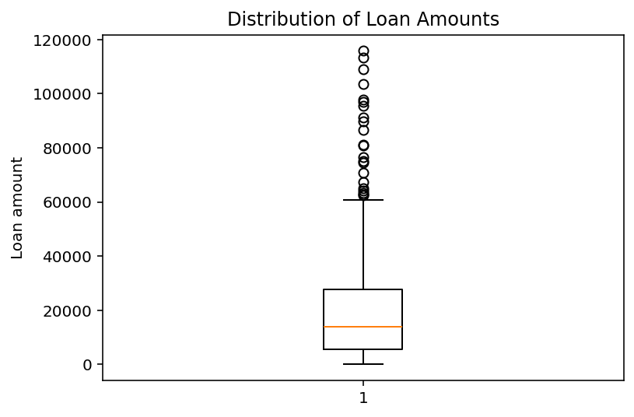
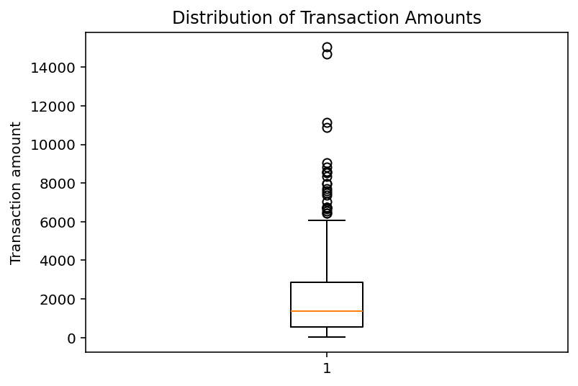
2. Data Cleaning and Preparation
Outlier were kept because they may indicate real fraud cases, no scaling applied until the modeling pipeline
Detect and Handle Outliers
Data Standardization
Data already clean with no missing or duplicate records
However, some numeric variables use different scales
Age
personal_income
family_income
credit_score
loan_amount
transaction_amount
account_age_days
num_prev_transactions
avg_transaction_value
internet_usage_hrs
mobile_usage_hrs
fraud_amount
Upper boundary for loan amount: 61,180
*using Interquartile Range (IQR)
Outliers kept in data because they might represent fraudulent cases
Upper boundary for transaction amount: 6,315
*using Interquartile Range (IQR)
Standardization was not applied here. It is performed automatically inside the modelling pipeline.

Slide 5
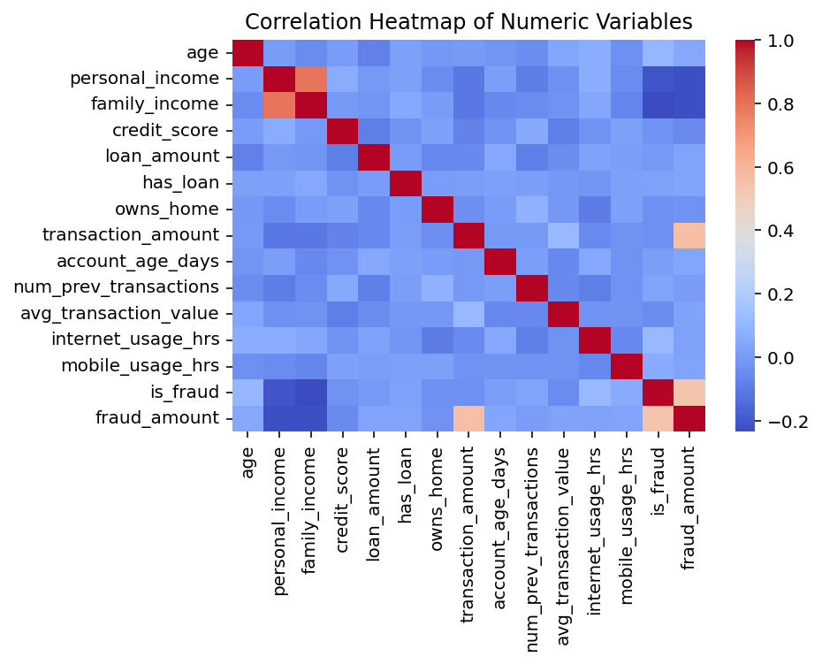
3. Exploratory Data Analysis (EDA) 1/2
Correlation analysis shows almost no fraud patterns. Income is the only small indicator.
Correlation Heatmap of Numeric Variables
Most numeric variables show very weak or no correlation with fraud
Personal income has slight negative correlation
Lower income → slightly higher fraud risk
Strong correlation appears between personal income and family income ( not related to fraud)

Slide 6
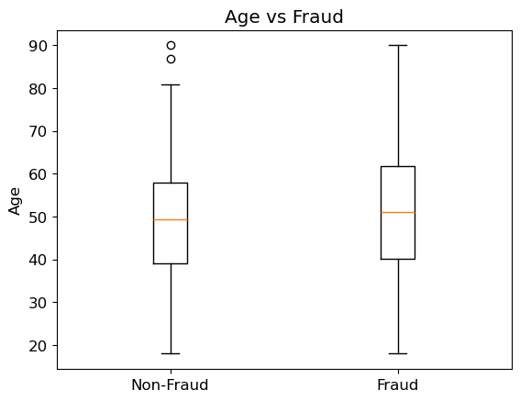
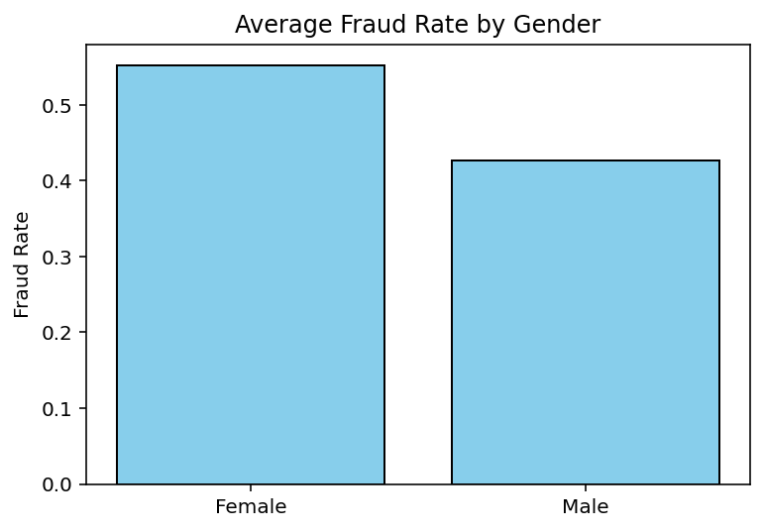
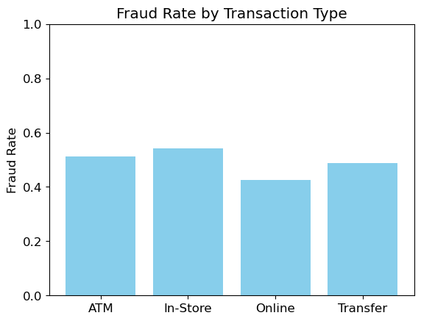
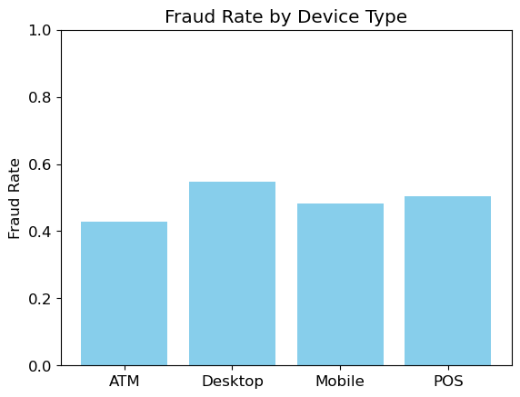
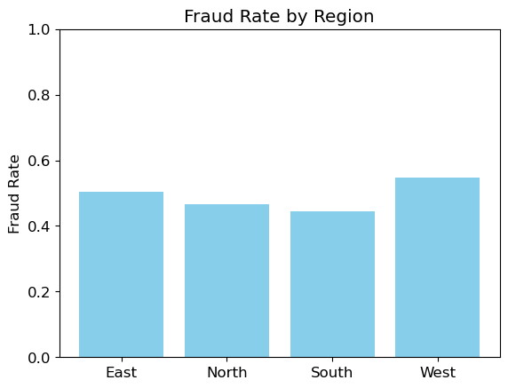
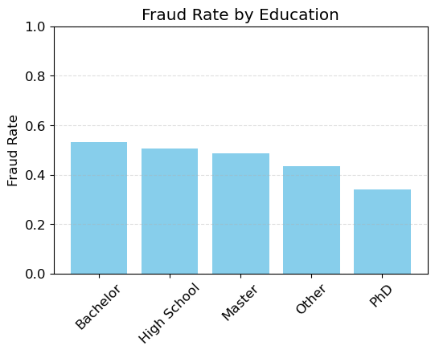
3. Exploratory Data Analysis (EDA) 2/2
EDA show no strong fraud patterns across demographic or transaction types.
Other Exploratory Data Analysis (sample)
1
2
3
1
Median age similar between non-fraud and fraud victims
2
Female customers 12% more likely to be victim of fraud than males
3
Fraud rate variations between transaction types are small
4
5
6
4
Fraud rate variations between device types are small
5
Fraud rate variations between regions are small
6
Except for PhD’s, fraud rate doesn’t vary much based on education

Slide 7
4. Fraud Analysis 1/2
Transaction and loan amounts show no meaningful difference between fraud and non-fraud.
Outliers Analysis
Confidence Interval Analysis
Outliers detected in loan and transaction amounts
Outlier kept because they may represent fraud
CI for mean transaction amount (fraud vs non-fraud)
Fraud transaction 95% CI : 1661 to 2197
Non-Fraud transaction 95% CI : 1826 to 2329
CI for mean loan amount (fraud vs non-fraud)
Fraud 95% CI: 17398.64 to 22151.45
Non-Fraud 95% CI: 17415.6 to 22584.95
Similar ranges
Variable | Outliers | Q1 | Q3 | IQR | Upper Bound
transaction_amount | 25 | 533.6 | 2846.2 | 2312.6 | 6315.1
loan_amount | 22 | 5612.3 | 27839.5 | 22227.2 | 61180.2
Transaction amount alone can not be used to identify fraud, and additional feature must be analyzed
Similar ranges
Loan amount does not help differentiate fraud from non-fraud

Slide 8
4. Fraud Analysis 2/2
Fraud is hard to predict with available features. Income is the only notable signal.
Hypothesis Testing
Predictive Modeling
Hypothesis
Test whether the average personal income is different between fraud and non-fraud customers (T-test)
H₀ (Null): Both groups have the same mean income
H₁ (Alternative): The groups have different mean incomes
Approach
Since EDA and statistical tests revealed weak individual patterns, modeling was applied to test whether combined variables improve fraud prediction
Data Preparation
Removed: fraud_amount, transaction_id, customer_id
Fraud_amount reveals the label and must be excluded
IDs do not contain predictive value
Result
t = –4.75, p = 2.9×10⁻⁶
⇒ statistically significant
Reject H₀
⇒ income differs between groups
Model
Creation
Logistic regression was chosen
Metrics used for evaluation: accuracy, precision, recall, and ROC-AUC
Fraudulent customers tend to have lower personal income
Model Performance
Models achieved moderate accuracy, not strong enough for reliable detection
Suggests need for additional behavioral & transactional features

Slide 9
5. Discussion and Recommendations
Overall, fraud shows no clear patterns, income is the only meaningful difference, and behavioral data is needed for better detection.
Key Analytical Findings
Modeling Implications
Fraud and non-fraud customers looked similar across most variables
Statistical tests showed no significant differences
Income was the only feature with meaningful difference (lower in fraud cases)
Suggests vulnerability among lower-income customers (not causation)
Logistic Regression reached ~61% accuracy with weak feature influence
Dataset lacks strong predictors of fraud
Demographics and amounts alone are insufficient
Fraud likely influenced by unobserved behavioral factors
1
Support Lower-income customers:
Fraud victims tend to have lower personal income. Provide extra prompts to verification checks for this group.
2
Focus on behavior, not demographics:
Since typical customer attributes do not predict fraud well, use behavioral indicators such as abnormal login activity, device changes, unusual transaction patterns.
3
Improve data collection:
Current variables offer weak predictive signals. Add richer features such as device information, IP address, log in location, failed login attempts. Rules should be updated frequently.
4
Retrain models regularly:
Fraud patterns evolve so models and rules should be updated frequently.

