Slide 1
T
TRACE
Trusted Recipient Arc Claim Escrow
Send USDC to an X identity. Claim with proof.
T
identity proof + wallet proof + Arc settlement
Non-custodial Arc escrow for handle-based USDC payments.
create escrow
verify X + wallet
claim / cancel / refund
TRACE — Trusted Recipient Arc Claim Escrow
01
Notes:
[Sources]
Local TRACE repository and project description.

Slide 2
PROBLEM
Stablecoin payments still depend on wallet addresses
Coordination happens through social identity; settlement still asks for a wallet first.
Payout stalls
Address risk
No recovery
The sender cannot act until the recipient shares a wallet address.
Copy/paste errors and impersonation are hard to catch before sending.
A direct transfer has no clean cancel or expiry path when context changes.
TRACE starts from the identity the sender already knows.
TRACE — Trusted Recipient Arc Claim Escrow
02
Notes:
[Sources]
Local TRACE product framing and UI flow.

Slide 3
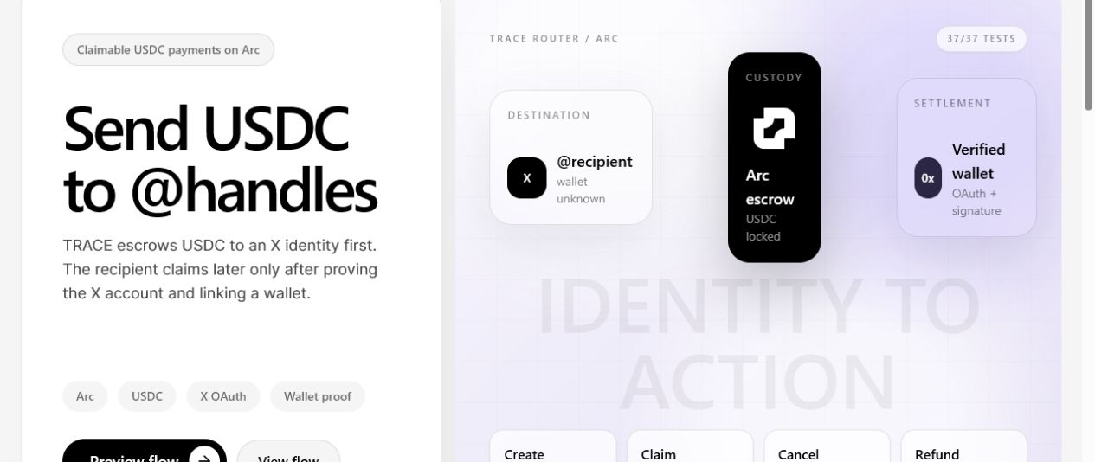
MECHANICS
A claim is valid only when three facts match
TRACE releases USDC only after identity proof, wallet proof and payment data align.
1. Identity lock
Payment is created for an X recipient identifier before a wallet address is known.
2. Wallet-bound claim
Recipient proves X control, signs with the claiming wallet, then claims through Arc escrow.
TRACE — Trusted Recipient Arc Claim Escrow
03
Notes:
[Sources]
Local screenshot captured from the current Vite landing page.

Slide 4
SOLUTION
TRACE separates intent, custody and claim
The sender can act immediately while settlement waits for proof.
X identity
Arc escrow
Wallet proof
Settlement
Recipient is addressed by a known public handle.
USDC custody sits in the contract lifecycle.
Recipient signs a wallet challenge after OAuth.
Claim, cancel or refund closes the route.
The backend indexes state; verified Arc transactions settle funds.
TRACE — Trusted Recipient Arc Claim Escrow
04
Notes:
[Sources]
Local TRACE architecture and contract lifecycle.

Slide 5
WHY TRACE
It is a claim lifecycle, not just address lookup
The moat is recoverable, proof-bound USDC settlement.
Direct transfer
Fast only when the address is already known
No identity claim / weak recovery
Custodial handle pay
Smooth UX
Custody and platform risk
TRACE
Send now, prove later, recover if needed
Non-custodial Arc escrow
TRACE — Trusted Recipient Arc Claim Escrow
05
Notes:
[Sources]
Product-pattern comparison based on local TRACE design.

Slide 6
ARC + USDC
The DeFi primitive is programmable stablecoin settlement
TRACE uses stablecoin custody, policy and recovery as the product core.
Arc
USDC
Policy
Treasury
Execution layer and testnet settlement path.
Principal, claim asset and fee unit.
Identity-bound claim, cancel and expiry.
Onchain fee routing while principal remains recoverable.
TRACE — Trusted Recipient Arc Claim Escrow
06
Notes:
[Sources]
Local TRACE implementation: Arc testnet, USDC escrow and fee model.

Slide 7
SECURITY
Claims require identity, wallet and digest agreement
The product should fail closed when proof or chain state is missing.
Recipient proof
X OAuth must match immutable recipient user ID.
Wallet proof
Signed challenge binds the destination wallet.
Claim digest
Payment, wallet, chain, contract and expiry are bound.
Recovery
Cancel/refund remains available under policy.
Privacy
Unauthorized API views omit sensitive payment details.
Gap
External review and role separation remain required.
TRACE — Trusted Recipient Arc Claim Escrow
07
Notes:
[Sources]
Local TRACE security model and known production gaps.

Slide 8
EVIDENCE
The working proof is already testable
Keep the proof large; long transaction hashes belong in README/explorer links.
37 / 37
5042002
0.50%
3 flows
automated tests passing
Arc Testnet chain ID
minimum protocol fee
claim, cancel, refund smoke
Contract: 0x5A3949aE67a37e7e37bFC77F5b7832Cc93f40A2a
TRACE — Trusted Recipient Arc Claim Escrow
08
Notes:
[Sources]
Local TRACE test and deployment evidence.

Slide 9
READINESS
Ready for demo; honest about hardening
This should be presented as a testnet pilot, not a production launch.
Ready now
Main risks
Before users
Deployment, lifecycle evidence and tests.
X API dependency and role/key custody.
HTTPS, managed DB, E2E, external review.
Honest positioning is stronger than pretending production readiness.
TRACE — Trusted Recipient Arc Claim Escrow
09
Notes:
[Sources]
Local readiness assessment from current project state.

Slide 10
ASK
Help turn the proof into a public Arc testnet pilot
The immediate milestone is packaging and verification.
Feedback
Public proof
Hardening
Arc/Circle fit, security model and DeFi-track positioning.
HTTPS demo, CI, explorer links and release tag.
Two-account X E2E, role separation and external review.
TRACE is focused: send USDC to an identity now, settle to a verified wallet later.
TRACE — Trusted Recipient Arc Claim Escrow
10
Notes:
[Sources]
Local roadmap and current submission goals.

