Slide 1
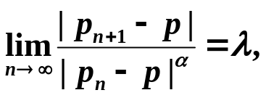
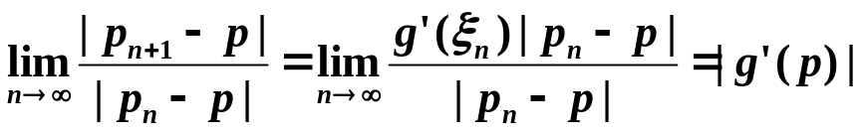
Chapter 2 Solutions of Equations in One Variable – Error Analysis for Iterative Methods
☑ 2.4 Error Analysis for Iterative Methods
Definition: Suppose { p_{n} } ( n = 0, 1, 2, …) is a sequence that converges to p, with p_{n} ≠ p for all n. If positive constants α and λ exist with
then { p_{n} } ( n = 0, 1, 2, …) converges to p of order α, with asymptotic error constant λ.
If α =1, the sequence is linearly convergent.
If α =2, the sequence is quadratically convergent.
Q: What is the order of convergence for an iterative method with g’(p) ≠ 0?
A:
Linearly convergent.
1/7

Slide 2
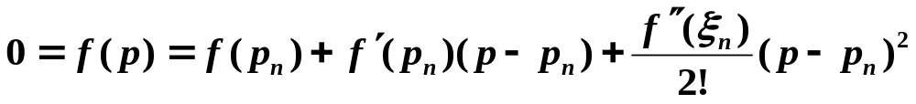
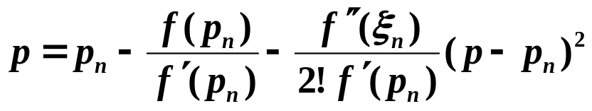
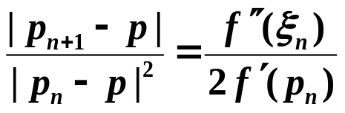

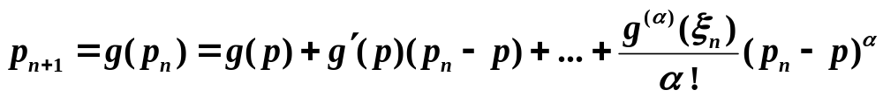
Chapter 2 Solutions of Equations in One Variable – Error Analysis for Iterative Methods
Discussion 8: What is the order of convergence for Newton’s method (where g’(p) = 0) ?
Fast near a simple root.
A: From Taylor’s expansion we have
As long as f ’(p) ≠ 0, Newton’s method is at least quadratically convergent.
Q: How can we practically determine α and λ ?
This is a one line proof...if we start sufficiently far to the left.
Theorem: Let p be a fixed point of g(x). If there exists some constant α ≥ 2 such that g ∈ C^{α} [p – δ, p + δ], g’(p) = … = g^{(α – 1)} (p) = 0, and g^{(α)} (p) ≠ 0. Then the iterations with p_{n} = g( p_{n – 1} ), n ≥ 1, is of order α.
p
n → ∞
λ
2/7

Slide 3
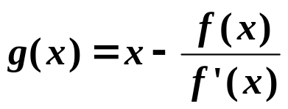
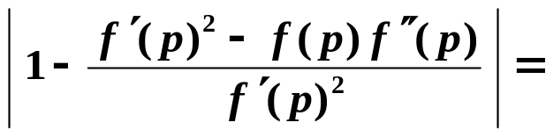
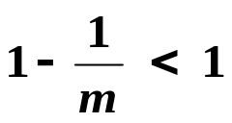
Chapter 2 Solutions of Equations in One Variable – Error Analysis for Iterative Methods
Discussion 9: What is the order of convergence for Newton’s method if the root is NOT simple ?
A: If p is a root of f of multiplicity m, then f(x) = (x – p)^{m}q(x) and q(p) ≠ 0.
Newton’s method is just p_{n} = g( p_{n – 1} ) for n ≥ 1 with
g’(p) =
It is convergent, but not quadratically.
Q: Is there anyway to speed it up?
A: Yes!
Equivalently transform the multiple root of f into the simple root of another function, and then apply Newton’s method.
3/7

Slide 4
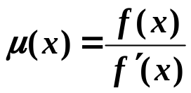
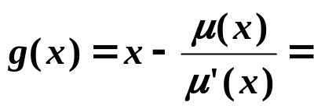
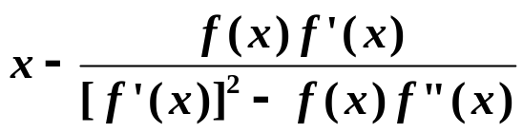
Chapter 2 Solutions of Equations in One Variable – Error Analysis for Iterative Methods
Let , then the multiple root of f = the simple root of μ .
Apply Newton’s method to μ :
Quadratic convergence
① Requires additional calculation of f ”(x);
② The denominator consists of the difference of two numbers that are both close to 0.
HW: p.86 #11
4/7

Slide 5
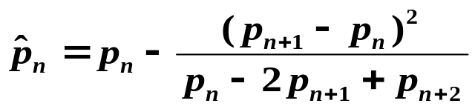
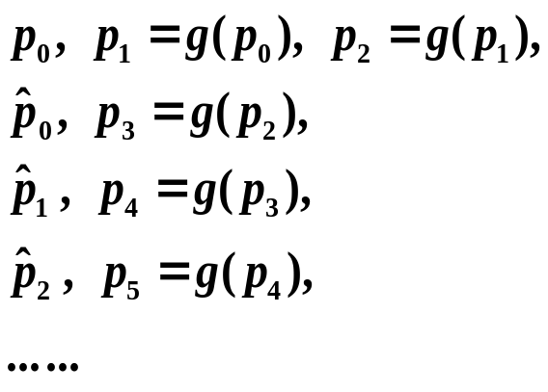
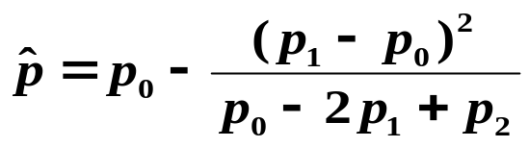

Chapter 2 Solutions of Equations in One Variable – Accelerating Convergence
☑ 2.5 Accelerating Convergence
➢ Aitken’s Δ² Method:
y
y = g(x)
y = x
t(p₁, p₂)
t(p₀, p₁)
x
p₁
p
p₂
p₀
5/7

Slide 6
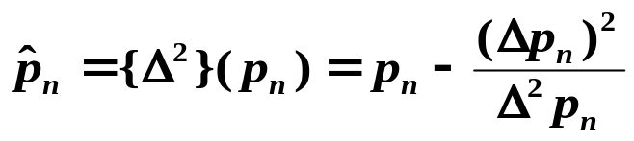

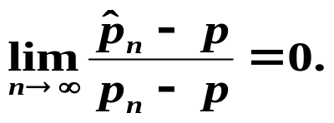
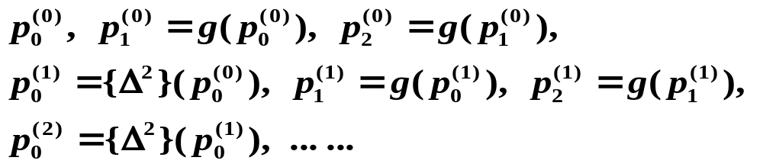
Chapter 2 Solutions of Equations in One Variable – Accelerating Convergence
Definition: For a given sequence { p_{n} } (n = 1, 2, …), the forward difference Δp_{n} is defined by Δp_{n} = p_{n+1} – p_{n} for n ≥ 0.
Higher powers, Δ^{k}p_{n}, are defined recursively by Δ^{k}p_{n} = Δ(Δ^{k – 1}p_{n} ) for for k ≥ 2.
Aitken’s Δ² Method:
for n ≥ 0.
Theorem: Suppose that { p_{n} } (n = 1, 2, …) is a sequence that converges linearly to the limit p and that for all sufficiently large values of n we have ( p_{n} – p )( p_{n+1} – p ) > 0. Then the sequence { } (n = 1, 2, …) converges to p faster than { p_{n} } (n = 1, 2, …) in the sense that
➢ Steffensen’s Method:
Local quadratic convergence if g’(p) ≠ 1.
6/7

Slide 7
Chapter 2 Solutions of Equations in One Variable – Accelerating Convergence
Algorithm: Steffensen’s Acceleration
Find a solution to x = g(x) given an initial approximation p₀.
Input: initial approximation p₀; tolerance TOL; maximum number of
iterations N_{max}.
Output: approximate solution x or message of failure.
Step 1 Set i = 1;
Step 2 While ( i ≤ N_{max}) do steps 3-6
Step 3 Set p₁ = g(p₀) ;
p₂ = g(p₁) ;
p = p₀ − ( p₁ − p₀ )² / ( p₂ − 2 p₁ + p₀ ) ;
Step 4 If | p − p₀ | < TOL then Output (p); /* successful */
STOP;
Step 5 Set i ++;
Step 6 Set p₀ = p ; /* update p₀ */
Step 7 Output (The method failed after N_{max} iterations); /* unsuccessful */
STOP.
7/7

